Slide 1
Year 4 Summer Block 2: Measurement Money
Pounds and Pence
NCLO: Estimate, compare and calculate different measures, including money in pounds and pence.

Slide 2
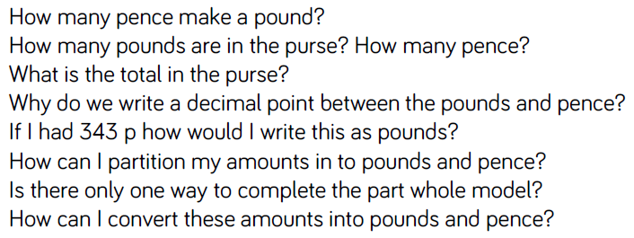
Key vocabulary and questions
Pounds, pence, decimal notation, £, p

Slide 3
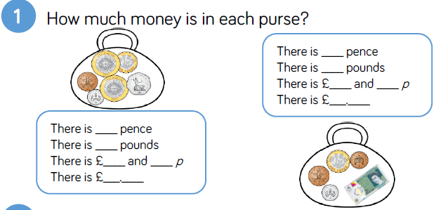
Fluency

Slide 4
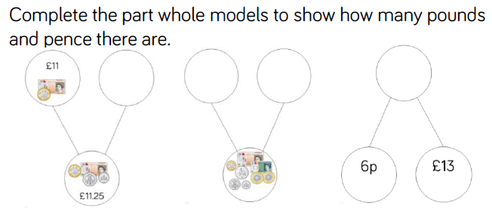
Fluency

Slide 5
Fluency

Slide 6
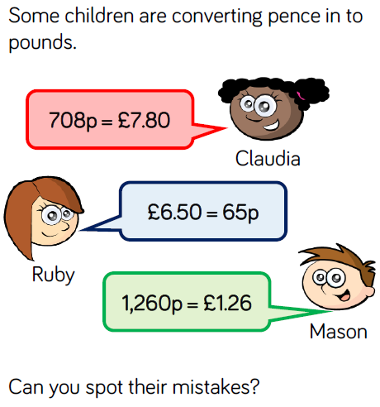
Reasoning and Problem Solving

Slide 7
Reasoning and Problem Solving

Slide 8
Year 4 Summer Block 2: Measurement Money
Ordering amounts of money
NCLO: Estimate, compare and calculate different measures, including money in pounds and pence.

Slide 9
Key vocabulary and questions
Ascending, descending, digit, larger, smaller, equivalent

Slide 10
Fluency

Slide 11
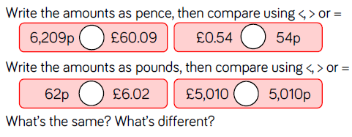
Fluency

Slide 12
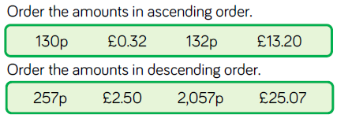
Fluency

Slide 13
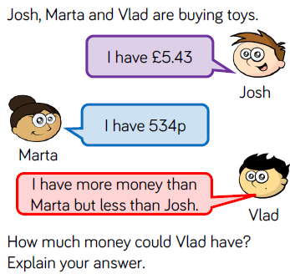
Reasoning and Problem Solving

Slide 14
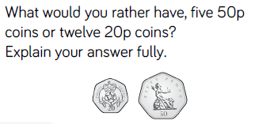
Reasoning and Problem Solving

Slide 15
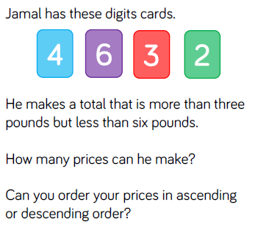
Reasoning and Problem Solving

Slide 16
Year 4 Summer Block 2: Measurement Money
Using rounding to estimate money
NCLO: Estimate, compare and calculate different measures including money in pounds and pence.

Slide 17
Key vocabulary and questions
Approximately, accurate, estimate

Slide 18
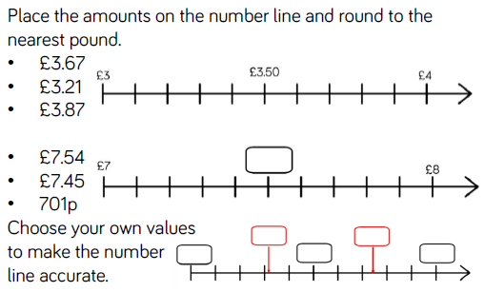
Fluency

Slide 19
Fluency

Slide 20
Fluency

Slide 21
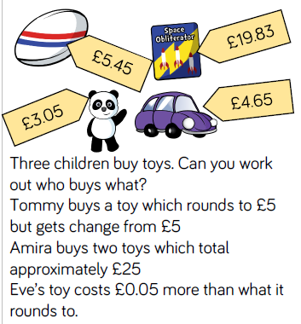
Reasoning and Problem Solving

Slide 22
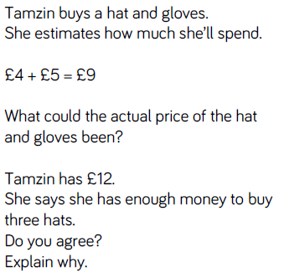
Reasoning and Problem Solving

Slide 23
Year 4 Summer Block 2: Measurement Money
Four operations
NCLO: Solve simple measure and money problems involving fractions and decimals to 2 decimal places.

Slide 24
Key vocabulary and questions

Slide 25
Fluency

Slide 26
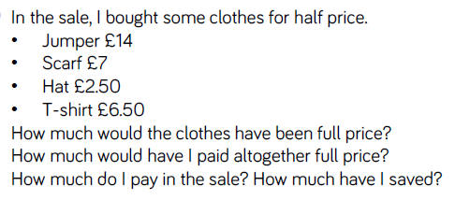
Fluency

Slide 27
Fluency

Slide 28
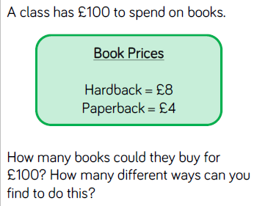
Reasoning and Problem Solving

Slide 29
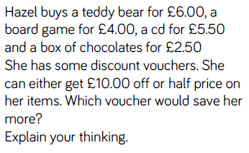
Reasoning and Problem Solving

Slide 30
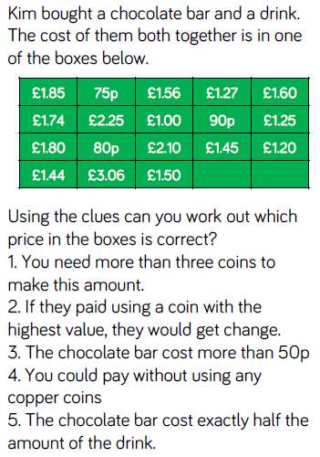
Reasoning and Problem Solving

