Slide 1
Year 1 Summer Block 2 Number: Fractions
Halving shapes or objects
NCLO: Recognise, find and name a half as one of two equal parts of an object, shape or quantity.

Slide 2
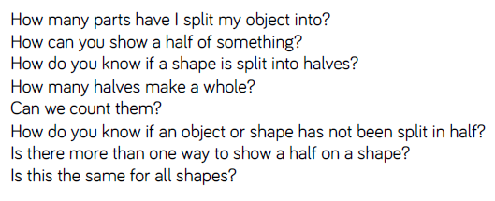
Key vocabulary and questions
Part, whole, half, halves, equal

Slide 3
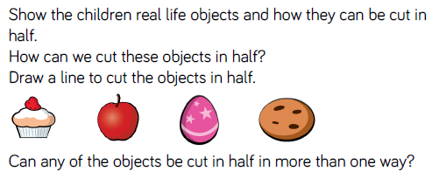
Fluency

Slide 4
Fluency

Slide 5
Fluency

Slide 6
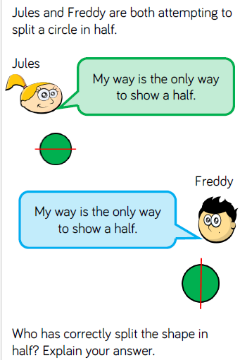
Reasoning and problem solving

Slide 7
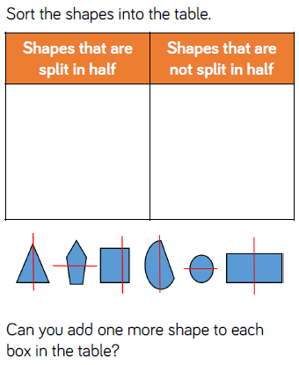
Reasoning and problem solving

Slide 8
Year 1 Summer Block 2 Number: Fractions
Halving a quantity
NCLO: Recognise, find and name a half as one of two equal parts of an object, shape or quantity.

Slide 9
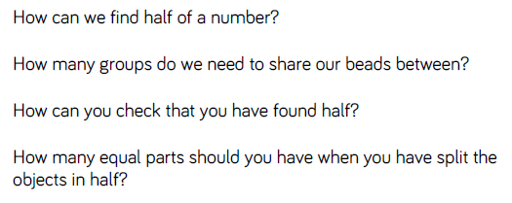
Key vocabulary and questions
Half, share, equal parts, whole

Slide 10
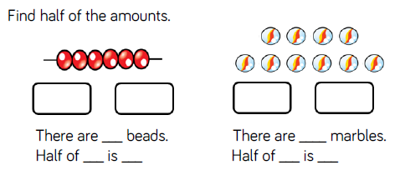
Fluency

Slide 11
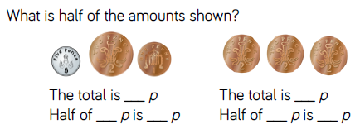
Fluency

Slide 12
Fluency

Slide 13
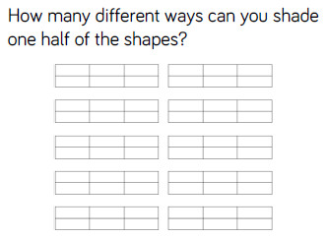
Reasoning and problem solving

Slide 14
Reasoning and problem solving

Slide 15
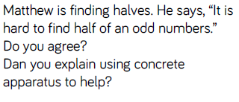
Reasoning and problem solving

Slide 16
Year 1 Summer Block 2 Number: Fractions
Find a quarter of a shape or object
NCLO: Recognise, find and name a quarter as one of two equal parts of an object, shape or quantity.

Slide 17
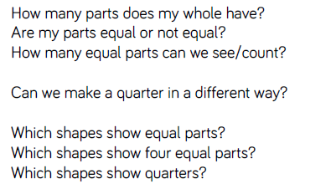
Key vocabulary and questions
Quarter, whole, equal parts

Slide 18
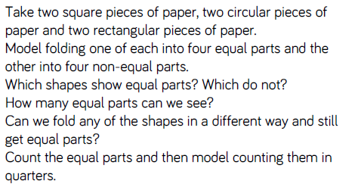
Fluency

Slide 19
Fluency

Slide 20
Fluency

Slide 21
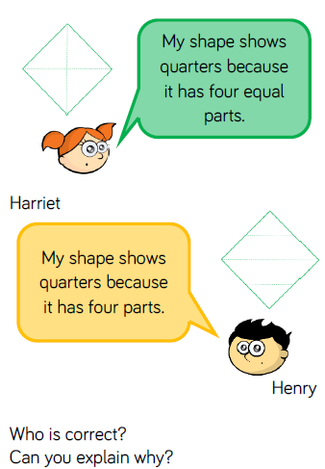
Reasoning and problem solving

Slide 22
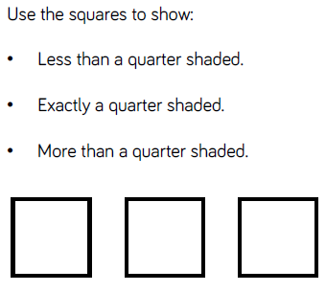
Reasoning and problem solving

Slide 23
Year 1 Summer Block 2 Number: Fractions
Find a quarter of a quantity
NCLO: Recognise, find and name a quarter as one of two equal parts of an object, shape or quantity.

Slide 24
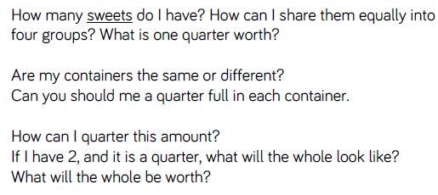
Key vocabulary and questions
Quarter, whole, equal part, share

Slide 25
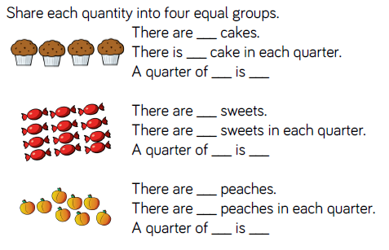
Fluency

Slide 26
Fluency

Slide 27
Fluency

Slide 28
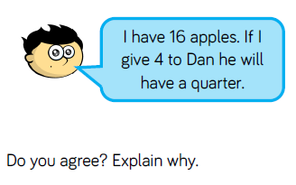
Reasoning and problem solving

Slide 29
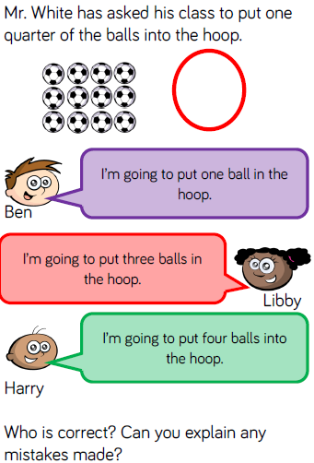
Reasoning and problem solving

