Slide 1
Year 5 Summer Block 2
Geometry: Properties of shape
Measuring angles in degrees
NCLO: Know angles are measured in degrees: estimate and compare acute, obtuse and reflex angles

Slide 2
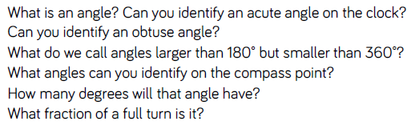
Key vocabulary and questions
Acute, obtuse, degrees, angle, turn

Slide 3
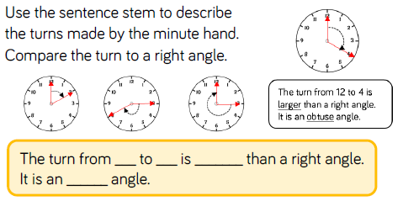
Fluency

Slide 4
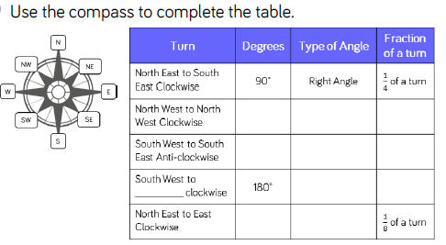
Fluency

Slide 5
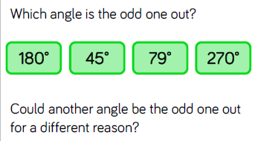
Reasoning and problem solving

Slide 6
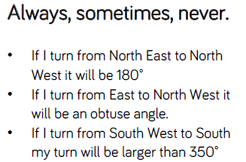
Reasoning and problem solving

Slide 7
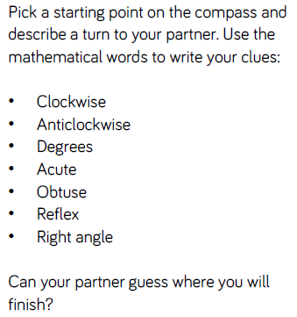
Reasoning and problem solving

Slide 8
Year 5 Summer Block 2
Geometry: Properties of shape
Measuring with a protractor 1
NCLO: Know angles are measured in degrees: estimate and compare acute, obtuse and reflex angles

Slide 9
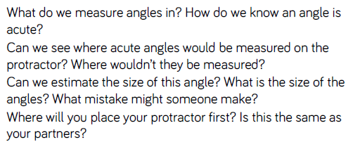
Key vocabulary and questions
protractor

Slide 10
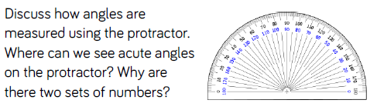
Fluency

Slide 11
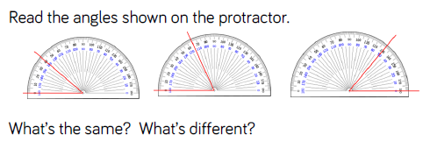
Fluency

Slide 12
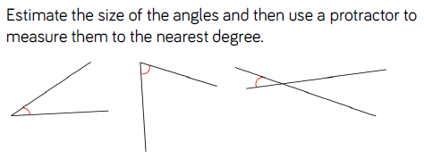
Fluency

Slide 13
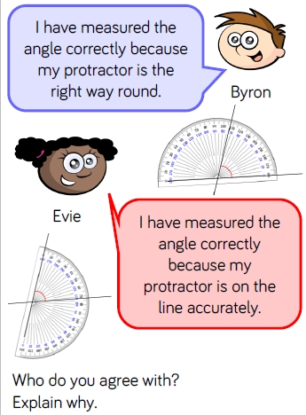
Reasoning and problem solving

Slide 14
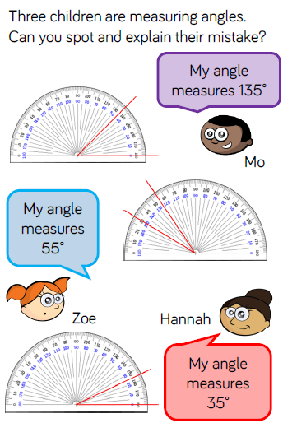
Reasoning and problem solving

Slide 15
Year 5 Summer Block 2
Geometry: Properties of shape
Measuring with a protractor 2
NCLO: Know angles are measured in degrees: estimate and compare acute, obtuse and reflex angles

Slide 16
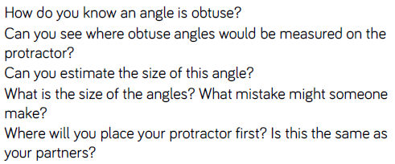
Key vocabulary and questions
Obtuse, acute, protractor

Slide 17
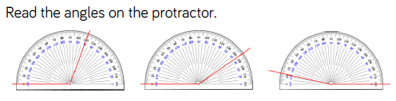
Fluency

Slide 18
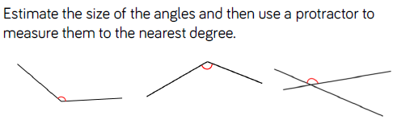
Fluency

Slide 19
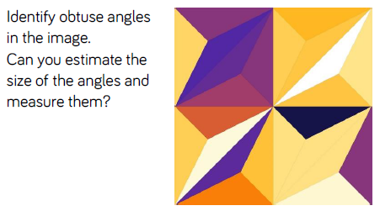
Fluency

Slide 20
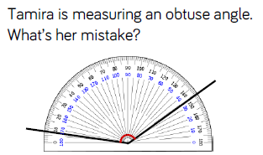
Reasoning and problem solving

Slide 21
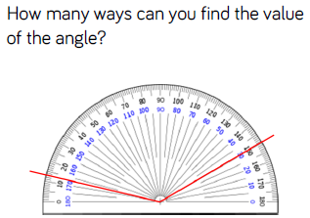
Reasoning and problem solving

Slide 22
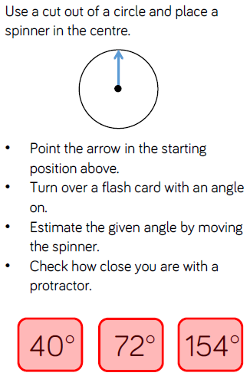
Reasoning and problem solving

Slide 23
Year 5 Summer Block 2
Geometry: Properties of shape
Drawing lines and angles accurately
NCLO: Draw given angles, and measure them in degrees

Slide 24
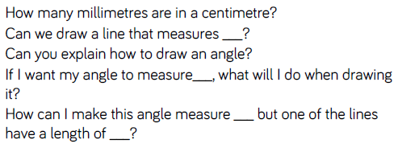
Key vocabulary and questions

Slide 25
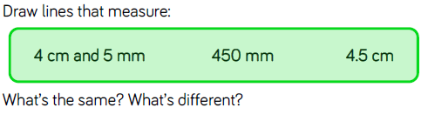
Fluency

Slide 26
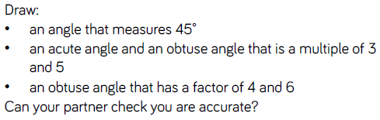
Fluency

Slide 27
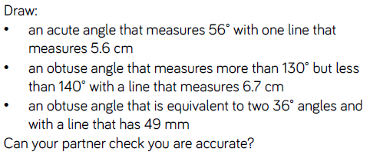
Fluency

Slide 28
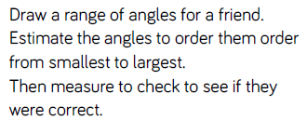
Reasoning and problem solving

Slide 29
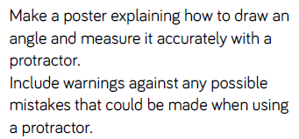
Reasoning and problem solving

Slide 30
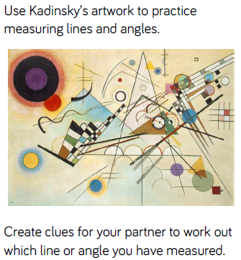
Reasoning and problem solving

Slide 31
Year 5 Summer Block 2
Geometry: Properties of shape
Calculating angles on a straight line
NCLO: Identify: angles at a point and one whole turn, angles at a point on a straight line, a half turn and other multiples of 90 degrees.

Slide 32
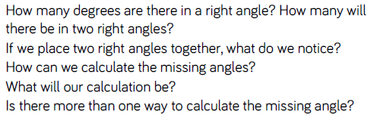
Key vocabulary and questions
Right angle

Slide 33
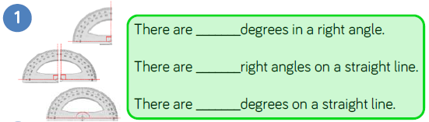
Fluency

Slide 34
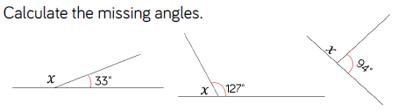
Fluency

Slide 35
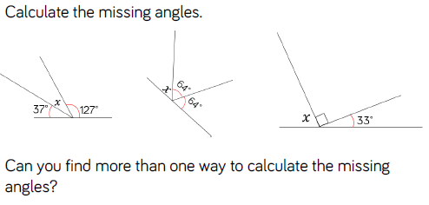
Fluency

Slide 36
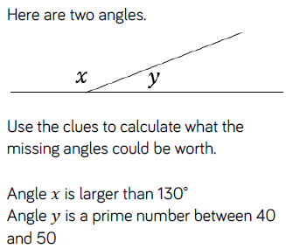
Reasoning and problem solving

Slide 37
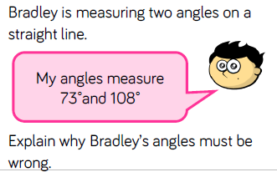
Reasoning and problem solving

Slide 38
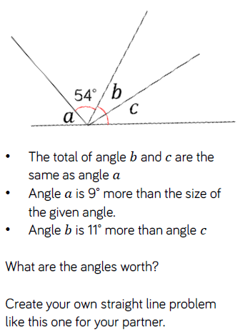
Reasoning and problem solving

Slide 39
Year 5 Summer Block 2
Geometry: Properties of shape
Calculating angles around a point
NCLO: Identify: angles at a point and one whole turn, angles at a point on a straight line, a half turn and other multiples of 90 degrees.

Slide 40
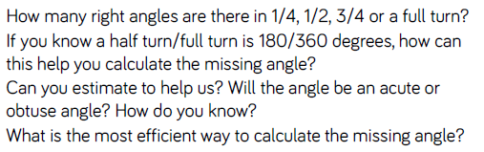
Key vocabulary and questions
Full turn, half turn, acute, obtuse

Slide 41
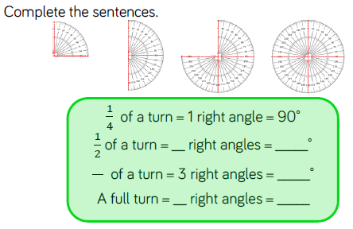
Fluency

Slide 42
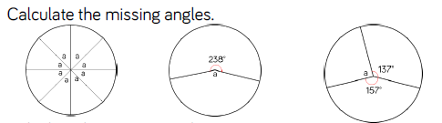
Fluency

Slide 43
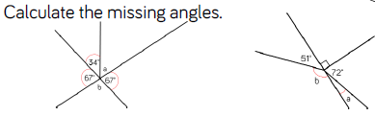
Fluency

Slide 44
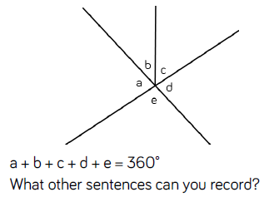
Reasoning and problem solving

Slide 45
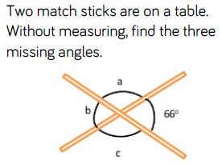
Reasoning and problem solving

Slide 46
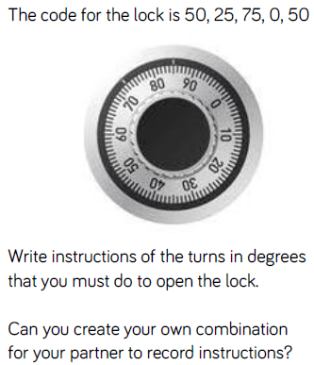
Reasoning and problem solving

Slide 47
Year 5 Summer Block 2
Geometry: Properties of shape
Calculating lengths and angles in shapes
NCLO: use the properties of rectangles to deduce related facts and find missing lengths and angles.

Slide 48
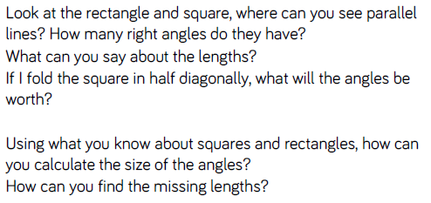
Key vocabulary and questions
Parallel, diagonal

Slide 49
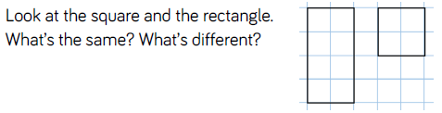
Fluency

Slide 50
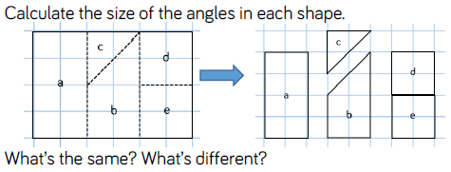
Fluency

Slide 51
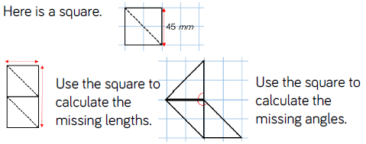
Fluency

Slide 52
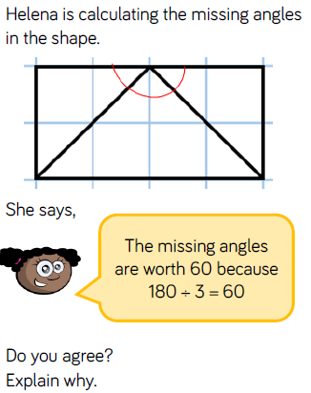
Reasoning and problem solving

Slide 53
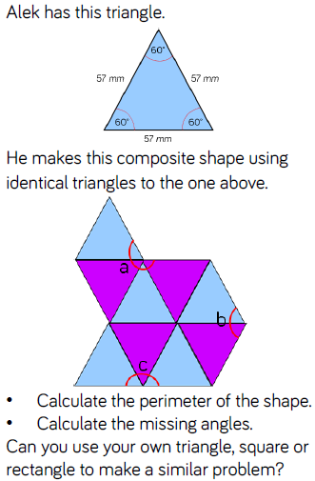
Reasoning and problem solving

Slide 54
Year 5 Summer Block 2
Geometry: Properties of shape
Regular and irregular polygons
NCLO: distinguish between regular and irregular polygons based on reasoning about equal sides and angles.

Slide 55
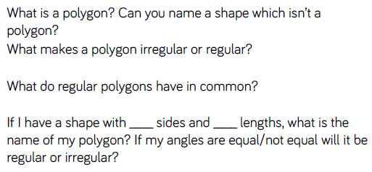
Key vocabulary and questions
Polygon, regular, irregular

Slide 56
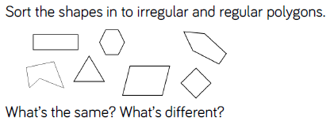
Fluency

Slide 57
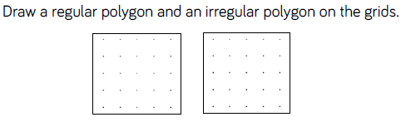
Fluency

Slide 58
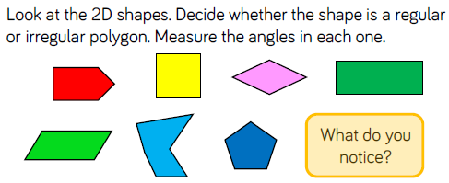
Fluency

Slide 59

Reasoning and problem solving

Slide 60

Reasoning and problem solving

Slide 61

Reasoning and problem solving

Slide 62
Year 5 Summer Block 2
Geometry: Properties of shape
Reasoning about 3D shapes
NCLO: identify 3D shapes, including cubes and other cuboids, from 2D representations

Slide 63

Key vocabulary and questions
Face, curved surface, net, opposite, vertex, vertices, prism

Slide 64

Fluency

Slide 65

Fluency

Slide 66

Fluency

Slide 67

Reasoning and problem solving

Slide 68

Reasoning and problem solving

Slide 69

Reasoning and problem solving

