Slide 1
Year 3 Summer Block 2 Number: Time
Months and Years
NCLO: Know the number of seconds in a minute and the number of days in each month, year and leap year.

Slide 2
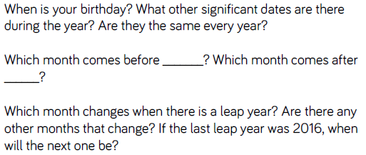
Key vocabulary and questions
Year, month, leap year

Slide 3
Fluency

Slide 4
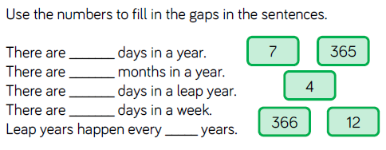
Fluency

Slide 5
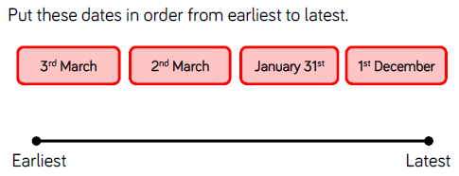
Fluency

Slide 6
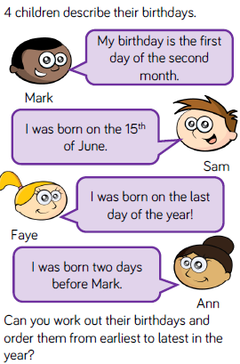
Reasoning and problem solving

Slide 7
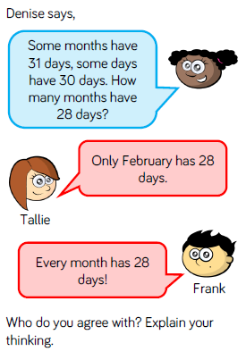
Reasoning and problem solving

Slide 8
Year 3 Summer Block 2 Number: Time
Hours in a day
NCLO: Know the number of seconds in a minute and the number of days in each month, year and leap year.

Slide 9
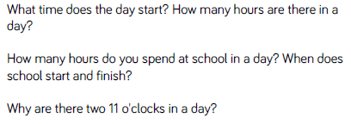
Key vocabulary and questions

Slide 10
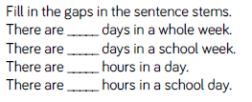
Fluency

Slide 11
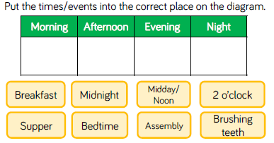
Fluency

Slide 12
Fluency

Slide 13
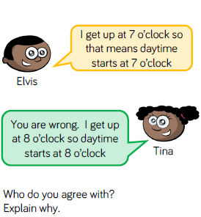
Reasoning and problem solving

Slide 14
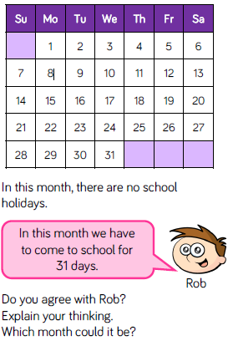
Reasoning and problem solving

Slide 15
Year 3 Summer Block 2 Number: Time
Telling the time to 5 minutes
NCLO: Estimate and read time with increasing accuracy to the nearest minute.

Slide 16
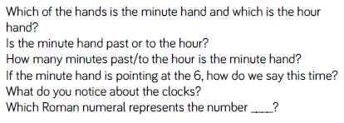
Key vocabulary and questions
Minute hand, hour hand

Slide 17
Fluency

Slide 18
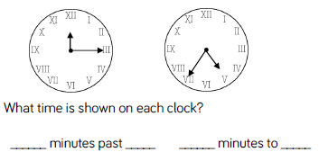
Fluency

Slide 19
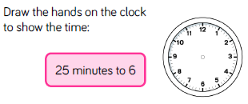
Fluency

Slide 20
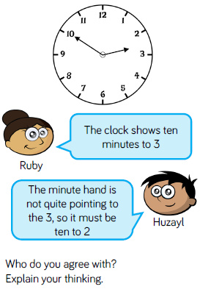
Reasoning and problem solving

Slide 21
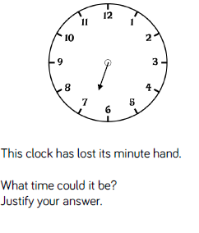
Reasoning and problem solving

Slide 22
Year 3 Summer Block 2 Number: Time
Telling the time to the minute
NCLO: Estimate and read time with increasing accuracy to the nearest minute.

Slide 23
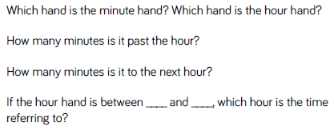
Key vocabulary and questions

Slide 24
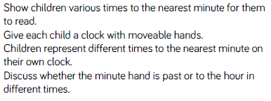
Fluency

Slide 25
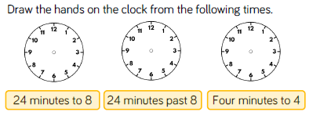
Fluency

Slide 26
Fluency

Slide 27
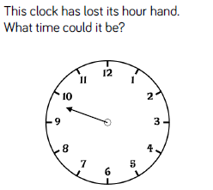
Reasoning and problem solving

Slide 28
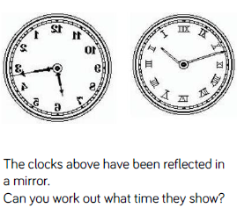
Reasoning and problem solving

Slide 29
Year 3 Summer Block 2 Number: Time
AM and PM
NCLO: Use vocabulary such as a.m. / p.m., morning, afternoon, noon and midnight

Slide 30
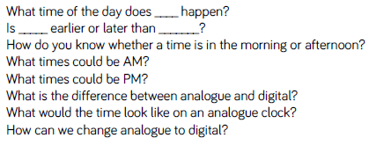
Key vocabulary and questions
a.m., p.m., analogue, digital

Slide 31
Fluency

Slide 32
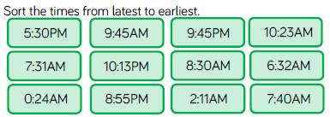
Fluency

Slide 33
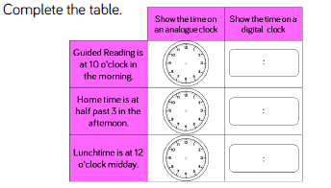
Fluency

Slide 34
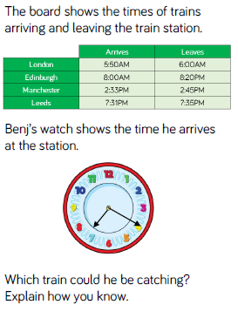
Reasoning and problem solving

Slide 35
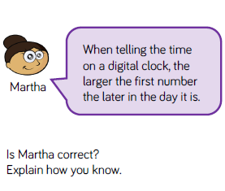
Reasoning and problem solving

Slide 36
Year 3 Summer Block 2 Number: Time
24 hour clock
NCLO: Tell and write the time from an analogue clock, including using Roman Numerals from I to XII and 12 and 24 hour clocks

Slide 37
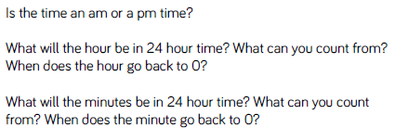
Key vocabulary and questions
24 hour clock

Slide 38
Fluency

Slide 39
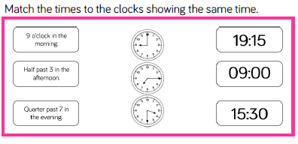
Fluency

Slide 40
Fluency

Slide 41
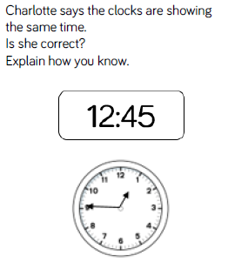
Reasoning and problem solving

Slide 42
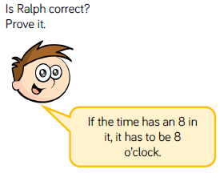
Reasoning and problem solving

Slide 43
Year 3 Summer Block 2 Number: Time
Finding the duration
NCLO: Compare durations of events

Slide 44
Key vocabulary and questions
duration

Slide 45
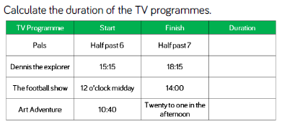
Fluency

Slide 46
Fluency

Slide 47
Fluency

Slide 48
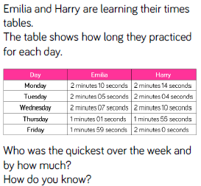
Reasoning and problem solving

Slide 49
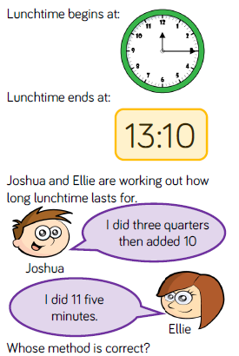
Reasoning and problem solving

Slide 50
Year 3 Summer Block 2 Number: Time
Compare the duration
NCLO: Compare durations of events

Slide 51
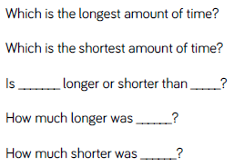
Key vocabulary and questions

Slide 52
Fluency

Slide 53
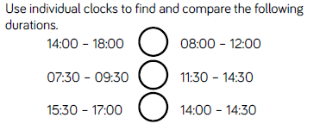
Fluency

Slide 54
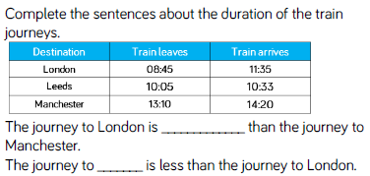
Fluency

Slide 55
Reasoning and problem solving

Slide 56
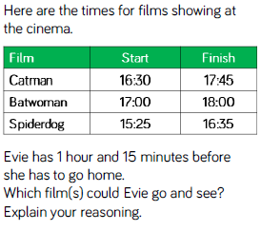
Reasoning and problem solving

Slide 57
Year 3 Summer Block 2 Number: Time
Start and end times
NCLO: Compare durations of events

Slide 58
Key vocabulary and questions
Clockwise, anti-clockwise, interval, duration

Slide 59
Fluency

Slide 60
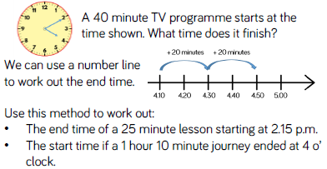
Fluency

Slide 61
Fluency

Slide 62
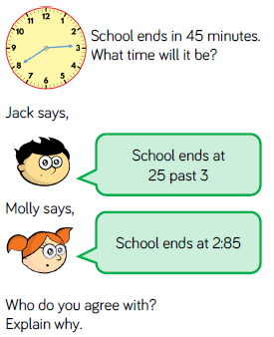
Reasoning and problem solving

Slide 63
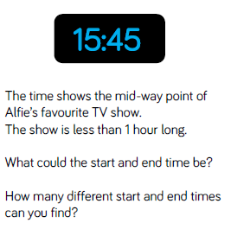
Reasoning and problem solving

Slide 64
Year 3 Summer Block 2 Number: Time
Measuring time in seconds
NCLO: Estimate and read time with increasing accuracy to the nearest minute

Slide 65
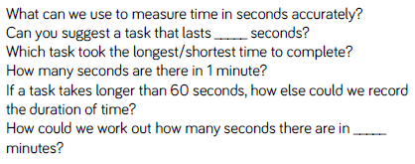
Key vocabulary and questions

Slide 66
Fluency

Slide 67
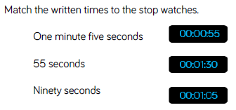
Fluency

Slide 68
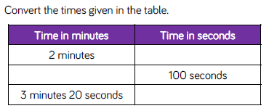
Fluency

Slide 69
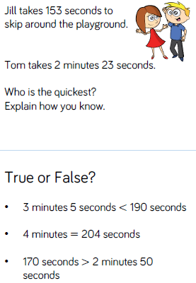
Reasoning and problem solving

Slide 70
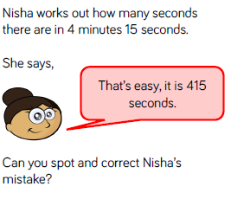
Reasoning and problem solving

