Slide 1
Year 5 Spring Block 3 Decimals and Percentages
To round decimal numbers with 2dp to the nearest whole number and to 1dp.

Slide 2
Key vocabulary and questions
Decimal places
Tenths
Hundredths

Slide 3
Key vocabulary and questions
3.56
What number is shown?
How many decimal places does it have?
When rounding to the nearest one decimal place, how many decimal places will the answer have?

Slide 4
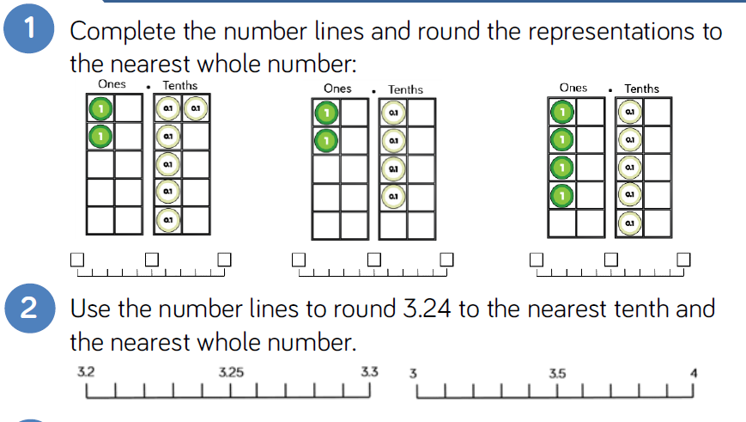
Fluency

Slide 5
Fluency

Slide 6
Fluency

Slide 7
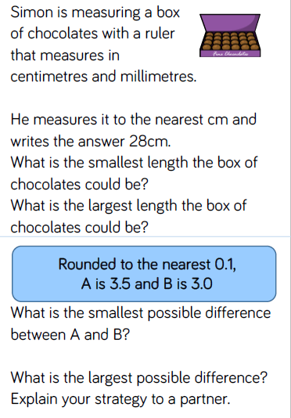
Reasoning and problem solving

Slide 8
Reasoning and problem solving

Slide 9
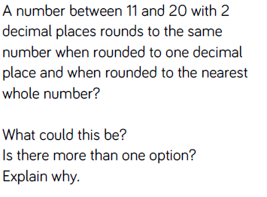
Reasoning and problem solving

Slide 10
Year 5 Spring Block 3 Decimals and Percentages
To order and compare numbers with up to 3 decimal places.

Slide 11
Key vocabulary and questions
Ascending
Descending

Slide 12
Key vocabulary and questions
7.86
What number is represented?
Complete the following sentence:
7.86 is greater/less than ______ because…
Explain how you know.
Can you build the number using place value counters?

Slide 13
Fluency

Slide 14
Fluency

Slide 15
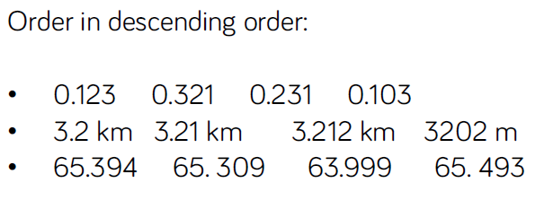
Fluency

Slide 16
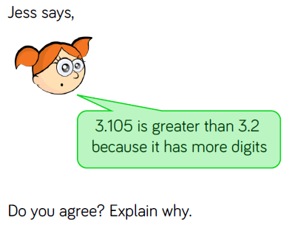
Reasoning and problem solving

Slide 17
Reasoning and problem solving

Slide 18
Year 5 Spring Block 3 Decimals and Percentages
To use and understand percentages as part of 100

Slide 19
Key vocabulary and questions
How many parts is the square split in to?
How many parts per hundred are shaded/not shaded?
Can we represent this percentage differently?

Slide 20
Fluency

Slide 21
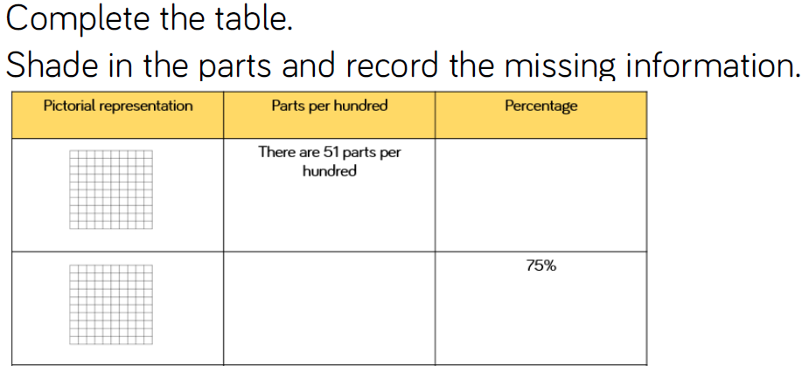
Fluency
In the table, what does the score represent? How many parts
per hundred did each score?

Slide 22
Fluency
Look at the bar model, how many parts is it split into?
If the bar is worth 100, what is each part worth?
How would we say this as a percentage?

Slide 23
Reasoning and problem solving

Slide 24
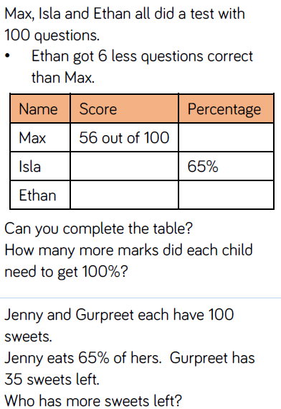
Reasoning and problem solving

Slide 25
Reasoning and problem solving

Slide 26
Year 5 Spring Block 3 Decimals and Percentages
To represent percentages as fractions and decimals

Slide 27
Key vocabulary and questions
0.75 and 75%
What do you notice about the percentage and the decimal?
What’s the same? What’s different about percentages, decimals and fractions?
How can we record this proportion as a fraction?
Explain your method.

Slide 28
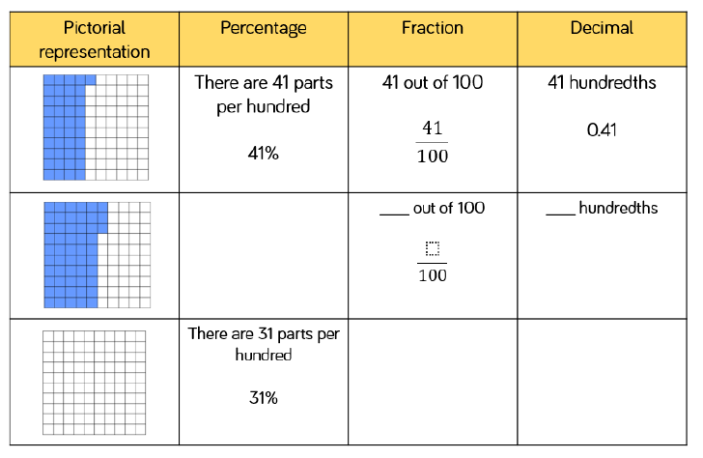
Fluency

Slide 29
Fluency

Slide 30
Fluency

Slide 31
Reasoning and problem solving

Slide 32
Reasoning and problem solving

Slide 33
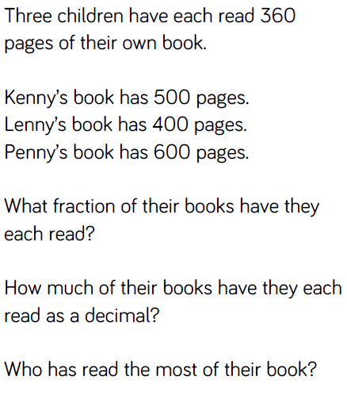
Reasoning and problem solving

Slide 34
Year 5 Spring Block 3 Decimals and Percentages
To solve problems using knowledge of equivalent fractions, decimals and percentages

Slide 35
Key vocabulary and questions
What FDP equivalences do you know?
Can we come up with a class list of ones we should know?
Which is closer to 100%,
4/5 or 70%? How do you know?

Slide 36
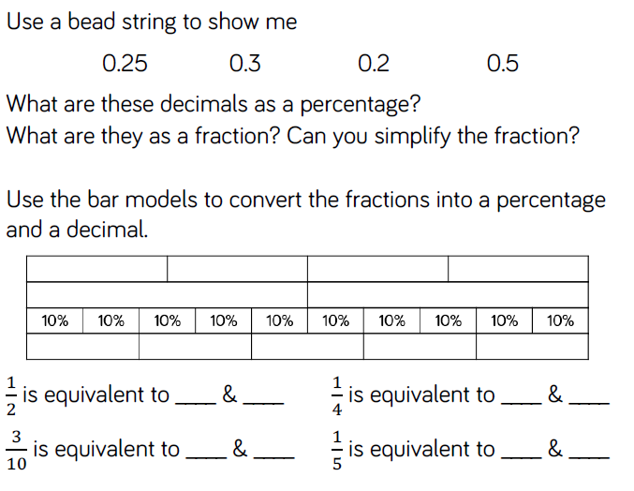
Fluency

Slide 37
Fluency

Slide 38
Fluency

Slide 39
Reasoning and problem solving

Slide 40
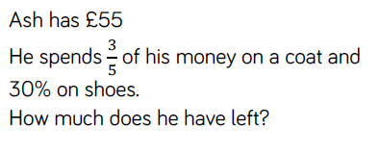
Reasoning and problem solving

Slide 41
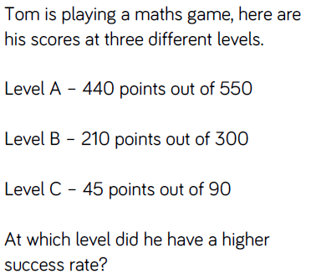
Reasoning and problem solving

