Slide 1
Year 4 Spring Block 3:Number Fractions
What is a fraction?
NCLO:Recognise and show, using diagrams, families of common equivalent fractions.

Slide 2
Key vocabulary and questions
Numerator, denominator, whole, part, unit fraction, non-unit fraction

Slide 3
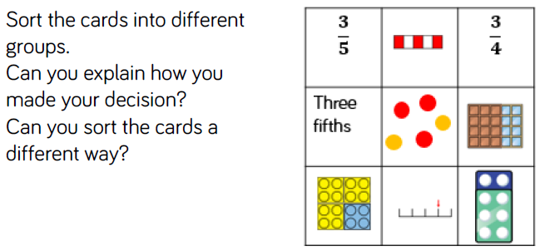
Fluency

Slide 4
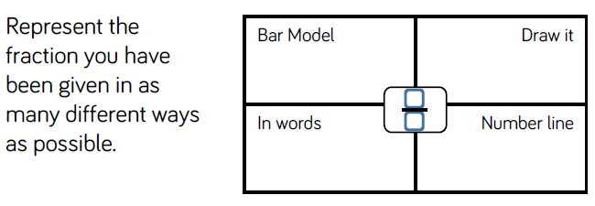
Fluency

Slide 5
Fluency

Slide 6
Reasoning and Problem Solving

Slide 7
Reasoning and Problem Solving

Slide 8
Year 4 Spring Block 3:Number Fractions
Equivalent fractions 1
NCLO:Recognise and show, using diagrams, families of common equivalent fractions.

Slide 9
Key vocabulary and questions
Whole, part, equal, numerator, denominator, equivalent fraction

Slide 10
Fluency

Slide 11
Fluency

Slide 12
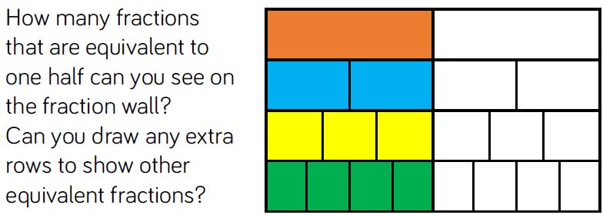
Fluency

Slide 13
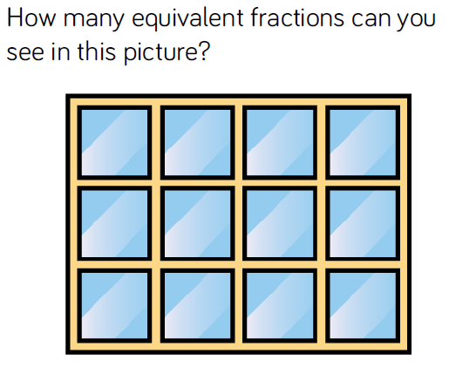
Reasoning and Problem Solving

Slide 14
Reasoning and Problem Solving

Slide 15
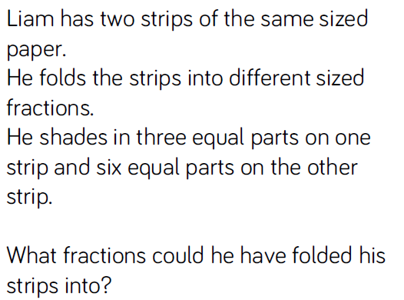
Reasoning and Problem Solving

Slide 16
Year 4 Spring Block 3:Number Fractions
Equivalent fractions 2
NCLO:Recognise and show, using diagrams, families of common equivalent fractions.

Slide 17
Key vocabulary and questions
Numerator, denominator, part, whole, equal, equivalent fractions

Slide 18
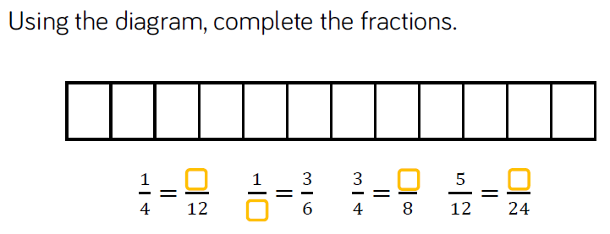
Fluency

Slide 19
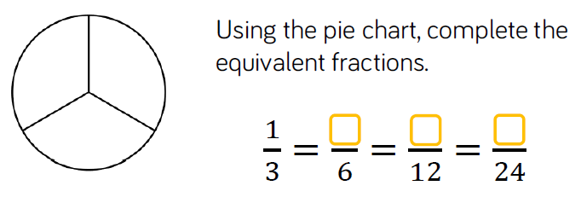
Fluency

Slide 20
Fluency

Slide 21
Reasoning and Problem Solving

Slide 22
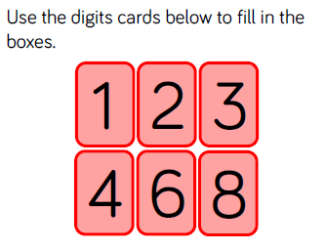
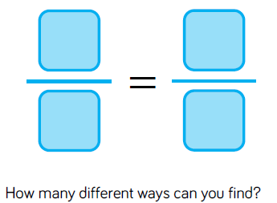
Reasoning and Problem Solving

Slide 23
Year 4 Spring Block 3:Number Fractions
Fractions greater than 1
NCLO:Recognise and show, using diagrams, families of common equivalent fractions.

Slide 24
Key vocabulary and questions
Part, whole, numerator, denominator, equivalent fraction

Slide 25
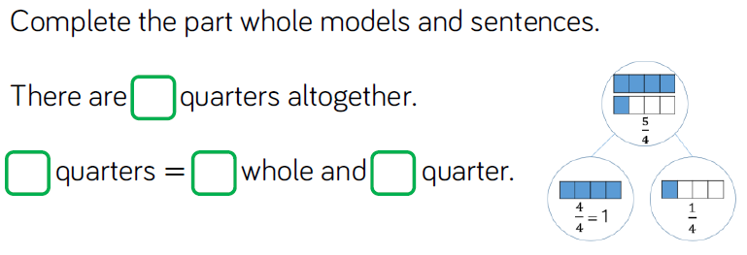
Fluency

Slide 26
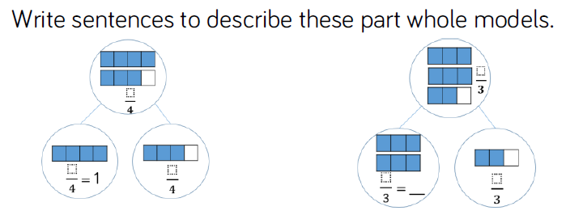
Fluency

Slide 27
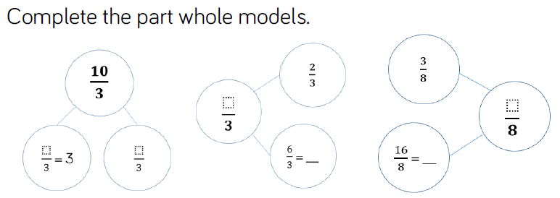
Fluency

Slide 28
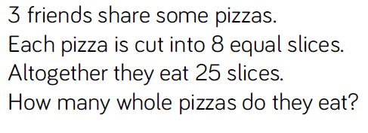
Reasoning and Problem Solving

Slide 29
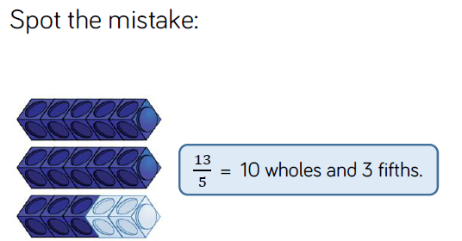
Reasoning and Problem Solving

Slide 30
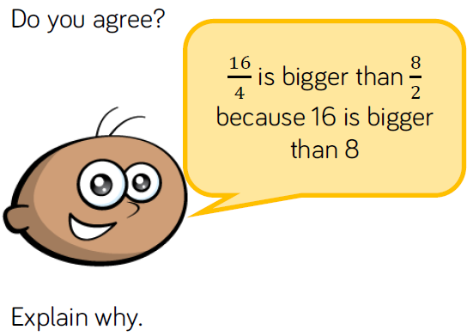
Reasoning and Problem Solving

Slide 31
Year 4 Spring Block 3:Number Fractions
Count in fractions
NCLO:Count up and down in hundredths; recognize that hundredths arise when dividing and object by one hundred and by dividing tenths by ten.

Slide 32
Key vocabulary and questions
Part, whole, complement

Slide 33
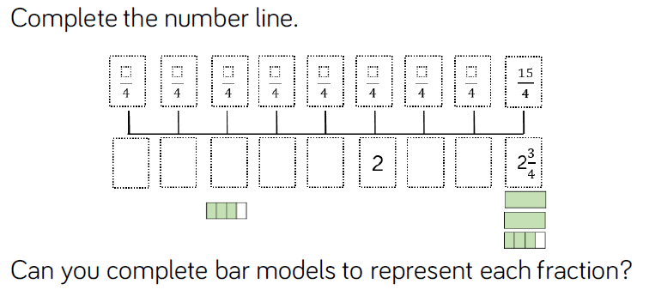
Fluency

Slide 34
Fluency

Slide 35
Fluency

Slide 36
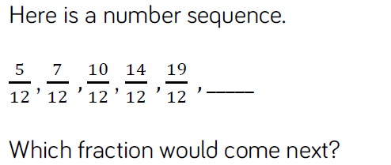
Reasoning and Problem Solving

Slide 37
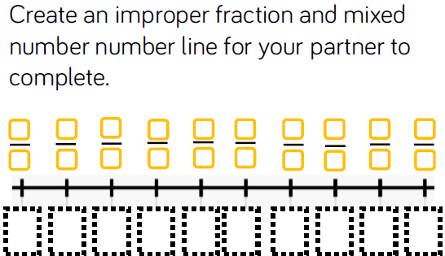
Reasoning and Problem Solving

Slide 38
Year 4 Spring Block 3:Number Fractions
Add 2 or more fractions
NCLO: Add and subtract fractions with the same denominator

Slide 39
Key vocabulary and questions
Total, whole, part, equal

Slide 40
Fluency

Slide 41
Fluency

Slide 42
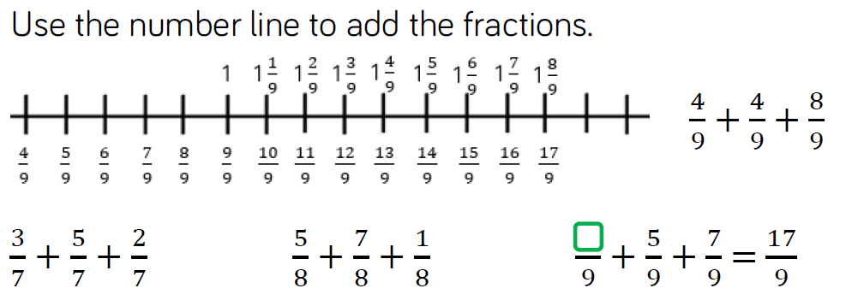
Fluency

Slide 43
Reasoning and Problem Solving

Slide 44
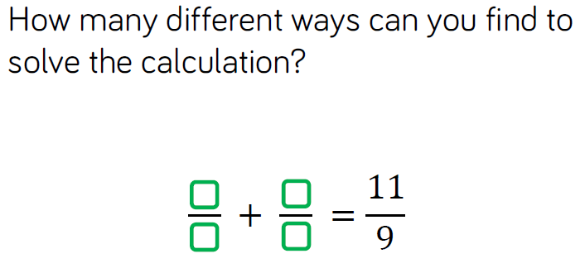
Reasoning and Problem Solving

Slide 45
Reasoning and Problem Solving

Slide 46
Year 4 Spring Block 3:Number Fractions
Subtract 2 fractions
NCLO: Add and subtract fractions with the same denominator

Slide 47
Key vocabulary and questions
Difference, partition

Slide 48
Fluency

Slide 49
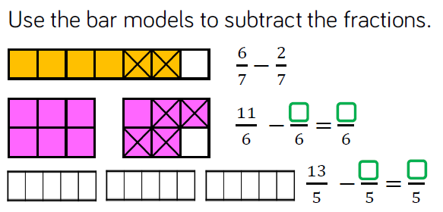
Fluency

Slide 50
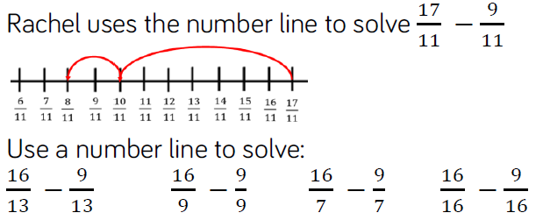
Fluency

Slide 51
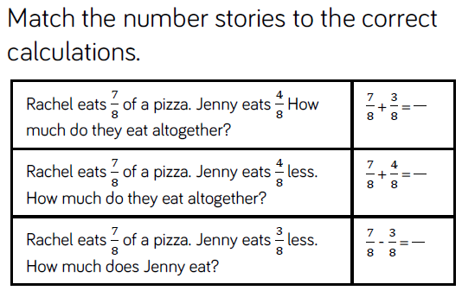
Reasoning and Problem Solving

Slide 52
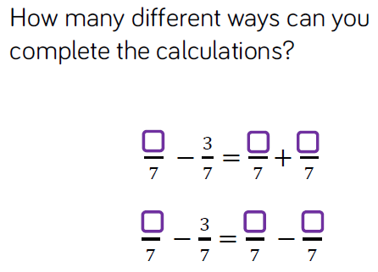
Reasoning and Problem Solving

Slide 53
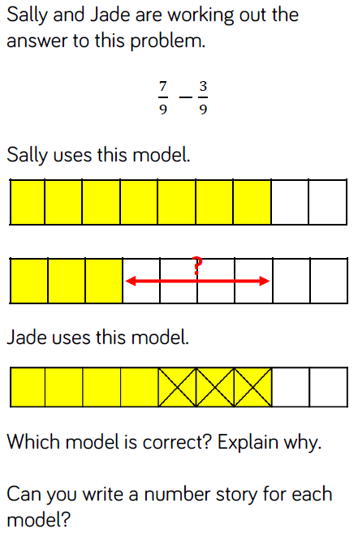

Slide 54
Year 4 Spring Block 3:Number Fractions
Subtract from whole amounts
NCLO: Add and subtract fractions with the same denominator

Slide 55
Key vocabulary and questions
Whole number, fraction

Slide 56
Fluency

Slide 57
Fluency

Slide 58
Fluency

Slide 59
Reasoning and Problem Solving

Slide 60
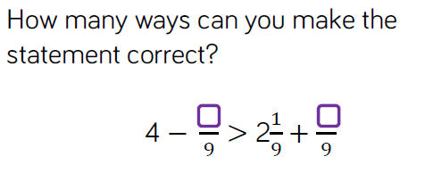
Reasoning and Problem Solving

Slide 61
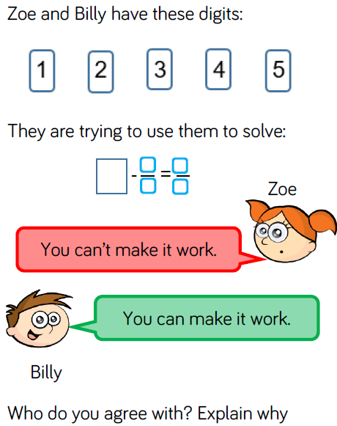

Slide 62
Year 4 Spring Block 3:Number Fractions
Calculate fractions of a quantity
NCLO: Solve problems involving increasingly harder fractions to calculate quantities and fractions to divide quantities including non-unit fractions where the answer is a whole number

Slide 63
Key vocabulary and questions
Whole, part, numerator, denominator, bar model

Slide 64
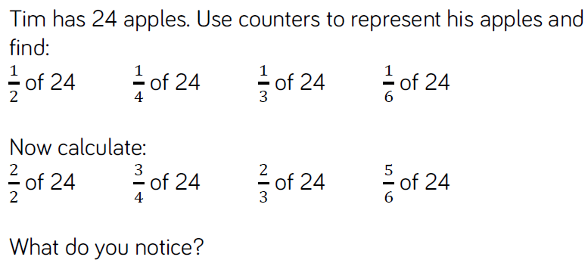
Fluency

Slide 65
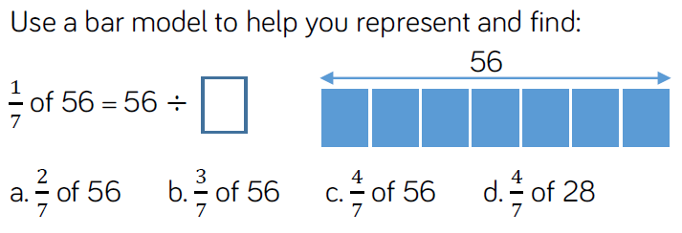
Fluency

Slide 66
Fluency

Slide 67
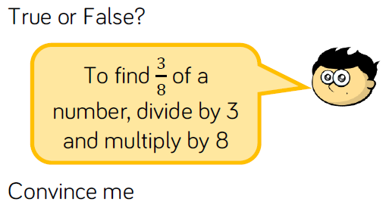
Reasoning and Problem Solving

Slide 68
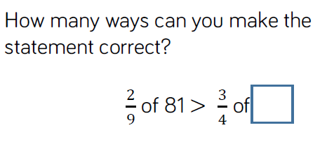
Reasoning and Problem Solving

Slide 69
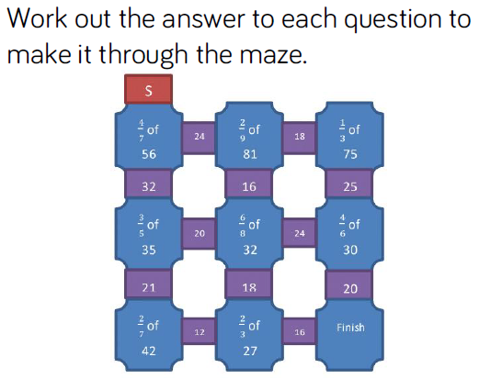
Reasoning and Problem Solving

Slide 70
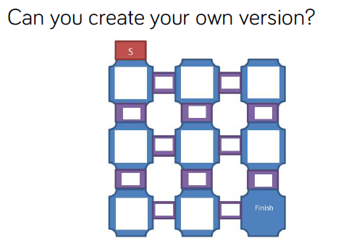
Reasoning and Problem Solving

Slide 71
Year 4 Spring Block 3:Number Fractions
Problem solving – calculate quantities
NCLO: Solve problems involving increasingly harder fractions to calculate quantities and fractions to divide quantities including non-unit fractions where the answer is a whole number

Slide 72
Key vocabulary and questions
Equal parts, whole, bar model

Slide 73
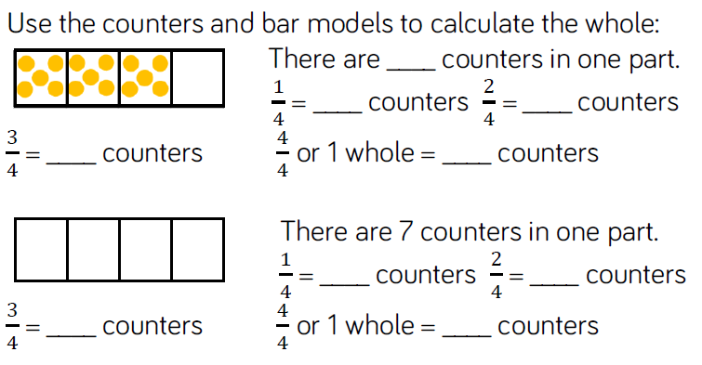
Fluency

Slide 74
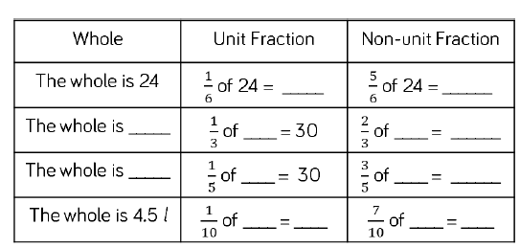
Fluency

Slide 75
Fluency

Slide 76
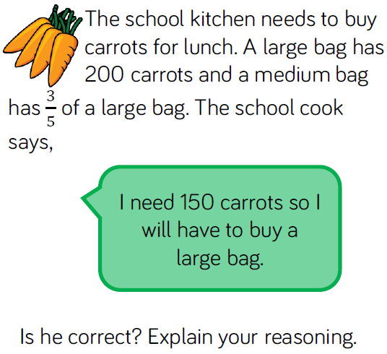
Reasoning and Problem Solving

Slide 77
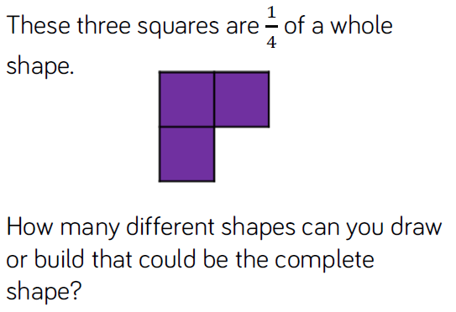
Reasoning and Problem Solving

Slide 78
Reasoning and Problem Solving

