Slide 1
Lines of symmetry
NCLO: to identify and describe the properties of 2D shape including the number of lines of symmetry
Year 2 Spring Block 3
Geometry- Properties of Shape

Slide 2
Key Questions
What is a vertical line of symmetry?
What does vertical mean?
Which is the odd shape out? How do you know?
What resources could you use to check if a shape has a vertical line of symmetry?

Slide 3
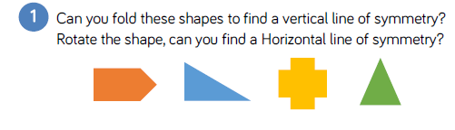
Fluency

Slide 4
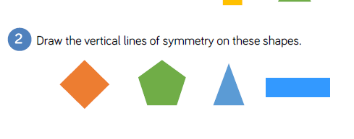
Fluency

Slide 5
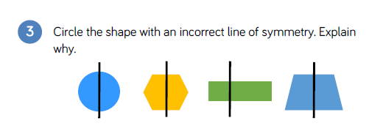
Fluency

Slide 6
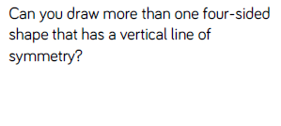

Slide 7
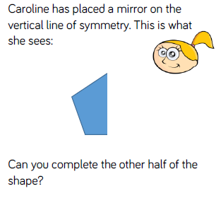

Slide 8
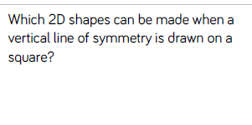

Slide 9
Sort 2D shapes
NCLO: to compare and sort common 2D shapes
Year 2 Spring Block 3
Geometry- Properties of Shape

Slide 10
Key Questions
How have you sorted your shapes?
How do you know you have sorted your shapes correctly?
Which method have you used to sort your shapes?

Slide 11
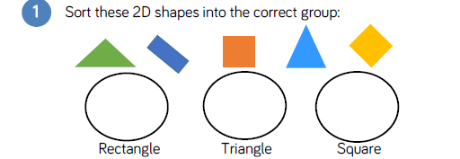

Slide 12
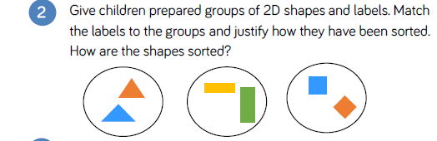

Slide 13
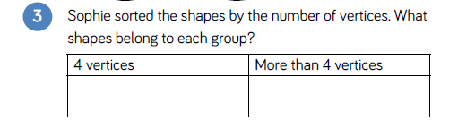

Slide 14
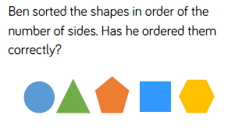

Slide 15
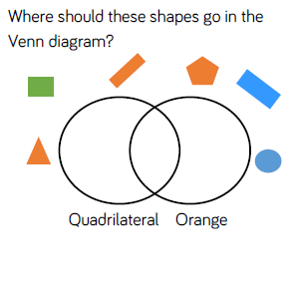

Slide 16
Make patterns with 2D shapes
NCLO: to order and arrange combinations of mathematical objects in patterns
Year 2 Spring Block 3
Geometry- Properties of Shape

Slide 17
Can you explain the pattern?
How many times does the pattern repeat?
How are these patterns similar?
How are these patterns different?
How can you work out which shape will come ____th?
Key Questions

Slide 18


Slide 19
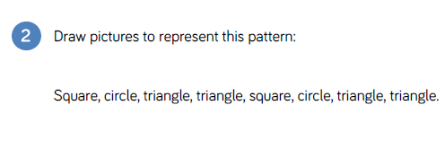

Slide 20
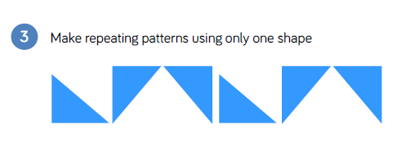

Slide 21
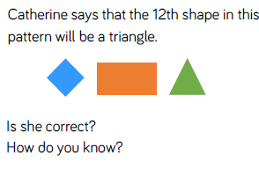

Slide 22
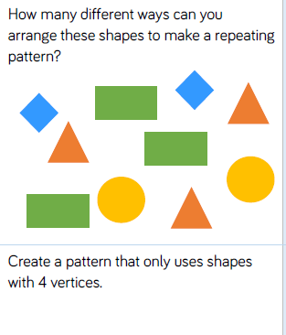

Slide 23
Count faces on 3D shapes
NCLO: to compare and sort common 3D shapes
Year 2 Spring Block 3
Geometry- Properties of Shape

Slide 24
Key Questions
What do we mean by the ‘face’ of a shape?
What is the difference between a face and a curved surface?
What real life objects have 6 faces like a cube?
Does a cuboid always have 2 square faces and 4 rectangular faces?
Which 2D shapes can you see on different 3D shapes?

Slide 25
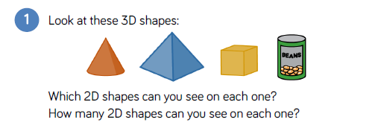

Slide 26
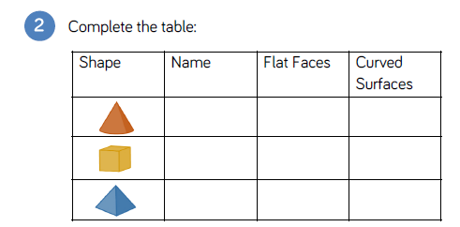

Slide 27


Slide 28
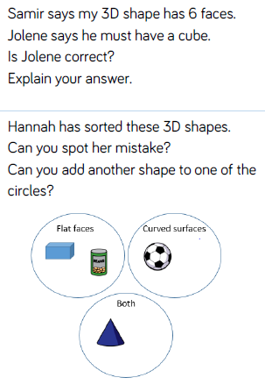

Slide 29
