Slide 1
Year 2 Block 3 Geometry: Properties of Shape Small Step 9
Count edges on 3D Shapes
NCLO: Identify and describe the properties of 3-D shapes, including the number of edges, vertices and faces.

Slide 2
Key vocabulary and questions
Shape, edges and vertices

Slide 3
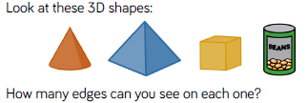
Fluency

Slide 4
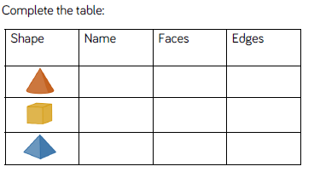
Fluency

Slide 5
Fluency
Sort your shapes depending on the number of edges and/or faces.

Slide 6
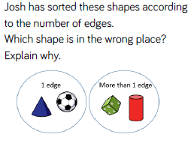
Reasoning and problem solving

Slide 7
Reasoning and problem solving
Anna says my 3D shape has 12 edges.
Lilly says she could have a cube, cuboid or square based pyramid.
Is Lilly correct? Explain your answer.

Slide 8
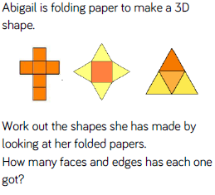
Reasoning and problem solving

Slide 9
Year 2 Block 3 Geometry: Properties of Shape Small Step 10
Count vertices on 3D Shapes
NCLO: Identify and describe the properties of 3-D shapes, including the number of edges, vertices and faces.

Slide 10
Key vocabulary and questions
count, shape, vertices, edges,

Slide 11
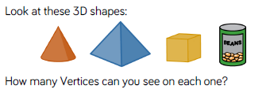
Fluency

Slide 12
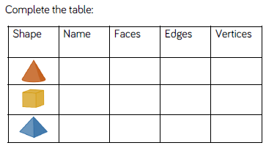
Fluency

Slide 13
Fluency
Alex has a shape with 8 vertices. What 3D shape could it be?

Slide 14
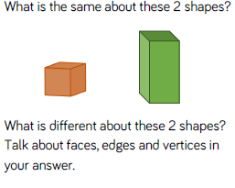
Reasoning and problem solving

Slide 15
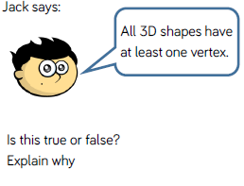
Reasoning and problem solving

Slide 16
Year 2 Block 3 Geometry: Properties of Shape Small Step 11
Sort 3D Shapes
NCLO: Compare and sort common 2-D and 3-D shapes and everyday objects.

Slide 17
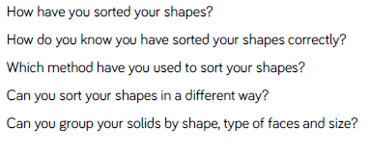
Key vocabulary and questions
sort, explain. shape, describe, edges, vertices and faces

Slide 18
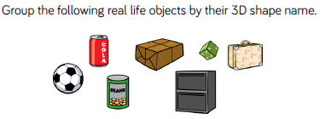
Fluency

Slide 19
Fluency
Sort the 3D shapes on your table. How have you grouped them? Label the groups.

Slide 20
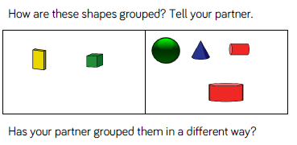
Fluency

Slide 21
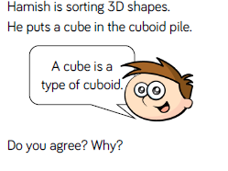
Reasoning and problem solving

Slide 22
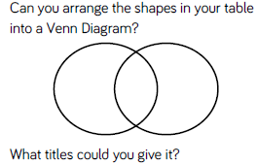
Reasoning and problem solving

Slide 23
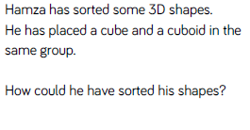
Reasoning and problem solving

Slide 24
Year 2 Block 3 Geometry: Properties of Shape Small Step 12
Make patterns with 3D shapes
NCLO: Identify and describe the properties of 3-D shapes, including the number of edges, vertices and faces.

Slide 25
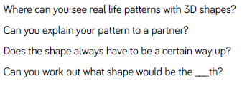
Key vocabulary and questions
pattern, edges, vertices, faces, explain

Slide 26
Fluency
Use some different coloured cubes to make a repeating pattern. Can you describe the pattern to your partner?

Slide 27
Fluency
Make a sequence of 3D shapes with real life objects. You could use food cans, boxes, balls, or other things in your classroom. Describe the pattern.

Slide 28
Fluency

Slide 29
Reasoning and problem solving

Slide 30
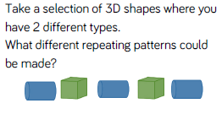
Reasoning and problem solving

Slide 31
Reasoning and problem solving

