Slide 1
Year 5 Summer Block 5 Geometry: Position and Direction
Position in the first quadrant
NCLO:Identify, describe and represent the position of a shape following a reflection or translation, using the appropriate language, and know that the shape has not changed.

Slide 2
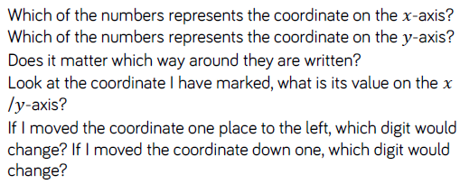
Key vocabulary and questions
Coordinate, x axis, y axis, reflection, translation

Slide 3
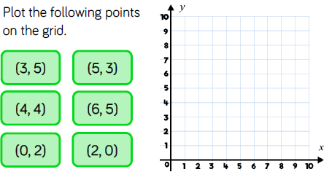
Fluency

Slide 4
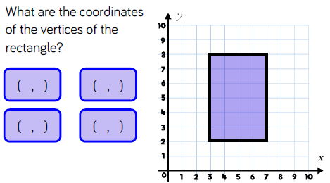
Fluency

Slide 5
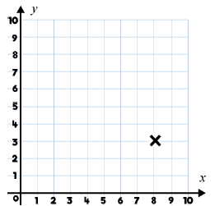
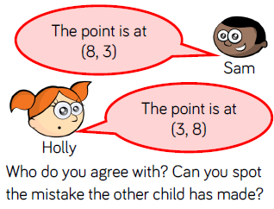
Reasoning and problem solving

Slide 6
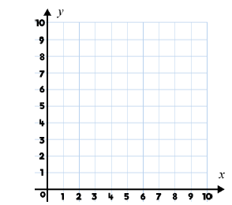
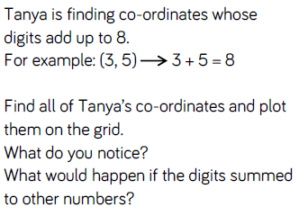
Reasoning and problem solving

Slide 7
Year 5 Summer Block 5 Geometry: Position and Direction
Reflection
NCLO:Identify, describe and represent the position of a shape following a reflection or translation, using the appropriate language, and know that the shape has not changed.

Slide 8
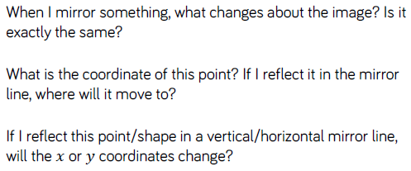
Key vocabulary and questions
Mirror, image, coordinate, reflect, vertical, horizontal

Slide 9
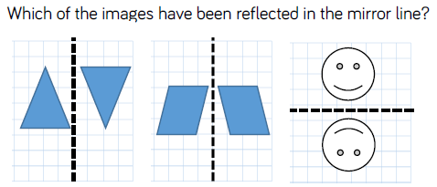
Fluency

Slide 10
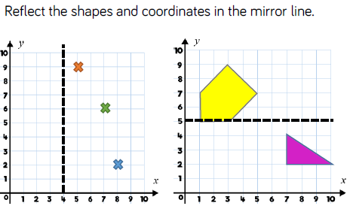
Fluency

Slide 11
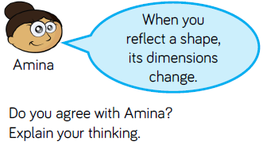
Reasoning and problem solving

Slide 12
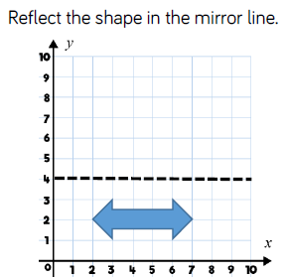
Reasoning and problem solving

Slide 13
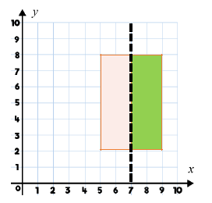
Reasoning and problem solving

Slide 14
Year 5 Summer Block 5 Geometry: Position and Direction
Reflection with coordinates
NCLO:Identify, describe and represent the position of a shape following a reflection or translation, using the appropriate language, and know that the shape has not changed.

Slide 15
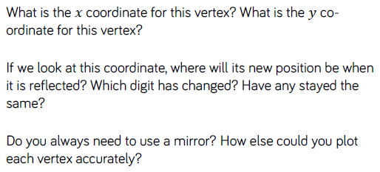
Key vocabulary and questions
Vertex, coordinate, position, reflected, digit

Slide 16
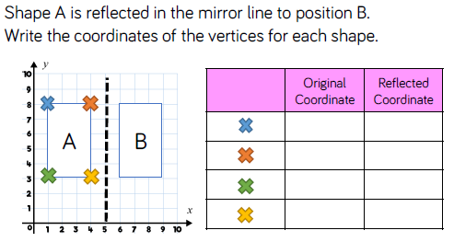
Fluency

Slide 17
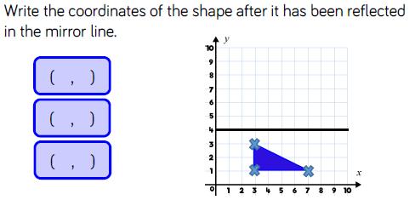
Fluency

Slide 18
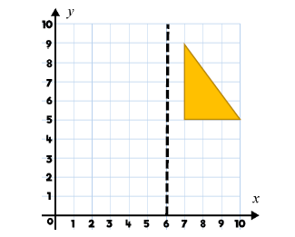
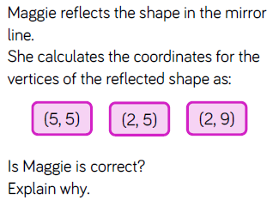
Reasoning and problem solving

Slide 19
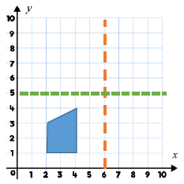
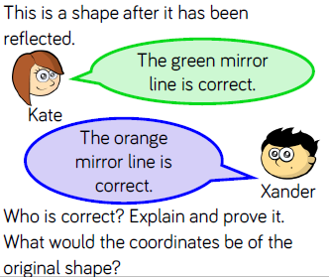
Reasoning and problem solving

Slide 20
Year 5 Summer Block 5 Geometry: Position and Direction
Translation
NCLO:Identify, describe and represent the position of a shape following a reflection or translation, using the appropriate language, and know that the shape has not changed.

Slide 21
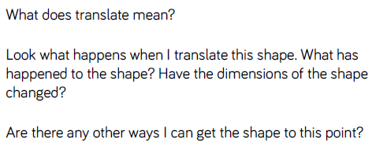
Key vocabulary and questions
Translate, dimensions

Slide 22
Fluency

Slide 23
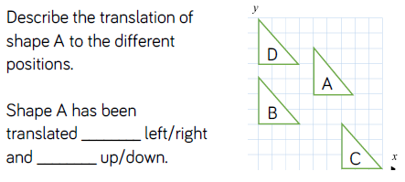
Fluency

Slide 24
Fluency

Slide 25
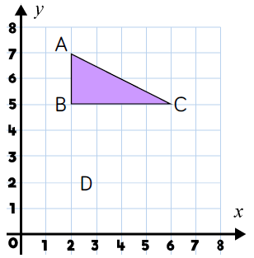
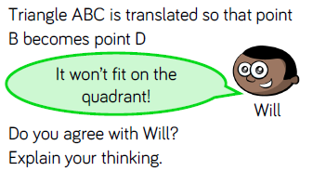
Reasoning and problem solving

Slide 26
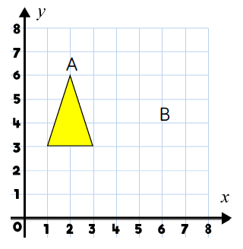
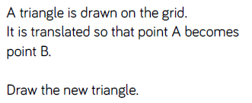
Reasoning and problem solving

Slide 27
Year 5 Summer Block 5 Geometry: Position and Direction
Translation with coordinates
NCLO:Identify, describe and represent the position of a shape following a reflection or translation, using the appropriate language, and know that the shape has not changed.

Slide 28
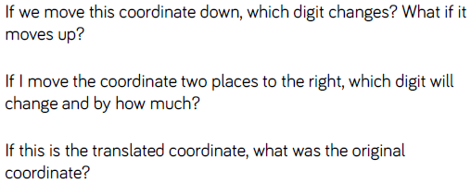
Key vocabulary and questions
Coordinate, digit, translation

Slide 29
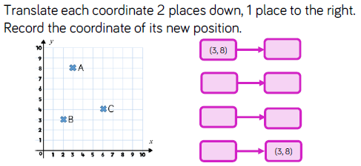
Fluency

Slide 30
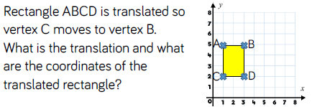
Fluency

Slide 31
Fluency

Slide 32
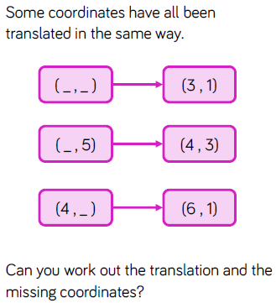
Reasoning and problem solving

Slide 33
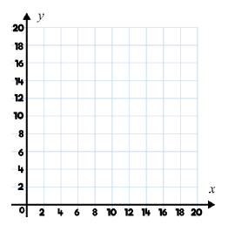
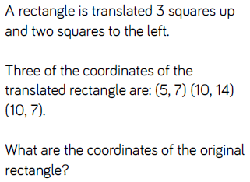
Reasoning and problem solving

