Slide 1
Year 1 Spring Block 3 Measurement Length and Height
Compare lengths and heights
NCLO: Compare, describe and solve
practical problems for:
lengths and heights (for
example, long/short,
longer/shorter, tall/short.

Slide 2
Vocabulary
length ,long, short, longer, shorter, tall, small, taller, smaller, equal, stem sentence

Slide 3
Key vocabulary and questions
Which person is taller/shorter?
Which pencil is shorter/longer?
Are we measuring the height or length of something?
What is the same? What is different?
How can we describe the height of the houses?

Slide 4
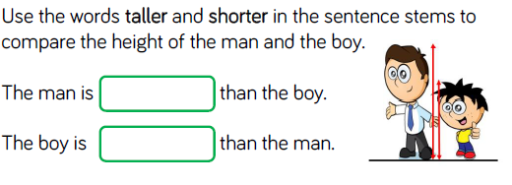
Fluency

Slide 5
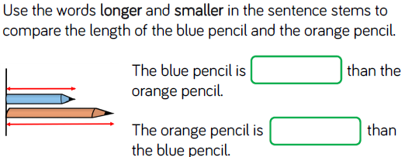
Fluency

Slide 6
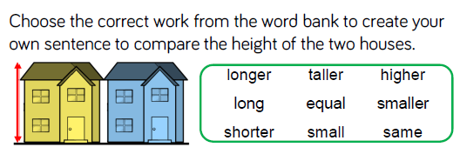
Fluency

Slide 7
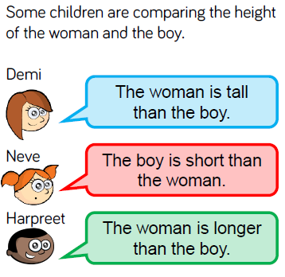
Reasoning and problem solving

Slide 8
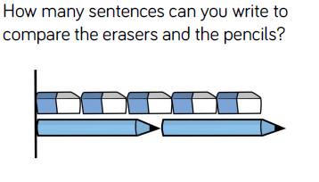
Reasoning and problem solving

Slide 9
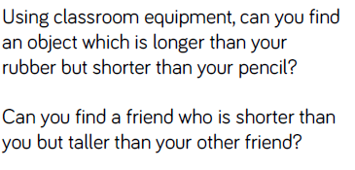
Reasoning and problem solving

Slide 10
Year 1 Spring Block 3 Measurement Length and Height
Measure length 1
NCLO: Measure and begin to record
lengths

Slide 11
Vocabulary
non-standard units, cubes, hands, straws measure, length, height.

Slide 12
Key vocabulary and questions
What other things could you use to measure how long a pencil is?
Would you use the same piece of equipment to measure the length of the classroom? Why?
What could you use to measure how tall you are?
How much longer is the pencil than the rubber?
How much shorter is the rubber than the pencil?

Slide 13
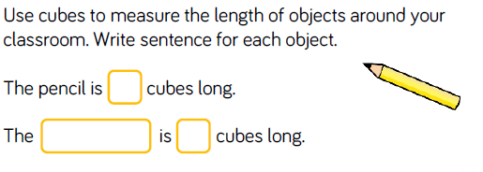
Fluency

Slide 14
Fluency

Slide 15
Fluency

Slide 16
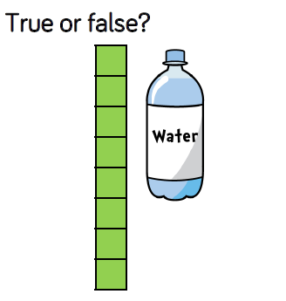
Reasoning and problem solving

Slide 17
Reasoning and problem solving

Slide 18
Year 1 Spring Block 3 Measurement Length and Height
Measure length 2
NCLO: Measure and begin to record
lengths

Slide 19
Vocabulary
non-standard units, cubes, hands, straws, ruler, vary, standard unit of measurement, centimetre (cm) measure, length, height.

Slide 20
Key vocabulary and questions
What do the numbers on the ruler mean? (1 cm etc)
Where should we place the end of the object to start measuring?
Does the ruler look like anything else we have used? (number line)
Can you count how many cm the ______ measures?
How does using a ruler help us to compare objects?

Slide 21
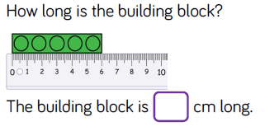
Fluency

Slide 22
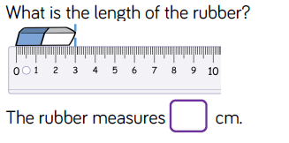
Fluency

Slide 23
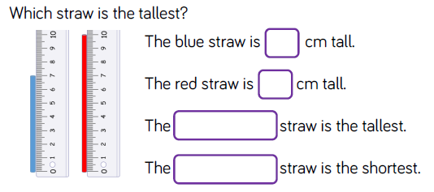
Fluency

Slide 24
Reasoning and problem solving

Slide 25
Reasoning and problem solving

Slide 26
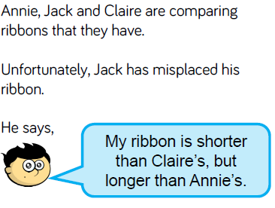
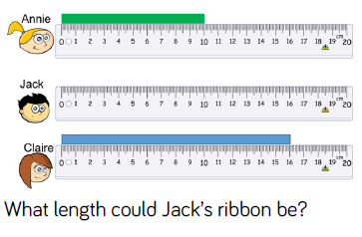
Reasoning and problem solving

