Slide 1
Year 2 Summer Block 3 Measurement Time
O’Clock and Half Past
NCLO: Tell and write the time to the hour (o’clock) and half past the hour.
Draw the hands on a clock face to show these times.

Slide 2
Vocabulary
clock, clock face, hour,
minute, time, hour hand, minute hand, o’clock, half past

Slide 3
Key questions
What do the numbers represent on the clock face?
Which is the hour hand? Which is the minute hand?
Where will the hour hand be at ____?
Where will the minute hand be at ____?
What do you notice about the minute hand at half past?
Can you show me _______?

Slide 4
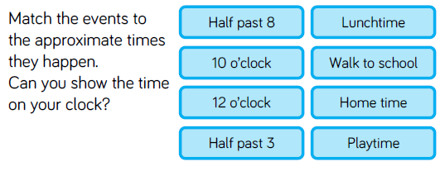
Fluency

Slide 5
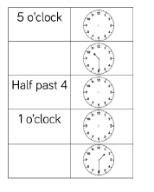
Fluency

Slide 6
Fluency

Slide 7
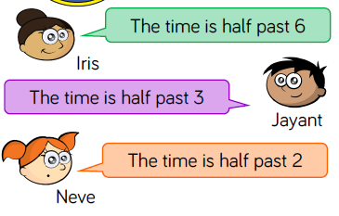
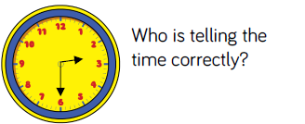
Reasoning and problem solving

Slide 8
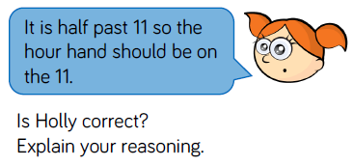
Reasoning and problem solving

Slide 9
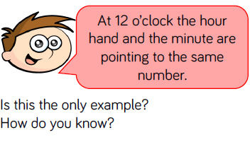
Reasoning and problem solving

Slide 10
Year 2 Summer Block 3 Measurement Time
Quarter Past & Quarter To
NCLO: Tell and write the time to the quarter past/ quarter to the hour.
Draw the hands on a clock face to show these times.

Slide 11
Vocabulary
quarter past, quarter to, fractions, turns, quarter turn, three quarter turn, hour hand, minute hand, hour number.

Slide 12
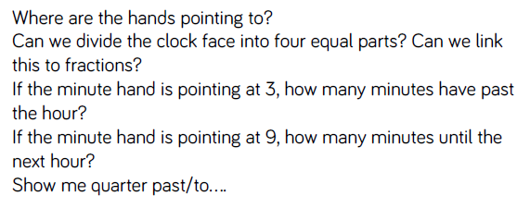
Key questions

Slide 13
Fluency
Look at the clocks .
How has the minute hand travelled?
Can you see a quarter past ?
Can you see a quarter to?
Can you make a quarter past on your clock?
Can you make a quarter to on your clock?

Slide 14
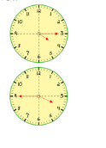
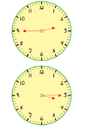
Fluency
Match the clocks to the correct time.
Quarter to 4
Quarter past 4
Quarter to 3
Quarter past 3

Slide 15
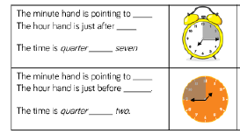
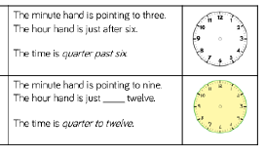
Fluency
Complete the table

Slide 16
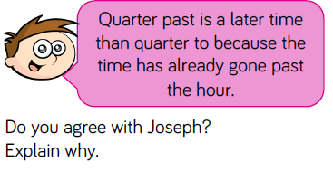
Reasoning and problem solving

Slide 17
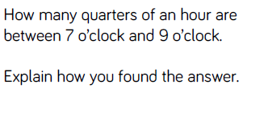
Reasoning and problem solving

Slide 18
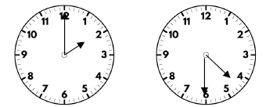
Reasoning and problem solving

Slide 19
Year 2 Summer Block 3 Measurement Time
Telling the time to 5 minutes
NCLO: Tell and write the time to t5 minutes past the hour.
Draw the hands on a clock face to show these times.

Slide 20
Vocabulary
analogue time , 5 minute intervals, count, steps, zero, five, ten, fifteen, twenty, twenty-five, thirty, thirty – five, forty, forty-five, fifty, fifty-five, sixty, minute hand, ‘to’ the next hour, ‘past’ the hour.

Slide 21
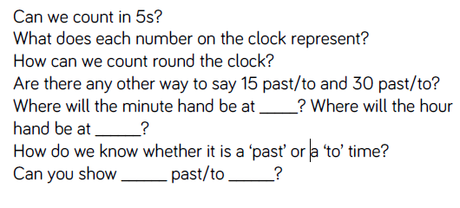
Key questions

Slide 22
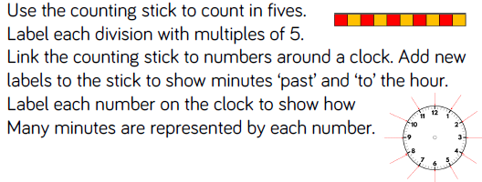
Fluency

Slide 23
Fluency

Slide 24
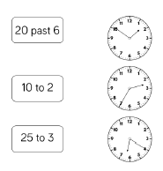
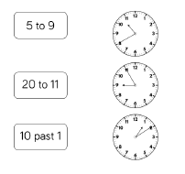
Fluency
Match the times to the correct clock

Slide 25
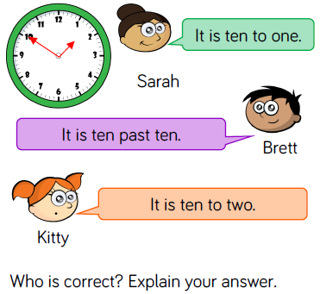
Reasoning and problem solving

Slide 26
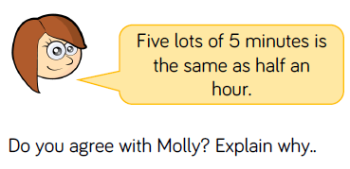
Reasoning and problem solving

Slide 27
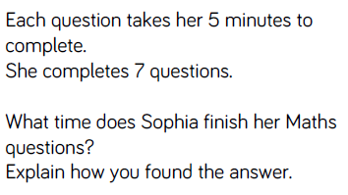
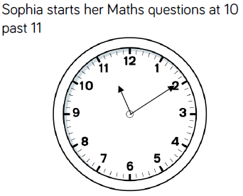
Reasoning and problem solving

Slide 28
Year 2 Summer Block 3 Measurement Time
Minues in an hour, hours in a day
NCLO: Know the number of minutes in an hour and the number of hours in a
day. Compare and sequence intervals of
time.

Slide 29
Vocabulary
24 hours
day
60 minutes
hour
convert
analogue time

Slide 30
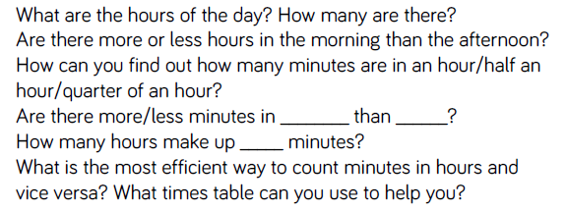
Key questions

Slide 31
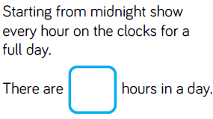
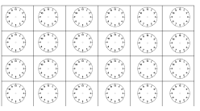
Fluency

Slide 32
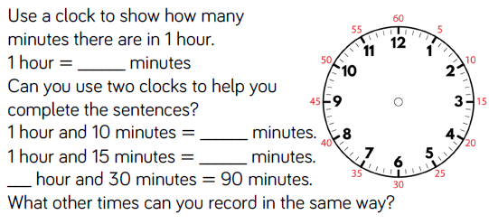
Fluency

Slide 33
Fluency

Slide 34
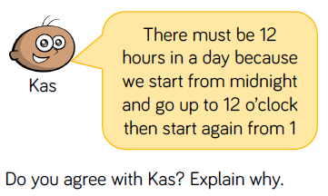
Reasoning and problem solving

Slide 35
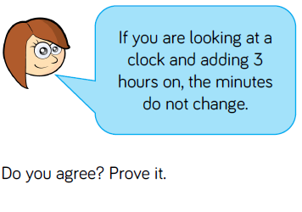
Reasoning and problem solving

Slide 36
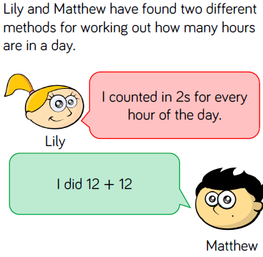
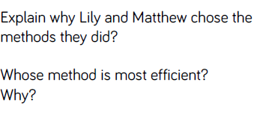
Reasoning and problem solving

Slide 37
Year 2 Summer Block 3 Measurement Time
Find durations of time
NCLO: Compare and sequence intervals of time.

Slide 38
Vocabulary
start
finish
How long something lasts?
duration

Slide 39
Key questions

Slide 40
Fluency

Slide 41
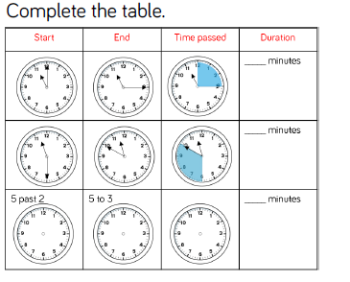
Fluency

Slide 42
Fluency

Slide 43
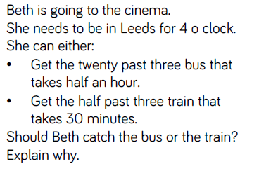
Reasoning and problem solving

Slide 44
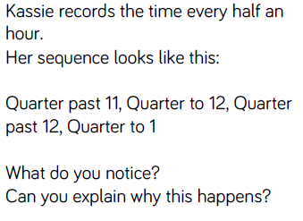
Reasoning and problem solving

Slide 45
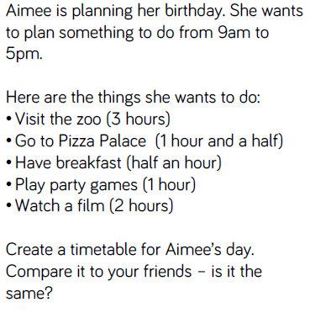
Reasoning and problem solving

Slide 46
Year 2 Summer Block 3 Measurement Time
Compare durations of time
NCLO: Compare and sequence intervals of time.

Slide 47
Vocabulary
Longer
longest
shorter
shortest
duration

Slide 48
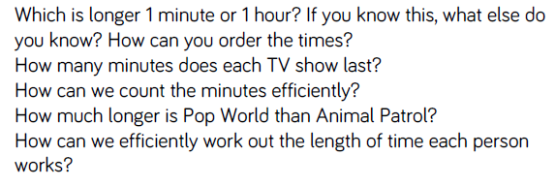
Key questions

Slide 49
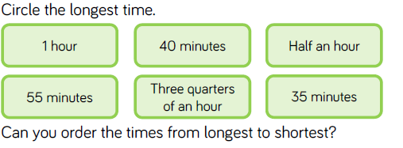
Fluency

Slide 50
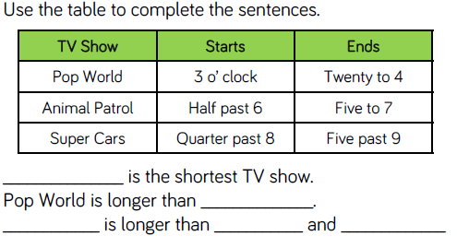
Fluency

Slide 51
Fluency

Slide 52
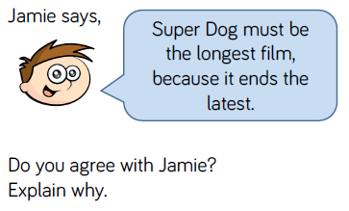
Reasoning and problem solving

Slide 53
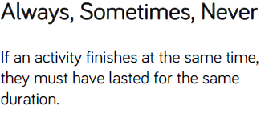
Reasoning and problem solving

Slide 54
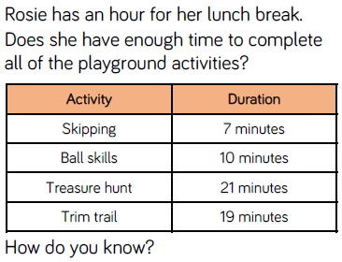
Reasoning and problem solving

