Slide 1
Year 3 Summer Block 3 Properties of Shape
Turns and angles
NCLO: Recognise angles as a property of shape or a description of a turn.

Slide 2
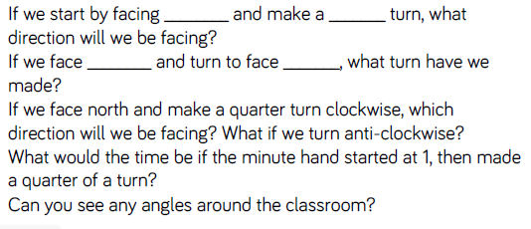
Key vocabulary and questions
Quarter turn, half turn, full turn, clockwise, anti-clockwise

Slide 3
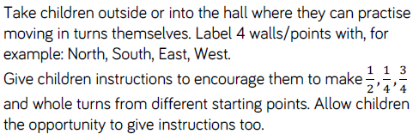
Fluency

Slide 4
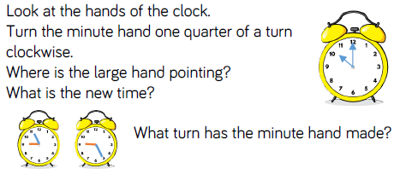
Fluency

Slide 5
Fluency

Slide 6
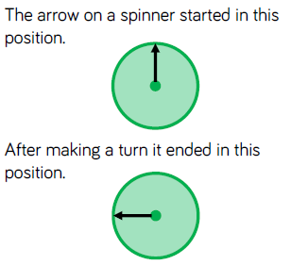
Reasoning and problem solving

Slide 7
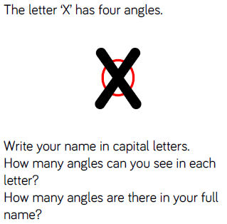
Reasoning and problem solving

Slide 8
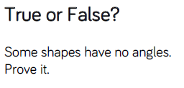
Reasoning and problem solving

Slide 9
Year 3 Summer Block 3 Properties of Shape
Right angles in shapes
NCLO: Identify right angles, recognise that 2 right angles make a half turn, 3 make ¾ of a turn and 4 complete the turn.

Slide 10
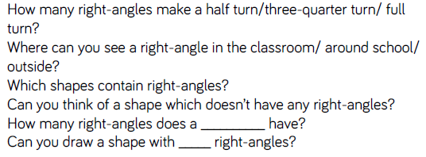
Key vocabulary and questions
Right-angle, half turn, ¾ turn, full turn

Slide 11
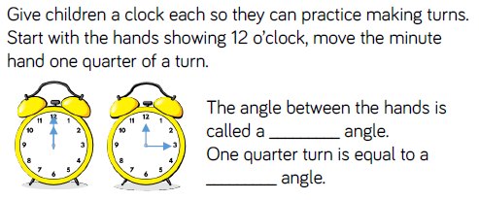
Fluency

Slide 12
Fluency

Slide 13
Fluency

Slide 14
Reasoning and problem solving

Slide 15
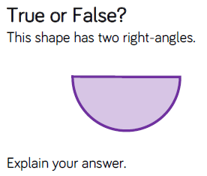
Reasoning and problem solving

Slide 16
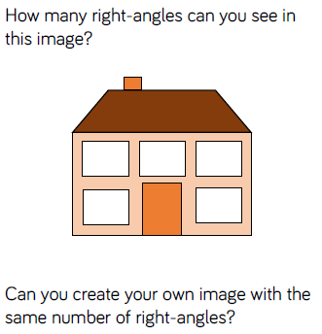
Reasoning and problem solving

Slide 17
Year 3 Summer Block 3 Properties of Shape
Compare angles
NCLO: Identify whether angles are greater than or less than a right angle.

Slide 18
Key vocabulary and questions
Acute, obtuse

Slide 19
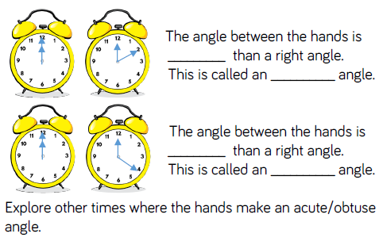
Fluency

Slide 20
Fluency

Slide 21
Fluency

Slide 22
Reasoning and problem solving

Slide 23
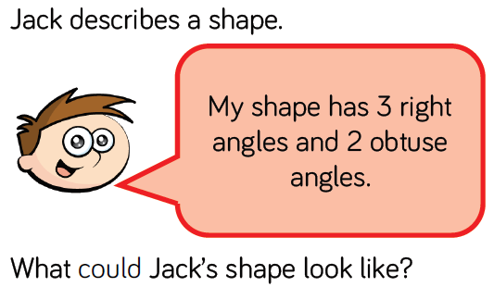
Reasoning and problem solving
Describe a shape in terms of its angles for a friend to draw.

Slide 24
Year 3 Summer Block 3 Properties of Shape
Draw accurately
NCLO: Draw 2-D shapes and make 3-D shapes using modelling materials.

Slide 25
Key vocabulary and questions
Millimetres, centimetres, mm, cm

Slide 26
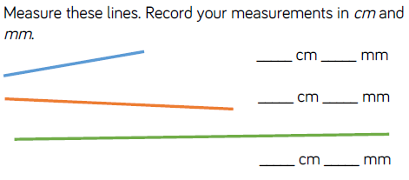
Fluency

Slide 27
Fluency

Slide 28
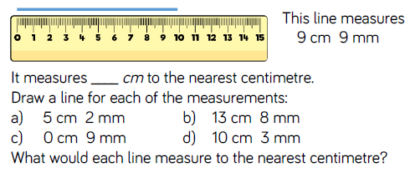
Fluency

Slide 29
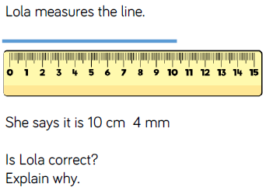
Reasoning and problem solving

Slide 30
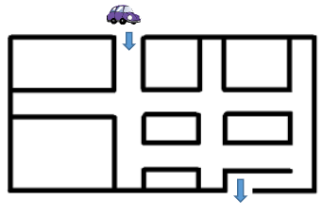
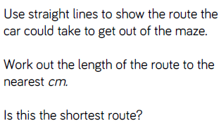
Reasoning and problem solving

Slide 31
Year 3 Summer Block 3 Properties of Shape
Horizontal and vertical
NCLO: Identify horizontal and vertical lines and pairs of perpendicular and parallel lines

Slide 32
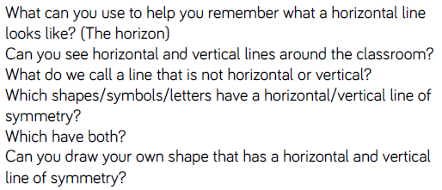
Key vocabulary and questions
Horizontal, vertical

Slide 33
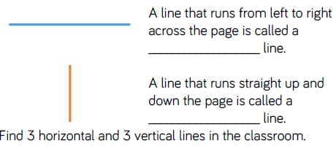
Fluency

Slide 34
Fluency

Slide 35
Fluency

Slide 36
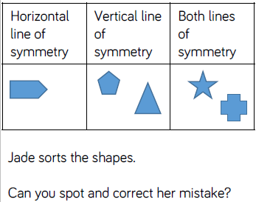
Reasoning and problem solving

Slide 37
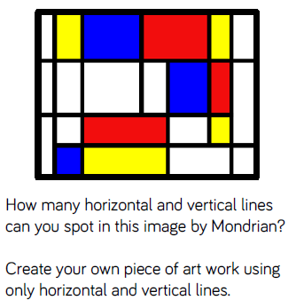
Reasoning and problem solving

Slide 38
Year 3 Summer Block 3 Properties of Shape
Parallel and perpendicular
NCLO: Identify horizontal and vertical lines and pairs of perpendicular and parallel lines

Slide 39
Key vocabulary and questions
Parallel and perpendicular

Slide 40
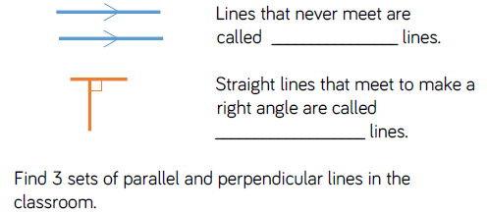
Fluency

Slide 41
Fluency

Slide 42
Fluency

Slide 43
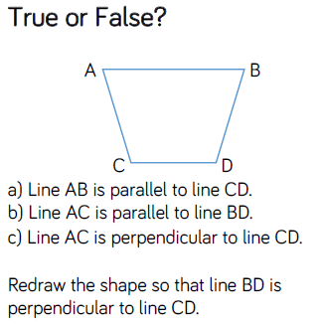
Reasoning and problem solving

Slide 44
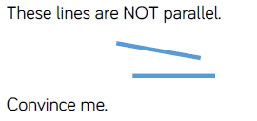
Reasoning and problem solving

Slide 45
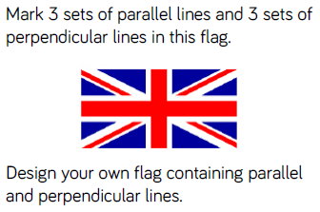
Reasoning and problem solving

Slide 46
Year 3 Summer Block 3 Properties of Shape
Recognise and describe 2D shapes
NCLO: Draw 2-D shapes and make 3-D shapes using modelling materials.

Slide 47
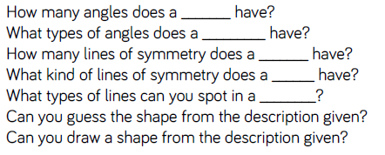
Key vocabulary and questions
Line of symmetry

Slide 48
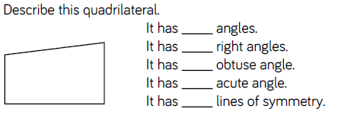
Fluency

Slide 49
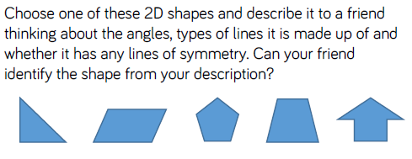
Fluency

Slide 50
Fluency

Slide 51
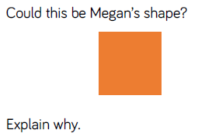
Reasoning and problem solving

Slide 52
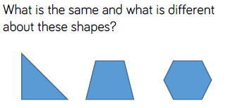
Reasoning and problem solving

Slide 53
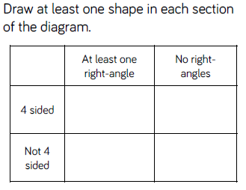
Reasoning and problem solving

Slide 54
Year 3 Summer Block 3 Properties of Shape
Recognise and describe 3D shapes
NCLO: Recognise 3D shapes in different orientations and describe them.

Slide 55
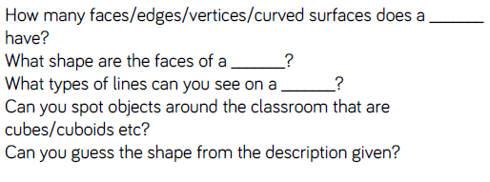
Key vocabulary and questions
Faces, vertices, edges, prism

Slide 56
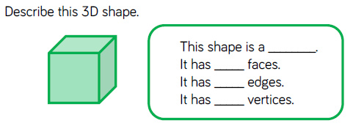
Fluency

Slide 57
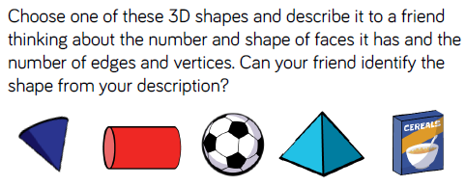
Fluency

Slide 58
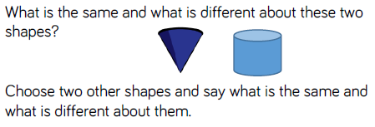
Fluency

Slide 59
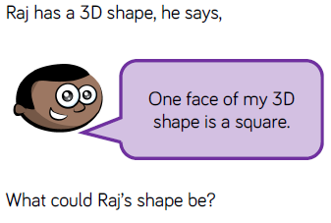
Reasoning and problem solving

Slide 60
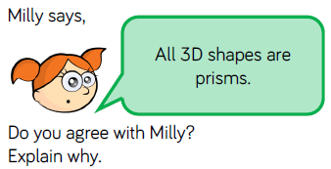
Reasoning and problem solving

Slide 61
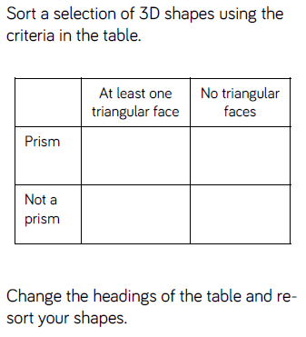
Reasoning and problem solving

Slide 62
Year 3 Summer Block 3 Properties of Shape
Make 3D shapes
NCLO: Draw 2D shapes and make 3D shapes using modelling materials.

Slide 63
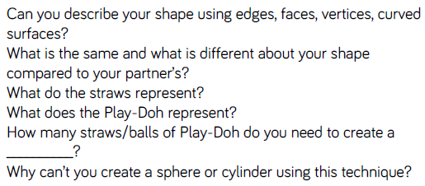
Key vocabulary and questions
Edges, face, vertex, curved surfaces

Slide 64
Fluency

Slide 65
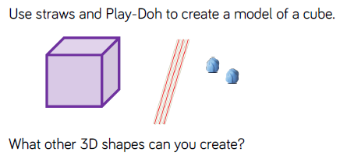
Fluency

Slide 66
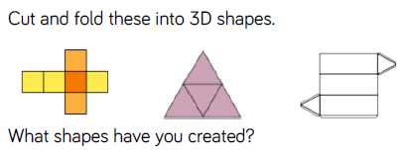
Fluency

Slide 67
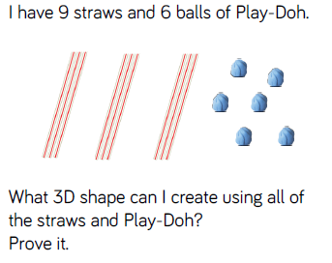
Reasoning and problem solving

Slide 68
Reasoning and problem solving

Slide 69
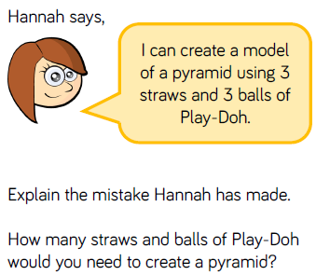
Reasoning and problem solving

