Slide 1
Year 6 Block 3 Statistics
Read and interpret line graphs
NCLO: Interpret and construct pie charts and line graphs and use these to solve problems.

Slide 2
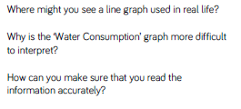
Key vocabulary and questions
Read, interpret, graphs

Slide 3
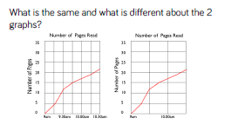
Fluency

Slide 4
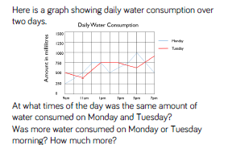
Fluency

Slide 5
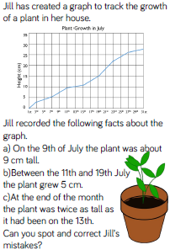
Reasoning and problem solving

Slide 6
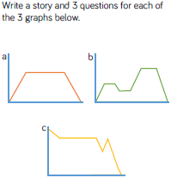
Reasoning and problem solving

Slide 7
Year 6 Block 3 Statistics
Draw line graphs
NCLO: Interpret and construct pie charts and line graphs and use these to solve problems.

Slide 8
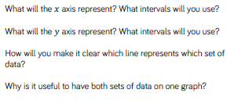
Key vocabulary and questions
Read, interpret, graphs

Slide 9
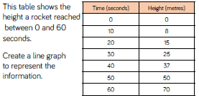
Fluency

Slide 10
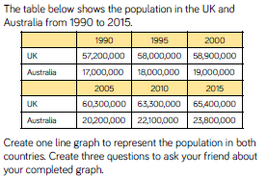
Fluency

Slide 11
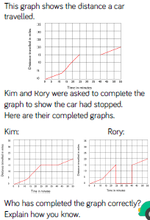
Reasoning and problem solving

Slide 12
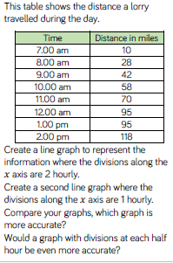
Reasoning and problem solving

Slide 13
Year 6 Block 3 Statistics
Use line graphs to solve problems
NCLO: Interpret and construct pie charts and line graphs and use these to solve problems.

Slide 14
Key vocabulary and questions
Read, interpret, graphs

Slide 15
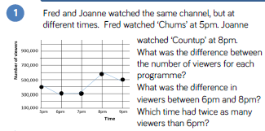
Fluency

Slide 16
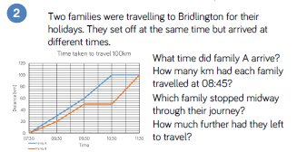
Fluency

Slide 17
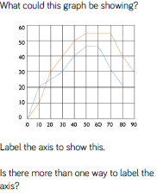
Reasoning and problem solving

Slide 18
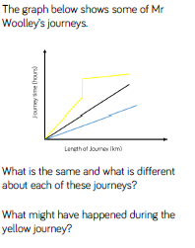
Reasoning and problem solving

Slide 19
Year 6 Block 3 Statistics
Circles
NCLO: Illustrate and name parts of circles, including radius, diameter and circumference and know that the diameter is twice the radius.

Slide 20
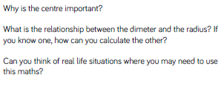
Key vocabulary and questions
circumference, radius, diameter

Slide 21
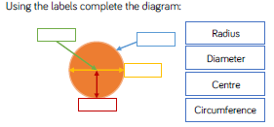
Fluency

Slide 22
Fluency

Slide 23
Fluency

Slide 24
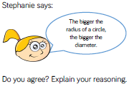
Reasoning and problem solving

Slide 25
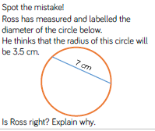
Reasoning and problem solving

Slide 26
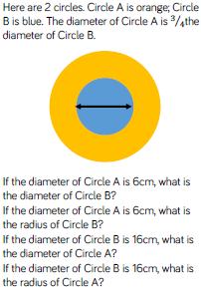
Reasoning and problem solving

Slide 27
Year 6 Block 3 Statistics
Read and interpret pie charts
NCLO: Interpret and construct pie charts and line graphs and use these to solve problems.

Slide 28
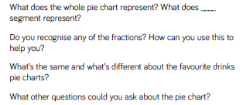
Key vocabulary and questions
pie chart, read, interpret.

Slide 29
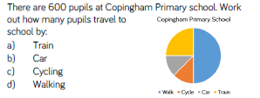
Fluency

Slide 30
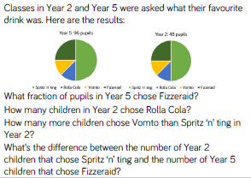
Fluency

Slide 31
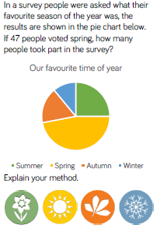
Reasoning and problem solving

Slide 32
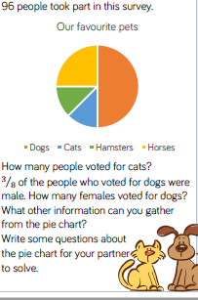
Reasoning and problem solving

Slide 33
Year 6 Block 3 Statistics
Pie charts and percentages
NCLO: Interpret and construct pie charts and line graphs and use these to solve problems.

Slide 34
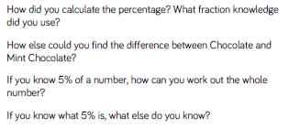
Key vocabulary and questions
pie chart, read, interpret, percentages.

Slide 35
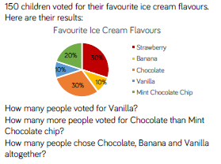
Fluency

Slide 36
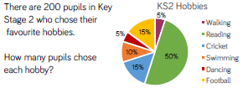
Fluency

Slide 37
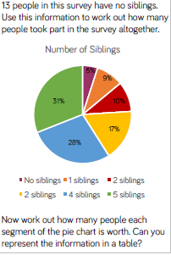
Reasoning and problem solving

Slide 38
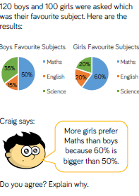
Reasoning and problem solving

Slide 39
Year 6 Block 3 Statistics
Draw pie charts
NCLO: Interpret and construct pie charts and line graphs and use these to solve problems.

Slide 40
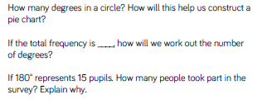
Key vocabulary and questions
pie chart, read, interpret, draw.

Slide 41
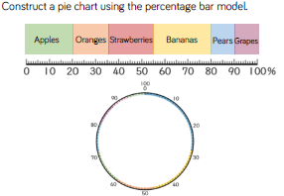
Fluency

Slide 42
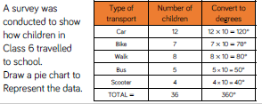
Fluency

Slide 43
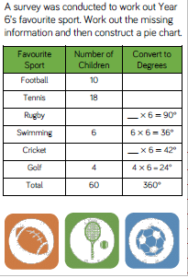
Reasoning and problem solving

Slide 44
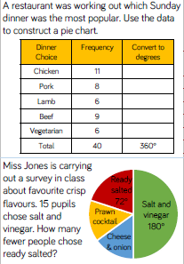
Reasoning and problem solving

Slide 45
Year 6 Block 3 Statistics
The mean
NCLO: Calculate the mean as an average.

Slide 46
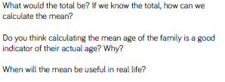
Key vocabulary and questions
mean, average.

Slide 47
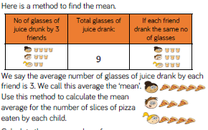
Fluency

Slide 48
Fluency

Slide 49
Fluency

Slide 50
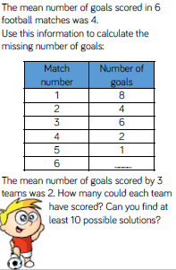
Reasoning and problem solving

Slide 51
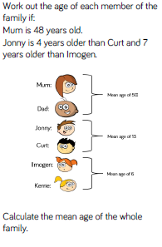
Reasoning and problem solving

