Slide 1
Year 4 Summer Block 3: Time
Hours, Minutes and Seconds
NCLO: Read, write and convert time
between analogue and digital 12-
and 24-hour clocks.

Slide 2
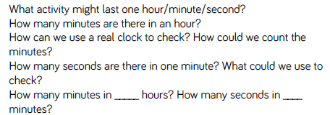
Key vocabulary and questions
Hours, minutes, seconds

Slide 3
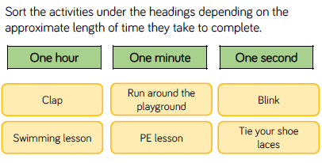
Fluency

Slide 4
Fluency

Slide 5
Fluency

Slide 6
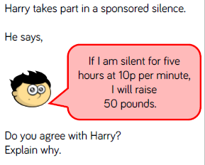
Reasoning and Problem Solving

Slide 7
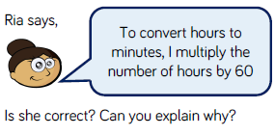
Reasoning and Problem Solving

Slide 8
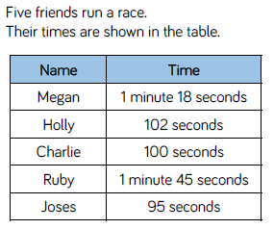
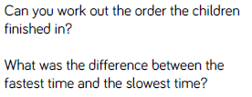
Reasoning and Problem Solving

Slide 9
Year 4 Summer Block 3: Time
Years, months, days and weeks
NCLO: Solve problems involving converting from hours to minutes, minutes to seconds, years to months, weeks to days

Slide 10
Key vocabulary and questions
Years, months, weeks, days, calendar

Slide 11
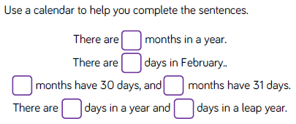
Fluency

Slide 12
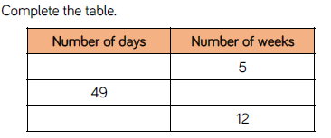
Fluency

Slide 13
Fluency

Slide 14
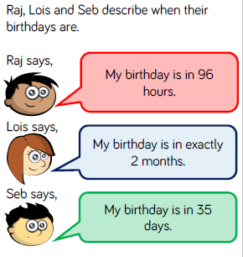
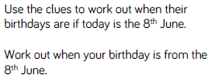
Reasoning and problem solving

Slide 15
Reasoning and problem solving

Slide 16
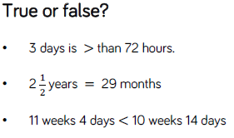
Reasoning and problem solving

Slide 17
Year 4 Summer Block 3: Time
Analogue to digital- 12 hour
NCLO: Read, write and convert time
between analogue and digital 12-
and 24-hour clocks.

Slide 18
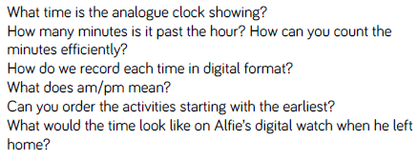
Key vocabulary and questions
Analogue, digital, convert, am, pm

Slide 19
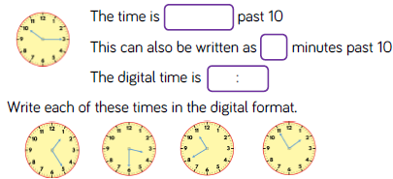
Fluency

Slide 20
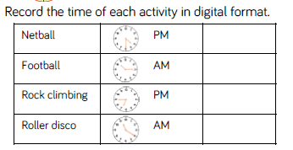
Fluency

Slide 21
Fluency

Slide 22
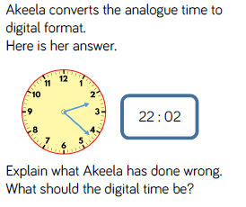
Reasoning and problem solving

Slide 23
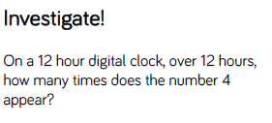
Reasoning and problem solving

Slide 24
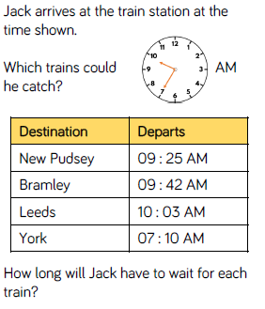
Reasoning and problem solving

Slide 25
Year 4 Summer Block 3: Time
Analogue to digital – 24 hours
NCLO: Read, write and convert time
between analogue and digital 12-
and 24-hour clocks.

Slide 26
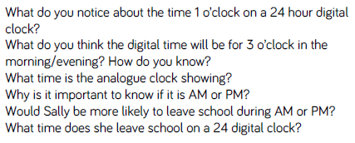
Key vocabulary and questions
Analogue, digital, convert, am, pm, 24 hour

Slide 27
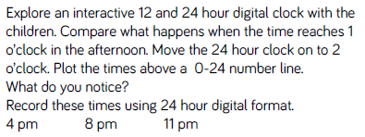
Fluency

Slide 28
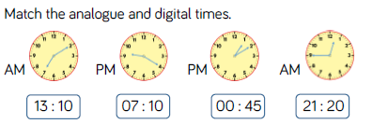
Fluency

Slide 29
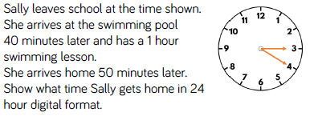
Fluency

Slide 30
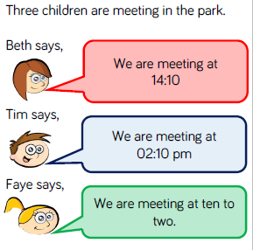
Reasoning and problem solving

Slide 31
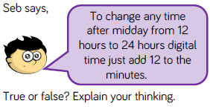
Reasoning and problem solving

Slide 32
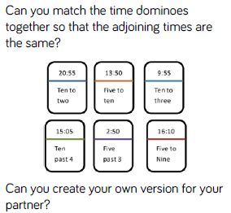
Reasoning and problem solving

