Slide 1
Year 4 Spring Block 4 - Decimals
Recognise tenths and hundredths
NCLO: To recognise and write decimal equivalents of any number of tenths or hundredths.

Slide 2
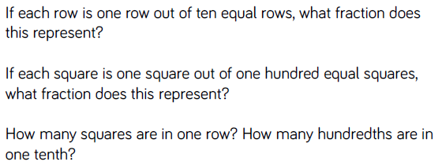
Decimal, fraction, tenths, hundredths, equivalent

Slide 3
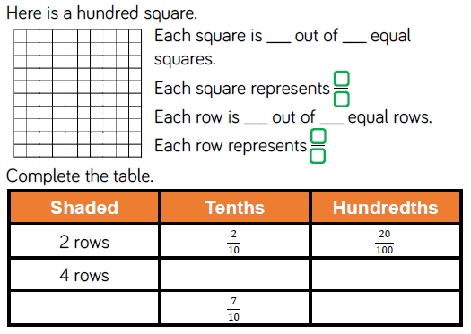
Fluency

Slide 4
Fluency

Slide 5
Reasoning and problem solving

Slide 6
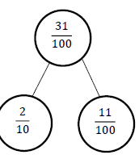
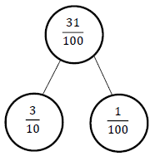
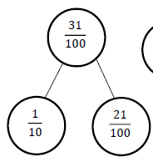
Reasoning and problem solving

Slide 7
Year 4 Spring Block 4 - Decimals
Tenths as decimals
NCLO: To recognise and write decimal equivalents of any number of tenths or hundredths.

Slide 8
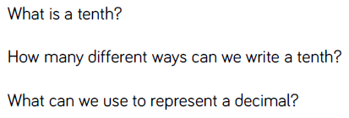

Slide 9
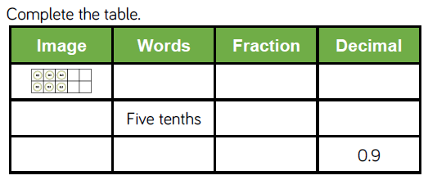
Fluency

Slide 10
Fluency

Slide 11
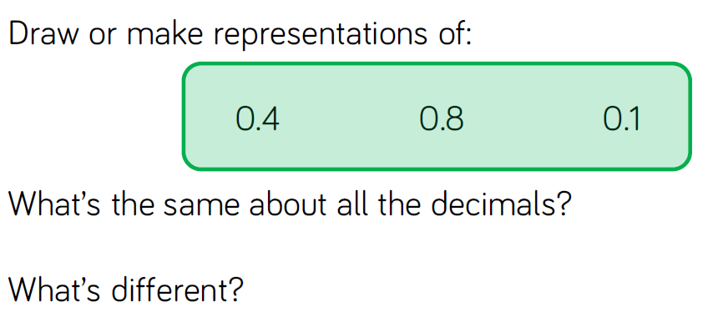
Fluency

Slide 12
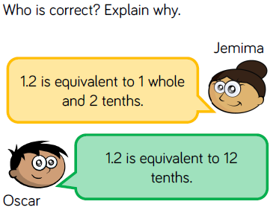
Reasoning and problem solving

Slide 13
Reasoning and problem solving

Slide 14
Year 4 Spring Block 4 - Decimals
Tenths on a place value grid
NCLO: To recognise and write decimal equivalents of any number of tenths or hundredths.

Slide 15
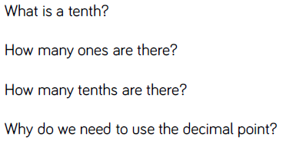
Key vocabulary and questions

Slide 16
Fluency

Slide 17
Fluency

Slide 18
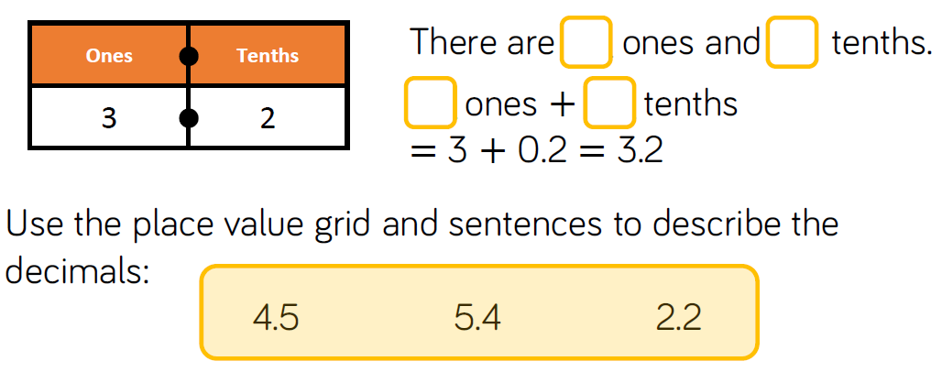
Fluency

Slide 19
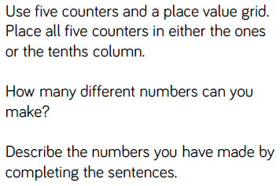
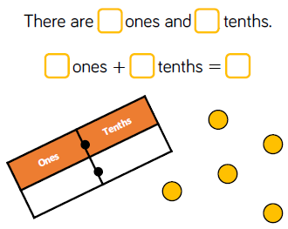
Reasoning and problem solving

Slide 20
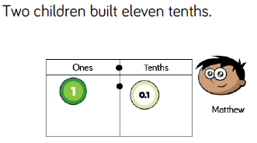
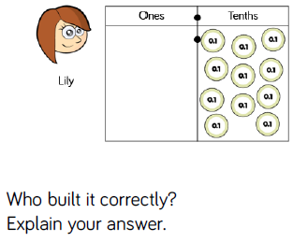
Reasoning and problem solving

Slide 21
Year 4 Spring Block 4 - Decimals
Tenths on a number line
NCLO: To recognise and write decimal equivalents of any number of tenths or hundredths.

Slide 22
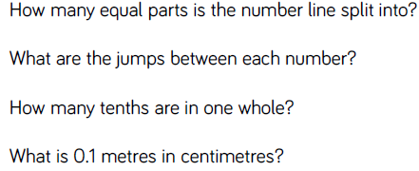

Slide 23
Fluency

Slide 24
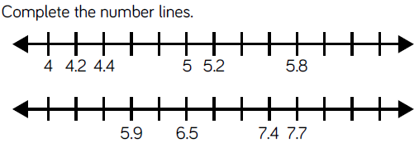

Slide 25
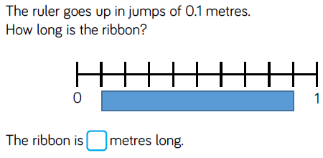

Slide 26
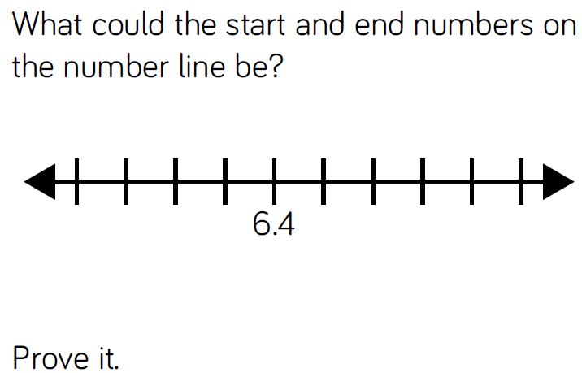

Slide 27
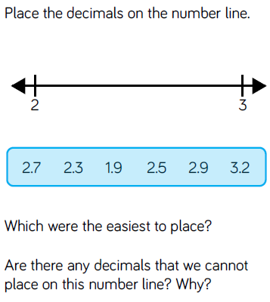

Slide 28
Year 4 Spring Block 4 - Decimals
Divide 1-digit by 10
NCLO: To find the effect of dividing a one or two digit number by 10, identifying the value of the digits in the answer as ones, tenths and hundredths.

Slide 29
place value, divide

Slide 30
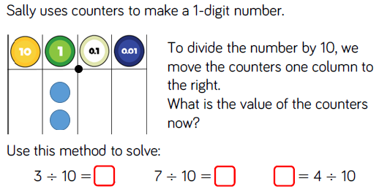

Slide 31
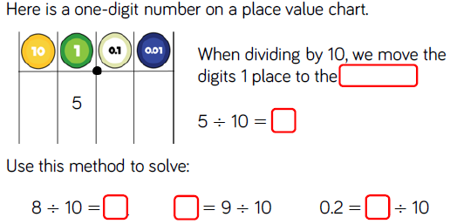

Slide 32
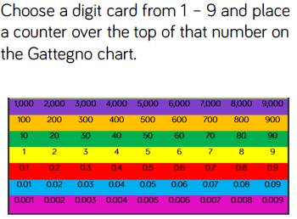
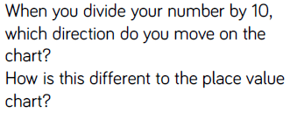

Slide 33
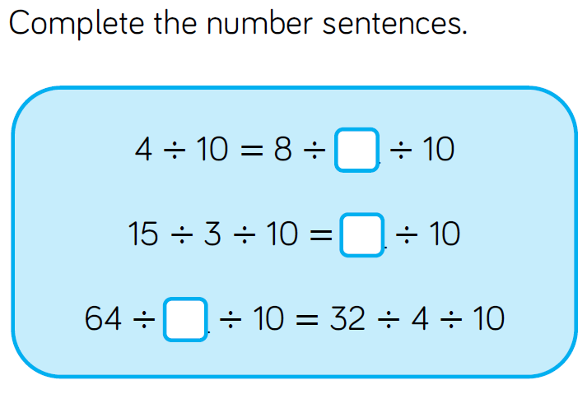

Slide 34
Year 4 Spring Block 4 - Decimals
Divide 2-digits by 10
NCLO: To find the effect of dividing a one or two digit number by 10, identifying the value of the digits in the answer as ones, tenths and hundredths.

Slide 35
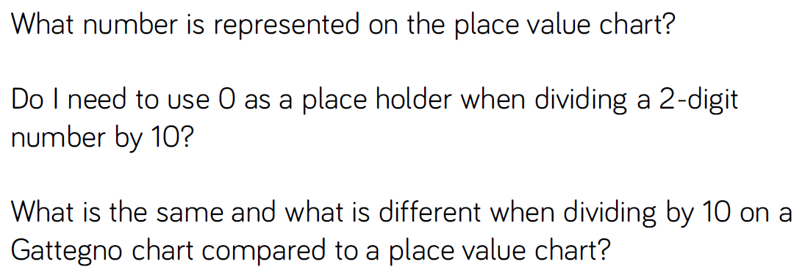
place value, divide, place holder

Slide 37
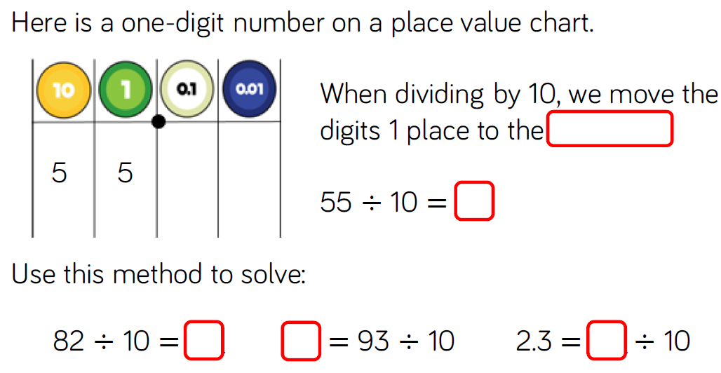

Slide 40
Year 4 Spring Block 4 - Decimals
Hundredths
NCLO: To find the effect of dividing a one or two digit number by 10, identifying the value of the digits in the answer as ones, tenths and hundredths.

Slide 41
Equal parts, hundredths, exchange, equivalent

Slide 42
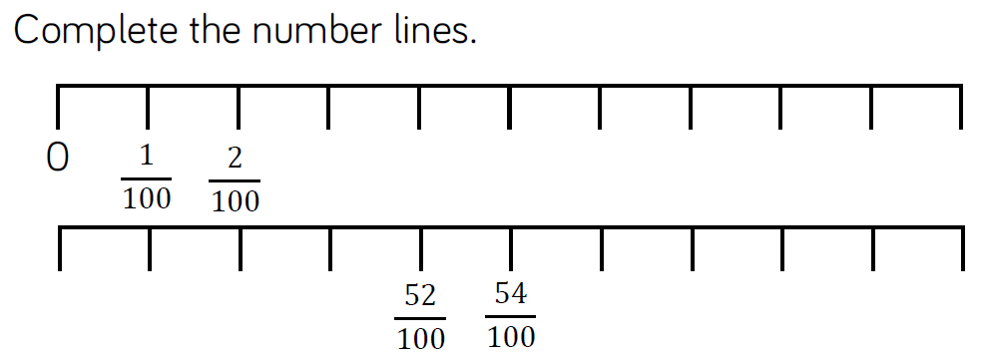

Slide 43
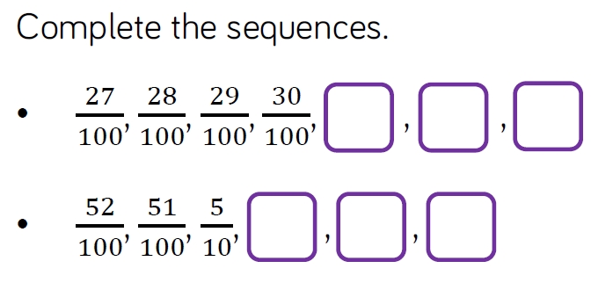

Slide 44
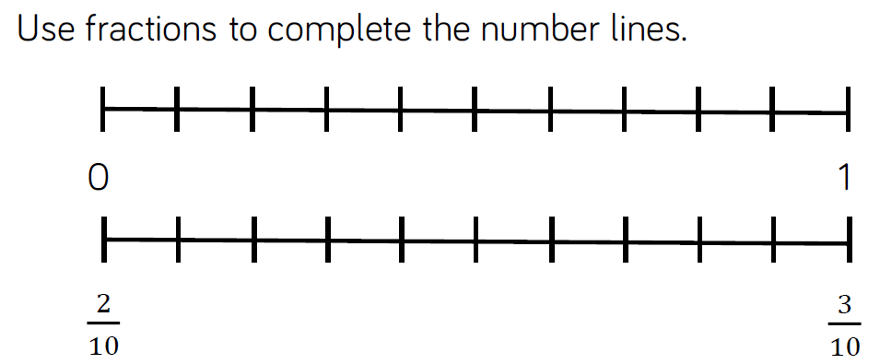

Slide 46
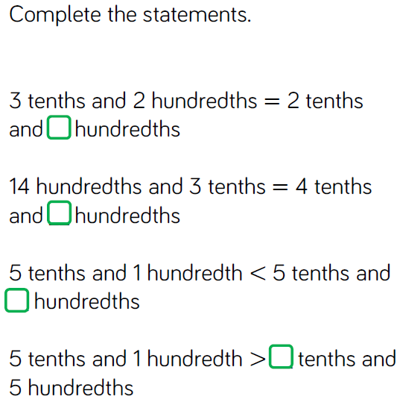

Slide 47
Year 4 Spring Block 4 - Decimals
Hundredths as decimals
NCLO: To find the effect of dividing a one or two digit number by 10, identifying the value of the digits in the answer as ones, tenths and hundredths.

Slide 48
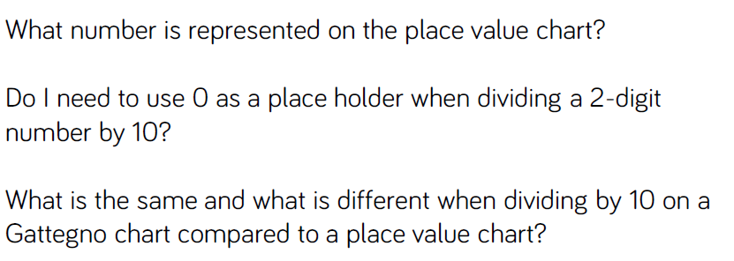

Slide 49
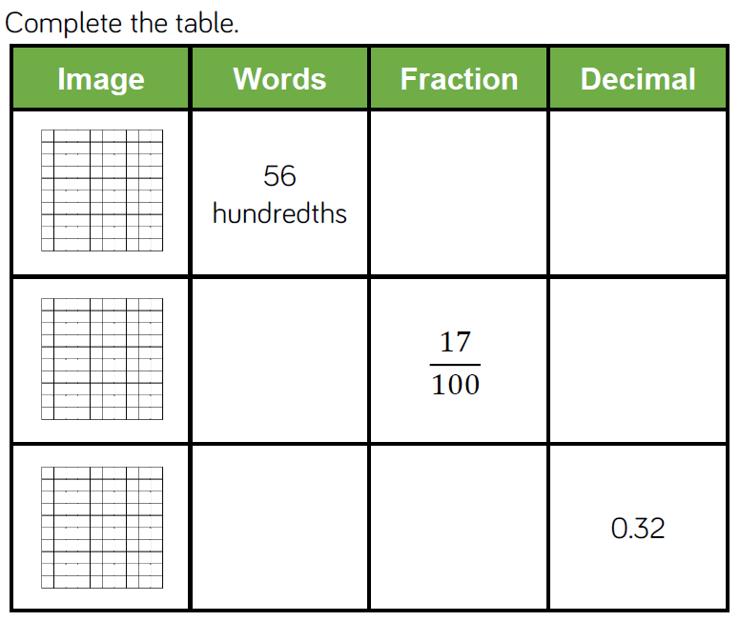

Slide 52
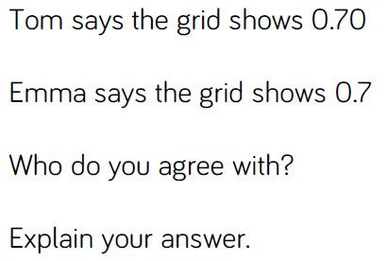

Slide 53
Year 4 Spring Block 4 - Decimals
Hundredths on a place value grid
NCLO: To find the effect of dividing a one or two digit number by 10, identifying the value of the digits in the answer as ones, tenths and hundredths.

Slide 54
Hundredth, tenth, equivalent, partition

Slide 55
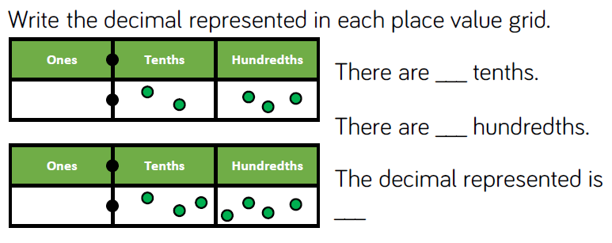

Slide 57
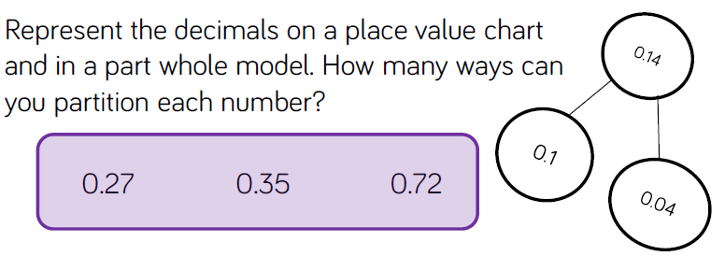

Slide 58
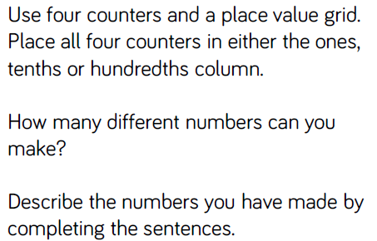

Slide 59
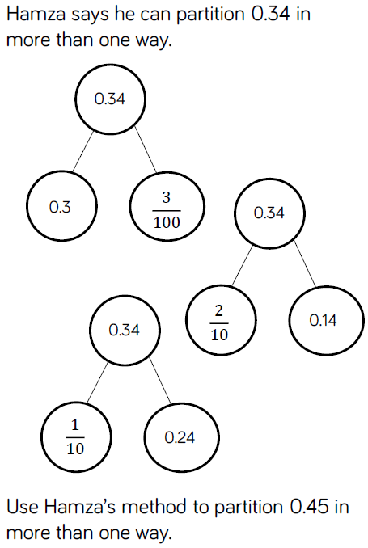

Slide 60
Year 4 Spring Block 4 - Decimals
Divide 1 or 2 digits by 100
NCLO: To find the effect of dividing a one or two digit number by 10, identifying the value of the digits in the answer as ones, tenths and hundredths.

Slide 61
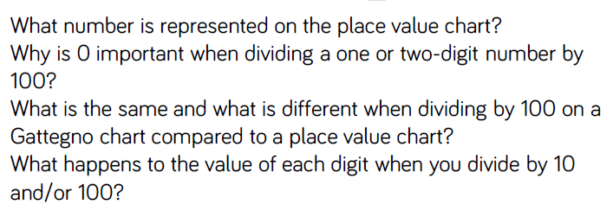

Slide 63
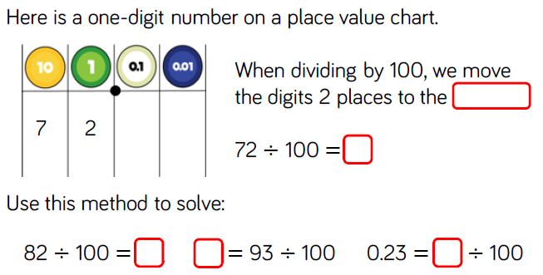

Slide 64
