Slide 1
Year 4 Summer Block 4 Mass and Capacity
NCLO: To measure mass using standard units and scales

Slide 2
Grams
Kilograms
Mass
Weight
How can we measure the mass or weight of an object?
When would we use kilograms or grams to measure the mass of
something?

Slide 5
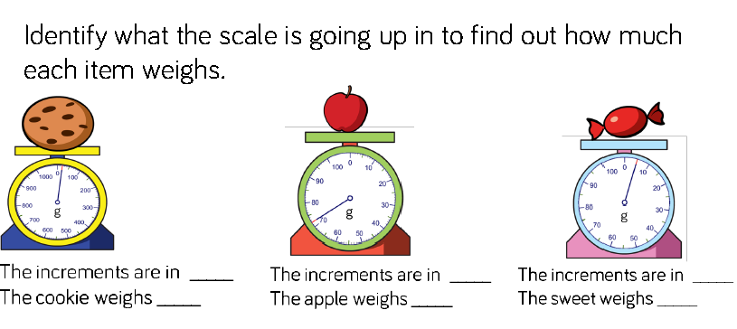

Slide 7
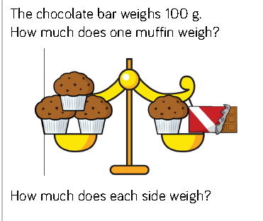

Slide 8
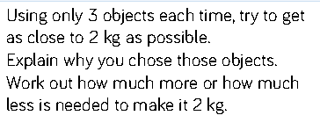

Slide 9
Year 4 Summer Block 4 Mass and Capacity
NCLO: To measure and record mass using standard units

Slide 10
How many grams are in 1 kilogram? If we know this, what else do we know?
Look at the scale, show me where ____ would be.
How much does ____ weigh? How can we record this as kg and g?
Where would I show the weight of the bananas on the scale?

Slide 11
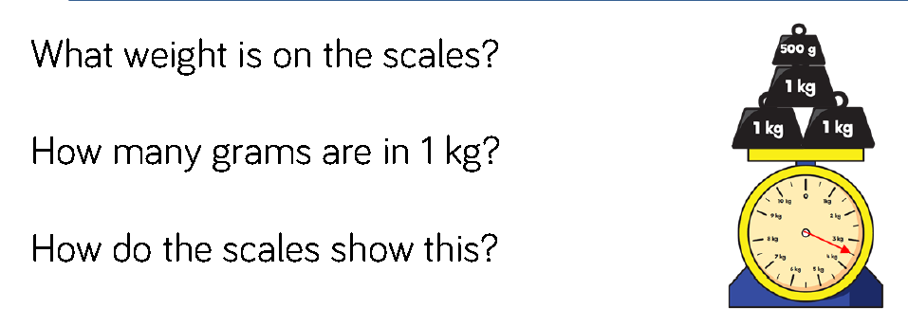

Slide 12
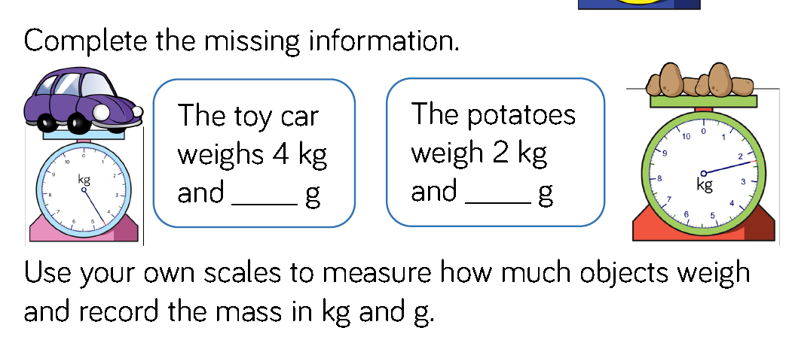

Slide 15
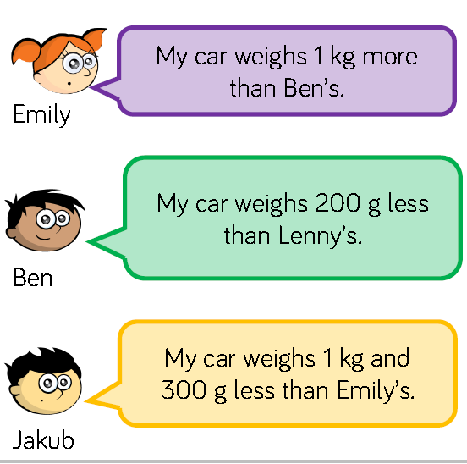

Slide 16
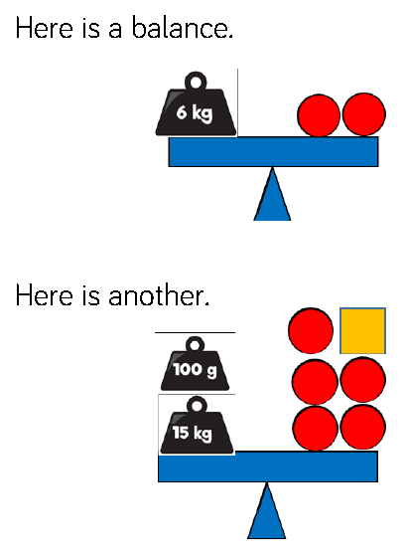
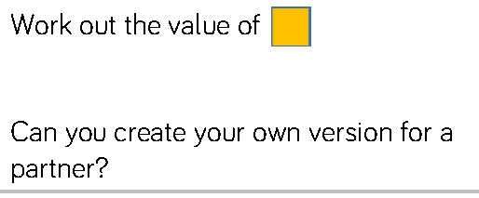

Slide 17
Year 4 Summer Block 4 Mass and Capacity
NCLO: To compare measurements of mass

Slide 18
Which item is heavier or lighter? How do you know?
Using the symbols <, > or =, what can you tell me about each of
the scales?
If I added an extra item, what would happen?
Can I work out how much one item weighs? Would this be more
or less than the other item?

Slide 19
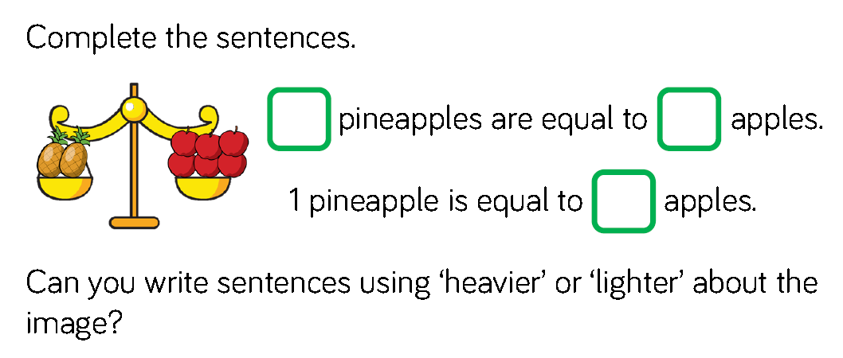

Slide 20
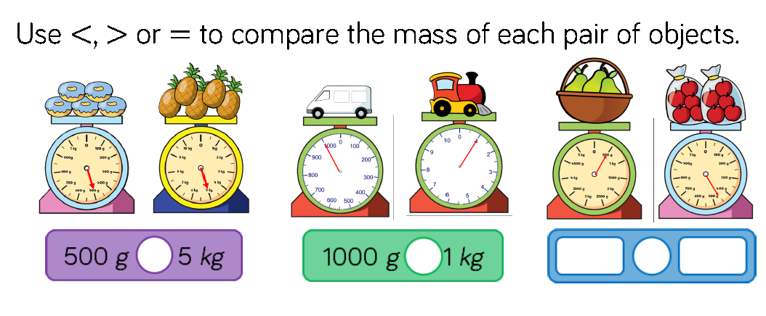

Slide 22
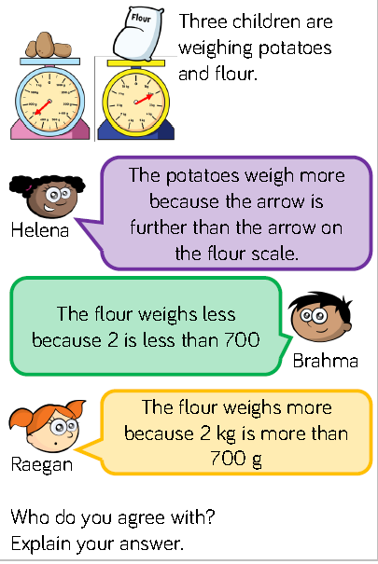

Slide 23
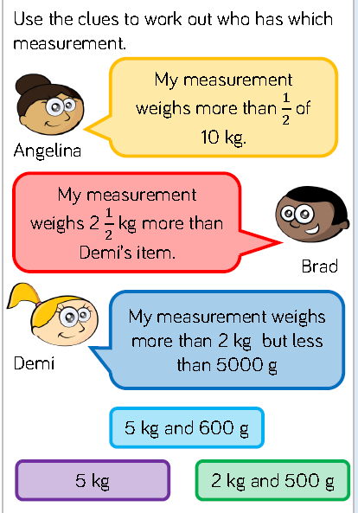

Slide 24
Year 4 Summer Block 4 Mass and Capacity
NCLO: To add and subtract measurements of mass

Slide 25
How many grams are in a kilogram? How could I represent this using concrete resources?
How can you add/subtract the masses?
What do you know about kilograms or grams that can help you solve this question?
How can you represent this problem with a bar model?

Slide 26
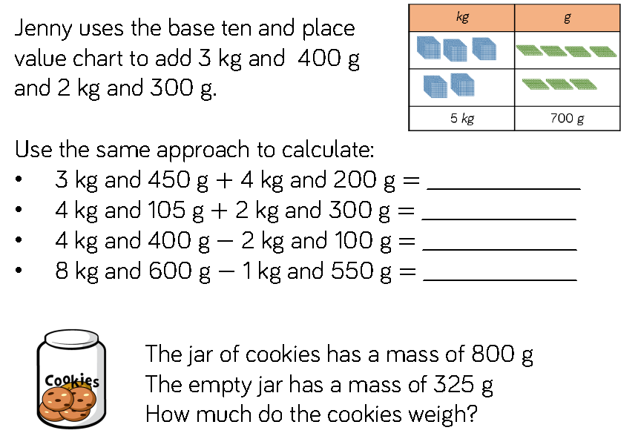

Slide 28
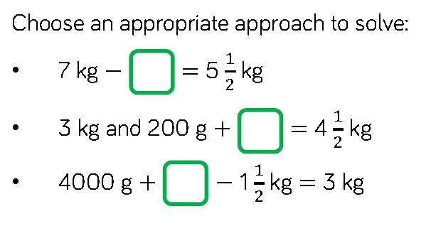

Slide 29
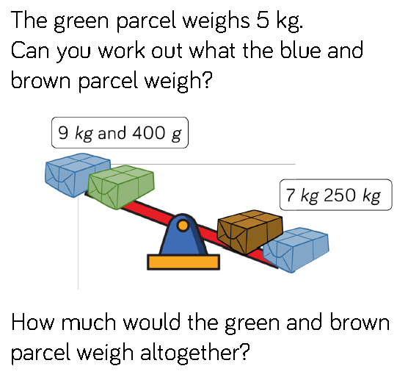

Slide 30
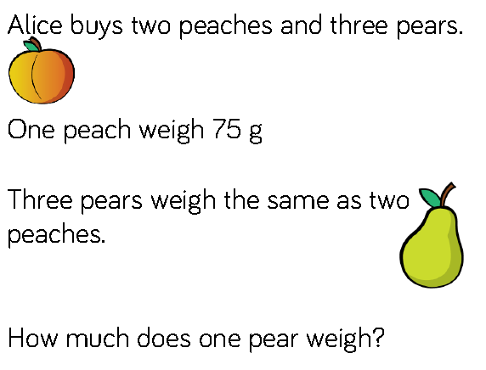

Slide 31
Year 4 Summer Block 4 Mass and Capacity
NCLO: To use litres and millilitres and standard scales to measure capacity

Slide 32
How do we measure liquid?
What does capacity mean? What does volume mean?
What do we measure capacity and volume in?
What unit of measure (ml or l) would we use to measure ____ ?
How much liquid is in the container?
What is the scale going up in?

Slide 37
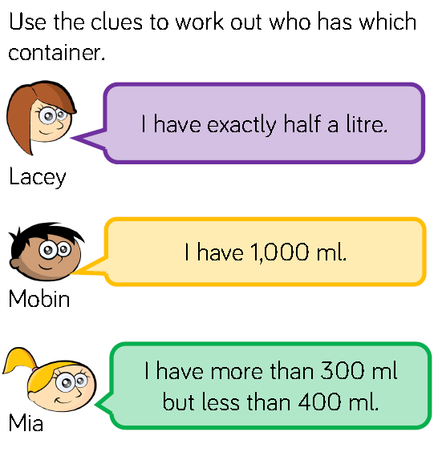
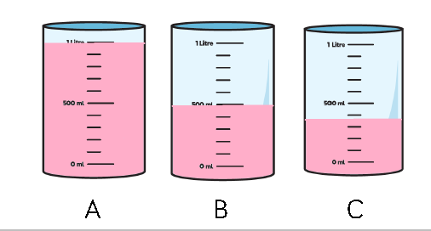

Slide 38
Year 4 Summer Block 4 Mass and Capacity
NCLO: To use litres and millilitres and standard scales to measure capacity

Slide 39
How many millilitres are in 1 litre? If we know this, what else do we know?
Look at the scale, show me where ____ would be?
What is the capacity of the ______? How can we record this as l and ml?
How would I show how much water is left on the scale?

Slide 41
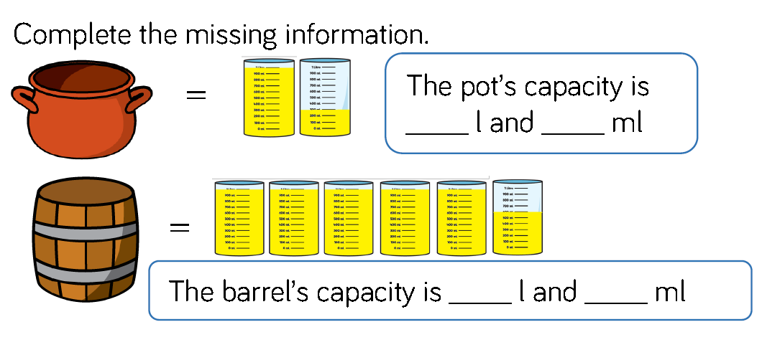

Slide 42
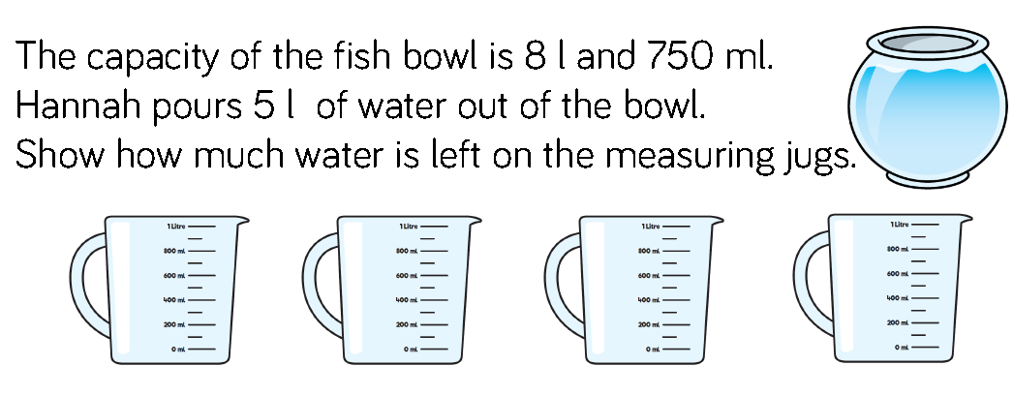

Slide 43
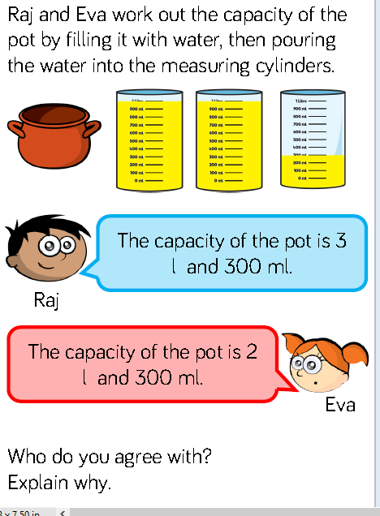

Slide 45
Year 4 Summer Block 4 Mass and Capacity
NCLO: To compare measurements of capacity

Slide 46
Which container is the most full?
Which container is the least full?
Which has the most liquid in it?
What does the liquid measure?
Which has the least liquid in it?
What does the liquid measure?

Slide 50
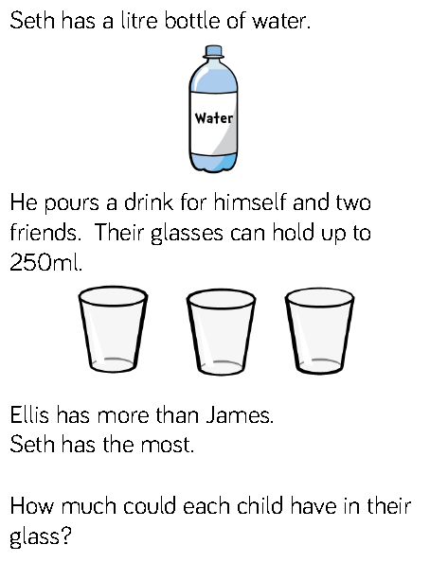

Slide 51
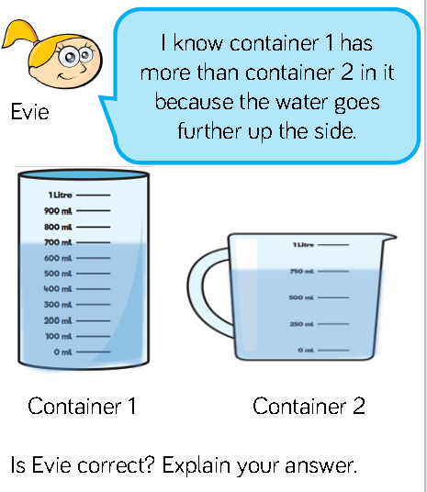

Slide 52
Year 4 Summer Block 4 Mass and Capacity
NCLO:

Slide 53
What many millilitres are in one litre? How could I show this using concrete resources?
How many litres are there in total?
How many millilitres are there in total?
What methods can we use to add capacities?
What methods can we use to subtract capacities?

Slide 54
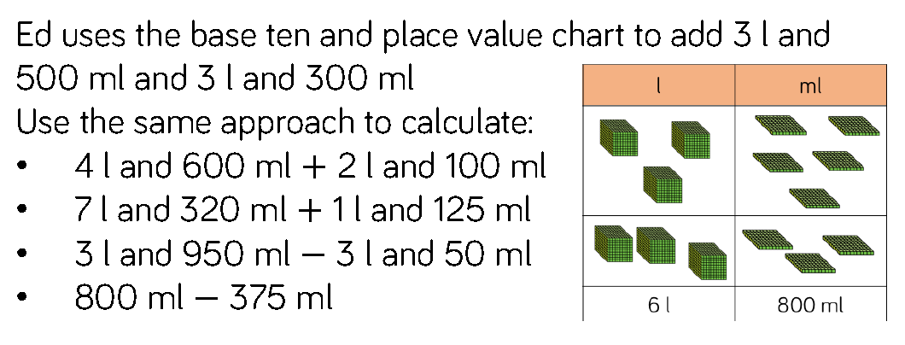

Slide 55
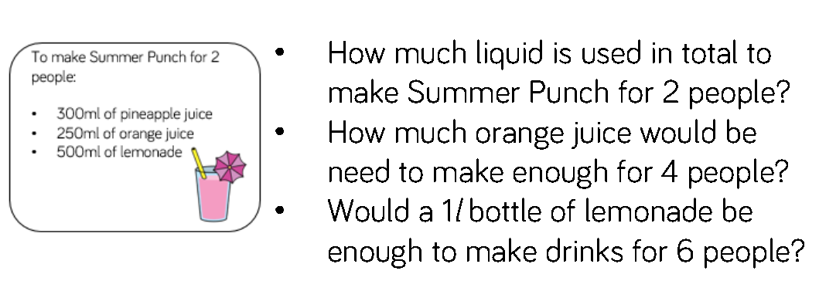

Slide 56
