Slide 1
Year 5 Summer Block 4 Measurement - Converting Units
To convert between different units of metric measure.

Slide 2
Key vocabulary and questions
convert
metres
kilometres
grams
kilograms
millimetres
centimetres

Slide 3
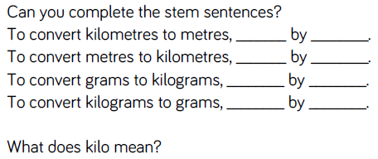
Key vocabulary and questions

Slide 4
Fluency

Slide 5
Fluency

Slide 6
Fluency

Slide 7
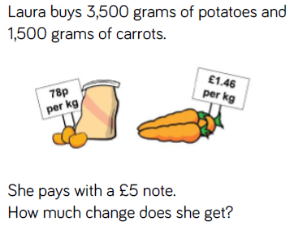
Reasoning and problem solving

Slide 8
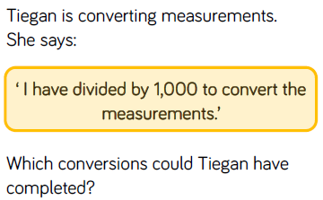
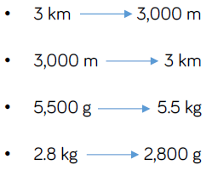
Reasoning and problem solving

Slide 9
Year 5 Summer Block 4 Measurement - Converting Units
To convert between different units of metric measure.

Slide 10
millilitres
litres
metres
centimetres
millimetres

Slide 11
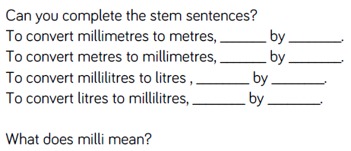
Key vocabulary and questions

Slide 12
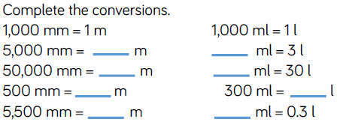
Fluency

Slide 13
Fluency

Slide 14
Fluency

Slide 15
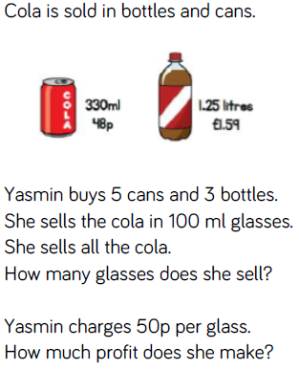
Reasoning and problem solving

Slide 16
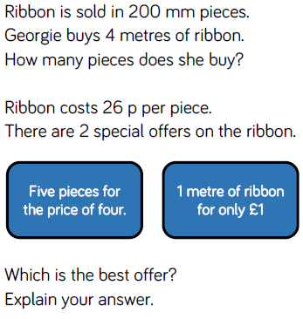
Reasoning and problem solving

Slide 17
Year 5 Summer Block 4 Measurement - Converting Units
To understand and use approximate equivalences between metric units.

Slide 18
Key vocabulary and questions
metres
centimetres
millimetres

Slide 19
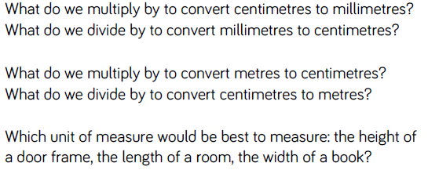
Key vocabulary and questions

Slide 20
Fluency

Slide 21
Fluency

Slide 22
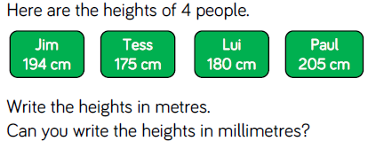
Fluency

Slide 23
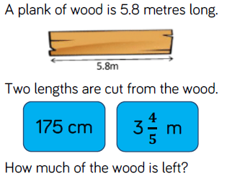
Reasoning and problem solving

Slide 24
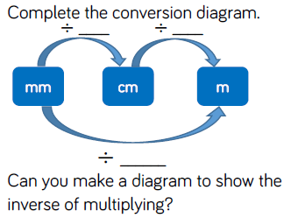
Reasoning and problem solving

Slide 25
Reasoning and problem solving

Slide 26
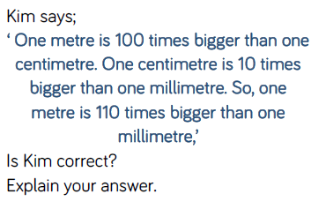
Reasoning and problem solving

Slide 27
Year 5 Summer Block 4 Measurement - Converting Units
To understand approximate equivalences between common imperial units such as inches, pounds and pints.

Slide 28
Key vocabulary and questions
imperial
inches
pounds
pints
approximate

Slide 29
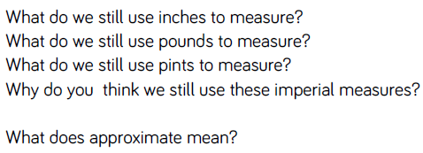
Key vocabulary and questions

Slide 30
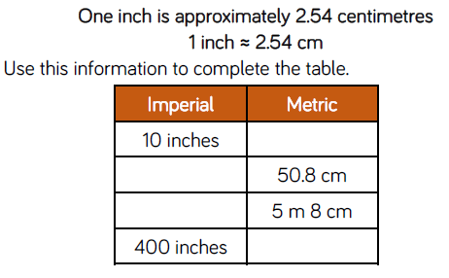
Fluency

Slide 31
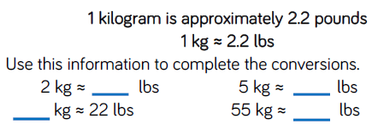
Fluency

Slide 32
Fluency

Slide 33
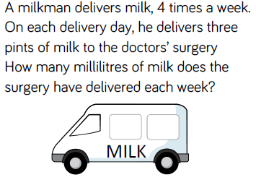
Reasoning and problem solving

Slide 34
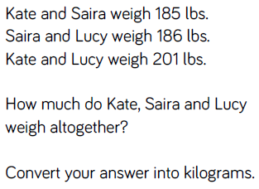
Reasoning and problem solving

Slide 35
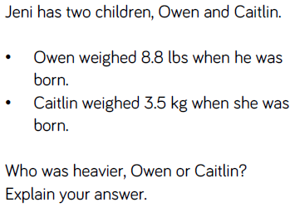
Reasoning and problem solving

Slide 36
Year 5 Summer Block 4 Measurement - Converting Units
To solve problems involving converting between units of time.

Slide 37
Key vocabulary and questions
convert
month
week
second
minute
hour
day

Slide 38
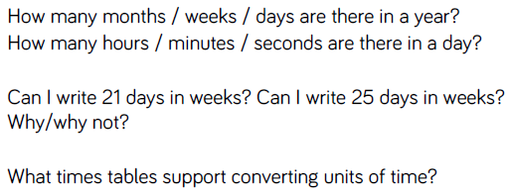
Key vocabulary and questions

Slide 39
Fluency

Slide 40
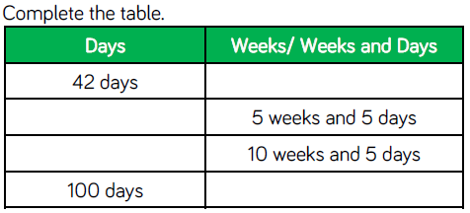
Fluency

Slide 41
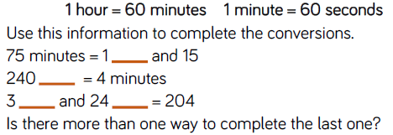
Fluency

Slide 42
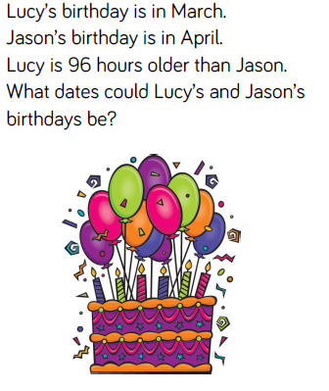
Reasoning and problem solving

Slide 43
Reasoning and problem solving

Slide 44
Year 5 Summer Block 4 Measurement - Converting Units
To solve problems involving converting between units of time.

Slide 45
Key vocabulary and questions
convert
month
week
second
minute
hour
day

Slide 46
Key vocabulary and questions

Slide 47
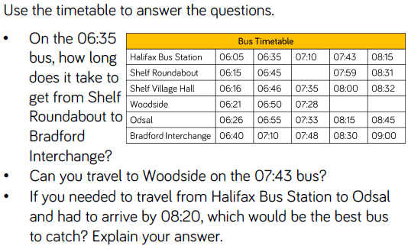
Fluency

Slide 48
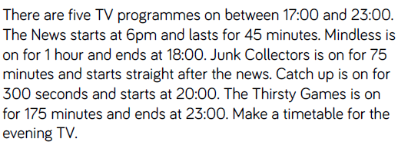
Fluency

Slide 49
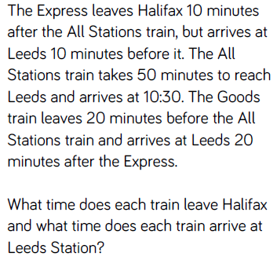
Reasoning and problem solving

Slide 50
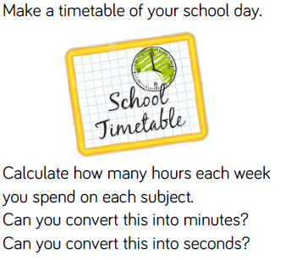
Reasoning and problem solving

