Slide 1
Year 4 Summer Block 4: Statistics
Interpret charts
NCLO: Interpret and present discrete and continuous data using appropriate graphical methods, including bar charts and time graphs.

Slide 2
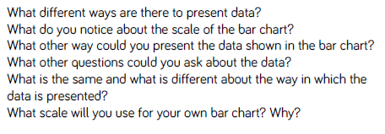
Key vocabulary and questions
Data, charts, bar charts, time graphs, scale

Slide 3
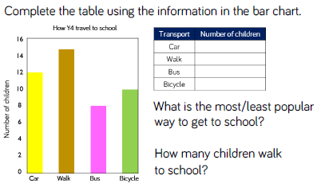
Fluency

Slide 4
Fluency

Slide 5
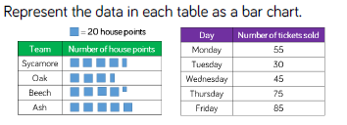
Fluency

Slide 6
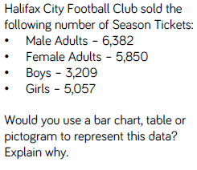
Reasoning and Problem Solving

Slide 7
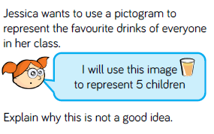
Reasoning and Problem Solving

Slide 8
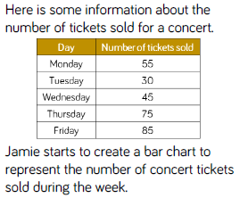
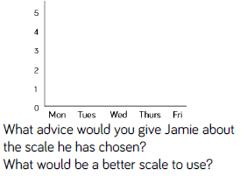
Reasoning and Problem Solving

Slide 9
Year 4 Summer Block 4: Statistics
Comparison, sum and difference
NCLO: Solve comparison, sum and difference problems using information presented in bar charts, pictograms, tables and other graphs.

Slide 10
Key vocabulary and questions
Comparison, sum, difference, pictogram, bar charts, table

Slide 11
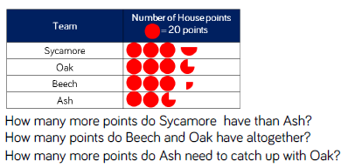
Fluency

Slide 12
Fluency

Slide 13
Fluency

Slide 14
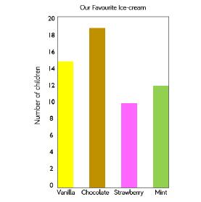
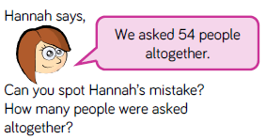
Reasoning and problem solving

Slide 15
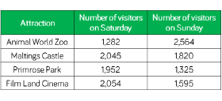
Reasoning and problem solving

Slide 16
Year 4 Summer Block 4: Statistics
Introducing line graphs
NCLO: Solve comparison, sum and difference problems using information presented in bar charts, pictograms, tables and other graphs.

Slide 17
Key vocabulary and questions
Y axis, x axis, graphs

Slide 18
Fluency

Slide 19
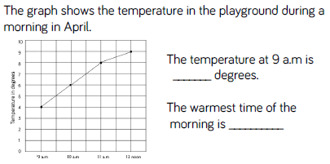
Fluency

Slide 20
Fluency

Slide 21
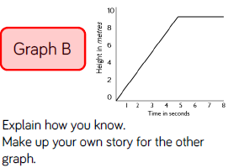
Reasoning and problem solving

Slide 22
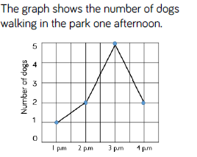
Reasoning and problem solving

Slide 23
Year 4 Summer Block 4: Statistics
Line graphs
NCLO: Solve comparison, sum and difference problems using information presented in bar charts, pictograms, tables and other graphs.

Slide 24
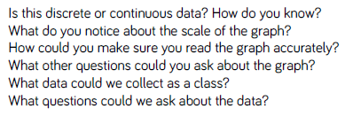
Key vocabulary and questions
Line graphs, axis, discrete, continuous

Slide 25
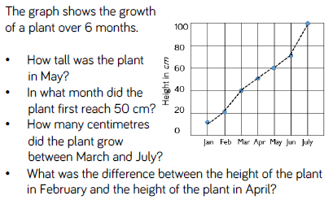
Fluency

Slide 26
Fluency

Slide 27
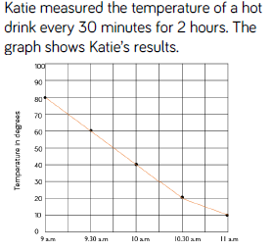
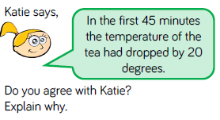
Reasoning and problem solving

Slide 28
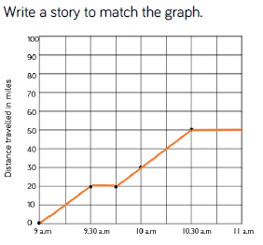
Reasoning and problem solving

