Slide 1
Year 4 Summer Block 5: Geometry – properties of shape
Identify angles
NCLO: identify acute and obtuse angles and compare and order angles up to two right angles by size.

Slide 2
Key vocabulary and questions
Degrees, acute, obtuse

Slide 3
Fluency

Slide 4
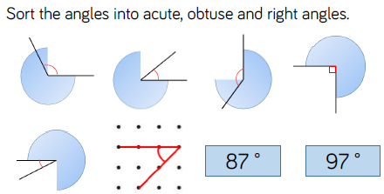
Fluency

Slide 5
Fluency

Slide 6
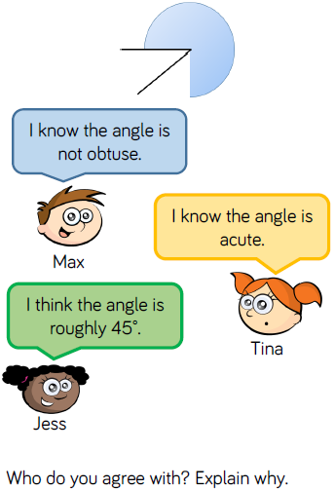
Reasoning and Problem Solving

Slide 7
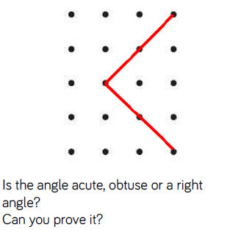
Reasoning and Problem Solving

Slide 8
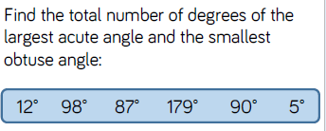
Reasoning and Problem Solving

Slide 9
Year 4 Summer Block 5: Geometry – properties of shape
Compare and order angles
NCLO: identify acute and obtuse angles and compare and order angles up to two right angles by size.

Slide 10
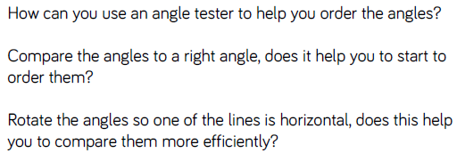
Key vocabulary and questions
Rotate, horizontal, compare, right angle

Slide 11
Fluency

Slide 12
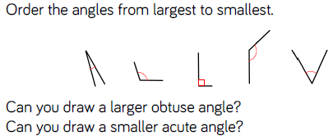
Fluency

Slide 13
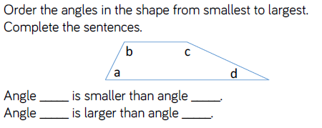
Fluency

Slide 14
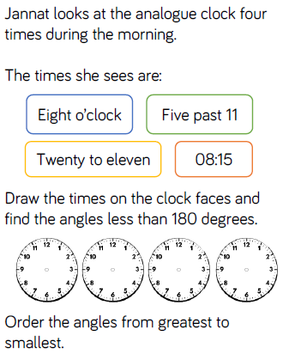
Reasoning and Problem Solving

Slide 15
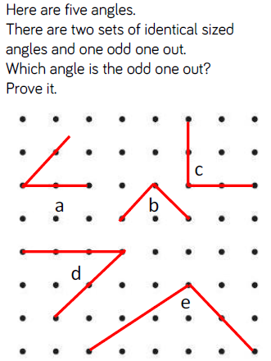
Reasoning and Problem Solving

Slide 16
Year 4 Summer Block 5: Geometry – properties of shape
Triangles
NCLO: Compare and classify geometric shapes, including quadrilaterals and triangles, based on their properties and sizes.

Slide 17
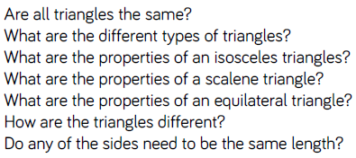
Key vocabulary and questions
Isosceles, scalene, equilateral

Slide 18
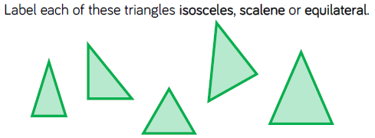
Fluency

Slide 19
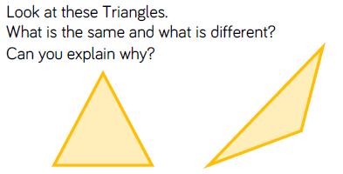
Fluency

Slide 20
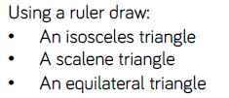
Fluency

Slide 21
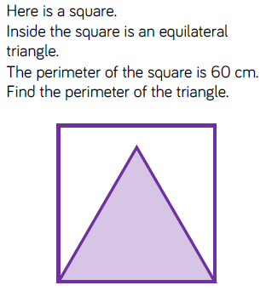
Reasoning and Problem Solving

Slide 22
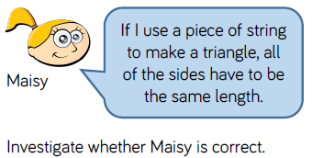
Reasoning and Problem Solving

Slide 23
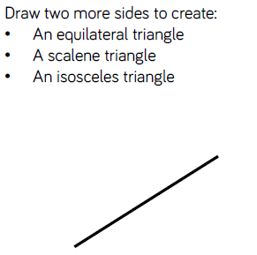
Reasoning and Problem Solving

Slide 24
Year 4 Summer Block 5: Geometry – properties of shape
Quadrilaterals
NCLO: Compare and classify geometric shapes, including quadrilaterals and triangles, based on their properties and sizes.

Slide 25
Key vocabulary and questions
Quadrilateral, polygon, rectangle, parallelogram, trapezium, rhombus, square

Slide 26
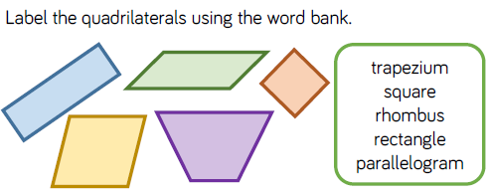
Fluency

Slide 27
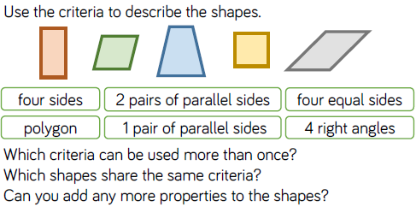
Fluency

Slide 28
Fluency

Slide 29
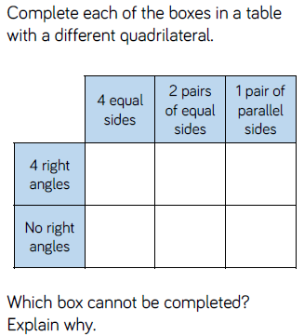
Reasoning and Problem Solving

Slide 30
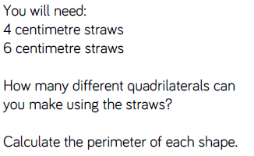
Reasoning and Problem Solving

Slide 31
Year 4 Summer Block 5: Geometry – properties of shape
Lines of symmetry
NCLO: Identify lines of symmetry in 2D shapes presented in different orientations.

Slide 32
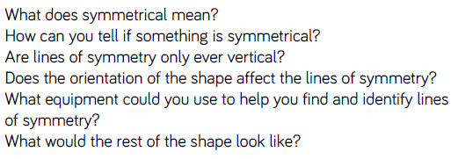
Key vocabulary and questions
Symmetrical, line of symmetry

Slide 33
Fluency

Slide 34
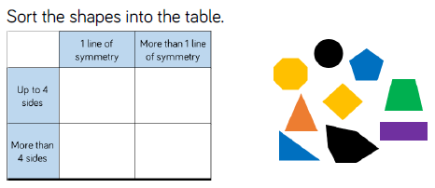
Fluency

Slide 35
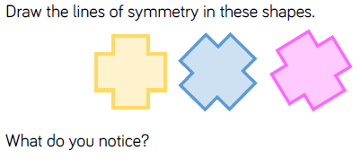
Fluency

Slide 36
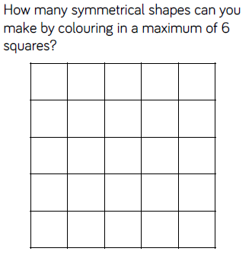
Reasoning and Problem Solving

Slide 37
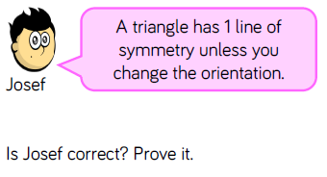
Reasoning and Problem Solving

Slide 38
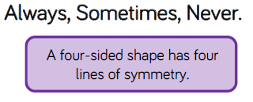
Reasoning and Problem Solving

Slide 39
Year 4 Summer Block 5: Geometry – properties of shape
Complete a symmetric figure
NCLO: Complete a simple symmetric figure with respect to a specific line of symmetry

Slide 40
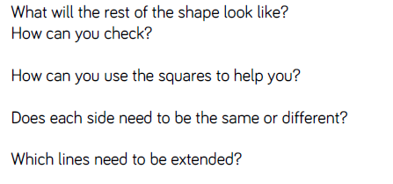
Key vocabulary and questions
Extend

Slide 41
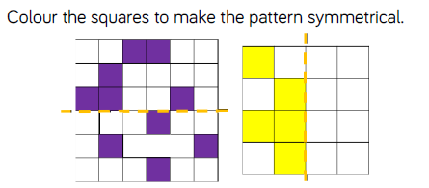
Fluency

Slide 42
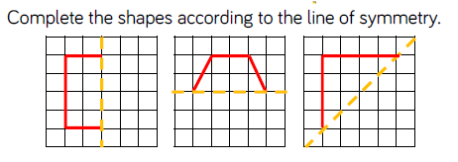
Fluency

Slide 43
Fluency

Slide 44
Reasoning and Problem Solving

Slide 45
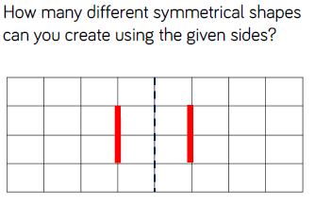
Reasoning and Problem Solving

