Slide 1
Year 2 Spring Block 5 Measurement – length and height
Measure length (cm)
NCLO: Choose and use appropriate standard units to estimate and measure length/height in any direction (m/cm) using rulers.

Slide 2
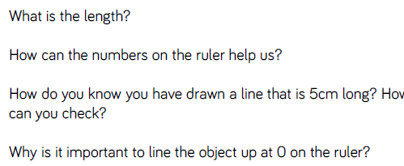
Key vocabulary and questions
centimetres / cm

Slide 3
Fluency

Slide 4
Fluency

Slide 5
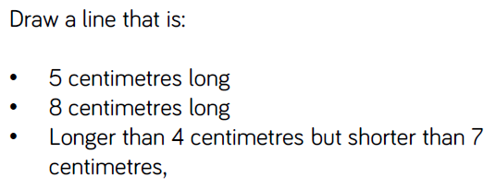
Fluency

Slide 6
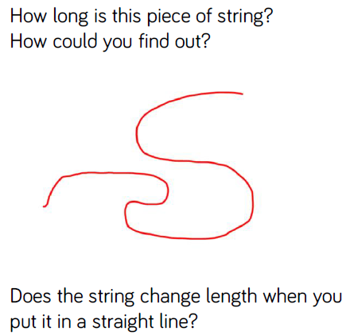
Reasoning and problem solving

Slide 7
Reasoning and problem solving

Slide 8
Year 2 Spring Block 5 Measurement – length and height
Measure length (m)
NCLO: Choose and use appropriate standard units to estimate and measure length/height in any direction (m/cm) using rulers.

Slide 9
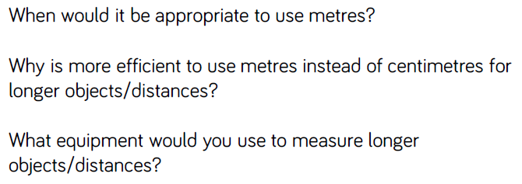
Key vocabulary and questions
Metres / m

Slide 10
Fluency

Slide 11
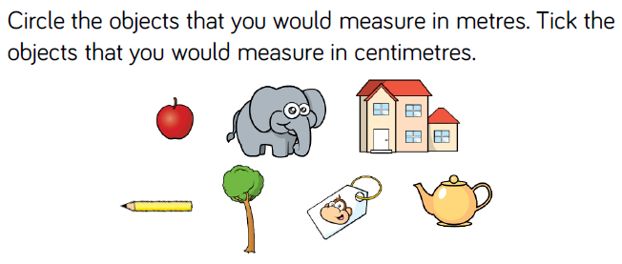
Fluency

Slide 12
Fluency

Slide 13
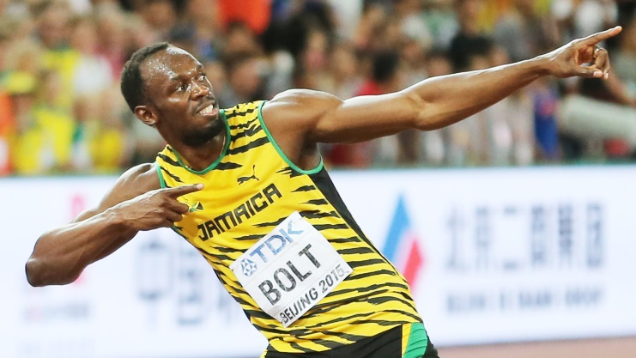
Reasoning and problem solving

Slide 14
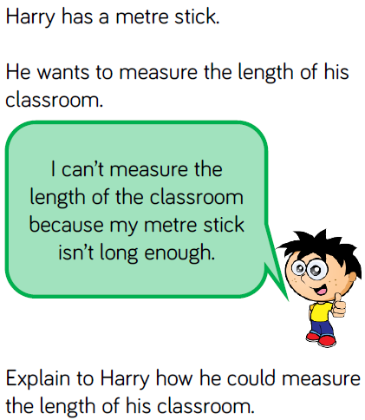
Reasoning and problem solving

Slide 15
Year 2 Spring Block 5 Measurement – length and height
Compare lengths
NCLO: Compare and order lengths and record the results using >, < and =.

Slide 16
Key vocabulary and questions

Slide 17
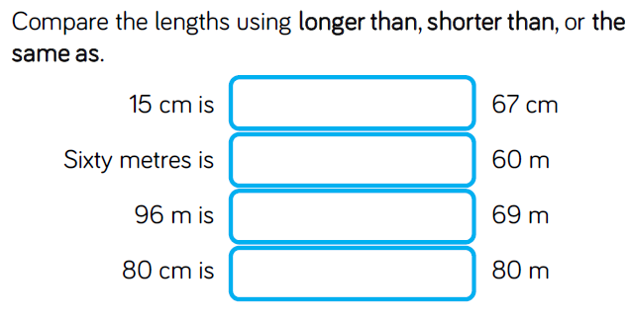
Fluency

Slide 18
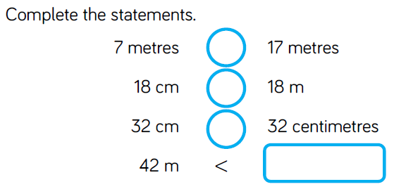
Fluency

Slide 19
Fluency

Slide 20
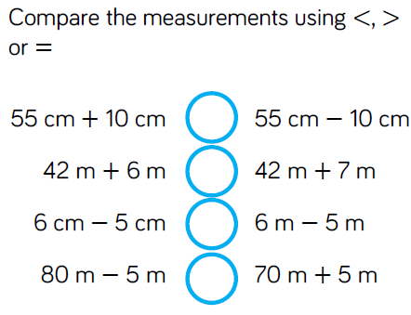
Reasoning and problem solving

Slide 21
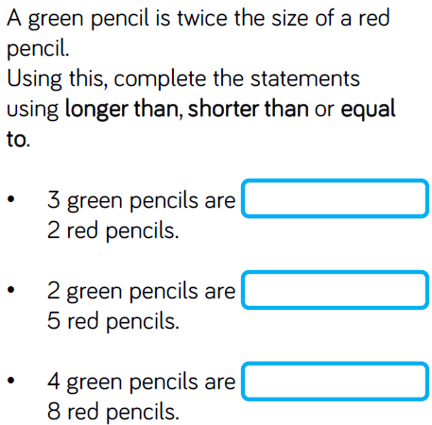
Reasoning and problem solving

Slide 22
Year 2 Spring Block 5 Measurement – length and height
Order lengths
NCLO: Compare and order lengths and record the results using >, < and =.

Slide 23
Key vocabulary and questions
Compare, estimate, longer, longest, shorter, shortest

Slide 24
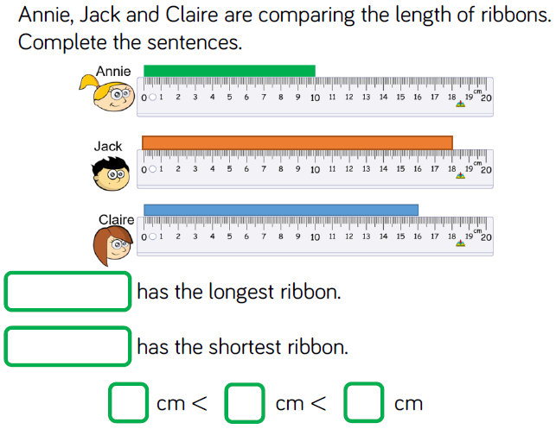
Fluency

Slide 25
Fluency

Slide 26
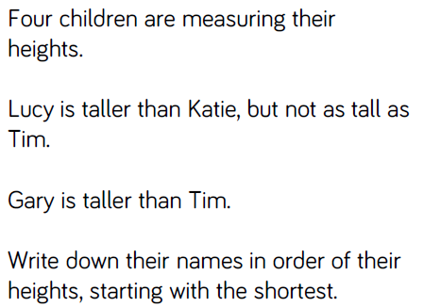
Reasoning and problem solving

Slide 27
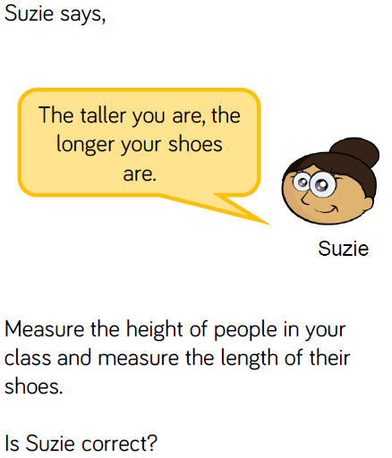
Reasoning and problem solving

Slide 28
Year 2 Spring Block 5 Measurement – length and height
Four operations with lengths
NCLO: Compare and order lengths and record the results using >, < and =.

Slide 29
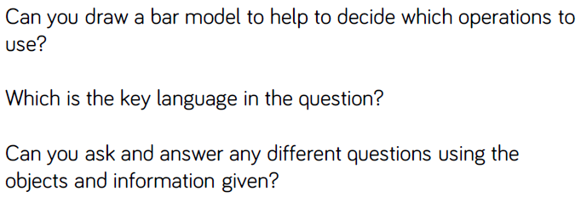
Key vocabulary and questions

Slide 30
Fluency

Slide 31
Fluency

Slide 32
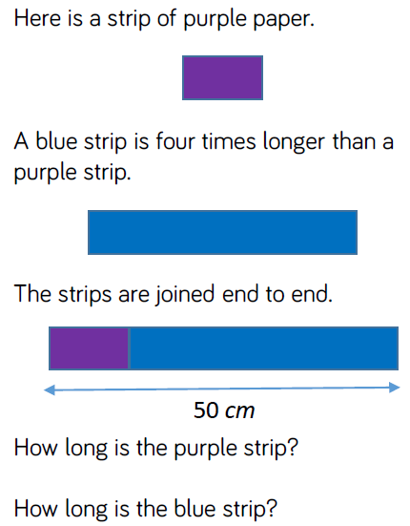
Reasoning and problem solving

Slide 33
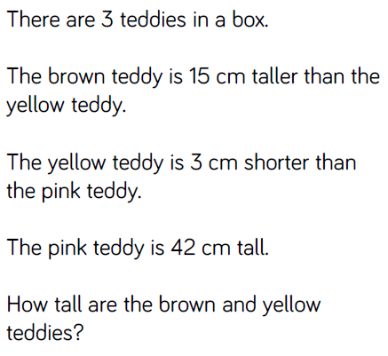
Reasoning and problem solving

