Slide 1
Year 1 Summer Block 5 Measurement: Money
Recognising coins
NCLO: Recognise and know the value of different denominations of coins and notes.

Slide 2
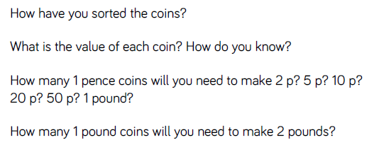
Key vocabulary and questions

Slide 3
Fluency

Slide 4
Fluency

Slide 5
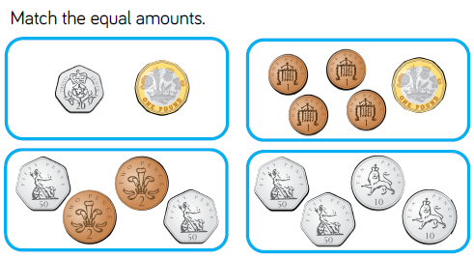
Fluency

Slide 6
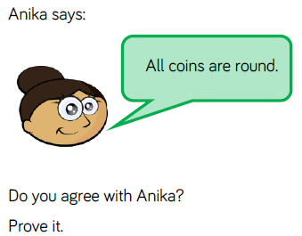
Reasoning and problem solving

Slide 7
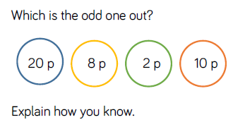
Reasoning and problem solving

Slide 8
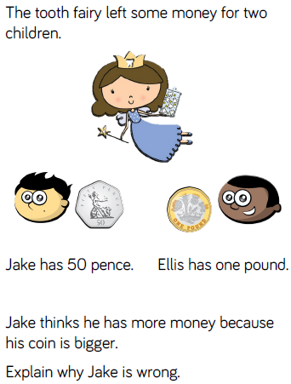
Reasoning and problem solving

Slide 9
Year 1 Summer Block 5 Measurement: Money
Recognising notes
NCLO: Recognise and know the value of different denominations of coins and notes.

Slide 10
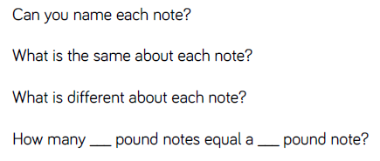
Key vocabulary and questions

Slide 11
Fluency

Slide 12
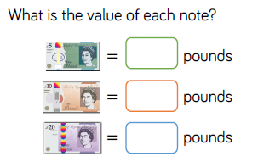
Fluency

Slide 13
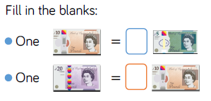
Fluency

Slide 14
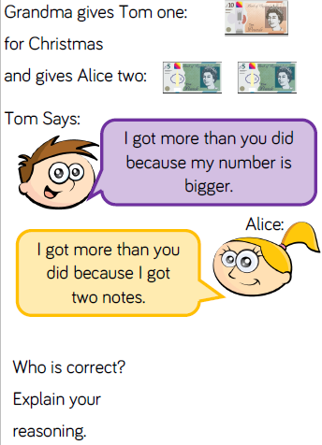
Reasoning and problem solving

Slide 15
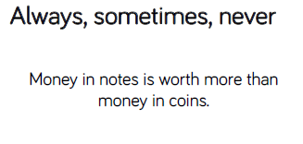
Reasoning and problem solving

Slide 16
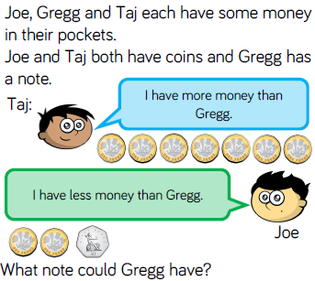
Reasoning and problem solving

Slide 17
Year 1 Summer Block 5 Measurement: Money
Counting in coins
NCLO: Recognise and know the value of different denominations of coins and notes.

Slide 18
Key vocabulary and questions

Slide 19
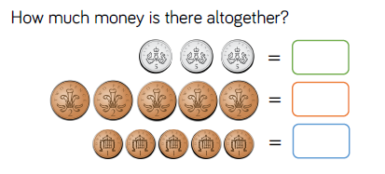
Fluency

Slide 20
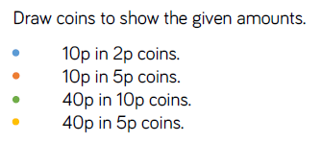
Fluency

Slide 21
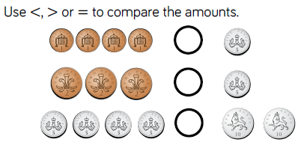
Fluency

Slide 22
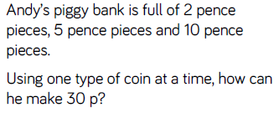
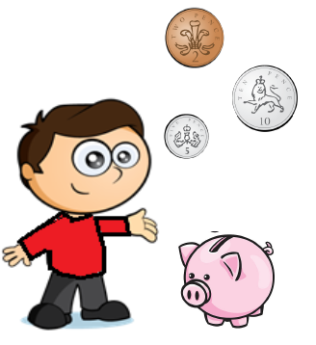
Reasoning and problem solving

Slide 23
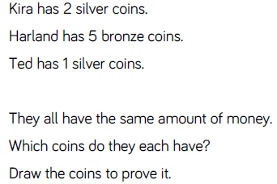
Reasoning and problem solving

