Slide 1
Year 5 Summer Block 5 Measurement - Volume
What is volume?
NCLO:Estimate volume (eg using 1cm³ blocks to build cuboids) and capacity (eg using water).
Use all 4 operations to solve problems involving measure.

Slide 2
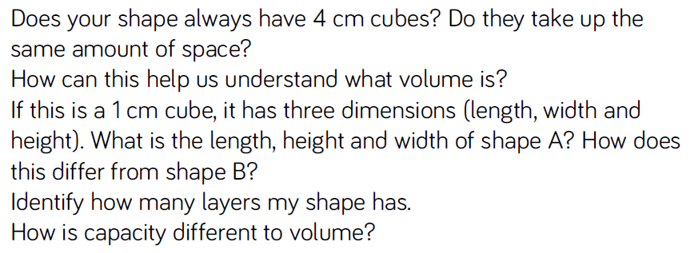
Key vocabulary and questions
Volume, cube, dimensions, layers, capacity

Slide 3
Fluency

Slide 4
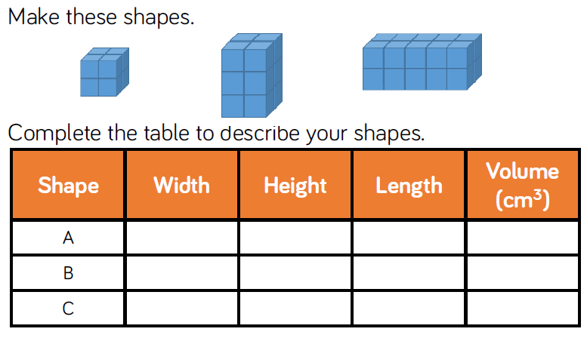
Fluency

Slide 5
Fluency

Slide 6
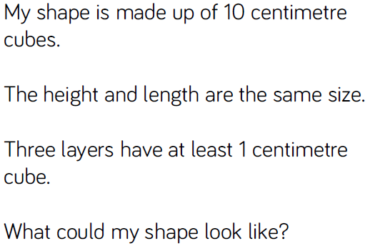
Reasoning and problem solving

Slide 7
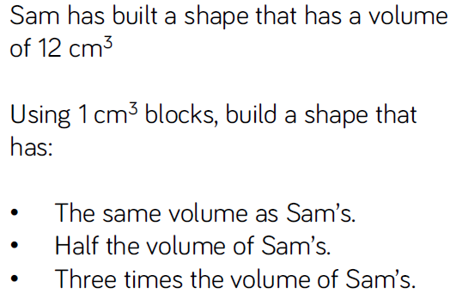
Reasoning and problem solving

Slide 8
Year 5 Summer Block 5 Measurement - Volume
Compare volume
NCLO: Estimate volume (eg using 1cm³ blocks to build cuboids) and capacity (eg using water).
Use all 4 operations to solve problems involving measure.

Slide 9
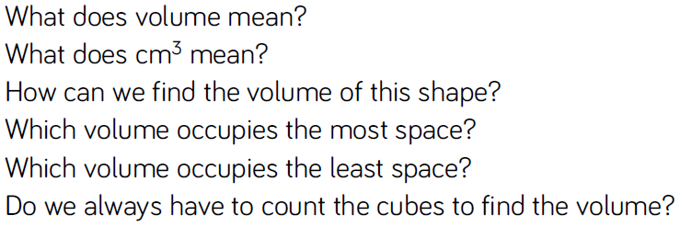
Key vocabulary and questions
Volume, cm³, occupies

Slide 10
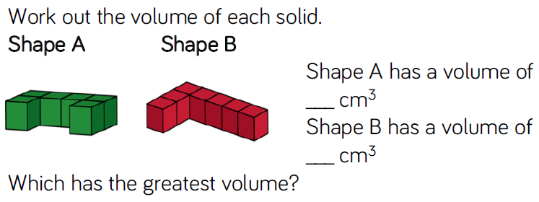
Fluency

Slide 11
Fluency

Slide 12
Fluency

Slide 13
Reasoning and problem solving

Slide 14
Reasoning and problem solving

Slide 15
Reasoning and problem solving

Slide 16
Year 5 Summer Block 5 Measurement - Volume
Estimate volume
NCLO: Estimate volume (eg using 1cm³ blocks to build cuboids) and capacity (eg using water).
Use all 4 operations to solve problems involving measure.

Slide 17
Key vocabulary and questions
Volume, capacity, unit of measure

Slide 18
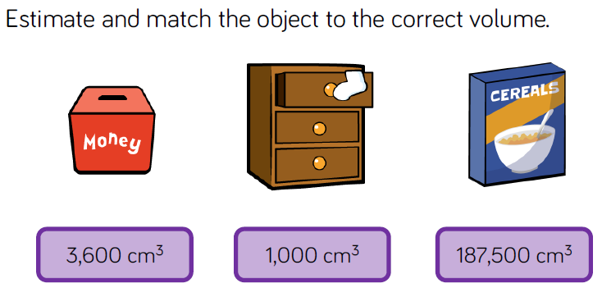
Fluency

Slide 19
Fluency

Slide 20
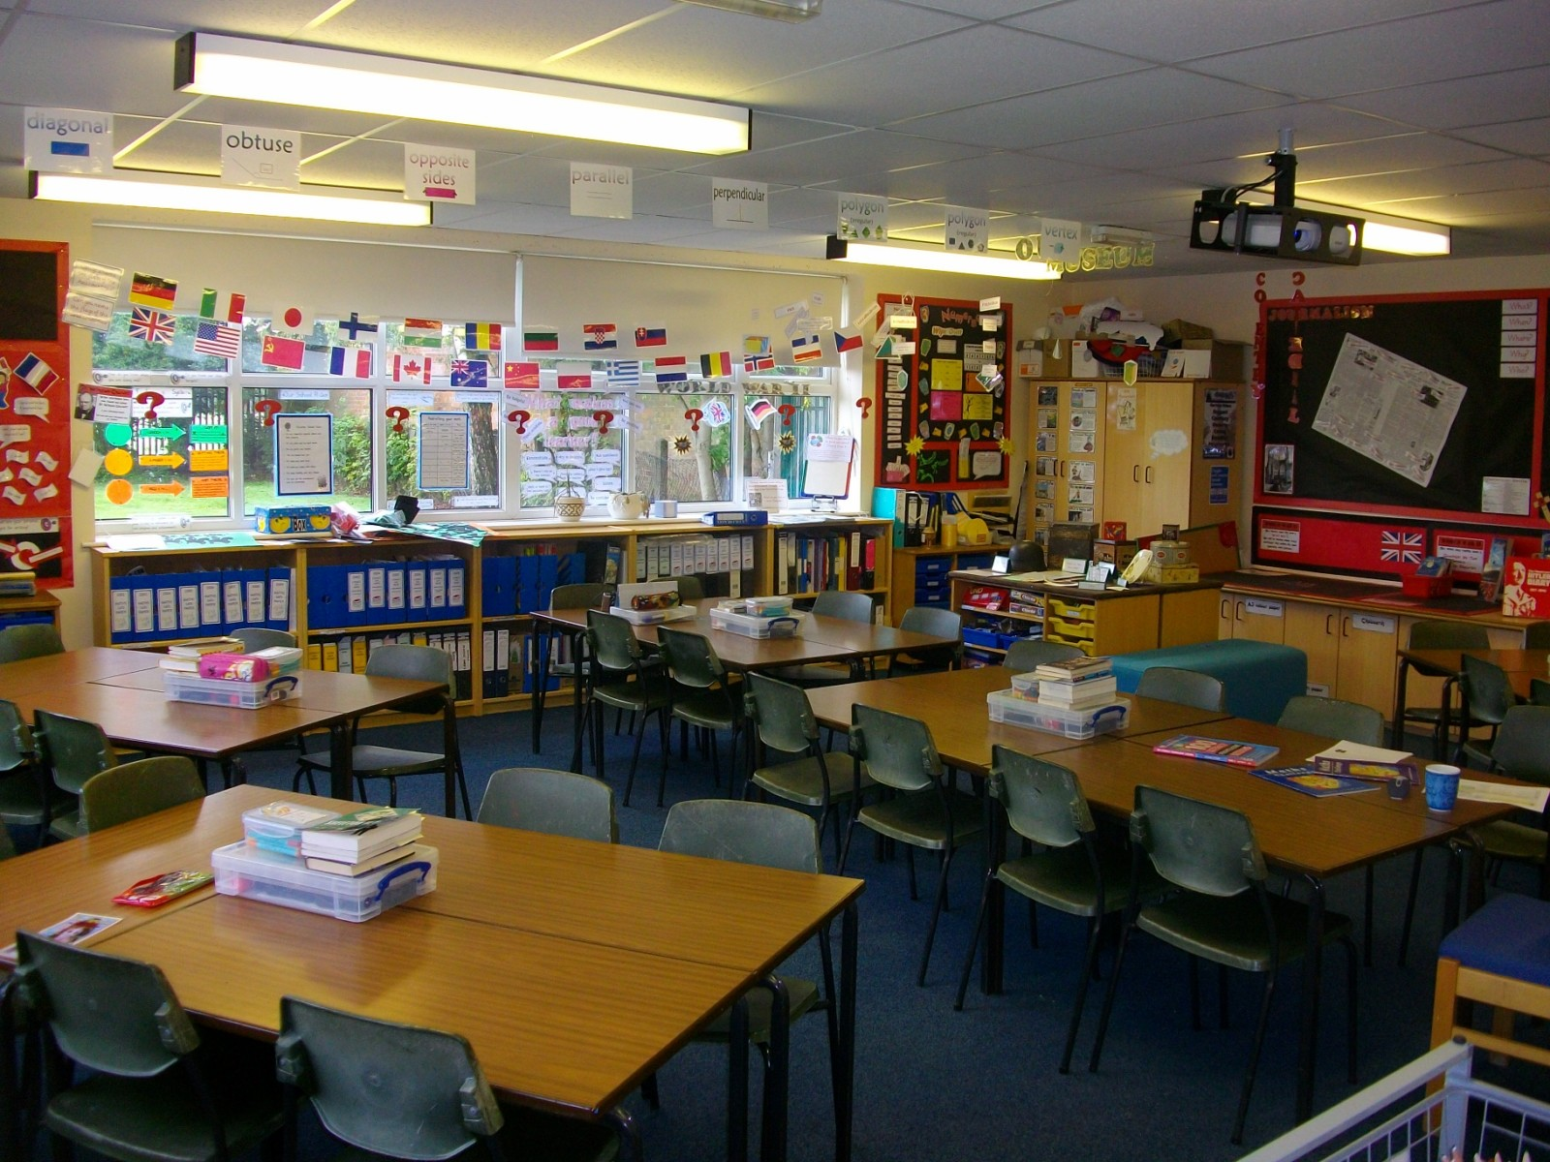
Fluency

Slide 21
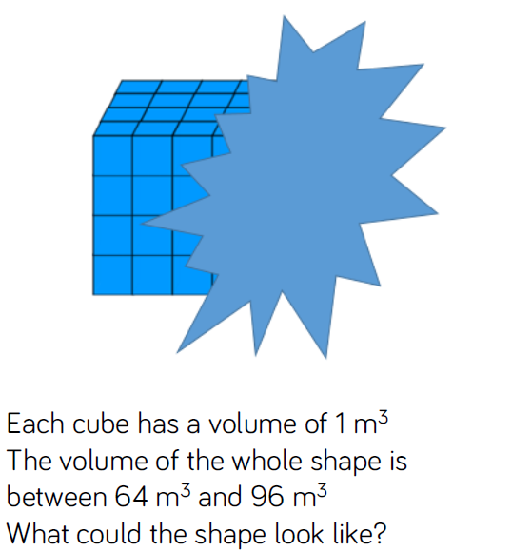
Reasoning and problem solving

Slide 22
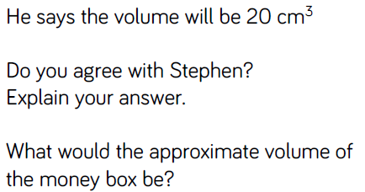
Reasoning and problem solving

Slide 23
Year 5 Summer Block 5 Measurement - Volume
Estimate capacity
NCLO: Estimate volume (eg using 1cm³ blocks to build cuboids) and capacity (eg using water).
Use all 4 operations to solve problems involving measure.

Slide 24
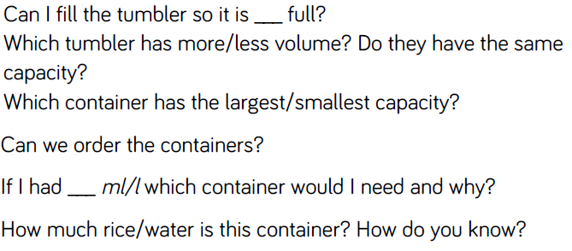
Key vocabulary and questions
Volume, full, empty, more, less, container

Slide 25
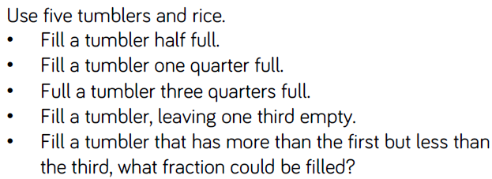
Fluency

Slide 26
Fluency

Slide 27
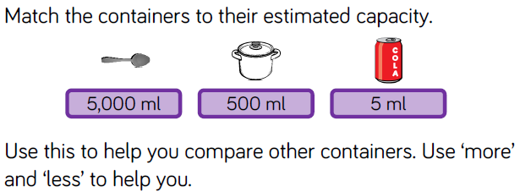
Fluency

Slide 28
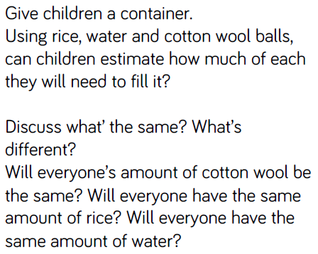
Reasoning and problem solving

Slide 29
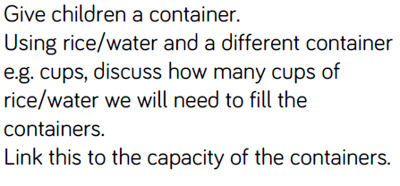
Reasoning and problem solving

