Slide 1
Year 4 Summer Block 6: Geometry – position and direction
Describe position
NCLO: Describe positions on a 2-D grid as coordinates in the first quadrant. Plot specified points and draw sides to complete a given polygon.

Slide 2
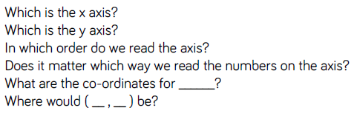
Key vocabulary and questions
X axis, y axis, co-ordinates

Slide 3

Fluency

Slide 4
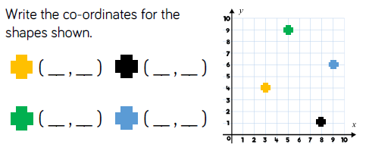
Fluency

Slide 5
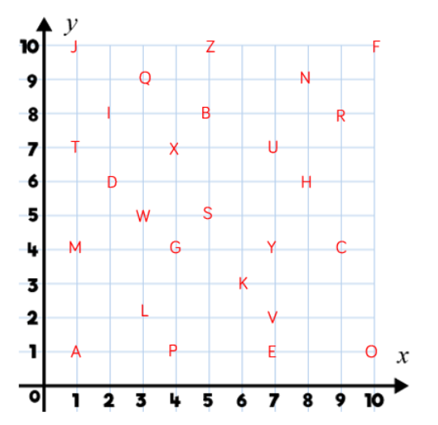
Fluency

Slide 6
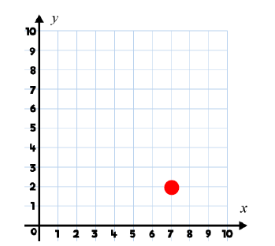
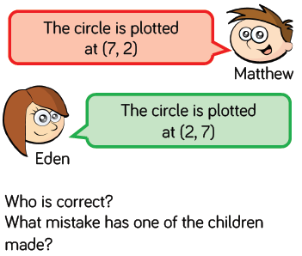
Reasoning and Problem Solving

Slide 7
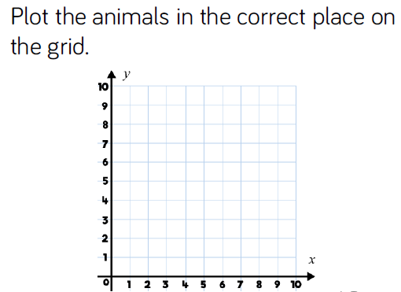
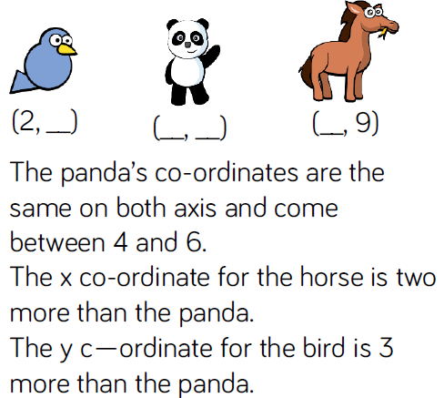
Reasoning and Problem Solving

Slide 8
Year 4 Summer Block 6: Geometry – position and direction
Draw on a grid
NCLO: Describe positions on a 2-D grid as coordinates in the first quadrant. Plot specified points and draw sides to complete a given polygon.

Slide 9
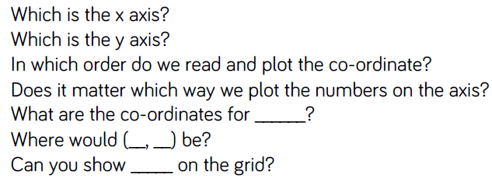
Key vocabulary and questions
X axis, y axis, plot, grid, co-ordinate

Slide 10
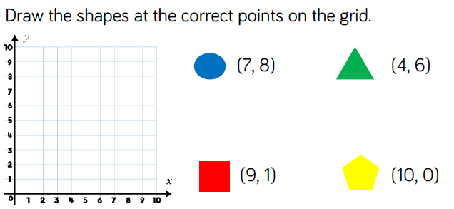
Fluency

Slide 11
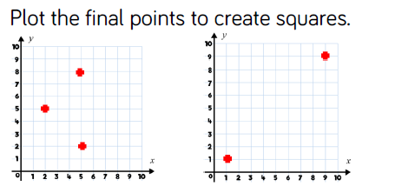
Fluency

Slide 12
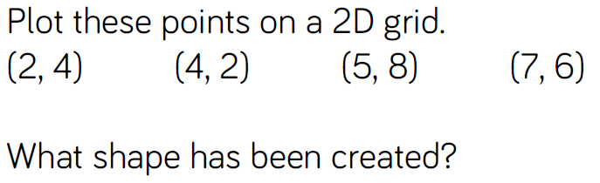
Fluency

Slide 13
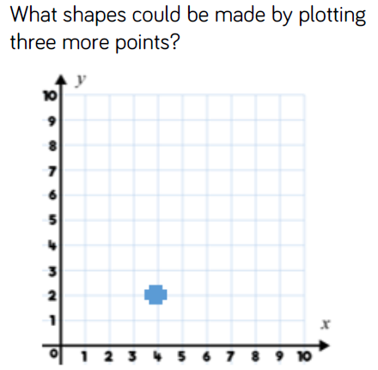
Reasoning and Problem Solving

Slide 14
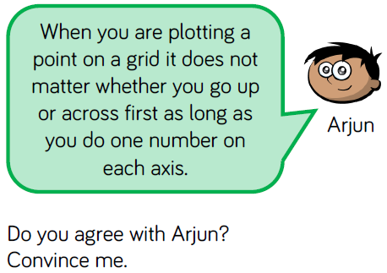
Reasoning and Problem Solving

Slide 15
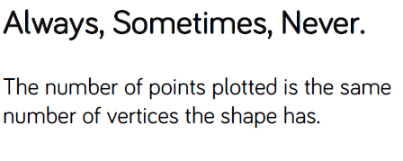
Reasoning and Problem Solving

Slide 16
Year 4 Summer Block 6: Geometry – position and direction
Move on a grid
NCLO:Describe movements between positions as translations of a given unit to the left/right and up/down.

Slide 17
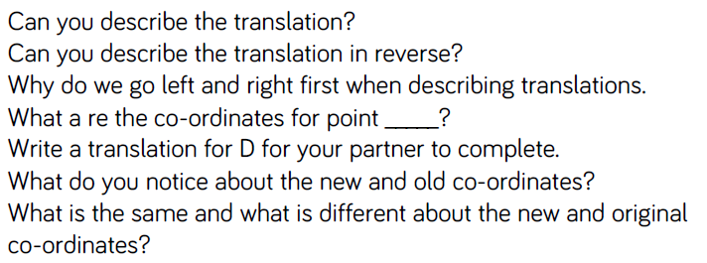
Key vocabulary and questions
Translation, reverse, left, right, co-ordinates

Slide 18
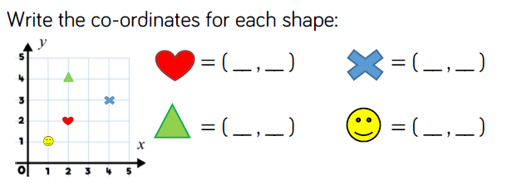
Fluency

Slide 19
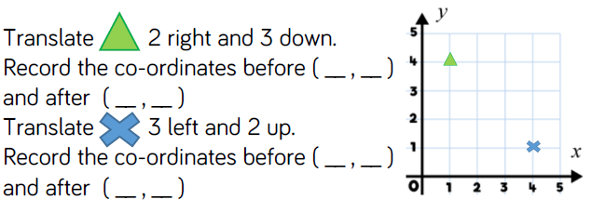
Fluency

Slide 20
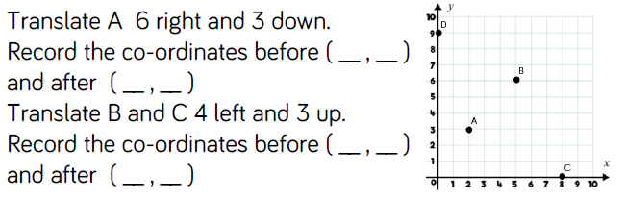
Fluency

Slide 21
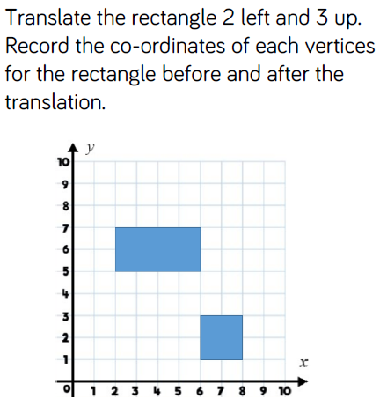
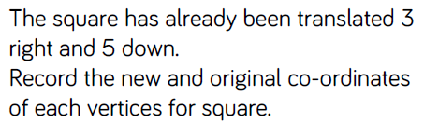
Reasoning and Problem Solving

Slide 22
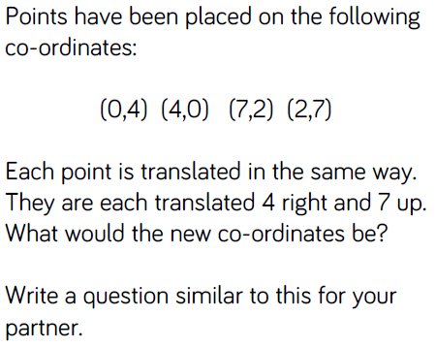
Reasoning and Problem Solving

Slide 23
Year 4 Summer Block 6: Geometry – position and direction
Describe a movement on a grid
NCLO:Describe movements between positions as translations of a given unit to the left/right and up/down.

Slide 24
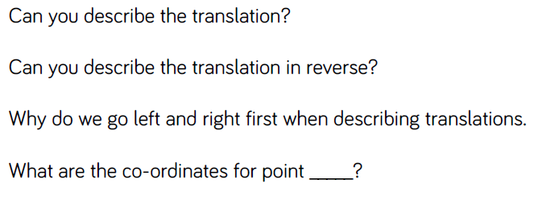
Key vocabulary and questions
Translation, reverse, left, right

Slide 25
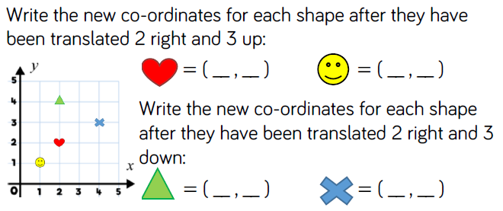
Fluency

Slide 26
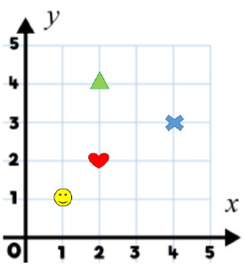
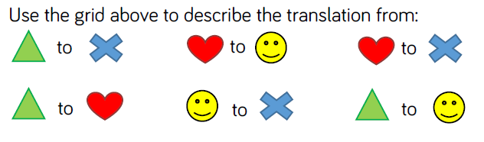
Fluency

Slide 27
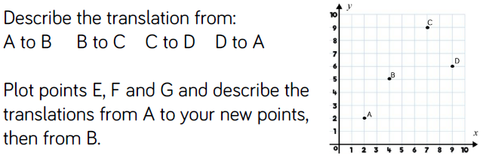
Fluency

Slide 28
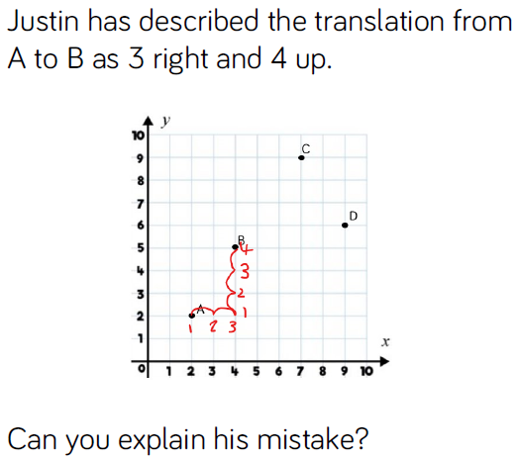
Reasoning and Problem Solving

Slide 29
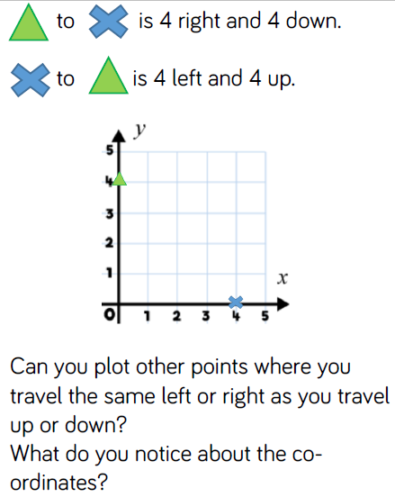
Reasoning and Problem Solving

