Slide 1
Year 6 Spring Block 6 Using Ratio Language
NCLO:Solve problems involving the relative sizes of two quantities where missing values can be found by using integer multiplication and division facts

Slide 2
Key vocabulary and questions
How would your sentences change if there were 2 more blue flowers?
How would your sentences change if there were 10 more pink flowers?
Can you write a “for every…” sentence for the number of boys and girls in your class?

Slide 3
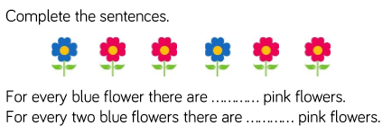
Fluency

Slide 4
Fluency

Slide 5
Fluency

Slide 6
Reasoning and problem solving
Notes:
Children sorted into boys and girls.
Children sorted into wearing white, wearing red.
Children sorted into white shoes, non-white shoes.

Slide 7
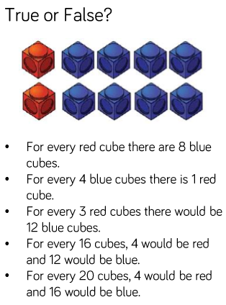
Reasoning and problem solving

Slide 8
Year 6 Spring Block 6 Ratio and Fractions
NCLO:Solve problems involving the relative sizes of two quantities where missing values can be found by using integer multiplication and division facts.

Slide 9
Key vocabulary and questions

Slide 10
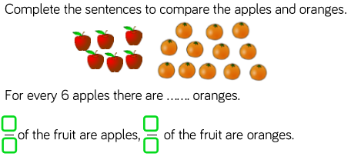
Fluency

Slide 11
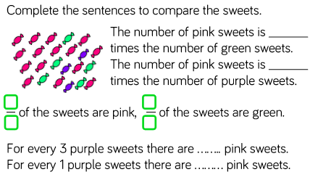
Fluency

Slide 12
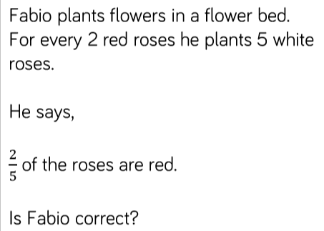
Reasoning and problem solving

Slide 13
Reasoning and problem solving
Notes:
Children sorted into boys and girls.
Children sorted into wearing white, wearing red.
Children sorted into white shoes, non-white shoes.

Slide 14
Reasoning and problem solving
Notes:
Children sorted into boys and girls.
Children sorted into wearing white, wearing red.
Children sorted into white shoes, non-white shoes.

Slide 15
Year 6 Spring Block 6 Introducing the ratio symbol.
NCLO:Solve problems involving the relative sizes of two quantities where missing values can be found by using integer multiplication and division facts.

Slide 16
Key vocabulary and questions

Slide 17
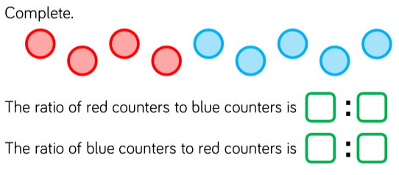
Fluency

Slide 18
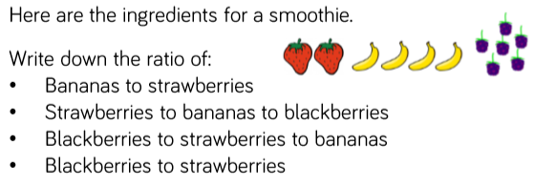
Fluency

Slide 19
Fluency

Slide 20
Reasoning and problem solving
Notes:
Children sorted into boys and girls.
Children sorted into wearing white, wearing red.
Children sorted into white shoes, non-white shoes.

Slide 21
Reasoning and problem solving

Slide 22
Year 6 Spring Block 6 Calculating ratio
NCLO:Solve problems involving the relative sizes of two quantities where missing values can be found by using integer multiplication and division facts.

Slide 23
Key vocabulary and questions

Slide 24
Fluency

Slide 25
Fluency

Slide 26
Fluency

Slide 27
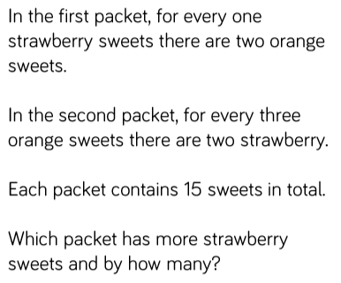
Reasoning and problem solving
Notes:
Children sorted into boys and girls.
Children sorted into wearing white, wearing red.
Children sorted into white shoes, non-white shoes.

Slide 28
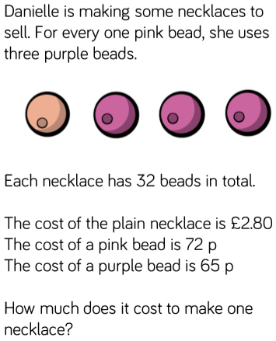
Reasoning and problem solving

Slide 29
Year 6 Spring Block 6 Using scale factors
NCLO: Solve problems involving similar shapes where the scale factor is known or can be found.

Slide 30
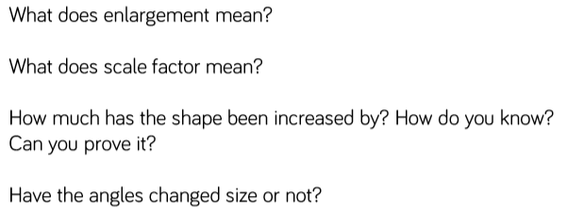
Key vocabulary and questions
Enlargement, scale factor

Slide 31
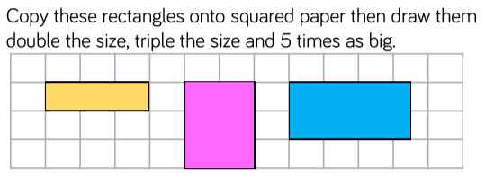
Fluency

Slide 32
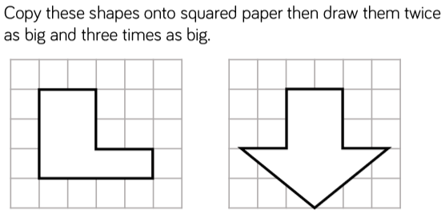
Fluency

Slide 33
Fluency

Slide 34
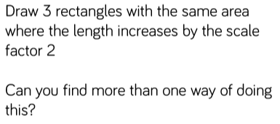
Reasoning and problem solving
Notes:
Children sorted into boys and girls.
Children sorted into wearing white, wearing red.
Children sorted into white shoes, non-white shoes.

Slide 35
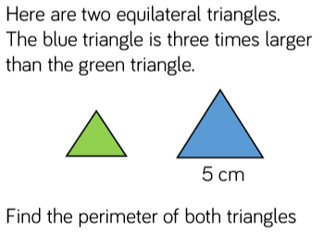
Reasoning and problem solving

Slide 36
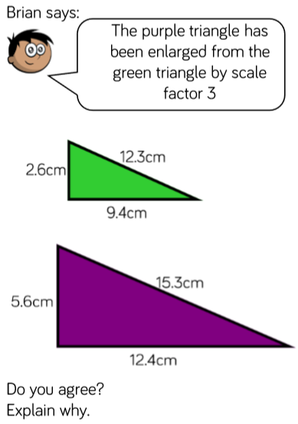
Reasoning and problem solving

Slide 37
Year 6 Spring Block 6 Calculating scale factors
NCLO:Solve problems involving similar shapes where the scale factor is known or can be found.

Slide 38
Key vocabulary and questions

Slide 39
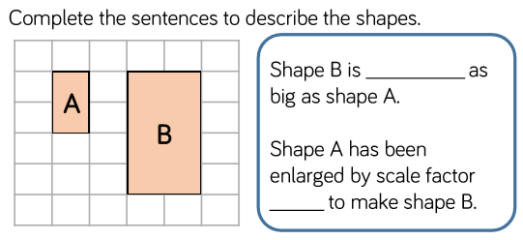
Fluency

Slide 40
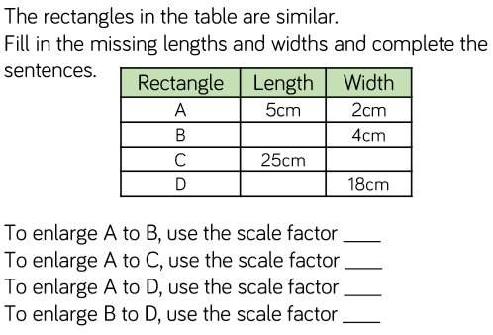
Fluency

Slide 41
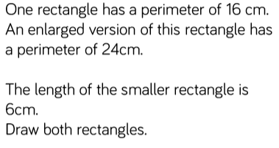
Reasoning and problem solving

Slide 42
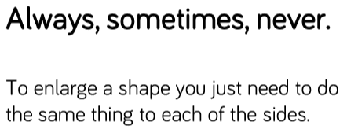
Reasoning and problem solving
Notes:
Children sorted into boys and girls.
Children sorted into wearing white, wearing red.
Children sorted into white shoes, non-white shoes.

Slide 43
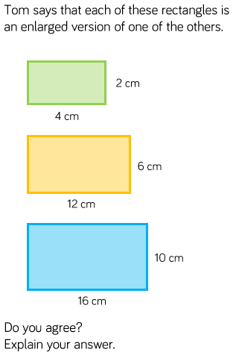
Reasoning and problem solving

Slide 44
Year 6 Spring Block 6 Ratio and proportion problems
NCLO: Solve problems involving unequal sharing and grouping using knowledge of fractions and multiples.

Slide 45
Key vocabulary and questions

Slide 46
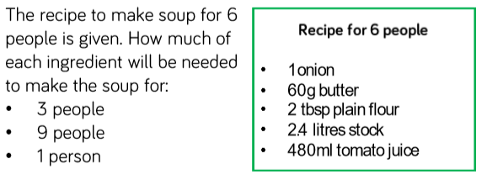
Fluency

Slide 47
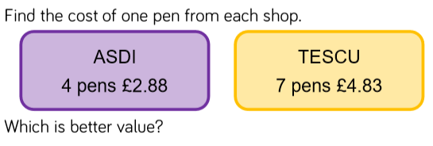
Fluency

Slide 48
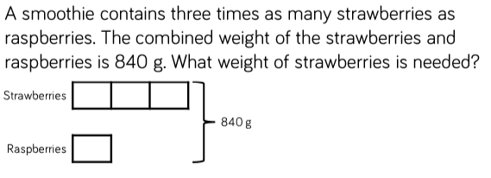
Fluency

Slide 49
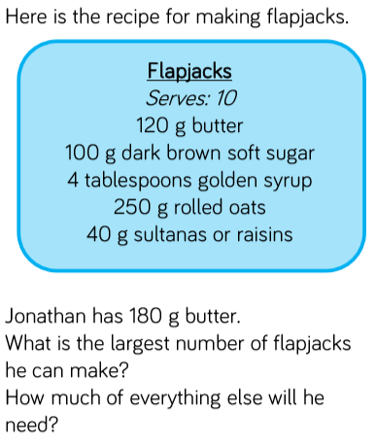
Reasoning and problem solving
Notes:
Children sorted into boys and girls.
Children sorted into wearing white, wearing red.
Children sorted into white shoes, non-white shoes.

Slide 50
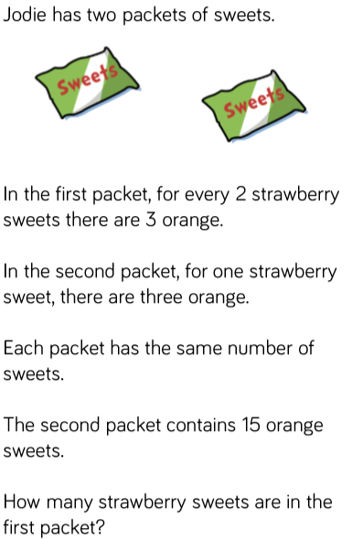
Reasoning and problem solving

