Slide 1
Year 1 Summer Block 6
Measurement: Time
Before and after
NCLO: Sequence events in chronological order using language (before and after, next, first, today, yesterday, tomorrow, morning, afternoon and evening.
Recognising coins
NCLO: Recognise and know the value of different denominations of coins and notes.

Slide 2
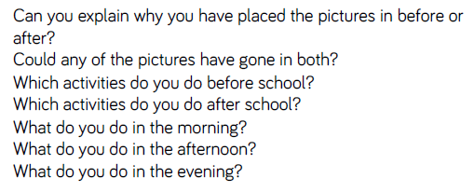
Key vocabulary and questions
Before, after, morning, afternoon, evening

Slide 3
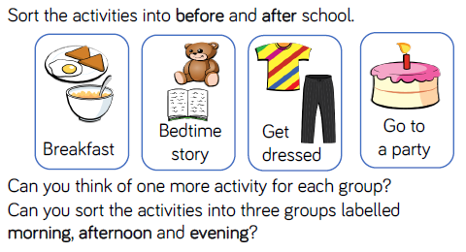
Fluency

Slide 4
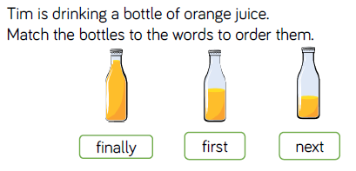
Fluency

Slide 5

Fluency

Slide 6
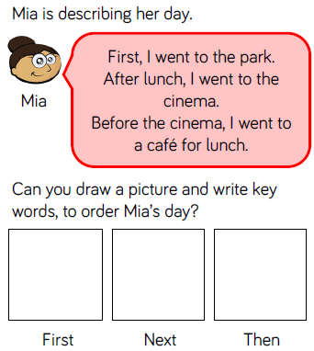
Reasoning and problem solving

Slide 7
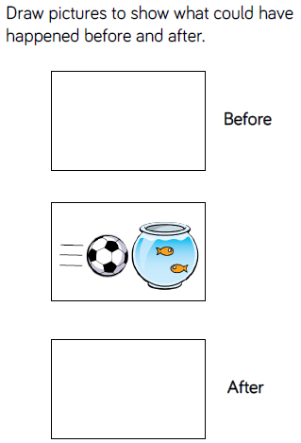
Reasoning and problem solving

Slide 8
Year 1 Summer Block 6
Measurement: Time
Dates
NCLO: To recognise and use language relating to dates, including days of the week, weeks, months and years

Slide 9
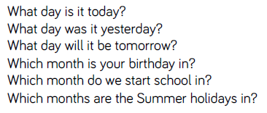
Key vocabulary and questions
Day, today, yesterday, tomorrow, month

Slide 10
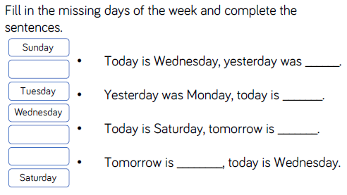
Fluency

Slide 11
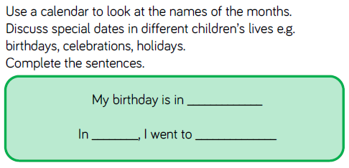
Fluency

Slide 12
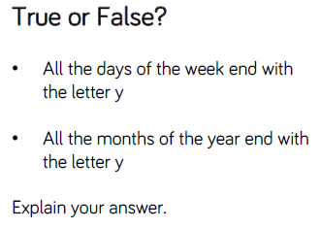
Reasoning and problem solving

Slide 13

Reasoning and problem solving

Slide 14
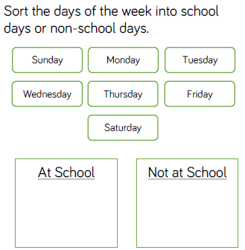
Reasoning and problem solving

Slide 15
Year 1 Summer Block 6
Measurement: Time
Time to the hour
NCLO:Tell the time to the hour and half past the hour and draw the hands on a clock face to show these times. Compare, describe and solve practical problems for time.

Slide 16
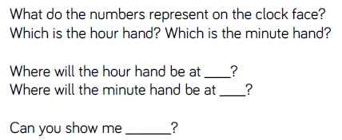
Key vocabulary and questions
Hour hand, minute hand

Slide 17
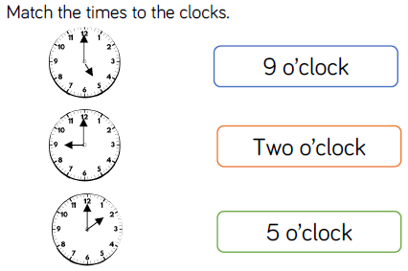
Fluency

Slide 18
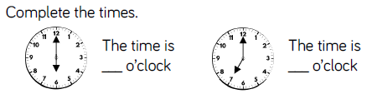
Fluency

Slide 19

Fluency

Slide 20
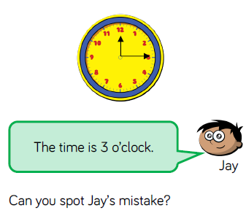
Reasoning and problem solving

Slide 21
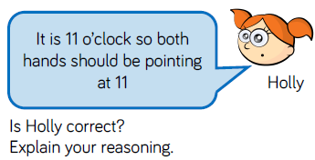
Reasoning and problem solving

Slide 22
Year 1 Summer Block 6
Measurement: Time
Time to the half hour
NCLO:Tell the time to the hour and half past the hour and draw the hands on a clock face to show these times. Compare, describe and solve practical problems for time.

Slide 23
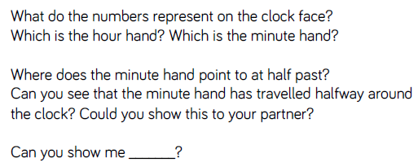
Key vocabulary and questions
Halfway, clock face, hour hand, minute hand

Slide 24
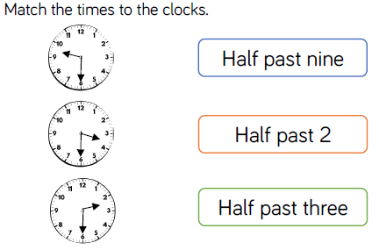
Fluency

Slide 25
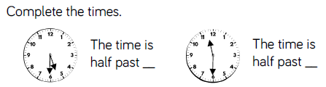
Fluency

Slide 26

Fluency

Slide 27
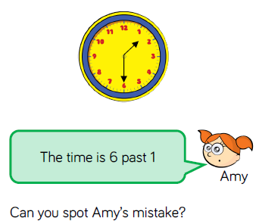
Reasoning and problem solving

Slide 28
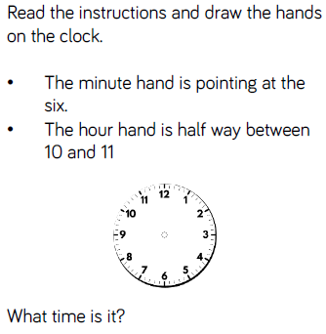
Reasoning and problem solving

Slide 29
Year 1 Summer Block 6
Measurement: Time
Writing time
NCLO: Measure and begin to record time (hours, minutes, seconds)

Slide 30
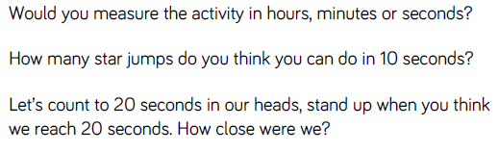
Key vocabulary and questions
Hours, minutes, seconds

Slide 31
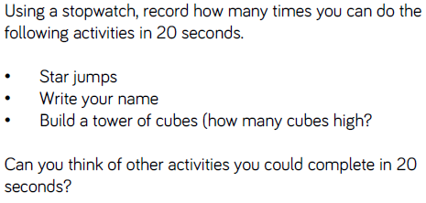
Fluency

Slide 32
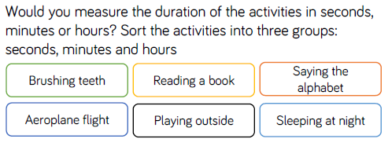
Fluency

Slide 33

Fluency

Slide 34
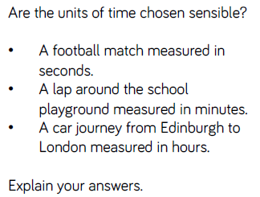
Reasoning and problem solving

Slide 35
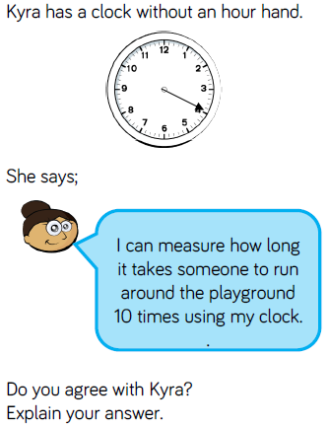
Reasoning and problem solving

Slide 36
Year 1 Summer Block 6
Measurement: Time
Comparing time
NCLO:Tell the time to the hour and half past the hour and draw the hands on a clock face to show these times. Compare, describe and solve practical problems for time.

Slide 37
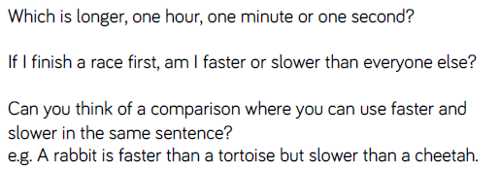
Key vocabulary and questions
Slower, faster, longer, shorter, hour, minute, second

Slide 38
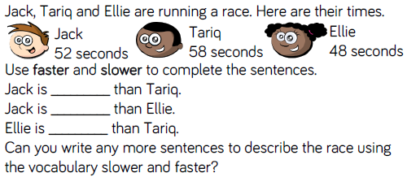
Fluency

Slide 39
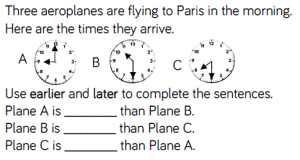
Fluency

Slide 40

Fluency

Slide 41
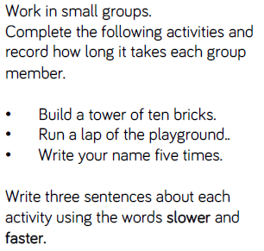
Reasoning and problem solving

Slide 42
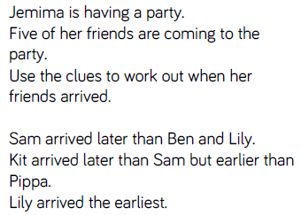
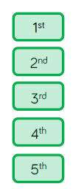
Reasoning and problem solving

