Slide 1
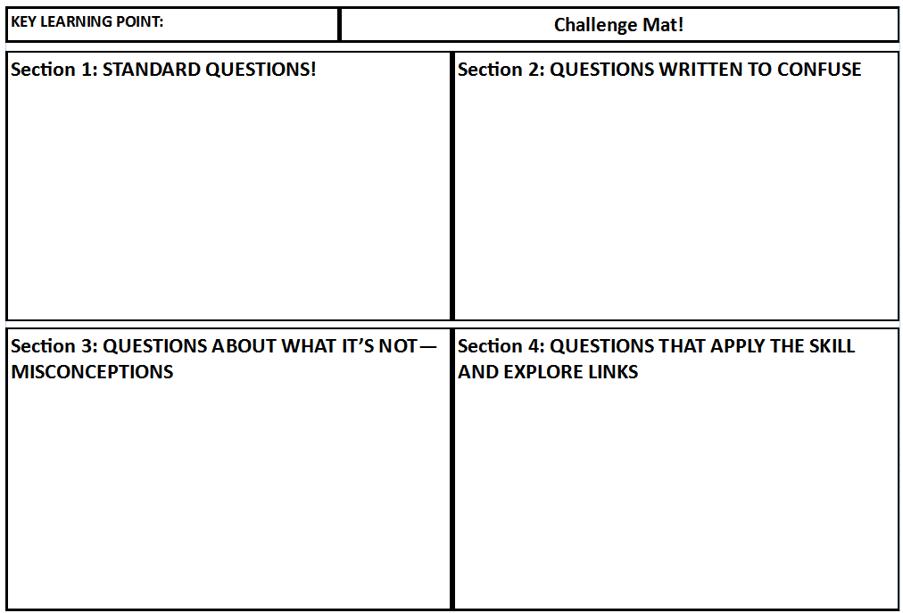
The Challenge Mat
Outline the steps to build a bridge
Below are the steps to build a bridge but 2 steps have been left out; which ones?
Here is a picture of a bridge that was built incorrectly, what is wrong? What effect will this have?
The technique of lateral bracing prevents the bridge from twisting or bending and gives greater strength. Where else may this be a useful technique?

Slide 2
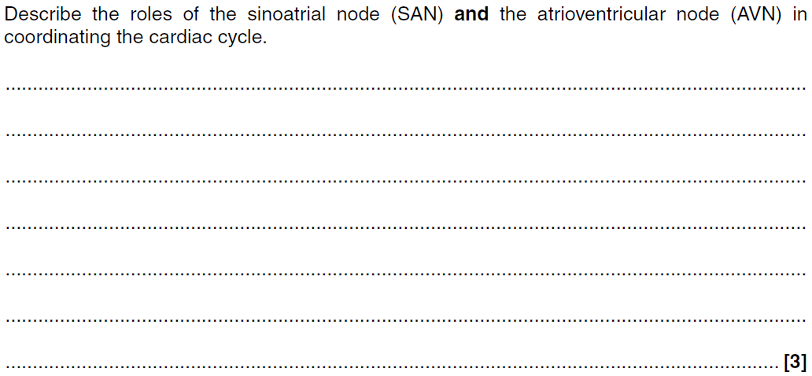
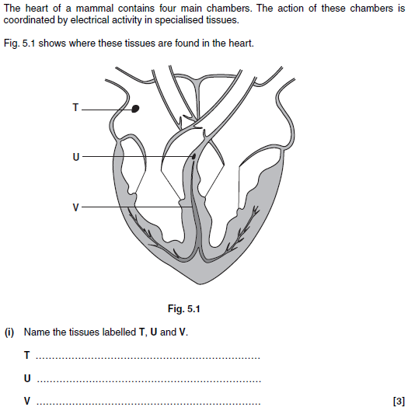
Section 1: STANDARD QUESTIONS

Slide 3
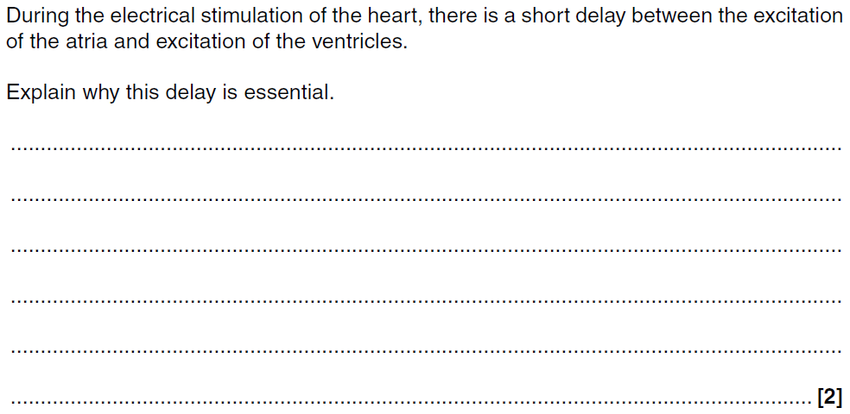
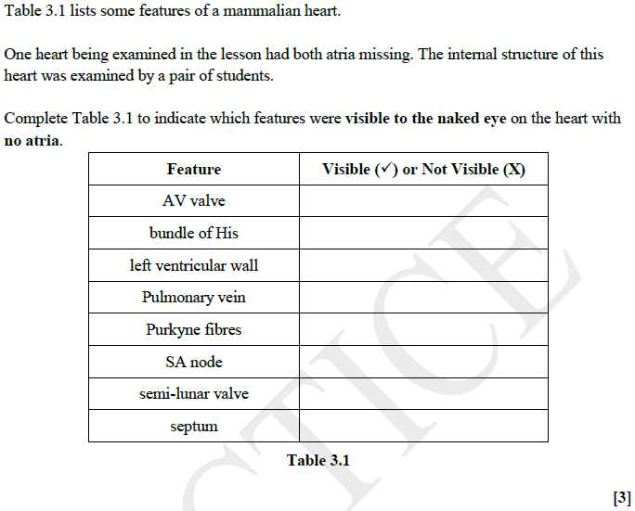
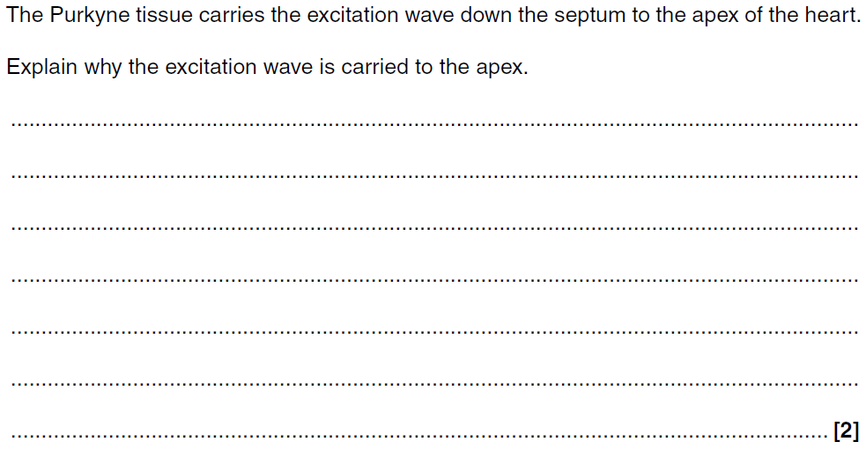
Section 2: MISCONCEPTIONS
Section 3: BUILDING LINKS

