Slide 1
Using padlet inside and outside of the classroom…
Session aim;
To be able to take away at least 1 practical strategy of how you can use padlet within your teaching

Slide 2
In the classroom…
Great for;
Starters- link back to previous knowledge
AFL checks- key terms; opinion based ideas
Evaluative tasks; especially if you have questions which are opinion based
Plenaries- summary of the entire lesson
Uploading reading and students extracting and uploading ideas

Slide 3
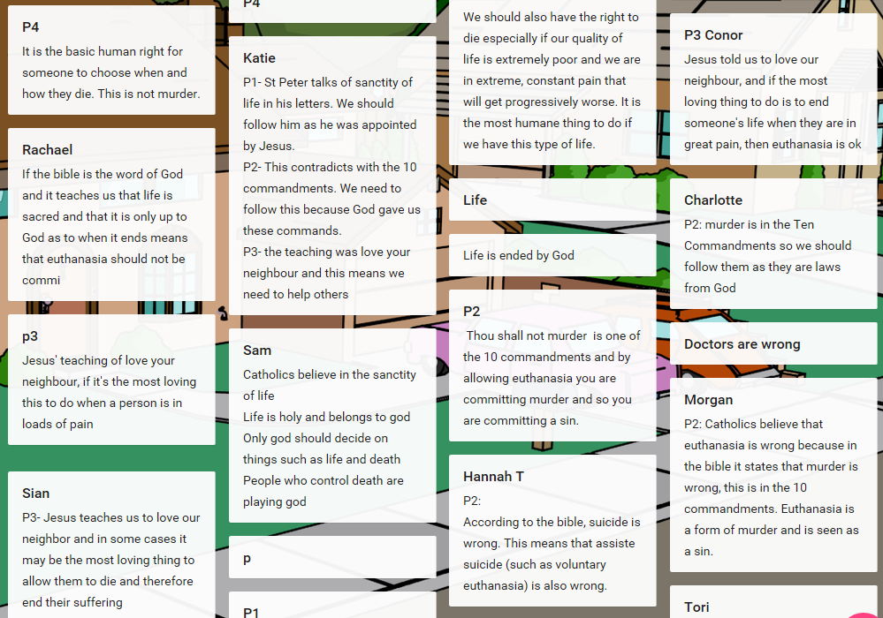
Examples of in the classroom…

Slide 4
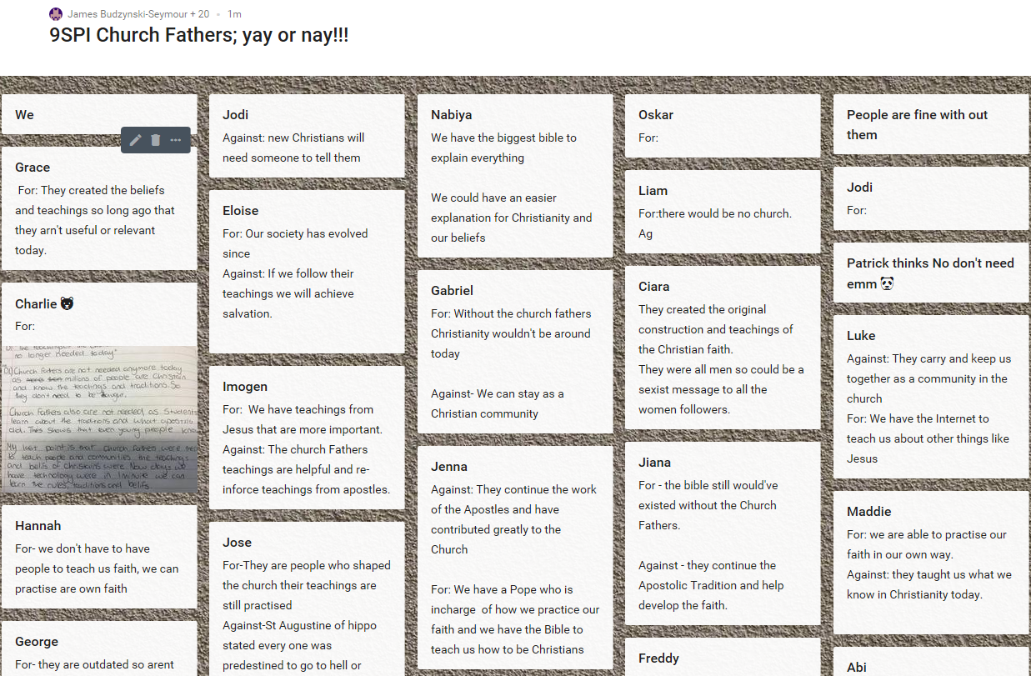
Examples of in the classroom…

Slide 5
Outside the classroom…
Great for;
Setting reflective based homeworks
Setting homework that are reading and note taking based
Uploading of media videos, or podcasts

Slide 6
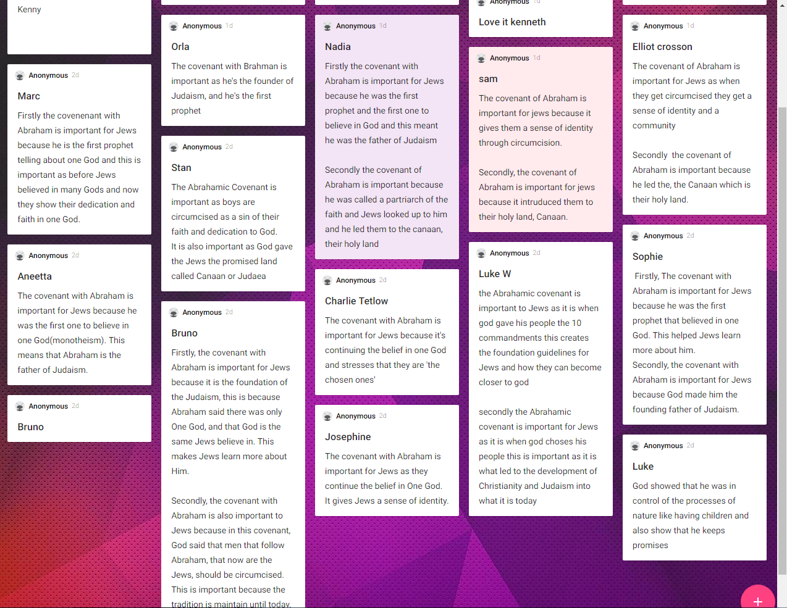
The responses were remarkably similar…
Students were asked to, based on prior learning, write responses on padlet for ‘Why is the covenant with Abraham important.’
They then added these responses IN PENCIL to their books, and then compared them to the exam responses.

Slide 7
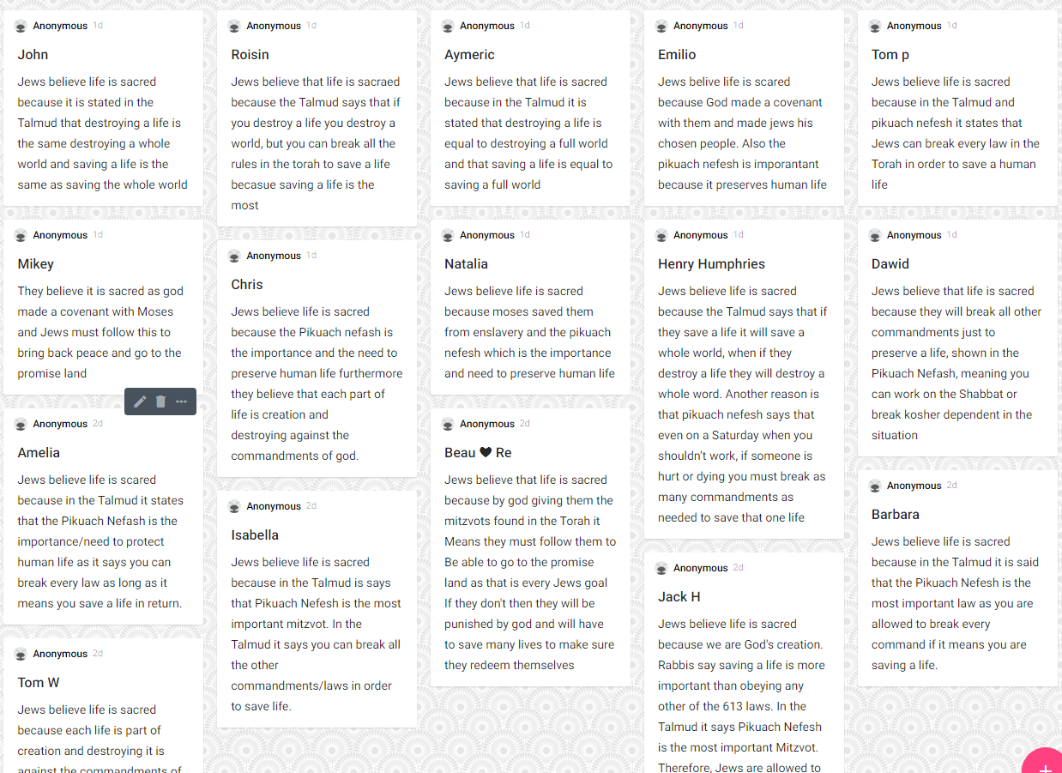
The responses were remarkably similar, and at times better…
Students similarly were asked to, based on prior learning, write responses on padlet for ‘Why Jews believe life is sacred.’
They then added these responses IN PENCIL to their books, and then compared them to the exam responses.

Slide 8
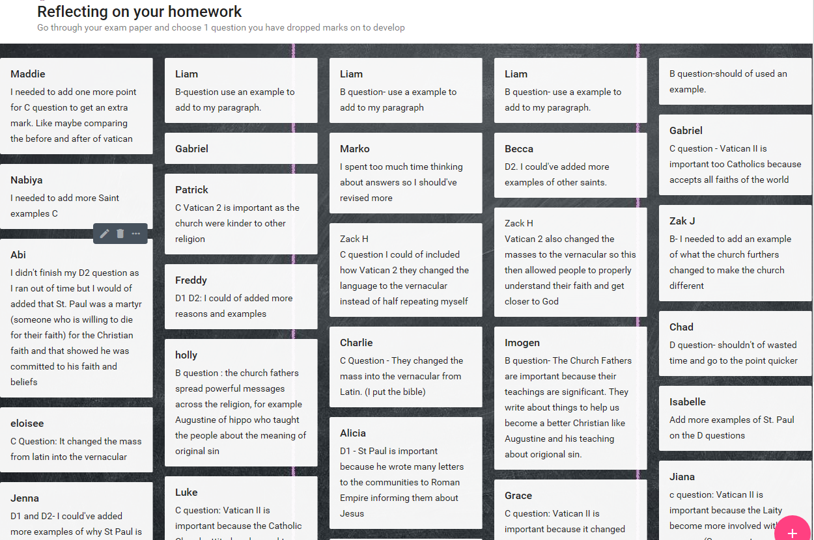
Outside the classroom…

Slide 9
Task:
Model how to use padlet then do the task!
Load up the padlet link.
Download the extract I have uploaded.
Onto the padlet wall, (1) state your favourite quote, and (2) explain why you have chosen this.
Make sure you include your name!!!

Slide 10
Why do I love padlet?
Personal
Adaptable
Differentiated
Linked
Easy
Timeless

Slide 11
Examples of in the classroom…

Slide 12
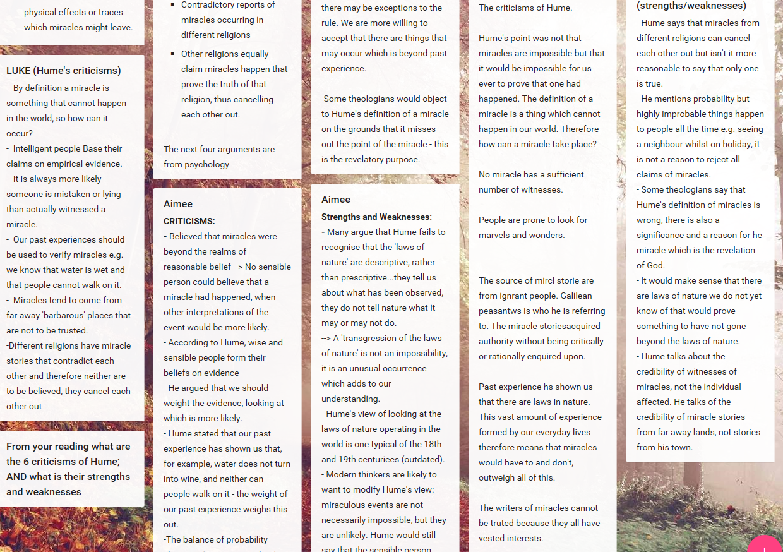
Outside the classroom…

