Slide 1
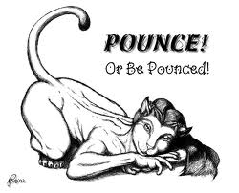
POSE A question to the class
PAUSE Silence is golden... Wait or think time
POUNCE Select a student to answer the Qu
BOUNCE Ask other students what they think, if they can give another reason

