Slide 1
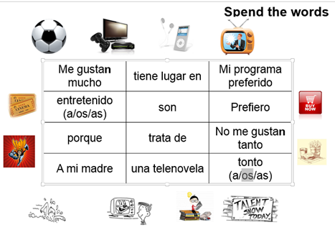
Spend the word!
Give the students certain words that are more challenging to use either in a discussion task or written task. This provides a challenge and gets them thinking creatively! Students can also set targets for certain words for their partners to use too.

