Slide 1
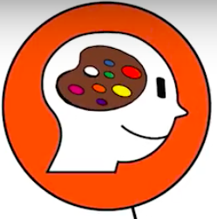
21st Century Skills
Initiative
Persistence/grit
Creativity
Critical Thinking
Curiosity
Initiative
Leadership
Collaboration
Social and cultural awareness
Social and cultural awareness
Adaptability
Communication
Notes:
CATT

Slide 2
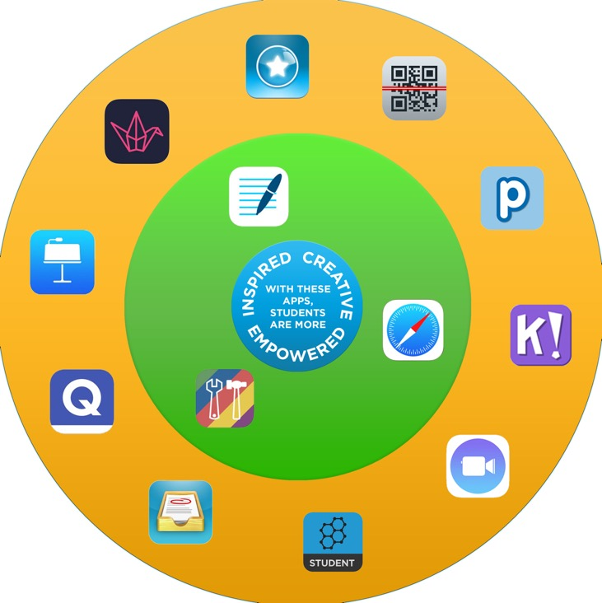
SAMR Model

Slide 3
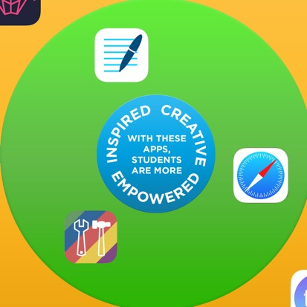
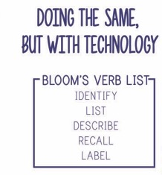
SAMR Model
Starbucks Americano
It’s still coffee: there’s no real change.
Substitution

Slide 4
SAMR Model
Starbucks Iced Coffee
We didn’t change the coffee, but it tastes better because we enhanced it with additional ingredients.
Augmentation

Slide 5
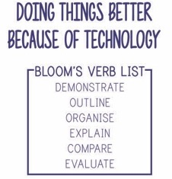
Augmentation

Slide 6
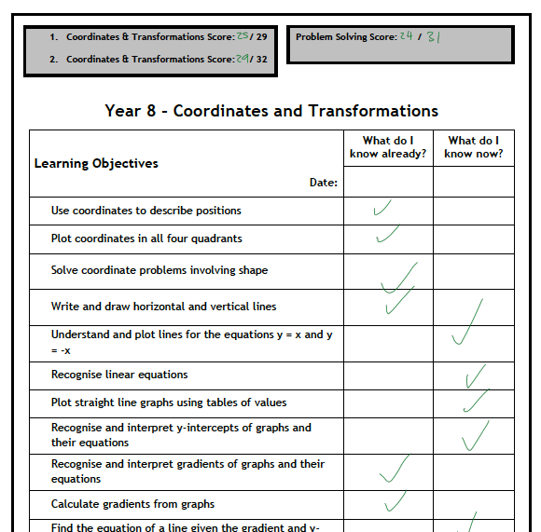
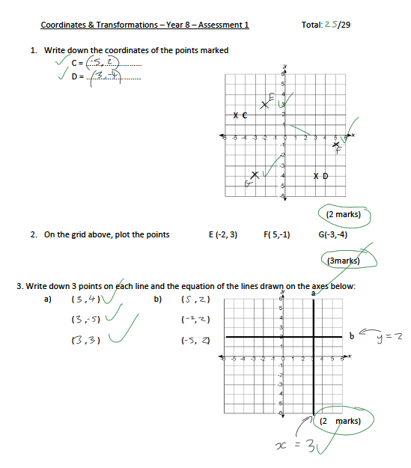
Augmentation

Slide 7
SAMR Model
Starbucks Caramel Coffee Frappe
We add some bells and whistles to the augmented coffee. We add a little whipped cream, caramel syrup, and some special sprinkles on top.
Modification

Slide 8
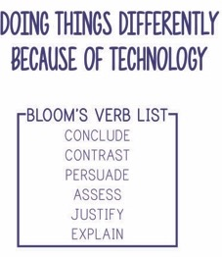
Modification
 | Augmentation | Modification
Writing a piece of work | In Goodnotes - Spell check options given on keyboard. - Extra research on Safari to delve deeper. | In Keynote - Students collaborate to support eachother with their written work, adding to other paragraphs to help improve
Giving feedback to students | Mark on Showbie - Students can access all work whilst you are marking. - Notification once feedback has been given. | Students assess each others work by posting feedback on Padlet. - Refer back to Padlet next time they work on a similar task to act on feedback.
Summarise learning | Popplet app - Photos from Safari added to make it more visual. - Unlimited scale of mind map to allow for lots of links between topics. | Students use iClips at the end of each lesson to summarise what they have learnt. Screen record used to talk about diagrams or text. All videos are combined at end of topic to use as a revision resource.
Collaboration
Communication
Critical Thinking
Creativity

Slide 9
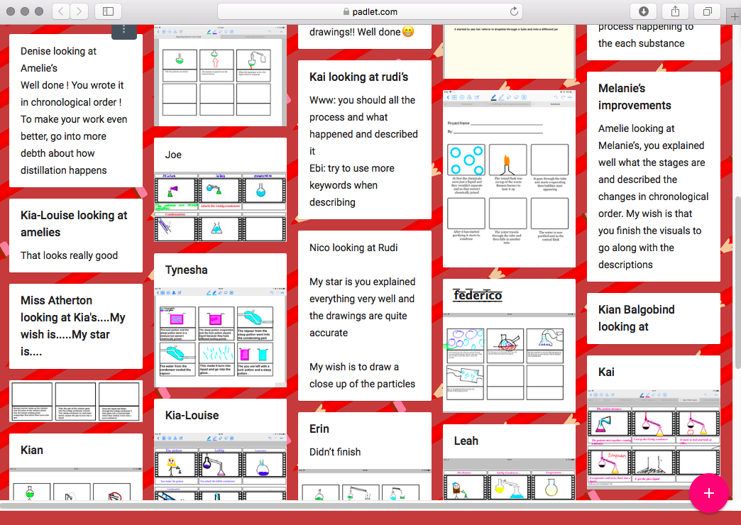
Modification

Slide 10
SAMR Model
Starbucks Pumpkin Spiced Latte
Transforming a regular cup of coffee to something you can only get at Starbucks.
A treat - too many calories to have all the time!
Redefinition

Slide 11
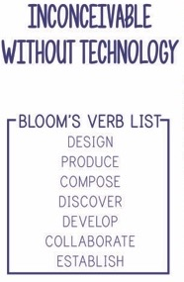
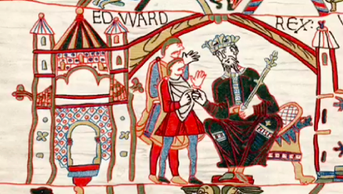
Redefinition
A fantastic video created by year 7 students using iClips that demonstrated their understanding of the Harrowing of the North in History
Notes:
v

Slide 12
Where are you now?
In your own personal use of technology?
Internet
Digital TV
Phone
In your teaching?
Integrating iPads into your planning
Encouraging the development of 21st Century skills

Slide 13
Things to Consider
Are your lessons teacher directed or student directed?
Is there choice in the learning, or is every student doing the same thing/ tackling a problem the same way?
Are the students consumers of information or are they producers of content?
Could you begin transforming learning with revision/summary tasks or HW?
“Simply put, we can’t keep preparing children for a world that doesn’t exist.”
Cathy N Davidson
Notes:
1- are you allowing students to be curious through student led activities?
2- are students given the power of choice - to use their initiative when considering how to tackle a problem?
3- are students able to be creative with their learning?
4- are you giving students the opportunity to collaborate or develop their communication skills either in or outside of the classroom? HWs or summary tasks are the perfect place for this - as long as you give student feedback or share their - this will often be where they are most proud of what they have created

