Slide 1
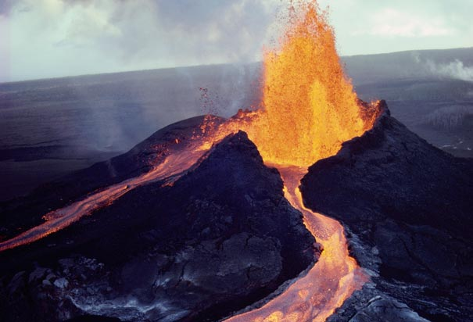
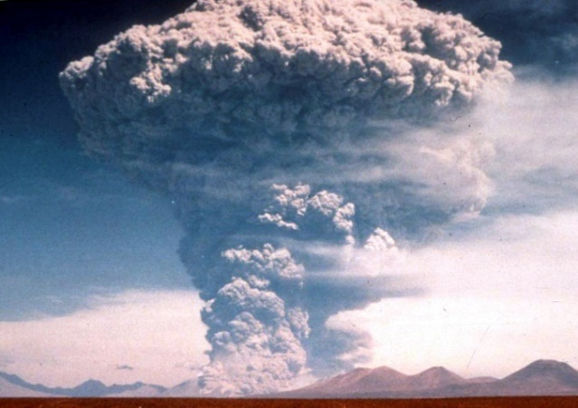
Be able to explain how the type of lava affects the explosivity of volcanoes.
Use these key words to explain why shield volcanoes are less dangerous than composite cone volcanoes. You have 1 minute!
Green words are worth 1 point each.
Orange words are worth 2 points each.
Red words are worth 3 points each.
There is a total of 29 points up for grabs!
Runny
Thick/blocky
Honey
Peanut butter
Gases
Explosive/explosivity
Effusive
Silica
Shield
Composite cone
Subduction zones
Intraplate hot spots
Viscous/viscosity
Andesitic and rhyolitic
Basaltic
Pyroclastic flow
Notes:
Engaged students
Challenge with colours

