Slide 1
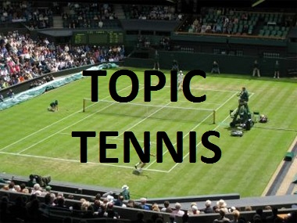
2 players: state words associated with the topic I will give you until your partner cannot go.
Score:
1 point every time the other person can't think of the next word
OR
use Tennis scoring (15 - love, deuce, etc)

