Slide 1



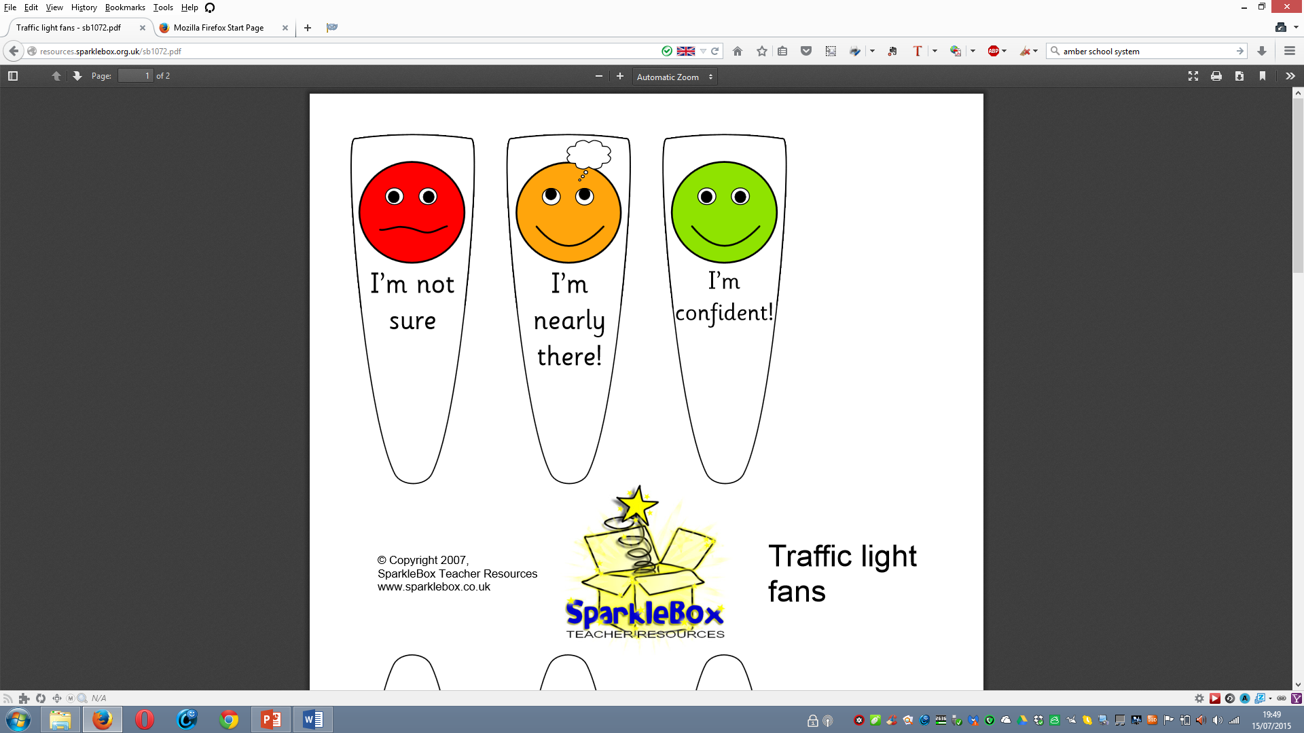
List hashtag keywords below:
#
#
#
Tweet what you have learnt
Could you highlight the keywords (important words) and write a sentence in a form of a tweet in no less than 20 words, what you have learnt.
List hashtag keywords below:
#
#
#
Name:
Write your tweet using the hashtag keywords you identified below:
How do you feel about the topic and explain why below?
Why? -
© Kasim Rashid

