Slide 1
Using Apple Clips in and out of the classroom
AIM: To be able to take away at least 1 practical strategy of how you can use Apple Clips in your teaching
Aaron Jewell

Slide 2
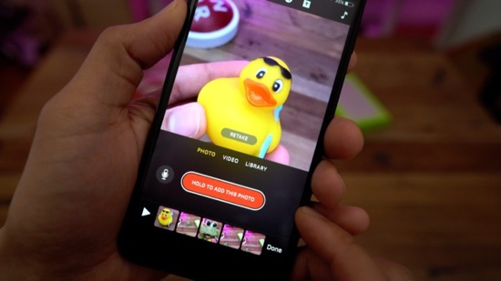
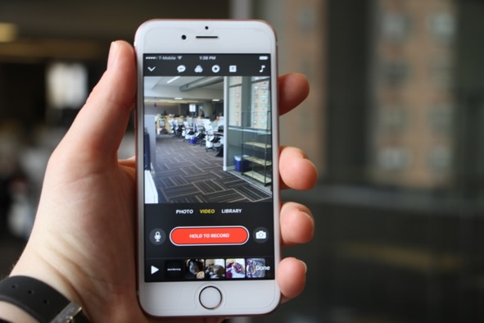
In the classroom...
This App is great for:
Starter recap activities
AFL checks – record answer to key questions and create compilation of lesson
Plenary – what have you learnt summaries
Creative tasks – news reports, field reports, keyword definitions, weather forecasts, etc.
Providing feedback
Explaining topics
Examine and discuss photos

Slide 3
Examples...

Slide 4
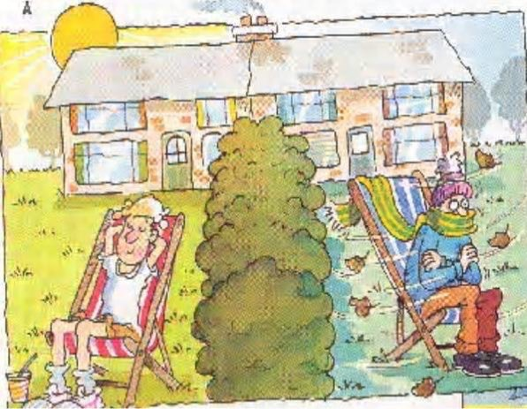
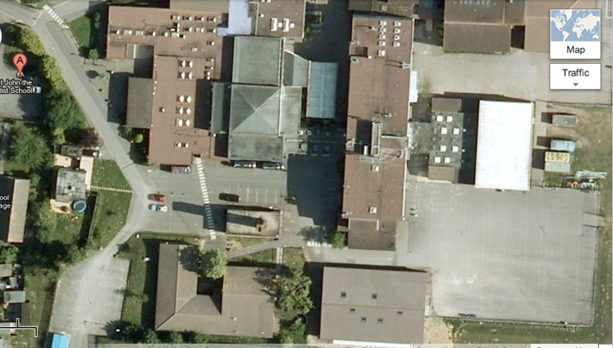
LO3: Validate your predictions by going out to collect real climatic data. (M)
Data Collection
Go and collect the data
Be prepared to analyse what you find and share with the rest of the class
Main block
HALL
Gym
Staff
room
Playground
6th form
Geog / History
Stretch and Challenge:
Can you take more than one measurement at each site and calculate the average?

Slide 5
LO3: Validate your predictions by going out to collect real climatic data. (M)
Data Analysis/Presentation
Choose an app of your choice (e.g. Popplet, Skitch, iMovie, CLIPS etc.)
As a group, you will present your results to the class
You must say why you think the temperature or wind speed changed at different sites
Did it match your predictions?
Stretch and Challenge:
Can you suggest what other data you would collect if you had the chance to do it again?

Slide 6
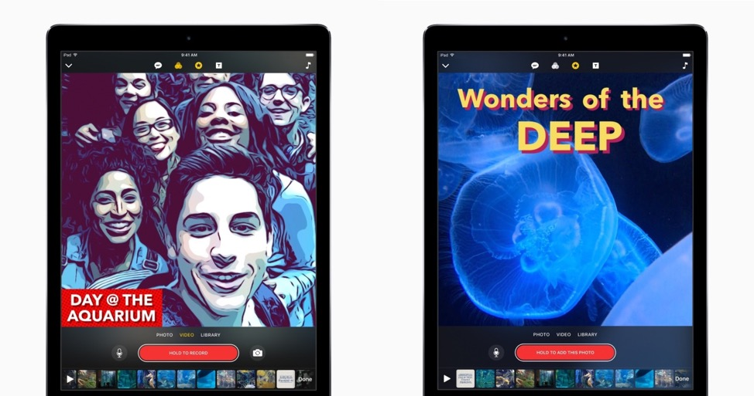
Outside the classroom...
Great for:
Reflective homework’s
Uploading media, vlog based tasks
Recording and commenting firsthand on fieldwork

Slide 7
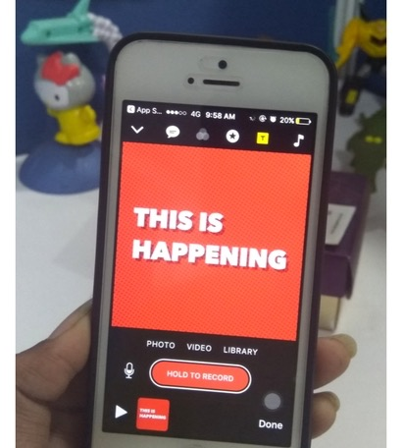
Why Apple Clips is better than iMovie!
Easy to use
Speech to text dictation in real time – up to 36 languages too!
Taps into social media generation with square video format and sharing capabilities- phone friendly
Soundtrack automatically adjusts to speech
Lots of overlays – all of which are animated and customisable
“Like iMovie but with social media style sprinkles throughout” – CNET 3/17

