Slide 1
Year 1 Summer Block 1 Number: Multiplication and Division
Count In Tens
NCLO:
Count in multiples of 2’s 5’s and 10’s.

Slide 2
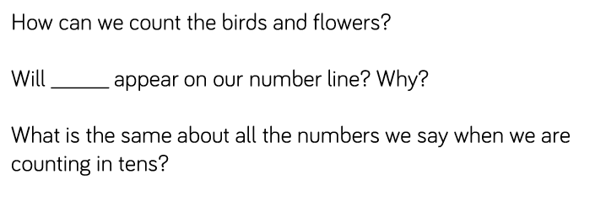
Key vocabulary and questions
Array, Equal, Groups.

Slide 3
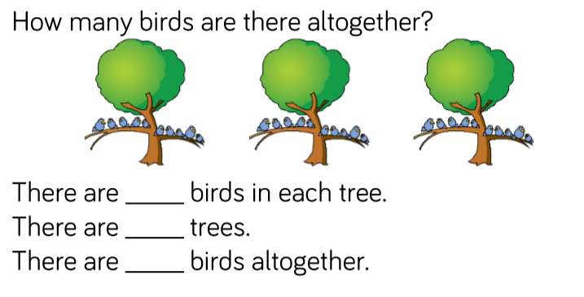
Fluency

Slide 4
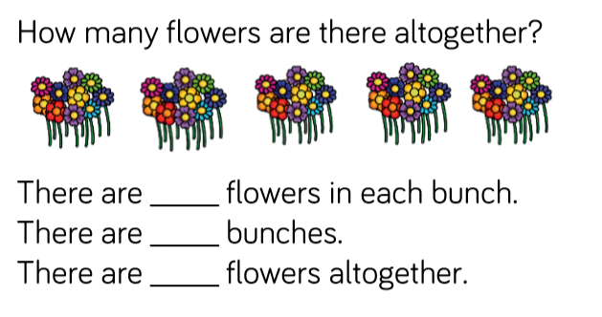
Fluency

Slide 5
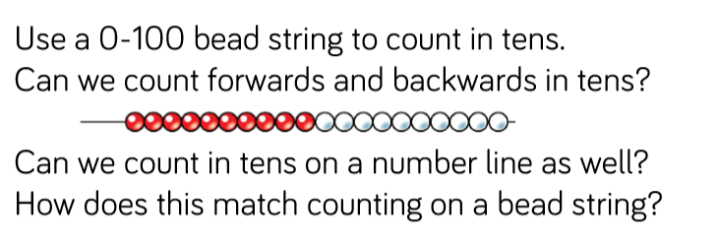
Fluency

Slide 6
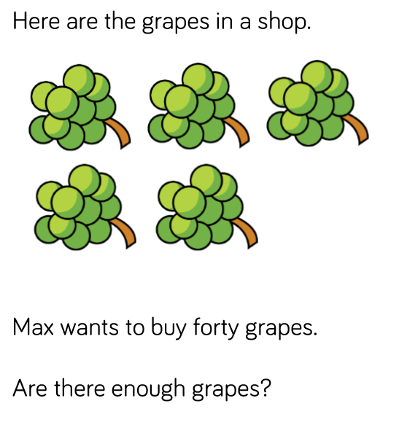
Reasoning and problem solving

Slide 7
Reasoning and problem solving

Slide 8
Year 1 Summer Block 1 Number: Multiplication and Division
Make Equal Groups
NCLO:
Count in multiples of 2’s 5’s and 10’s.

Slide 9
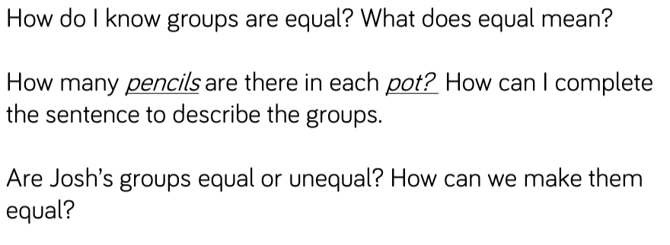
Key vocabulary and questions
Array, Equal, Groups.

Slide 10
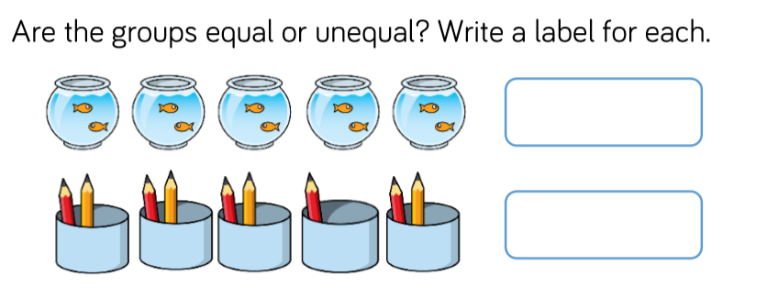
Fluency

Slide 11
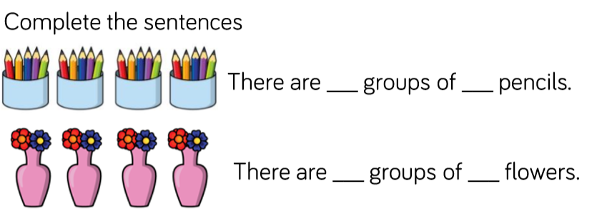
Fluency

Slide 12
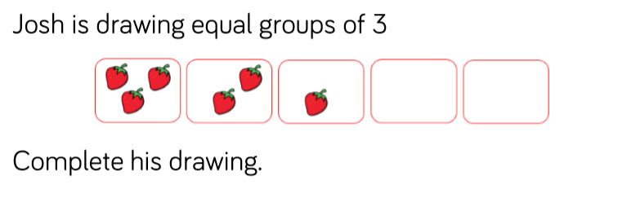
Fluency

Slide 13
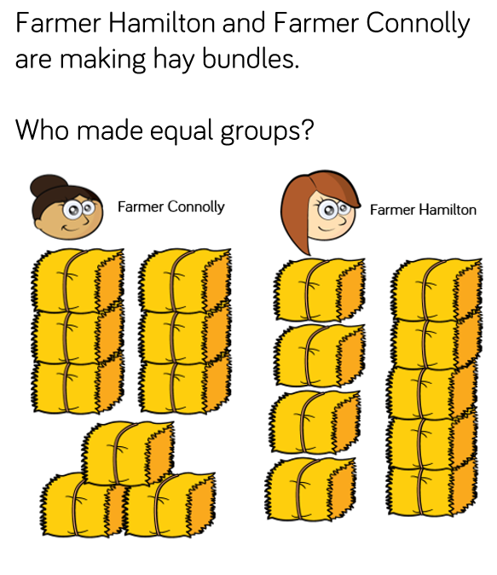
Reasoning and problem solving

Slide 14
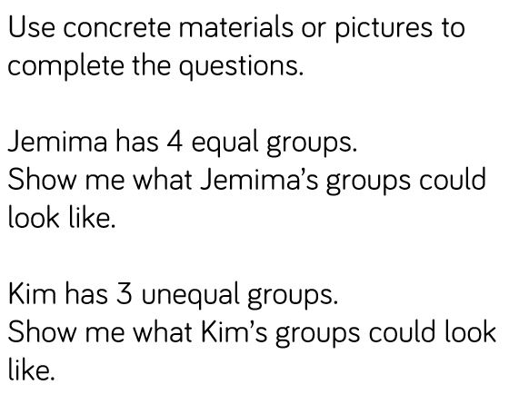
Reasoning and problem solving

Slide 15
Year 1 Summer Block 1 Number: Multiplication and Division
Add equal groups
NCLO:
Count in multiples of 2’s 5’s and 10’s.

Slide 16
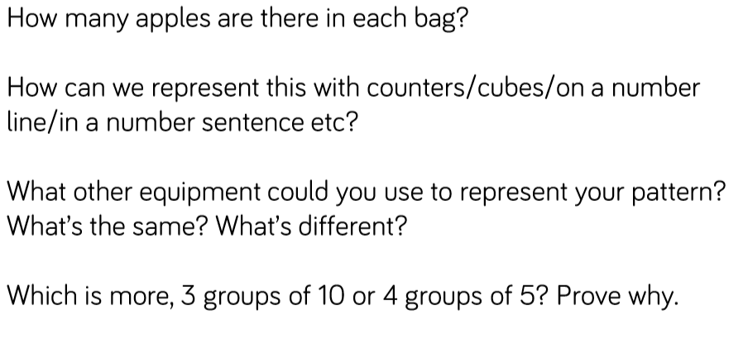
Key vocabulary and questions
Equals, Sharing, Array, Pattern.

Slide 17
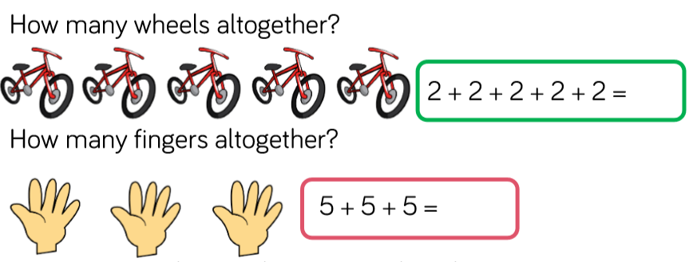
Fluency

Slide 18
Fluency

Slide 19
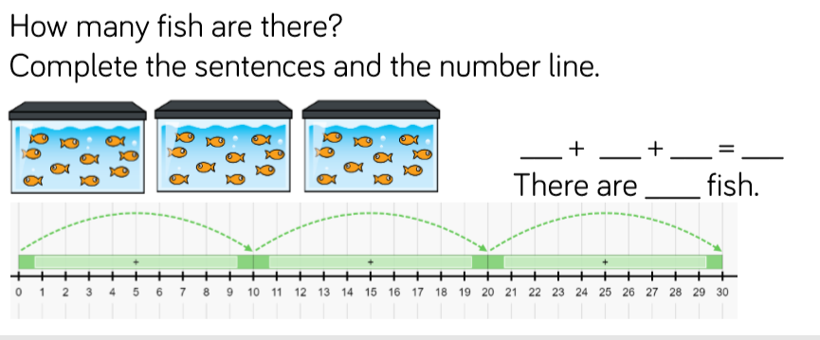
Fluency

Slide 20
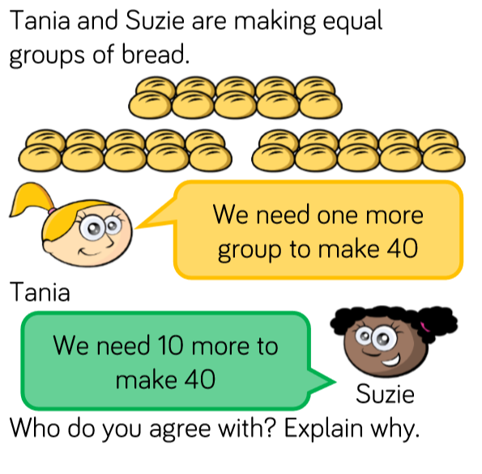
Reasoning and problem solving

Slide 21
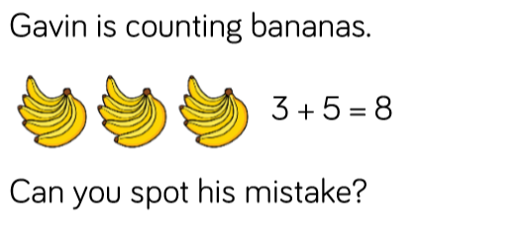
Reasoning and problem solving

Slide 22
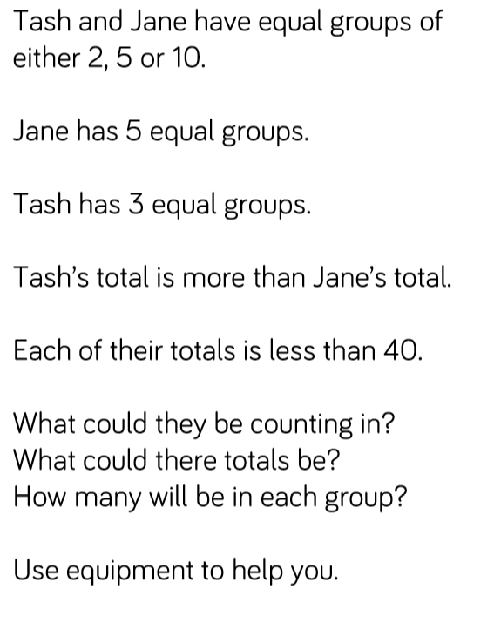
Reasoning and problem solving

Slide 23
Year 1 Summer Block 1 Number: Multiplication and Division
Make Arrays
NCLO:
Count in multiples of 2’s 5’s and 10’s.

Slide 24
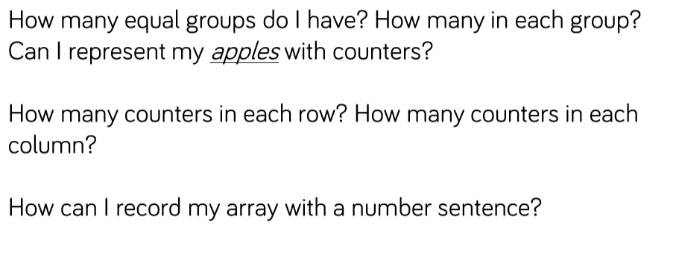
Key vocabulary and questions
Row, Equal, Array,

Slide 25
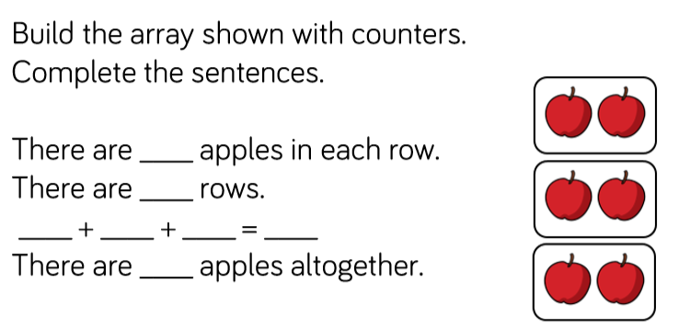
Fluency

Slide 26
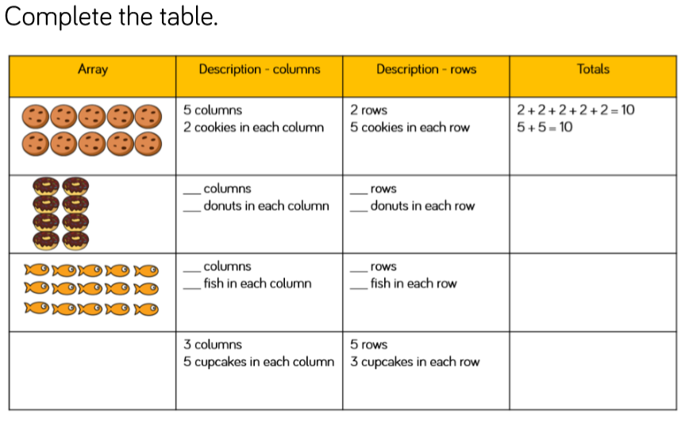
Fluency

Slide 27
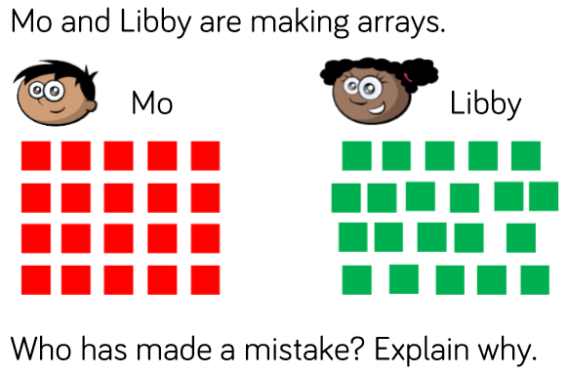
Reasoning and problem solving

Slide 28
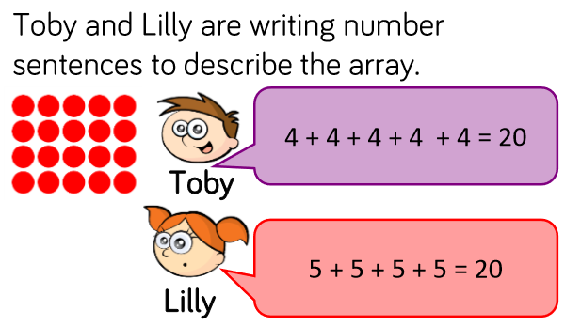
Reasoning and problem solving

Slide 29
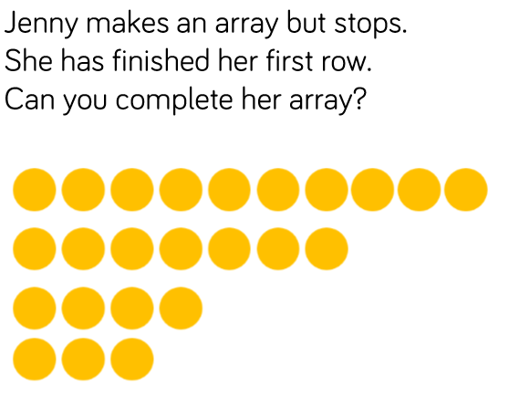
Reasoning and problem solving

Slide 30
Year 1 Summer Block 1 Number: Multiplication and Division
Make Doubles
NCLO:
Count in multiples of 2’s 5’s and 10’s.
Solve one step problems involving multiplication and division, by calculating the answer using concrete objects, pictorial representations and arrays with the support of the teacher.

Slide 31
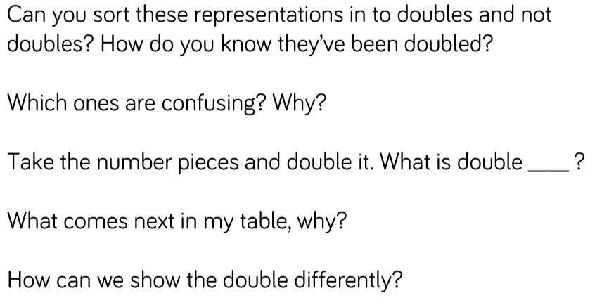
Key vocabulary and questions
Representations, Doubles, Array, Pattern

Slide 32
Fluency

Slide 33
Fluency

Slide 34
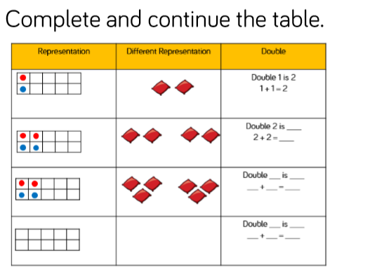
Fluency

Slide 35
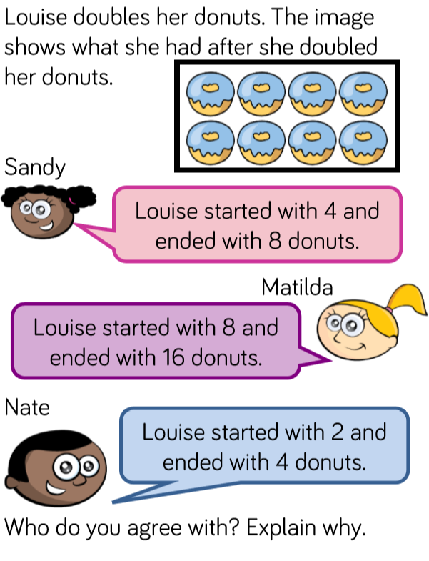
Reasoning and problem solving

Slide 36
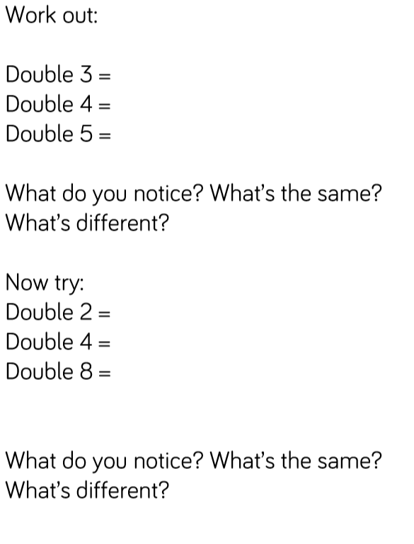
Reasoning and problem solving

Slide 37
Year 1 Summer Block 1 Number: Multiplication and Division
Make Equal Groups Grouping
NCLO:
Solve one step problems involving multiplication and division, by calculating the answer using concrete objects, pictorial representations and arrays with the support of the teacher.
.

Slide 38
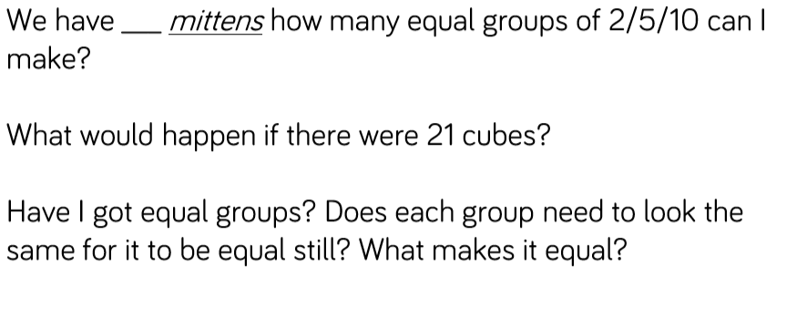
Key vocabulary and questions
Total, Equal, Groups, Array

Slide 39
Fluency

Slide 40
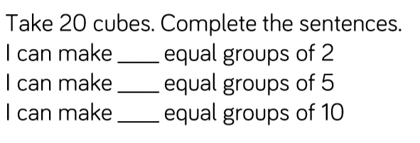
Fluency

Slide 41
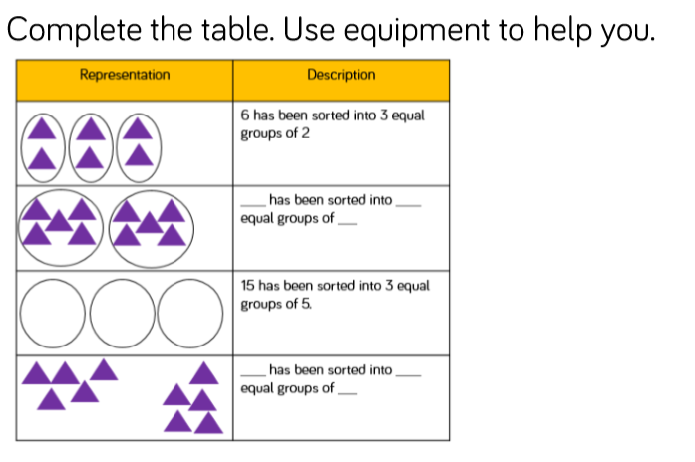
Fluency

Slide 42
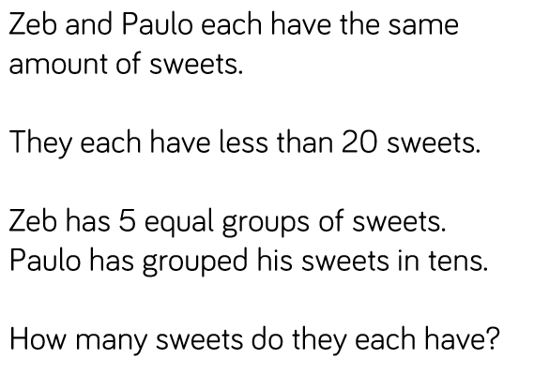
Reasoning and problem solving

Slide 43
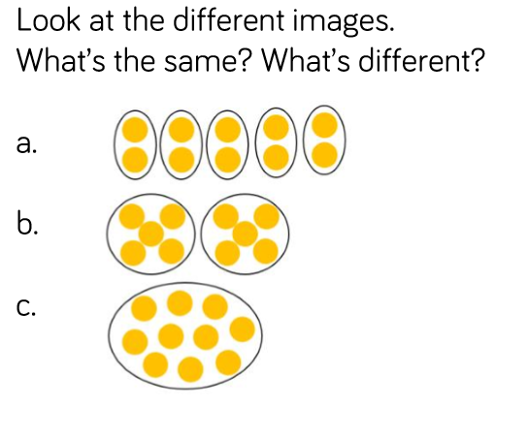
Reasoning and problem solving

Slide 44
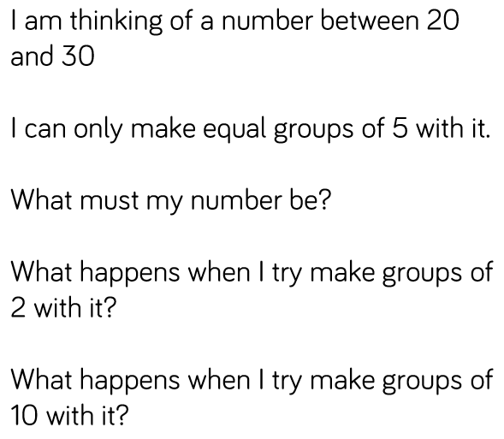
Reasoning and problem solving

Slide 45
Year 1 Summer Block 1 Number: Multiplication and Division
Make Equal Groups Sharing
NCLO:
Solve one step problems involving multiplication and division, by calculating the answer using concrete objects, pictorial representations and arrays with the support of the teacher.

Slide 46
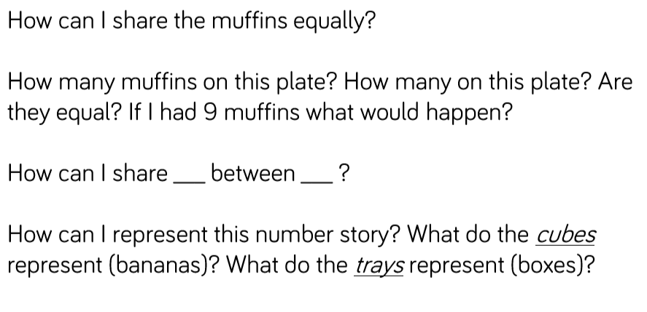
Key vocabulary and questions

Slide 47
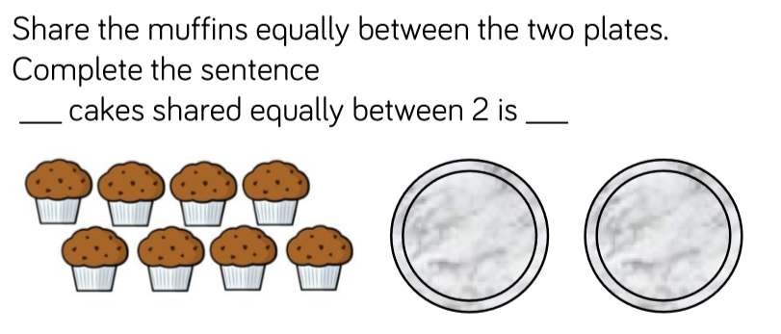
Fluency

Slide 48
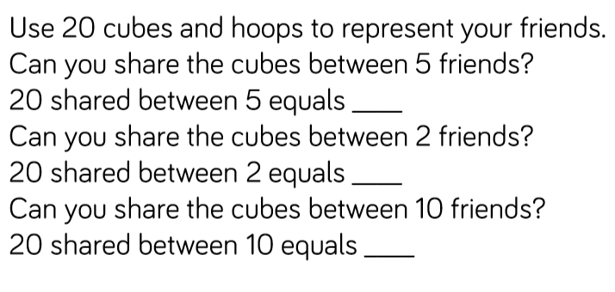
Fluency

Slide 49
Fluency

Slide 50
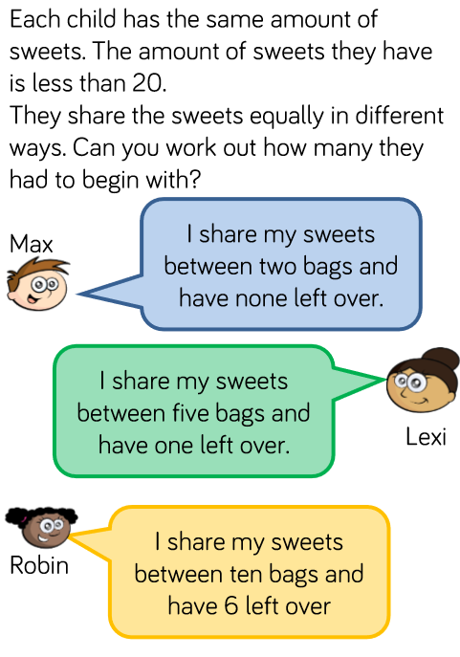
Reasoning and problem solving

Slide 51
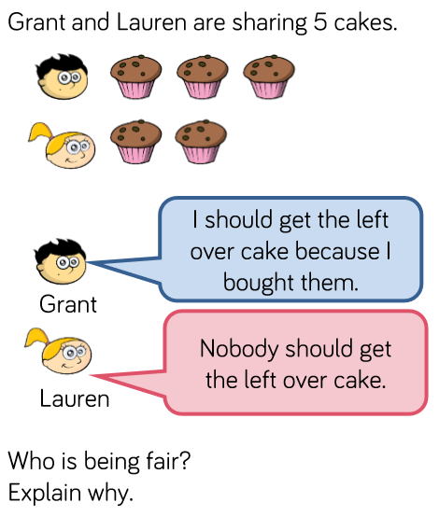
Reasoning and problem solving

