Slide 1
Year 1 Summer Block 3 Position and Direction
Describe Turns
NCLO: use

Slide 2
Key vocabulary and questions

Slide 3
Fluency

Slide 4
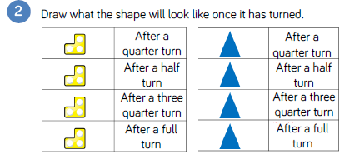
Fluency

Slide 5
Fluency

Slide 6
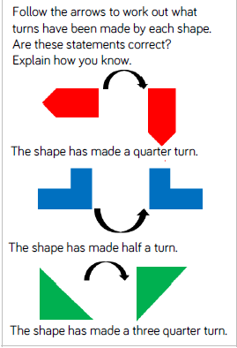
Reasoning and problem solving

Slide 7
Reasoning and problem solving

Slide 8
Year 1 Summer Block 3
Describe Position
NCLO:
.

Slide 9
Key vocabulary and questions

Slide 10
Fluency

Slide 11
Fluency

Slide 12
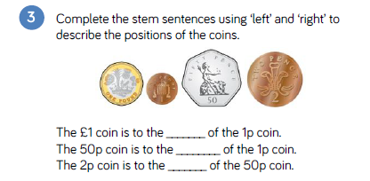
Fluency

Slide 13
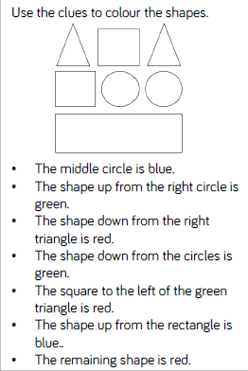
Reasoning and problem solving

Slide 14
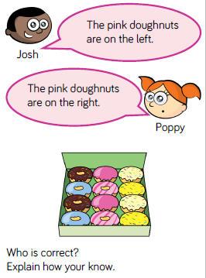
Reasoning and problem solving

Slide 15
Year 1 Summer Block 3
Describe position
NCLO:

Slide 16
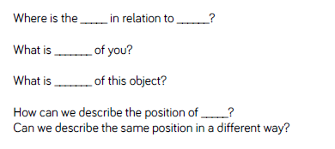
Key vocabulary and questions

Slide 17
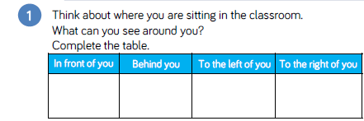
Fluency

Slide 18
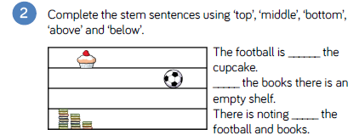
Fluency

Slide 19
Fluency

Slide 20
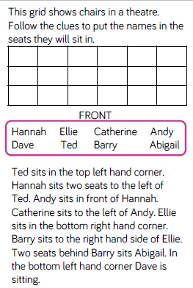
Reasoning and problem solving

Slide 21
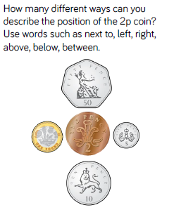
Reasoning and problem solving

