Slide 1
Year 2 Summer Block 1 Position & Direction
Describing Movement
NCLO:
Use mathematical vocabulary to describe movement, including movement in a straight line

Slide 2
Vocabulary
Movement, forwards, backwards, up, down, left, right, movement, straight line.

Slide 3
Key questions
How far have you/has your partner moved?
In what direction have you/has your partner moved?
What direction are we facing in at the start? Why is this important?
Can you describe the movements made by ____?
How could we record these movements?

Slide 4
Fluency
Using the words forwards, backwards, up, down, left and right, give your partner some instructions to complete around the classroom/playground.

Slide 5
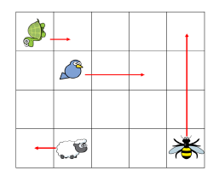
Fluency
Complete the stem sentences to describe the movements made.
The tortoise has moved
1 square _____.
The bee has moved ___
squares ______.
The _____ has moved
1 square backwards.
The ____ has moved ___
squares forwards.

Slide 6
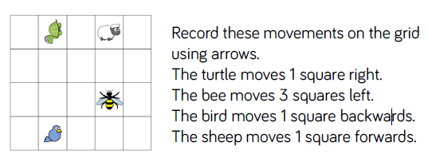
Fluency

Slide 7
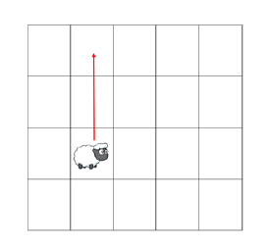
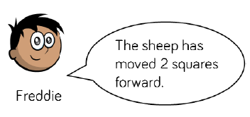
Reasoning and problem solving

Slide 8
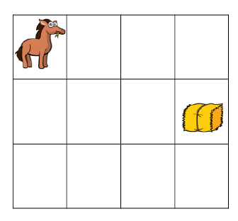
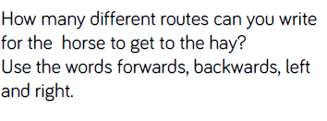
Reasoning and problem solving

Slide 9
Year 2 Summer Block 1 Position & Direction
Describing Turns
NCLO:
Use mathematical vocabulary to describe movement , distinguishing between rotation as a turn and in terms of right angles for quarter, half
and three-quarter turns (clockwise and anti-clockwise).

Slide 10
Vocabulary
Movement, forwards, backwards, up, down, left, right, movement, straight line, direction, clockwise, anti- clockwise, quarter turn, half turn,
three quarter turn, full turn.

Slide 11
Key questions
What is each turn called?
What direction was the turn in?
Can we end up facing the same direction if we started facing different directions?
How far has the shape turned?
What does the shape look like after a turn?

Slide 12
Fluency
Using the words forwards, backwards, up, down, left and right, give your partner some instructions to complete around the classroom/playground.

Slide 13
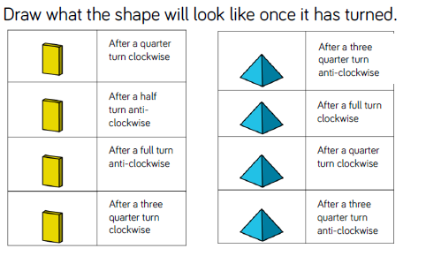
Fluency

Slide 14
Fluency

Slide 15
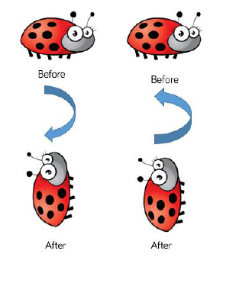
Reasoning and problem solving

Slide 16
Reasoning and problem solving
Always, Sometimes, Never
If two objects turn in different directions they will not be facing the same way.

Slide 17
Year 2 Summer Block 1 Position & Direction
Describing Movement and Turns
NCLO:
Use mathematical vocabulary to describe position, direction and movement including movement in astraight line and distinguishing between rotation as a turn and in terms of right angles for quarter, half and three-quarter turns (clockwiseand anti-clockwise).

Slide 18
Vocabulary
Movement, forwards, backwards, up, down, left, right, movement, straight line, direction, clockwise, anti- clockwise, quarter turn, half turn,
three quarter turn, full turn.

Slide 19
Key questions
Which direction is ____ facing to begin with? Why is this important?
Is ____ moving or just changing direction? How do you know?
How can we record the directions given?
How can we show the difference between a turn and moving?
Is there a more efficient route to take?

Slide 20
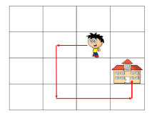
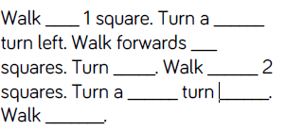
Fluency

Slide 21
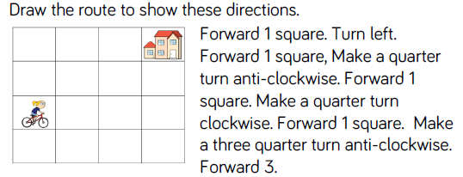
Fluency

Slide 22
Fluency

Slide 23
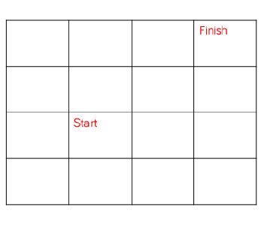
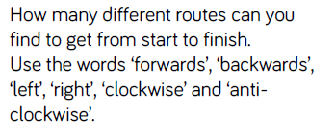
Reasoning and problem solving

Slide 24
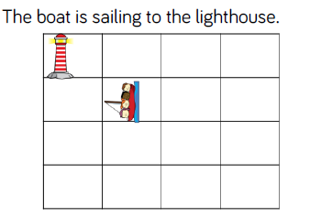
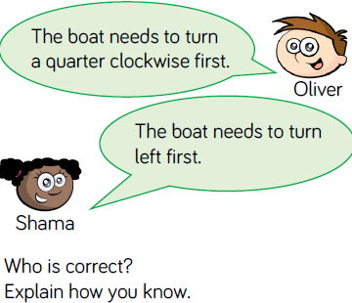
Reasoning and problem solving

Slide 25
Year 2 Summer Block 1 Position & Direction
Making Patterns with Shapes
NCLO:
Order and arrange combinations of
mathematical objects in patterns
and sequences

Slide 26
Vocabulary
Movement, forwards, backwards, up, down, left, right, movement, straight line, direction, clockwise, anti- clockwise, quarter turn, half turn,
three quarter turn, full turn, describing patterns, repeating patterns.

Slide 27
Key questions
What is happening in the pattern?
What would the next shape look like?
What would the ____ shape be?
How can we work out the missing shape?

Slide 28
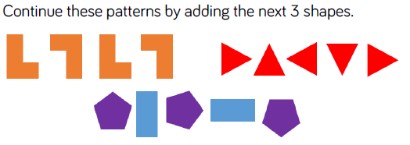
Fluency

Slide 29
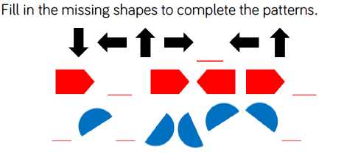
Fluency

Slide 30
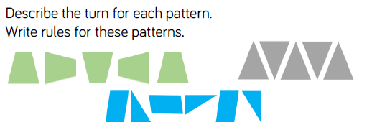
Fluency

Slide 31
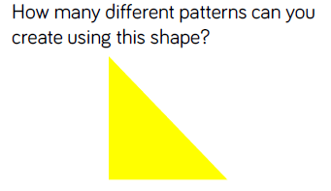
Reasoning and problem solving

Slide 32
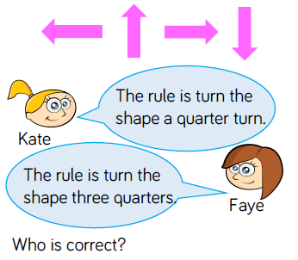
Reasoning and problem solving

Slide 33
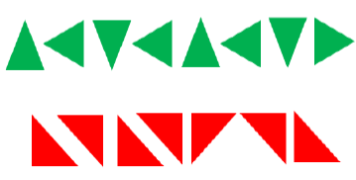
Reasoning and problem solving

