Slide 1
Year 2 Spring Block 2 Statistics
Making tally charts
NCLO: To construct and interpret simple tally charts.

Slide 2
Vocabulary
tally
tally chart
systematic
represent

Slide 3
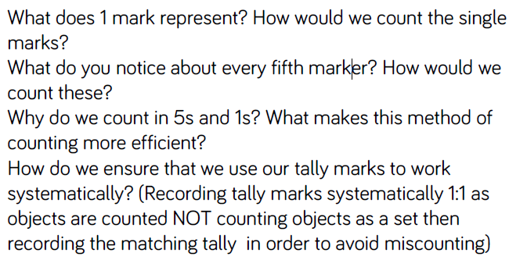
Key vocabulary and questions

Slide 4
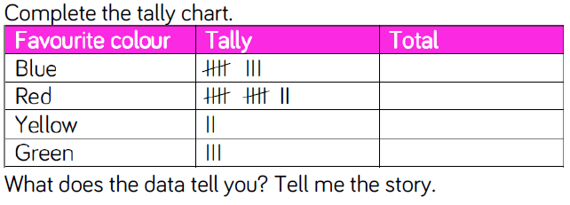
Fluency

Slide 5
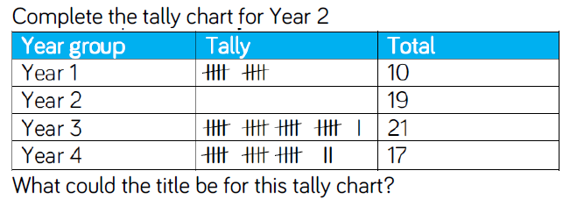
Fluency

Slide 6
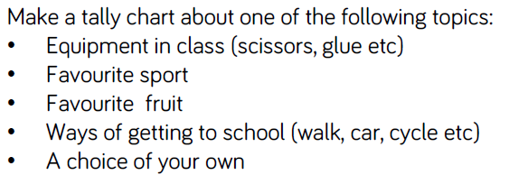
Fluency

Slide 7
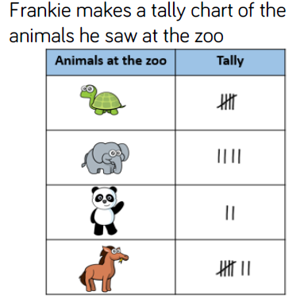
Reasoning and problem solving

Slide 8
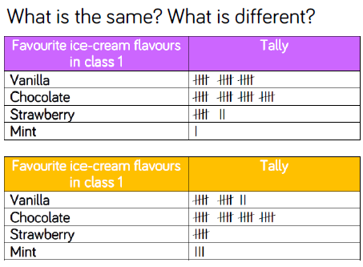
Reasoning and problem solving

Slide 9
Year 2 Spring Block 2 Statistics
Draw pictograms (1-1)
NCLO: To construct and interpret simple pictograms.

Slide 10
Vocabulary
images
pictogram
data

Slide 11
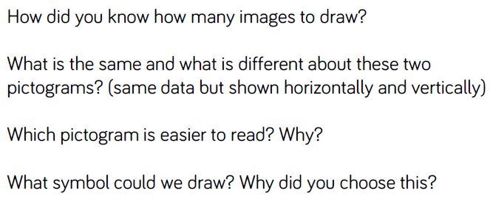
Key vocabulary and questions

Slide 12
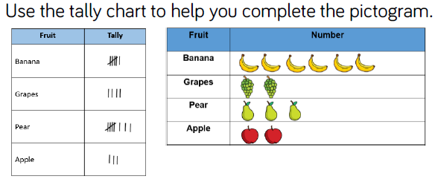
Fluency

Slide 13
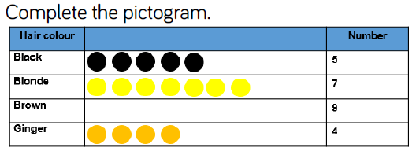
Fluency

Slide 14
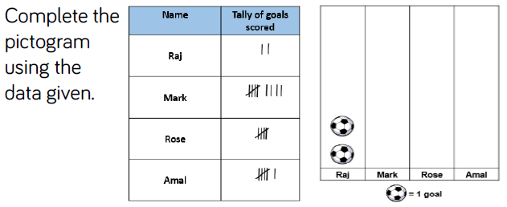
Fluency

Slide 15
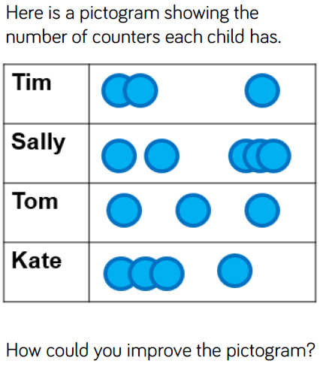
Reasoning and problem solving

Slide 16
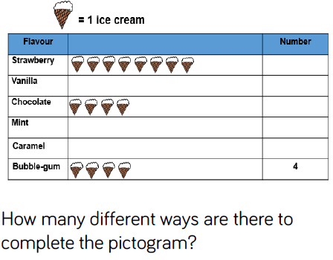
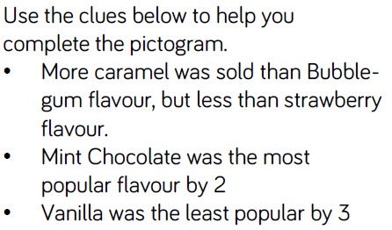
Reasoning and problem solving

Slide 17
Year 2 Spring Block 2 Statistics
Interpret pictograms (1-1)
NCLO: To construct and interpret simple pictograms.

Slide 18
Vocabulary
images
pictogram
data

Slide 19
Key vocabulary and questions

Slide 20
Fluency

Slide 21
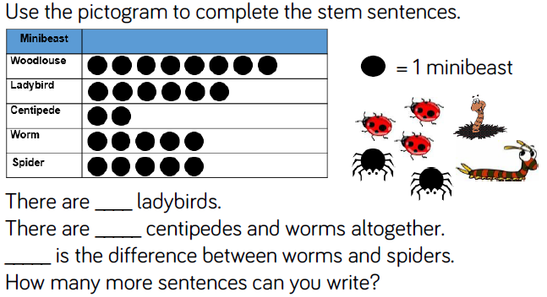
Fluency

Slide 22
Reasoning and problem solving

Slide 23
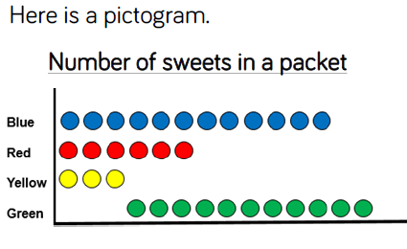
Reasoning and problem solving

Slide 24
Year 2 Spring Block 2 Statistics
Draw pictograms (2,5,10)
NCLO: To ask and answer simple questions by counting the number of objects in each category and sorting the categories by quantity.

Slide 25
Vocabulary
images
pictogram
data
represent
tally

Slide 26
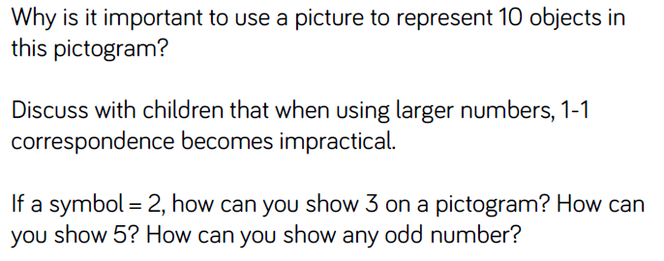
Key vocabulary and questions

Slide 27
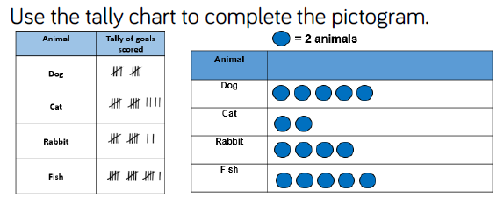
Fluency

Slide 28
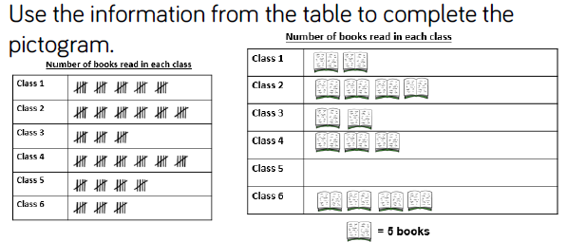
Fluency

Slide 29
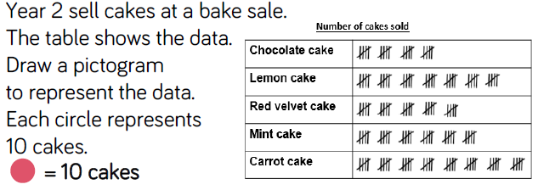
Fluency

Slide 30
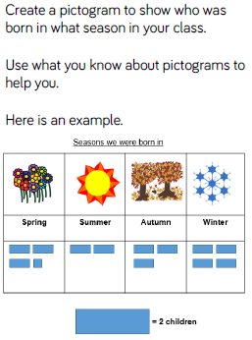
Reasoning and problem solving

Slide 31
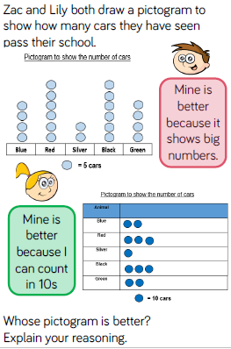
Reasoning and problem solving

Slide 32
Year 2 Spring Block 2 Statistics
Interpret pictograms (2.5.10)
NCLO: To ask and answer questions about totalling and comparing categorical data.

Slide 33
Vocabulary
images
pictogram
data
represent
compare
symbol
difference

Slide 34
Key vocabulary and questions

Slide 35
Fluency

Slide 36
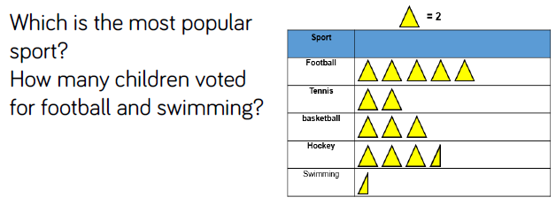
Fluency

Slide 37
Fluency

Slide 38
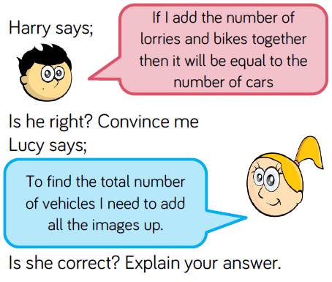
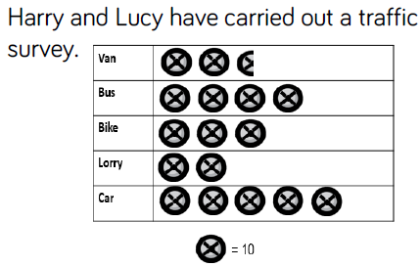
Reasoning and problem solving

Slide 39
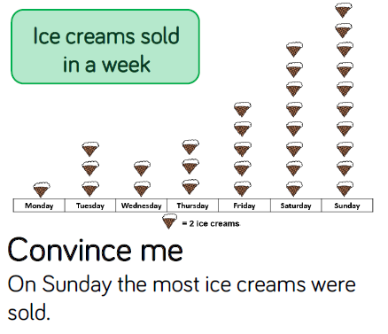
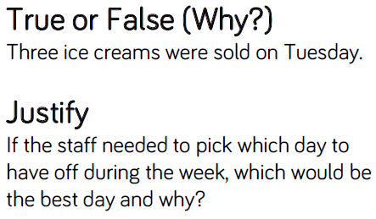
Reasoning and problem solving

Slide 40
Year 2 Spring Block 2 Statistics
Block diagrams
NCLO: To interpret and construct simple block diagrams.

Slide 41
Vocabulary
block diagram
data
represent
scale
results

Slide 42
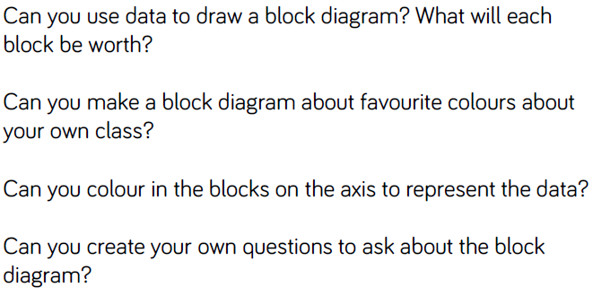
Key vocabulary and questions

Slide 43
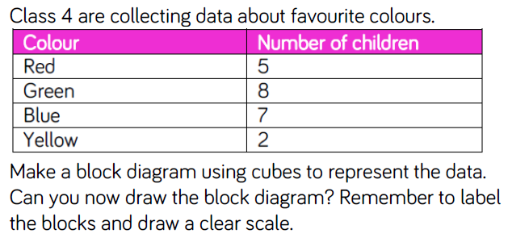
Fluency

Slide 44
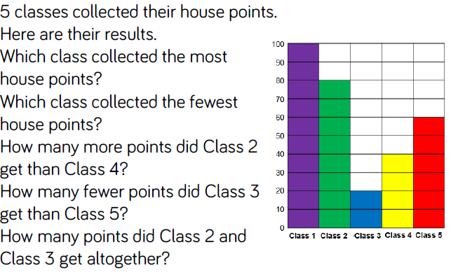
Fluency

Slide 45
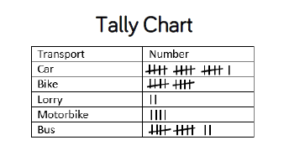
Reasoning and problem solving

Slide 46
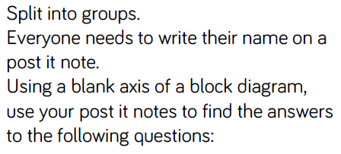
Reasoning and problem solving

