Slide 1
Year 2 Spring Block 3 Geometry – Properties of Shape
Recognise 2D and 3D Shape
NCLO: To identify and describe the properties of 2D shape, including the number of sides and line symmetry in a vertical line

Slide 2
Vocabulary
2 dimensional (2D)
3 dimensional (3D)
Faces

Slide 3
Key vocabulary and questions

Slide 4
Fluency

Slide 5
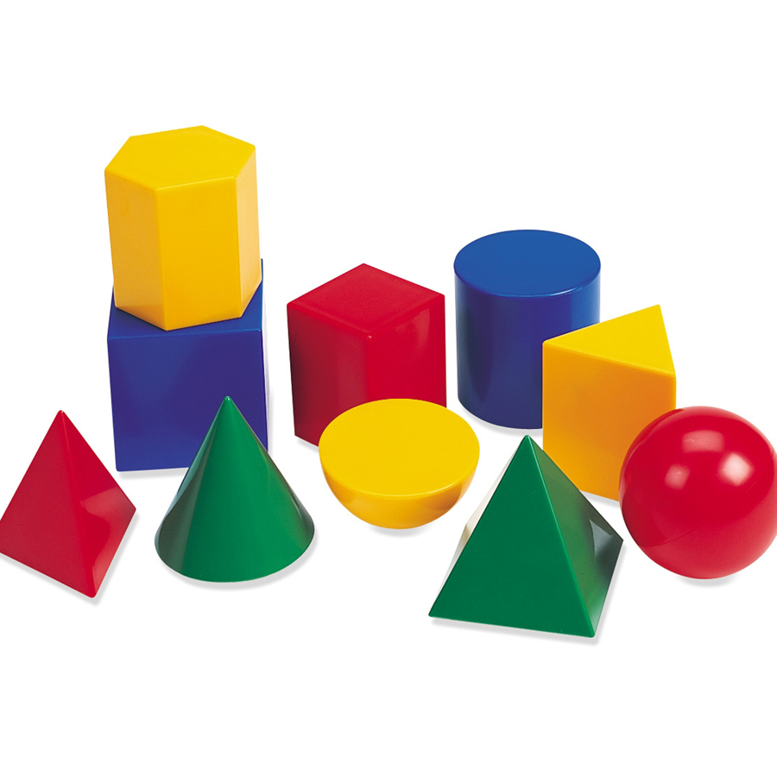
Fluency

Slide 6
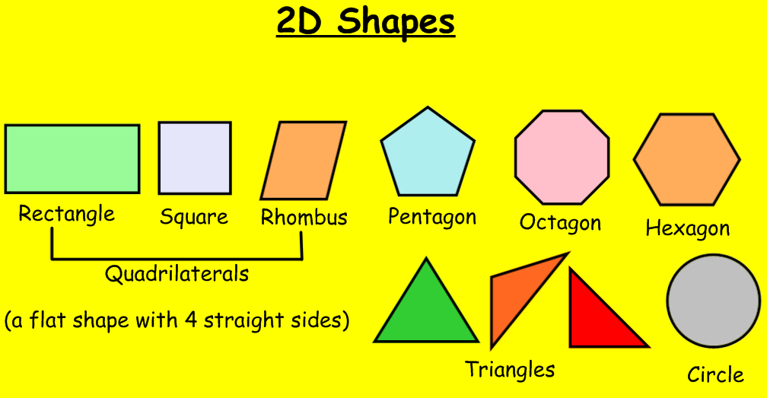
Fluency

Slide 7
Reasoning and problem solving

Slide 8
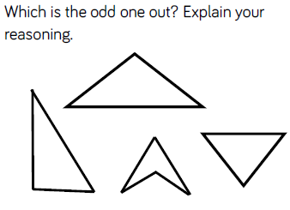
Reasoning and problem solving

Slide 9
Year 2 Spring Block 3 Geometry – Properties of Shape
Count sides on 2D shapes
NCLO:To identify and describe the properties of 2D shape, including the number of sides and line symmetry in a vertical line

Slide 10
Vocabulary
Side
Straight
Curved

Slide 11
Key vocabulary and questions

Slide 12
Fluency

Slide 13
Fluency

Slide 14
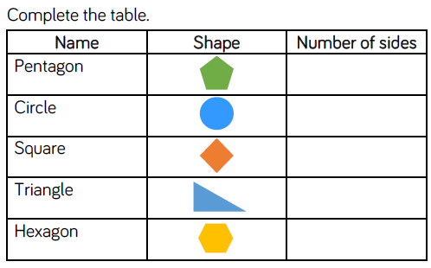
Fluency

Slide 15
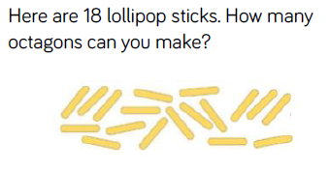
Reasoning and problem solving

Slide 16
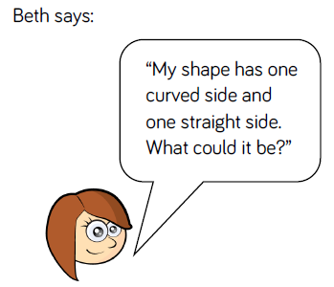
Reasoning and problem solving

Slide 17
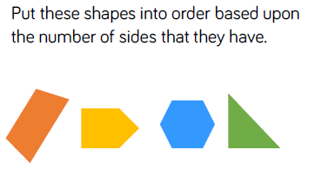
Reasoning and problem solving

Slide 18
Year 2 Spring Block 3 Geometry – Properties of Shape
Count vertices on 2D shapes
NCLO:To identify and describe the properties of 2D shape, including the number of sides and line symmetry in a vertical line

Slide 19
Vocabulary
Vertex
Vertices

Slide 20
Key vocabulary and questions

Slide 21
Fluency

Slide 22
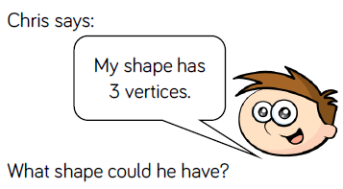
Fluency

Slide 23
Fluency

Slide 24
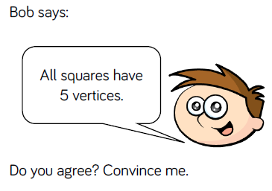
Reasoning and problem solving

Slide 25
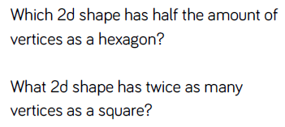
Reasoning and problem solving

Slide 26
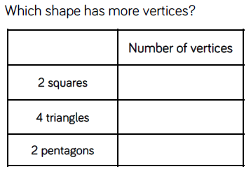
Reasoning and problem solving

