Slide 1
Year 3 Autumn Block 1 Place Value
Hundreds
NCLO: To find 100 more or less than a given number.

Slide 2
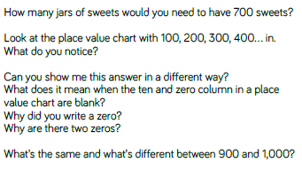
Key vocabulary and questions

Slide 3
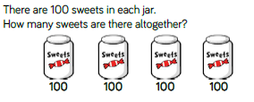
Fluency

Slide 4
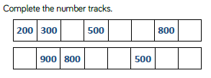
Fluency

Slide 5
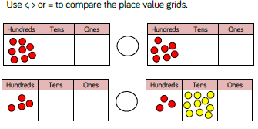
Fluency

Slide 6
Reasoning and problem solving

Slide 7
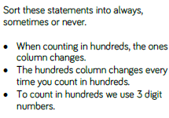
Reasoning and problem solving

Slide 8
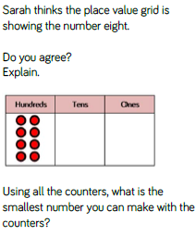
Reasoning and problem solving

Slide 9
Year 3 Autumn Block 1 Place Value
Numbers to 1,000
NCLO: To identify, represent and estimate numbers using different representations.

Slide 10
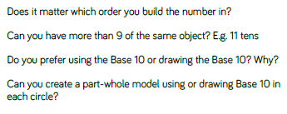
Key vocabulary and questions

Slide 11
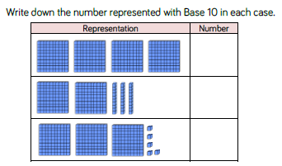
Fluency

Slide 12
Fluency

Slide 13
Fluency

Slide 14
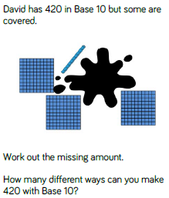
Reasoning and problem solving

Slide 15
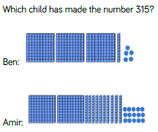
Reasoning and problem solving

Slide 16
Year 3 Autumn Block 1 Place Value
100s, 10s, 1s
NCLO: To identify, represent and estimate numbers using different representations.

Slide 17
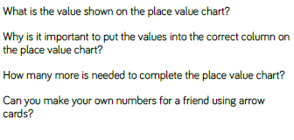
Key vocabulary and questions

Slide 18
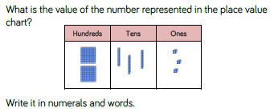
Fluency

Slide 19
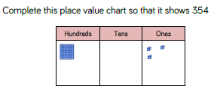
Fluency

Slide 20
Fluency

Slide 21
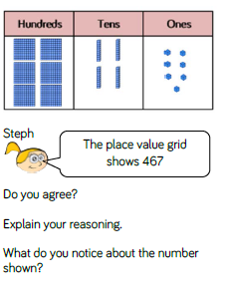
Reasoning and problem solving

Slide 22
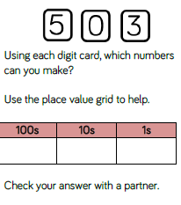
Reasoning and problem solving

Slide 23
Year 3 Autumn Block 1 Place Value
100s, 10s, 1s
NCLO: To identify, represent and estimate numbers using different representations.

Slide 24
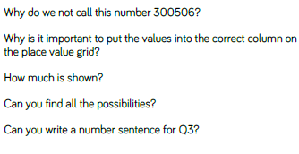
Key vocabulary and questions

Slide 25
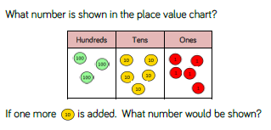
Fluency

Slide 26
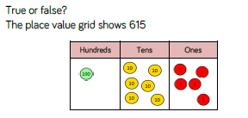
Fluency

Slide 27
Fluency

Slide 28
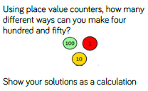
Reasoning and problem solving

Slide 29
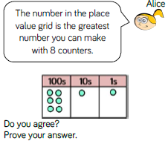
Reasoning and problem solving

Slide 30
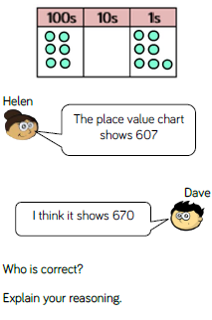
Reasoning and problem solving

Slide 31
Year 3 Autumn Block 1 Place Value
Number line to 1,00
NCLO: To compare and order numbers up to 1,000

Slide 32
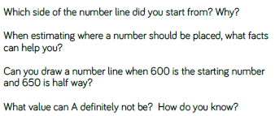
Key vocabulary and questions

Slide 33
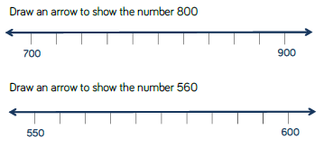
Fluency

Slide 34
Fluency

Slide 35
Fluency

Slide 36
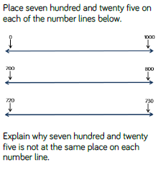
Reasoning and problem solving

Slide 37
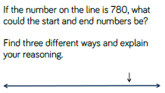
Reasoning and problem solving

Slide 38
Year 3 Autumn Block 1 Place Value
1, 10, 100 more or less
NCLO: Find 1, 10, or 100 more or less than a given number.

Slide 39
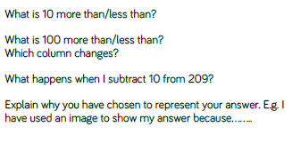
Key vocabulary and questions

Slide 40
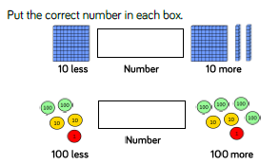
Fluency

Slide 41
Fluency

Slide 42
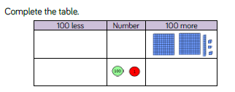
Fluency

Slide 43
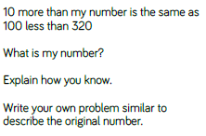
Reasoning and problem solving

Slide 44
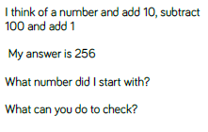
Reasoning and problem solving

Slide 45
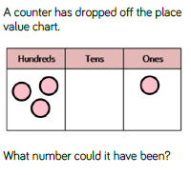
Reasoning and problem solving

Slide 46
Year 3 Autumn Block 1 Place Value
Comparing Objects
NCLO: To compare numbers up to 1,000.

Slide 47
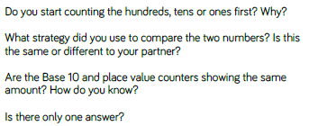
Key vocabulary and questions

Slide 48
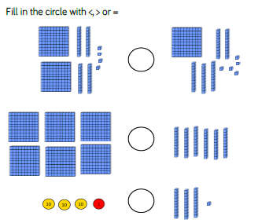
Fluency

Slide 49
Fluency

Slide 50
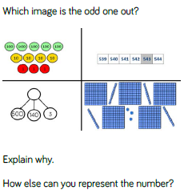
Reasoning and problem solving

Slide 51
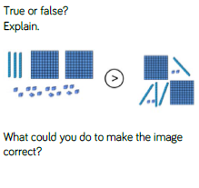
Reasoning and problem solving

Slide 52
Year 3 Autumn Block 1 Place Value
Comparing Numbers
NCLO: To compare numbers up to 1,000.

Slide 53
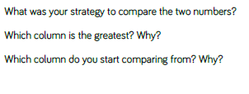
Key vocabulary and questions

Slide 54
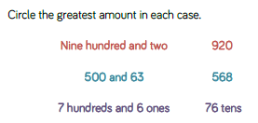
Fluency

Slide 55
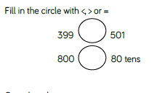
Fluency

Slide 56
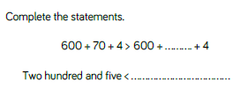
Fluency

Slide 57
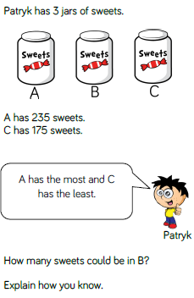
Reasoning and problem solving

Slide 58
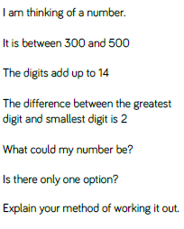
Reasoning and problem solving

Slide 59
Year 3 Autumn Block 1 Place Value
Ordering Numbers
NCLO: To compare and order numbers up to 1,000

Slide 60
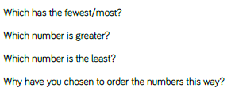
Key vocabulary and questions

Slide 61
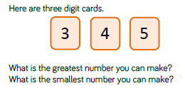
Fluency

Slide 62
Fluency

Slide 63
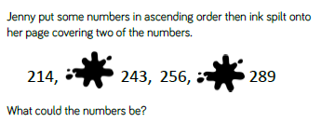
Fluency

Slide 64
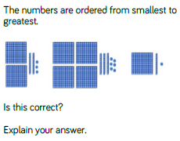
Reasoning and problem solving

Slide 65
Reasoning and problem solving

Slide 66
Year 3 Autumn Block 1 Place Value
Count in 50s
NCLO: To count in multiples of 50.

Slide 67
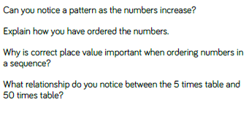
Key vocabulary and questions

Slide 68
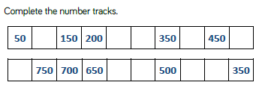
Fluency

Slide 69
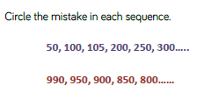
Fluency

Slide 70
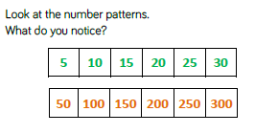
Fluency

Slide 71
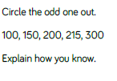
Reasoning and problem solving

Slide 72
Reasoning and problem solving

Slide 73
Reasoning and problem solving

Slide 74
Reasoning and problem solving

