Slide 1
Year 3 Block 2 Addition and Subtraction

Slide 2
Year 3 Block 2 Addition and Subtraction
WHITE ROSE SMALL STEP-Add and subtract multiples of 100.
NCLO: Add and subtract numbers with up to three digits.

Slide 3
Key vocabulary and questions
Add, subtract, ones, tens, hundreds, equal

Slide 4
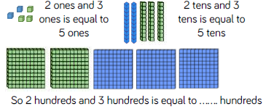
Fluency

Slide 5
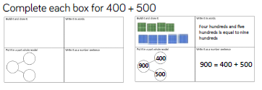
Fluency

Slide 6
Fluency

Slide 7
Reasoning and problem solving

Slide 8
Reasoning and problem solving

Slide 9
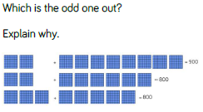
Reasoning and problem solving

Slide 10
Year 3 Block 2 Addition and Subtraction
WHITE ROSE SMALL STEP-Add and subtract 3-digit numbers and ones – not crossing 10.
NCLO: Add and subtract numbers with up to 3-digits, using formal written methods.

Slide 11
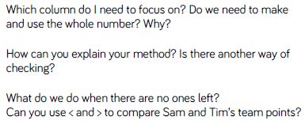
Key vocabulary and questions
Column, method, < > .

Slide 12
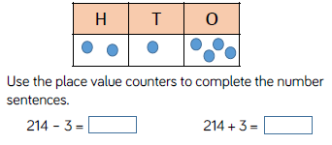
Fluency

Slide 13
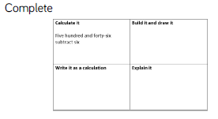
Fluency

Slide 14
Fluency

Slide 15
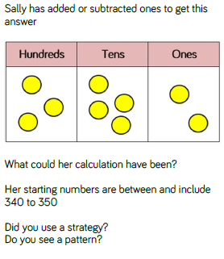
Reasoning and problem solving

Slide 16
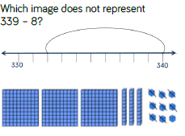
Reasoning and problem solving

Slide 17
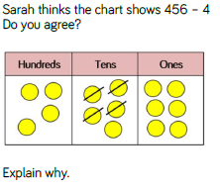
Reasoning and problem solving

Slide 18
Year 3 Block 2 Addition and Subtraction
WHITE ROSE SMALL STEP-Add 3-digit and 1-digit numbers –crossing 10.
NCLO: Add and subtract numbers with up to 3-digits, using formal written methods.

Slide 19
Key vocabulary and questions
Add, subtract, column, ones, tens.

Slide 20
Fluency

Slide 21
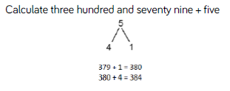
Fluency

Slide 22
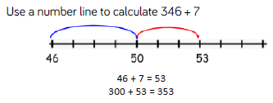
Fluency

Slide 23
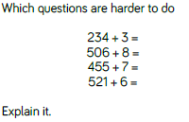
Reasoning and problem solving

Slide 24
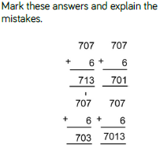
Reasoning and problem solving

Slide 25
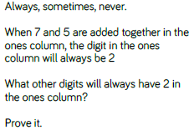
Reasoning and problem solving

Slide 26
Year 3 Block 2 Addition and Subtraction
WHITE ROSE SMALL STEP-Subtract a 1-digit number from a 3-digit number –crossing 10.
NCLO: Subtract numbers with up to 3-digits, using formal written methods.

Slide 27
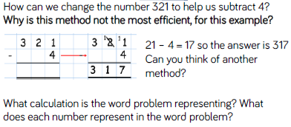
Key vocabulary and questions
Word problem, method, represent, calculation.

Slide 28
Fluency

Slide 29
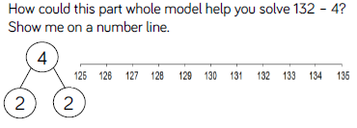
Fluency

Slide 30
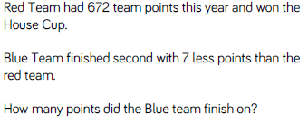
Fluency

Slide 31
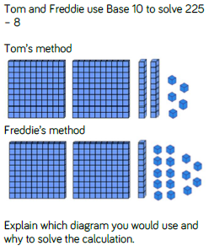
Reasoning and problem solving

Slide 32
Reasoning and problem solving

Slide 33
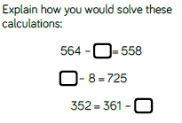
Reasoning and problem solving

Slide 34
Year 3 Block 2 Addition and Subtraction
WHITE ROSE SMALL STEP-Add and subtract 3-digit numbers and tens–crossing 100.
NCLO: Add and subtract numbers with up to 3-digits, using formal written methods.

Slide 35
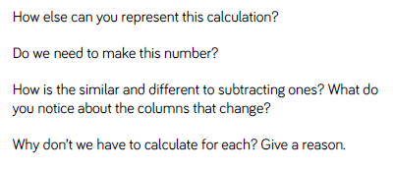
Key vocabulary and questions
Add, subtract, multiple, formal method

Slide 36
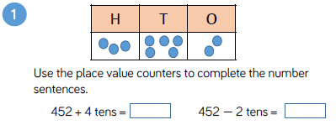
Fluency

Slide 37
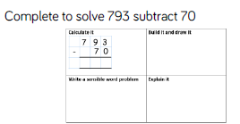
Fluency

Slide 38
Fluency

Slide 39
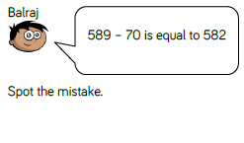
Reasoning and problem solving
Notes:
Tom has subtracted 7
ones instead of 7 tens.

Slide 40
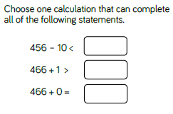
Reasoning and problem solving
Notes:
Possible answers:
496 – 30
406 + 50
416 + 40

Slide 41
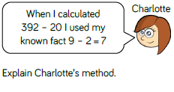
Reasoning and problem solving
Notes:
Charlotte was able to use this fact because 9 tens subtract 2 tens is like doing 9 ones subtract 2 ones.
We do not need to subtract any ones or hundreds so those columns will stay the same.

Slide 42
Year 3 Block 2 Addition and Subtraction
WHITE ROSE SMALL STEP-Add a 3-digit number and tens-crossing 100.
NCLO: Add multiples of 10 to a 3-digit number with exchanging.

Slide 43
Key vocabulary and questions Exchange, inverse

Slide 44
Fluency

Slide 45
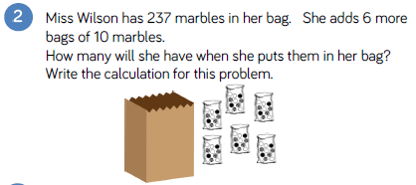
Fluency

Slide 46
Reasoning and problem solving
Notes:
Column addition, count in tens
mentally, add 100 then subtract 10

Slide 47
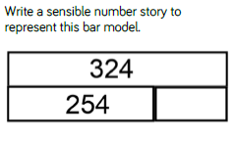
Reasoning and problem solving
Notes:
324 sandwiches are ordered for a school trip.
254 are eaten.
How many are left?

Slide 48
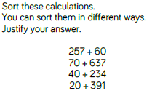
Reasoning and problem solving
Notes:
Possible ways to sort:
Odds and evens
Over and under 500
Exchanging and not exchanging

Slide 49
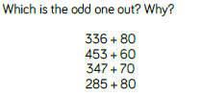
Reasoning and problem solving
Notes:
285 + 80 is the odd one out because in all the others the tens columns add up to 11 tens.

Slide 50
Year 3 Block 2 Addition and Subtraction
WHITE ROSE SMALL STEP-Subtract tens from a 3-digit number crossing 100.
NCLO: To subtract multiples of 10 from a 3-digit number, with exchanging.

Slide 51
Key vocabulary and questions
Number line, part-whole, strategy

Slide 52
Fluency

Slide 53
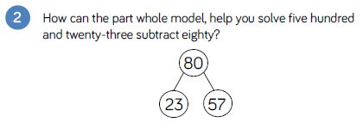
Fluency

Slide 54
Fluency

Slide 55
- 50 = 85
334 - = 294
545 = - 70
Notes:
135 because I know when subtracting a tens number the ones stay the same.
40 because I counted in tens four times from 294
475 because I did the calculation 545 – 70

Slide 56
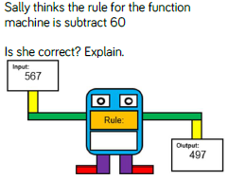
Reasoning and problem solving
Notes:
She is incorrect because 567 – 60 = 507
The rule is subtract 70
I used ____ to help me.

Slide 57
Reasoning and problem solving
Notes:
Possible methods: Count back in 9s
837 – 100 = 737
737 + 10 = 747
90 = 37 and 53 (could show in part whole model)
837 – 37 = 800
800 – 53 = 747
Expanded or formal written methods

Slide 58
Year 3 Block 2 Addition and Subtraction
WHITE ROSE SMALL STEP-Add and subtract 100s.
NCLO: To add and subtract 100s from a 3-digit number.

Slide 59
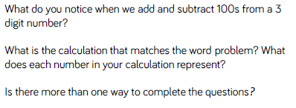
Key vocabulary and questions Digit, word problem, calculation

Slide 60
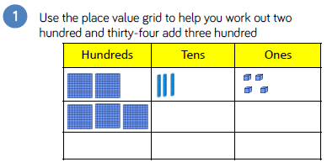
Fluency

Slide 61
Fluency

Slide 62
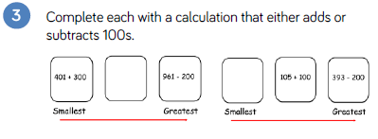
Fluency

Slide 63
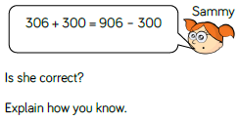
Reasoning and problem solving
Notes:
She is correct because both give an answer of 606

Slide 64
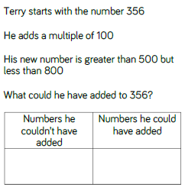
Reasoning and problem solving
Notes:
Couldn’t: 100, 500, 600
Could: 200, 300, 400

Slide 65
Reasoning and problem solving
Notes:
More than: Tim has raised £725. He has raised £300 more than his target. What was his target?
Less than: Amy spent £725 on a laptop. Tina spent £300 on a laptop. How much more does Amy spend?

Slide 66
Year 3 Block 2 Addition and Subtraction
WHITE ROSE SMALL STEP-Spotting patterns.
NCLO: Using number facts, place value and more complex addition and subtraction.

Slide 67
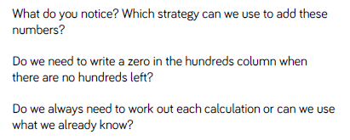
Key vocabulary and questions
Hundreds, column, pattern

Slide 68
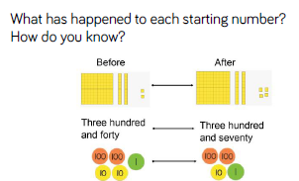
Fluency

Slide 69
Fluency

Slide 70
Fluency

Slide 71
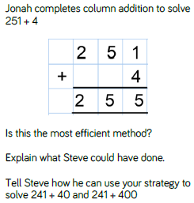
Reasoning and problem solving

Slide 72
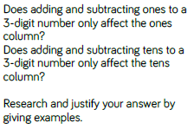
Reasoning and problem solving

Slide 73
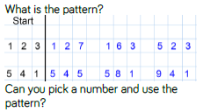
Reasoning and problem solving

Slide 74
Year 3 Block 2 Addition and Subtraction
WHITE ROSE SMALL-Add and subtract a 2-digit and 3-digit number- not crossing 10 or 100.
NCLO: Add and subtract numbers with up to 3-digits, using formal written methods.

Slide 75
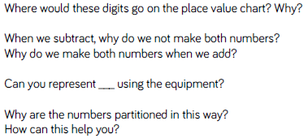
Key vocabulary and questions
Partition, digit, represent, calculation

Slide 76
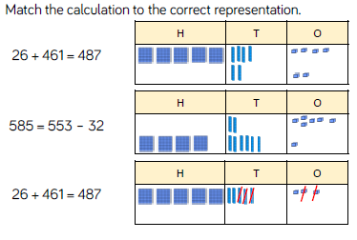
Fluency

Slide 77
Fluency

Slide 78
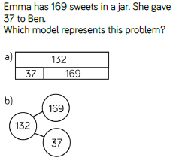
Reasoning and problem solving

Slide 79
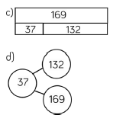
Reasoning and problem solving

Slide 80
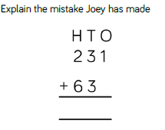
Reasoning and problem solving

Slide 81
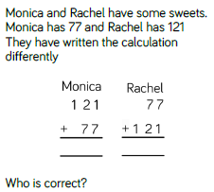
Reasoning and problem solving

Slide 82
Year 3 Block 2 Addition and Subtraction
WHITE ROSE SMALL-Add a 2-digit and 3-digit number- crossing 10 or 100.
NCLO: Add and subtract numbers with up to 3-digits using formal written methods.

Slide 83
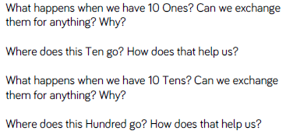
Key vocabulary and questions
Exchange, column addition, bar model

Slide 84
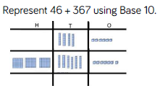
Fluency

Slide 85
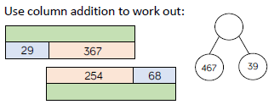
Fluency

Slide 86
Fluency

Slide 87
Reasoning and problem solving

Slide 88
Reasoning and problem solving

Slide 89
Reasoning and problem solving

Slide 90
Year 3 Block 2 Addition and Subtraction
WHITE ROSE SMALL-Subtract a 2-digit number from a 3-digit numbers- cross the 10 or 100.
NCLO: Add numbers with 3-digits using formal written methods.

Slide 91
Key vocabulary and questions
Exchange, ones, column

Slide 92
Fluency

Slide 93
Fluency

Slide 94
Fluency

Slide 95
Reasoning and problem solving

Slide 96
Reasoning and problem solving

Slide 97
Year 3 Block 2 Addition and Subtraction
WHITE ROSE SMALL-Add two 3-digit numbers- not crossing 10 or 100.
NCLO: Add numbers with up to 3-digits using formal written methods.

Slide 98
Key vocabulary and questions
Partition, digit, column

Slide 99
Fluency

Slide 100
Fluency

Slide 101
Fluency

Slide 102
Reasoning and problem solving

Slide 103
Reasoning and problem solving

Slide 104
Reasoning and problem solving

Slide 105
Year 3 Block 2 Addition and Subtraction
WHITE ROSE SMALL-Add two 3-digit number- crossing 10 or 100.
NCLO: Subtract numbers with up to 3-digits, using formal written methods.

Slide 106
Key vocabulary and questions
Place value, partition, digit, exchange

Slide 107
Fluency

Slide 108
Fluency

Slide 109
Fluency

Slide 110
Reasoning and problem solving

Slide 111
Reasoning and problem solving

Slide 112
Year 3 Block 2 Addition and Subtraction
WHITE ROSE SMALL-Subtract a 3-digit number from a 3-digit number- no exchange.
NCLO: Subtract numbers with up to 3-digits, using formal written methods.

Slide 113
Key vocabulary and questions
Difference, calculation, strategy

Slide 114
Fluency

Slide 115
Fluency

Slide 116
Fluency

Slide 117
Reasoning and problem solving

Slide 118
Reasoning and problem solving

Slide 119
Year 3 Block 2 Addition and Subtraction
WHITE ROSE SMALL-Subtract a 3-digit number from a 3-digit number- exchange.
NCLO: Subtract numbers with up to 3-digits, using formal written methods.

Slide 120
Key vocabulary and questions
Estimate, inverse, operation, column, exchange, method, calculation

Slide 121
Fluency

Slide 122
Fluency

Slide 123
Reasoning and problem solving

Slide 124
Reasoning and problem solving

Slide 125
Reasoning and problem solving

Slide 126
Reasoning and problem solving

Slide 127
Year 3 Block 2 Addition and Subtraction
WHITE ROSE SMALL-Estimate answers to calculations.
NCLO: Estimate the answer to a calculation and use inverse operations to check answers.

Slide 128
Key vocabulary and questions
Estimate, ‘near number’

Slide 129
Fluency

Slide 130
Fluency

Slide 131
Fluency

Slide 132
Reasoning and problem solving

Slide 133
Reasoning and problem solving

Slide 134
Year 3 Block 2 Addition and Subtraction
WHITE ROSE SMALL- Check answers.
NCLO: Use inverse operations to check answers.

Slide 135
Key vocabulary and questions
Multiple, bar model

Slide 136
Fluency

Slide 137
Fluency

Slide 138
Fluency

Slide 139
Reasoning and problem solving

Slide 140
Reasoning and problem solving

