Slide 1
Year 3 Spring Block 1 Multiplication and Division
Comparing Statements
NCLO: To recall and use multiplication and division facts for the 3, 4 and 8 x tables.

Slide 2
Vocabulary
multiplication
division
number sentence
array
greater than
less than

Slide 3
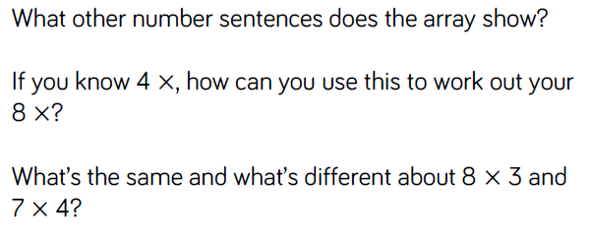
Key vocabulary and questions

Slide 4
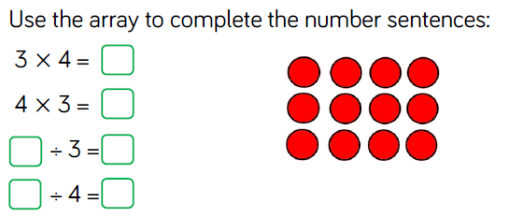
Fluency

Slide 5
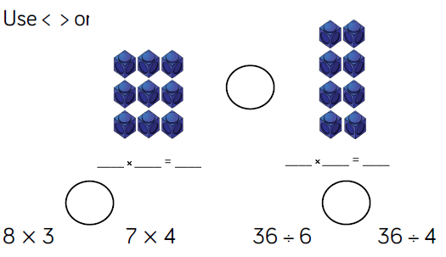
Fluency

Slide 6
Fluency

Slide 7
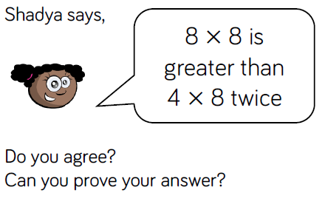
Reasoning and problem solving

Slide 8
Reasoning and problem solving

Slide 9
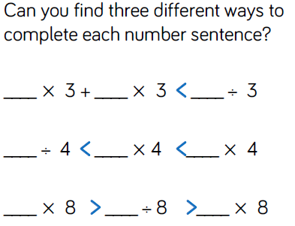
Reasoning and problem solving

Slide 10
Year 3 Spring Block 1 Multiplication and Division
Related calculations
NCLO: To write and calculate mathematical statements for multiplication and division, using the tables we know.

Slide 11
Vocabulary
multiplication
division
number sentence
array
greater than
less than
multiple

Slide 12
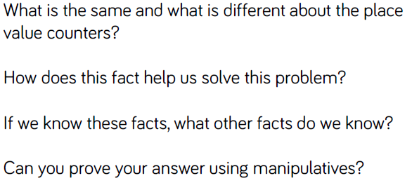
Key vocabulary and questions

Slide 13
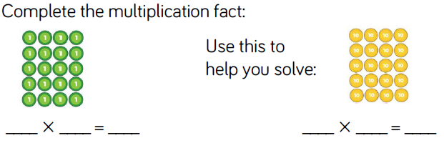
Fluency

Slide 14
Fluency

Slide 15
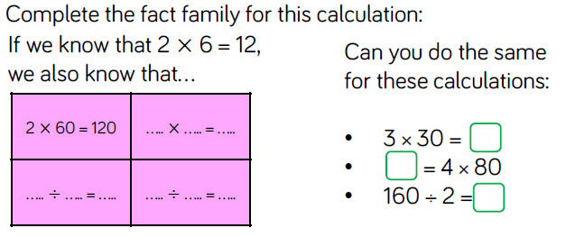
Fluency

Slide 16
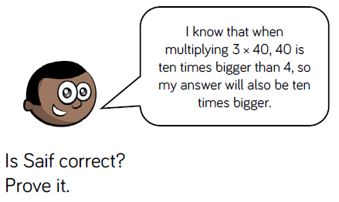
Reasoning and problem solving

Slide 17
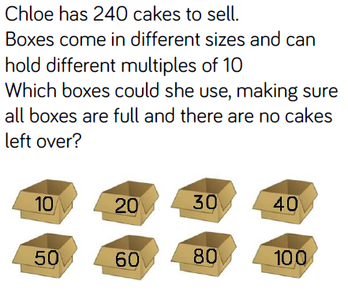
Reasoning and problem solving

Slide 18
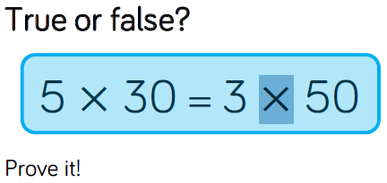
Reasoning and problem solving

Slide 19
Year 3 Spring Block 1 Multiplication and Division
Multiply 2-digits by 1-digit.
NCLO: To multiply using mental methods and progressing to formal written methods.

Slide 20
Vocabulary
multiplication
division
number sentence
array
greater than
less than
multiple

Slide 21
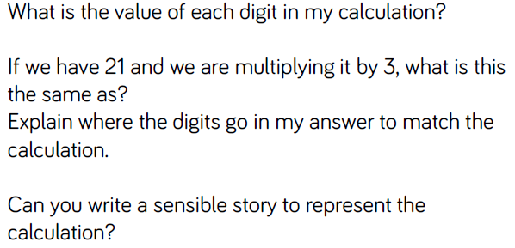
Key vocabulary and questions

Slide 22
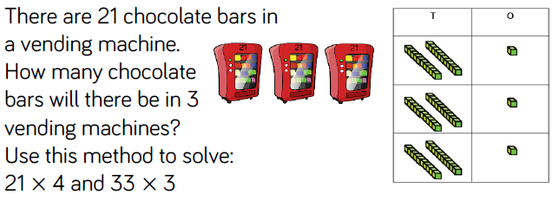
Fluency

Slide 23
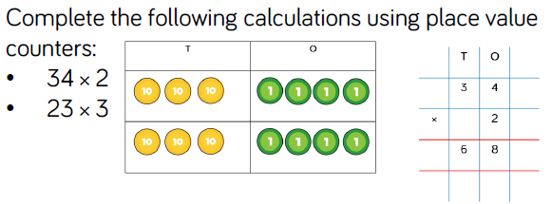
Fluency

Slide 24
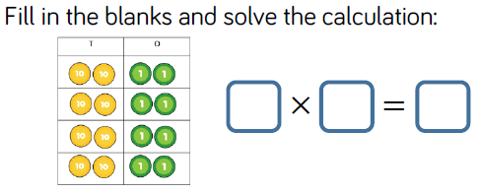
Fluency

Slide 25
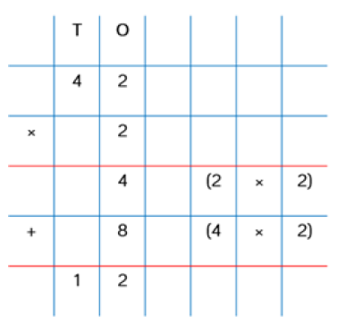
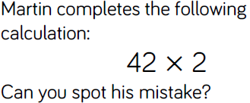
Reasoning and problem solving

Slide 26
Reasoning and problem solving

Slide 27
Reasoning and problem solving

Slide 28
Year 3 Spring Block 1 Multiplication and Division
Multiply 2-digits by 1-digit.
NCLO: To multiply using mental methods and progressing to formal written methods.

Slide 29
Vocabulary
multiplication
division
number sentence
array
greater than
less than
multiple
exchange

Slide 30
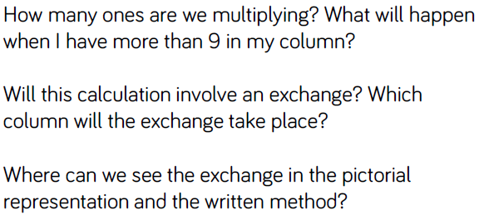
Key vocabulary and questions

Slide 31
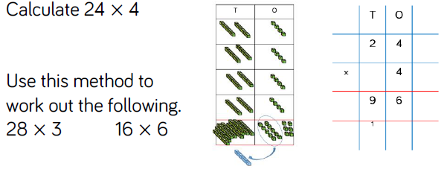
Fluency

Slide 32
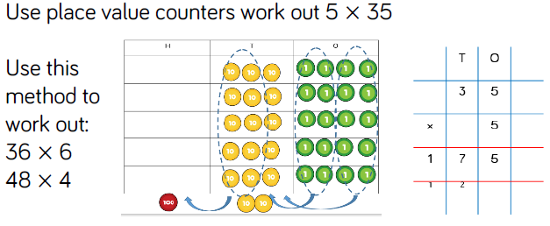
Fluency

Slide 33
Fluency

Slide 34
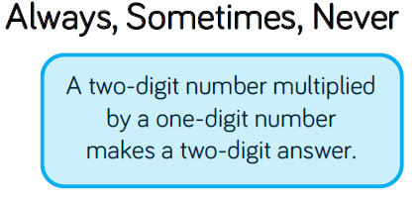
Reasoning and problem solving

Slide 35
Reasoning and problem solving

Slide 36
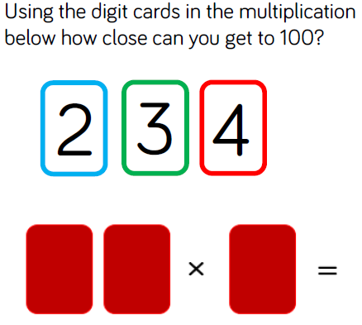
Reasoning and problem solving

Slide 37
Year 3 Spring Block 1 Multiplication and Division
Divide 2-digits by 1-digit.
NCLO: To divide using mental methods and progressing to formal written methods.

Slide 38
Vocabulary
multiplication
division
number sentence
array
greater than
less than
multiple
partition

Slide 39
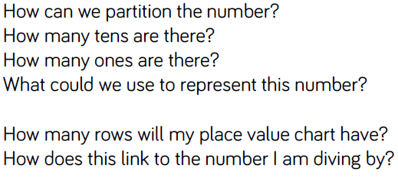
Key vocabulary and questions

Slide 40
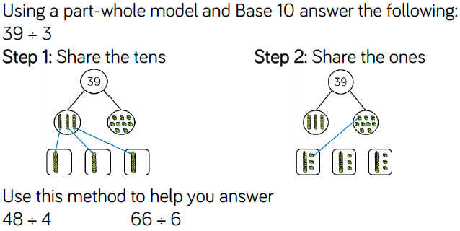
Fluency

Slide 41
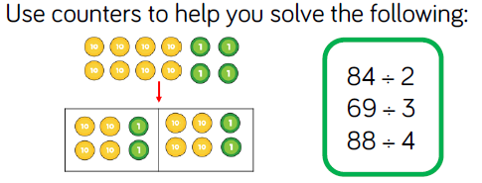
Fluency

Slide 42
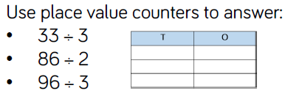
Fluency

Slide 43
Reasoning and problem solving

Slide 44
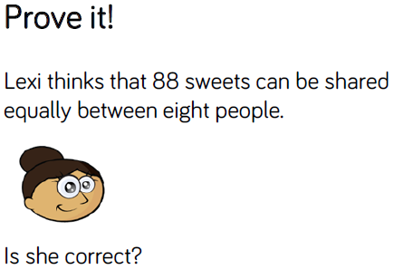
Reasoning and problem solving

Slide 45
Reasoning and problem solving

Slide 46
Year 3 Spring Block 1 Multiplication and Division
Divide 2-digits by 1-digit.
NCLO: To divide using mental methods and progressing to formal written methods.

Slide 47
Vocabulary
multiplication
division
number sentence
array
greater than
less than
multiple
partition

Slide 48
Key vocabulary and questions

Slide 49
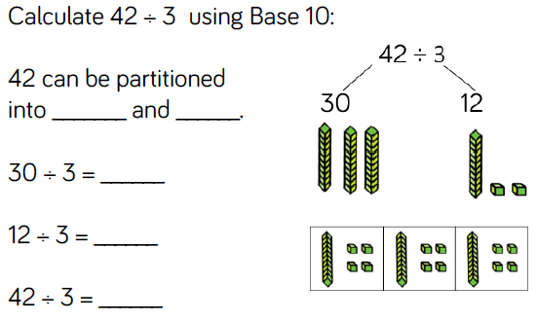
Fluency

Slide 50
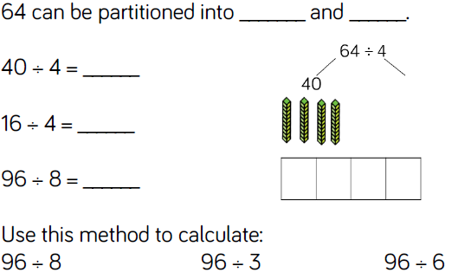
Fluency

Slide 51
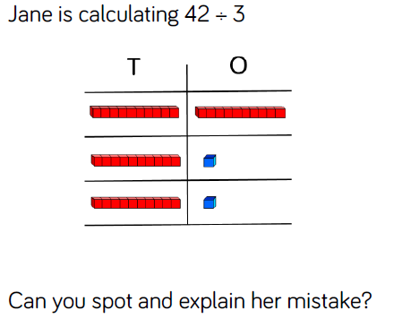
Reasoning and problem solving

Slide 52
Reasoning and problem solving

Slide 53
Year 3 Spring Block 1 Multiplication and Division
Divide 2-digits by 1-digit.
NCLO: To divide using mental methods and progressing to formal written methods. To solve division problems.

Slide 54
Vocabulary
multiplication
division
number sentence
array
greater than
less than
multiple
partition

Slide 55
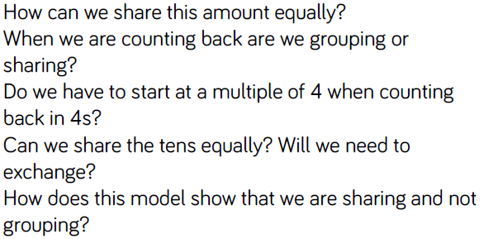
Key vocabulary and questions

Slide 56
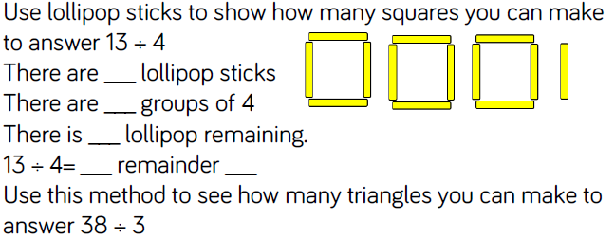
Fluency

Slide 57
Fluency

Slide 58
Fluency

Slide 59
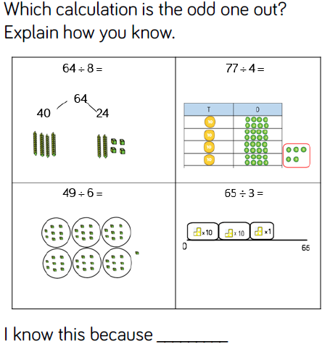
Reasoning and problem solving

Slide 60
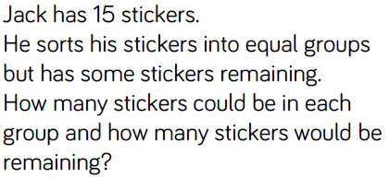
Reasoning and problem solving

Slide 61
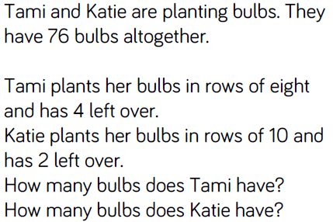
Reasoning and problem solving

Slide 62
Year 3 Spring Block 1 Multiplication and Division
Scaling
NCLO: To solve positive integer scaling problems and correspondence problems in which n objects are connected to m objects.

Slide 63
Vocabulary
multiplication
division
array
greater than
less than
multiple
partition
scaling

Slide 64
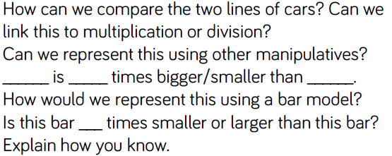
Key vocabulary and questions

Slide 65
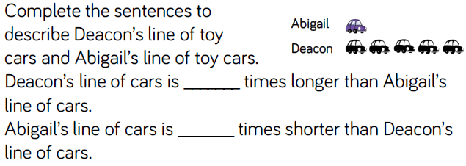
Fluency

Slide 66
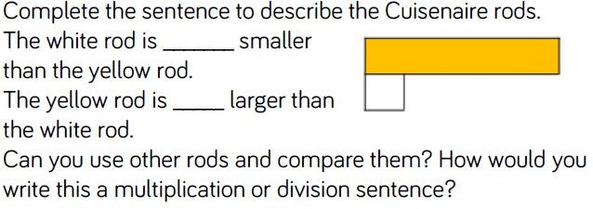
Fluency

Slide 67
Fluency

Slide 68
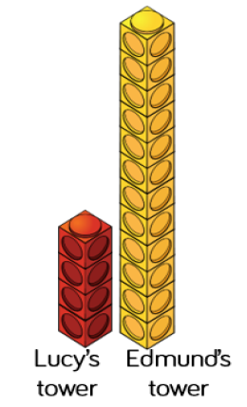
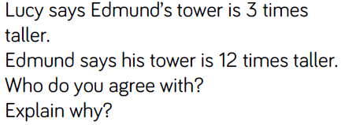
Reasoning and problem solving

Slide 69
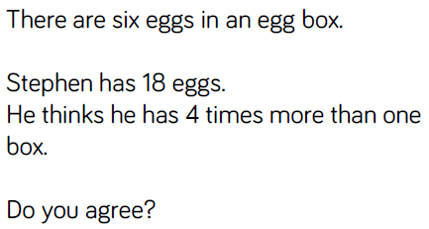
Reasoning and problem solving

Slide 70
Reasoning and problem solving

Slide 71
Year 3 Spring Block 1 Multiplication and Division
How many ways?
NCLO: To solve positive integer scaling problems and correspondence problems in which n objects are connected to m objects.

Slide 72
Vocabulary
multiplication
division
array
greater than
less than
multiple
partition
scaling

Slide 73
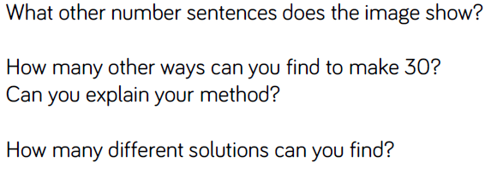
Key vocabulary and questions

Slide 74
Fluency

Slide 75
Fluency

Slide 76
Fluency

Slide 77
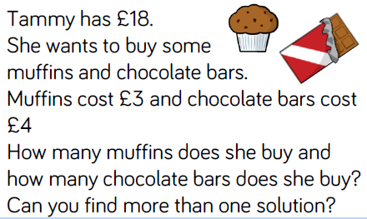
Reasoning and problem solving

Slide 78
Reasoning and problem solving

Slide 79
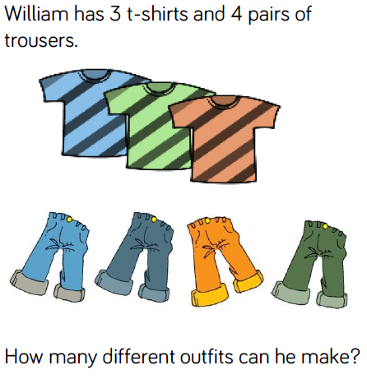
Reasoning and problem solving

