Slide 1
Year 3 Spring Block 2 Money
Pounds and pence
NCLO: To use both £ and p in practical contexts.

Slide 2
Vocabulary
pounds
pence
value
note
coin

Slide 3
Key vocabulary and questions

Slide 4
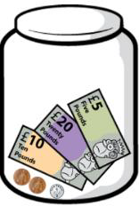
Fluency

Slide 5
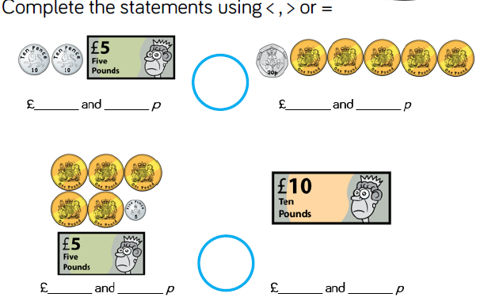
Fluency

Slide 6
Fluency

Slide 7
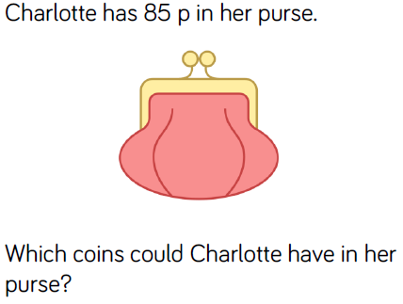
Reasoning and problem solving

Slide 8
Reasoning and problem solving

Slide 9
Year 3 Spring Block 2 Money
Converting pounds and pence
NCLO: To use both £ and p in practical contexts.

Slide 10
Vocabulary
pounds
pence
value
note
coin
convert

Slide 11
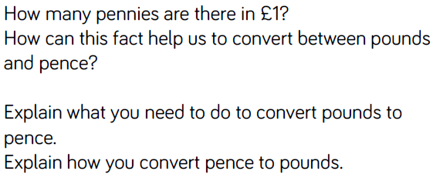
Key vocabulary and questions

Slide 12
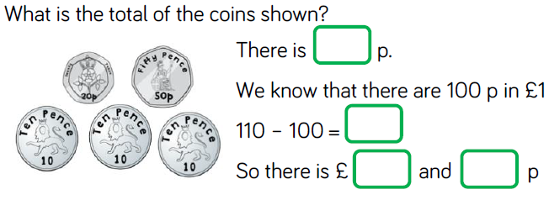
Fluency

Slide 13
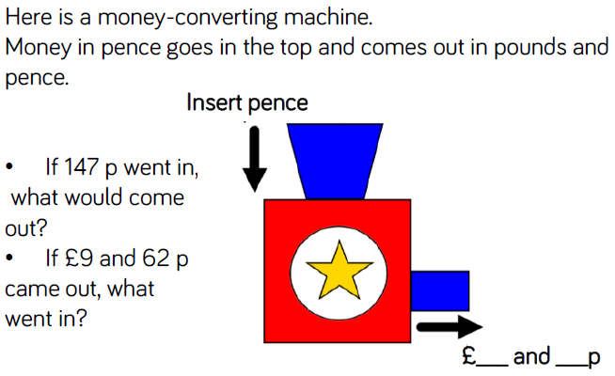
Fluency

Slide 14
Reasoning and problem solving

Slide 15
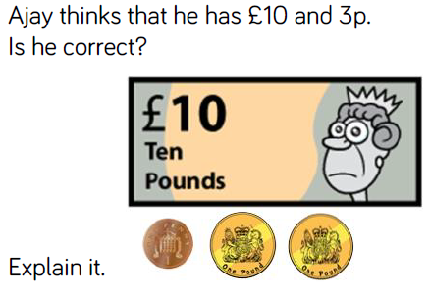
Reasoning and problem solving

Slide 16
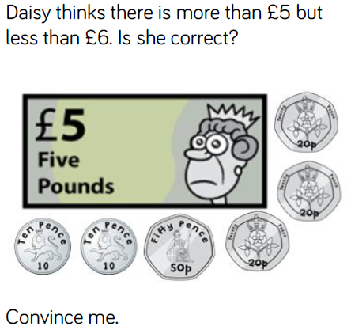
Reasoning and problem solving

Slide 17
Year 3 Spring Block 2 Money
Adding money.
NCLO: To add amounts of money, using both £ and p in practical contexts.

Slide 18
Vocabulary
pounds
pence
value
note
coin
add
partition

Slide 19
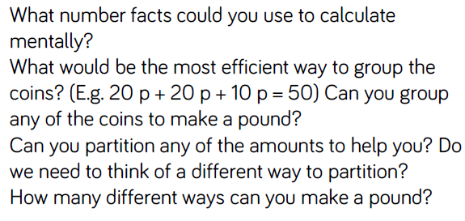
Key vocabulary and questions

Slide 20
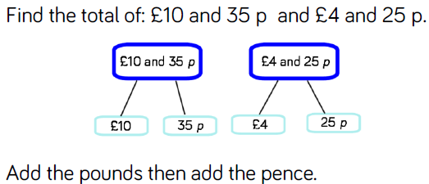
Fluency

Slide 21
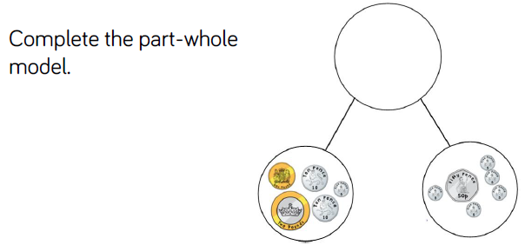
Fluency

Slide 22
Fluency

Slide 23
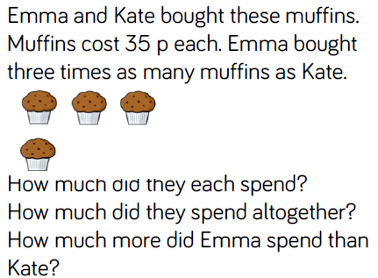
Reasoning and problem solving

Slide 24
Reasoning and problem solving

Slide 25
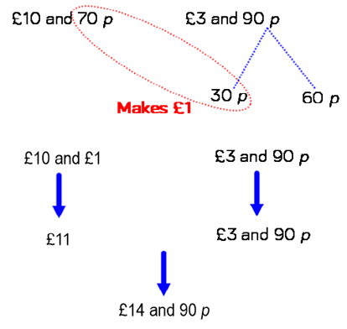
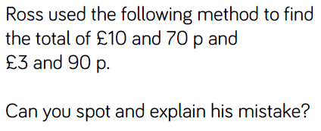
Reasoning and problem solving

Slide 26
Year 3 Spring Block 2 Money
Subtracting money.
NCLO: To subtract amounts of money to give change, using both £ and p in practical contexts.

Slide 27
Vocabulary
pounds
pence
value
note
coin
subtract
change

Slide 28
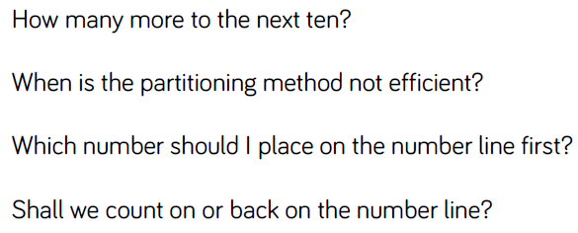
Key vocabulary and questions

Slide 29
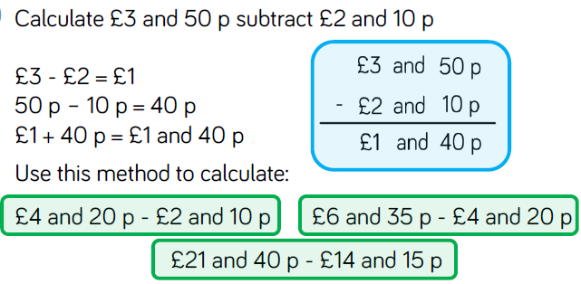
Fluency

Slide 30
Fluency

Slide 31
Fluency

Slide 32
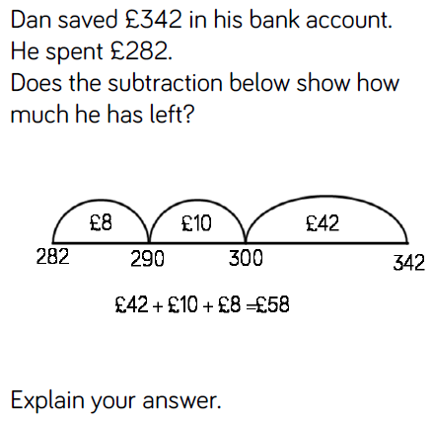
Reasoning and problem solving

Slide 33
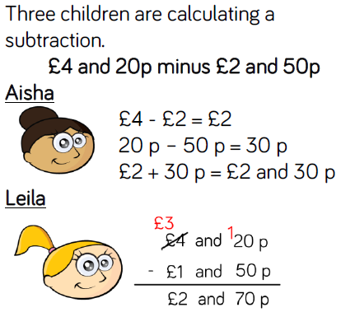
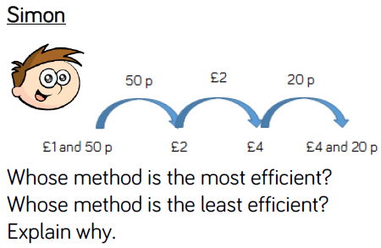
Reasoning and problem solving

Slide 34
Year 3 Spring Block 2 Money
Giving change.
NCLO: To add and subtract amounts of money to give change, using both £ and p in practical contexts.

Slide 35
Vocabulary
pounds
pence
value
Note
coin
subtract
add
change

Slide 36
Key vocabulary and questions

Slide 37
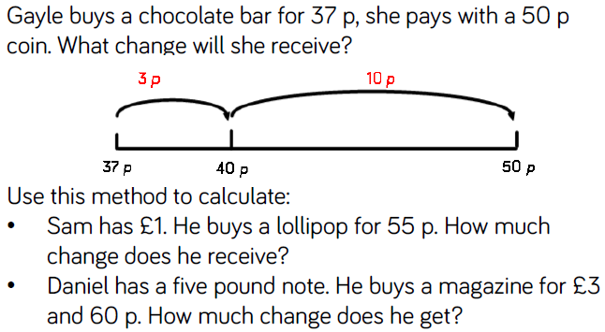
Fluency

Slide 38
Fluency

Slide 39
Fluency

Slide 40
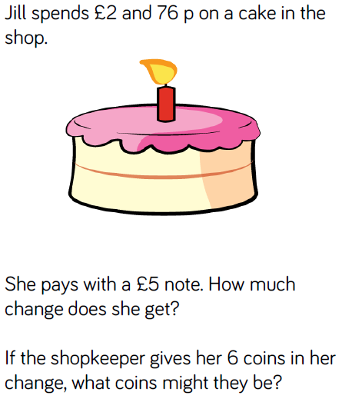
Reasoning and problem solving

Slide 41
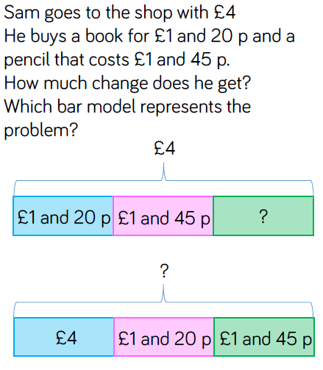
Reasoning and problem solving

