Slide 1
Year 3 Spring Block 3 Statistics
Pictograms
NCLO: To interpret and present data using bar charts, pictograms and tables. To solve one and two step questions using data presented in scaled bar charts, pictograms and tables.

Slide 2
Vocabulary
Pictogram
Symbol
Greatest
Smallest

Slide 3
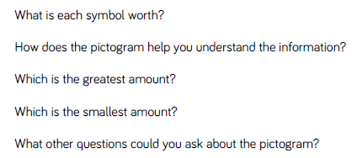
Key vocabulary and questions

Slide 4
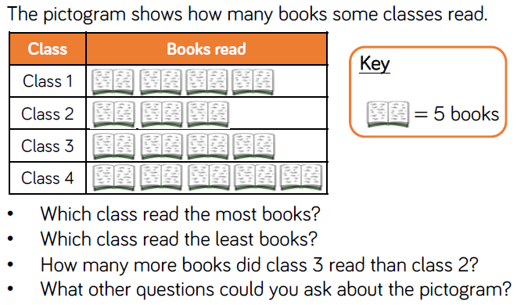
Fluency

Slide 5
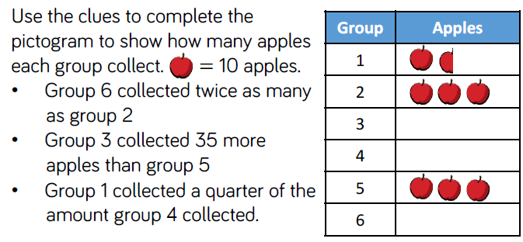
Fluency

Slide 6
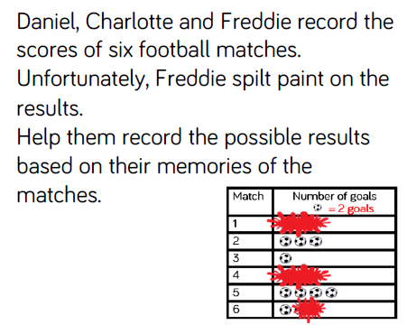
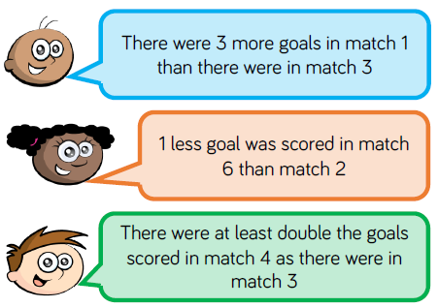
Reasoning and problem solving

Slide 7
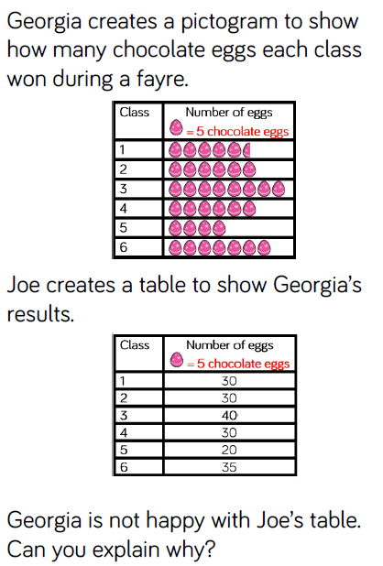
Reasoning and problem solving

Slide 8
Year 3 Spring Block 3 Statistics
Bar charts
NCLO:To interpret and present data using bar charts, pictograms and tables. To solve one and two step questions using data presented in scaled bar charts, pictograms and tables.

Slide 9
Vocabulary
Bar chart
Scale
Scaled

Slide 10
Key vocabulary and questions

Slide 11
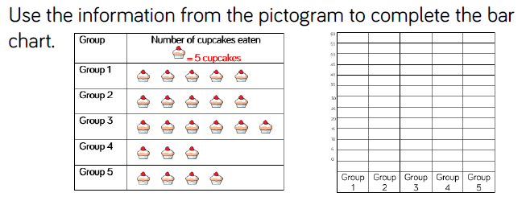
Fluency

Slide 12
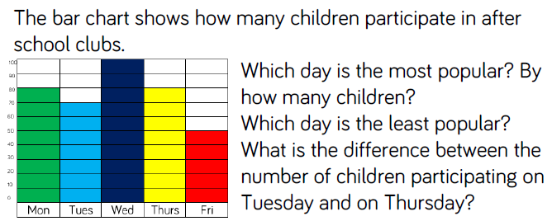
Fluency

Slide 13
Fluency

Slide 14
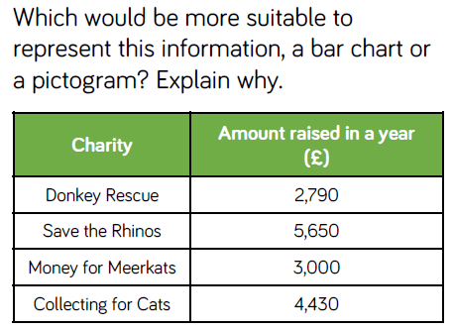
Reasoning and problem solving

Slide 15
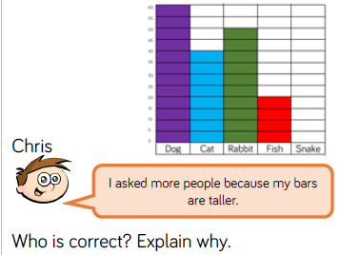
Reasoning and problem solving

Slide 16
Year 3 Spring Block 3 Statistics
Tables
NCLO:To interpret and present data using bar charts, pictograms and tables. To solve one and two step questions using data presented in scaled bar charts, pictograms and tables.

Slide 17
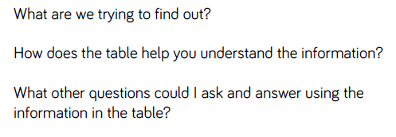
Key vocabulary and questions

Slide 18
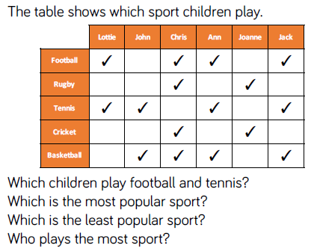
Fluency

Slide 19
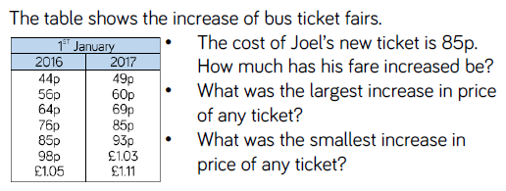
Fluency

Slide 20
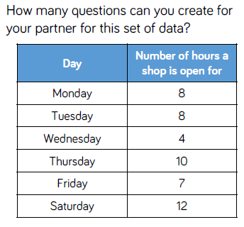
Reasoning and problem solving

Slide 21
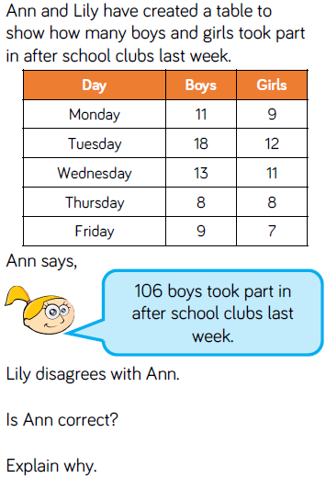
Reasoning and problem solving

