Slide 1
Year 4 Autumn Week 5 Maths
Addition and Subtraction
NCLO: To add 1s, 10s, 100s and 1,00s

Slide 2
Key vocabulary and questions
1s, 10s, 100s, 1,000s
Which is the highest value counter?
Can you make the same number using Base 10?
Which place value column are we focusing on?
If we are adding tens, is it only the tens column that changes?
5382 + 5 tens – Will only the tens column change?
Which other column will change?

Slide 3
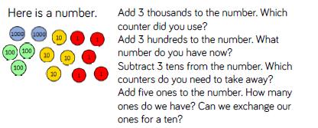
Fluency

Slide 4
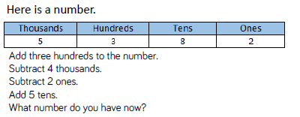
Fluency

Slide 5
Fluency

Slide 6
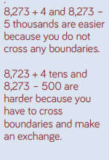
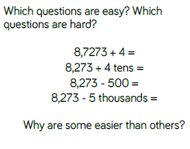
Reasoning and problem solving
Answers

Slide 7
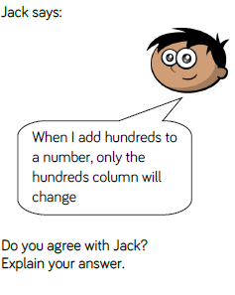
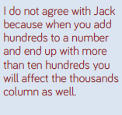
Reasoning and problem solving
Answer

Slide 8
Year 4 Autumn Week 5 Maths
Add two 4-digit numbers
NCLO: To add numbers with up to 4 digits using the formal written methods of columnar addition where appropriate.

Slide 9
Key vocabulary and questions
Place value
Addition
Column addition

Slide 10
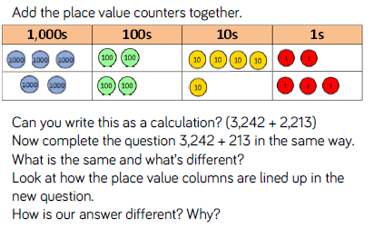
Fluency

Slide 11
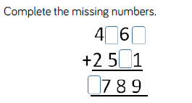
Fluency

Slide 12
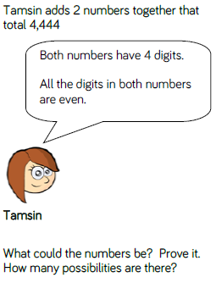
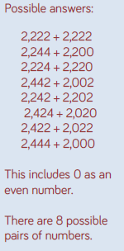
Reasoning and problem solving
Answer

Slide 13
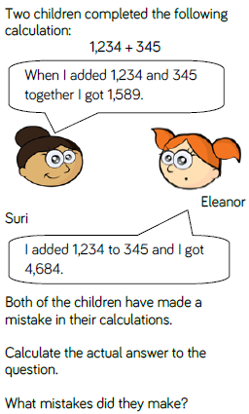
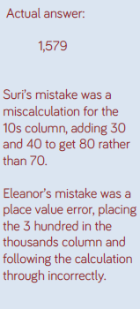
Reasoning and problem solving
Answer

Slide 14
Year 4 Autumn Week 5 Maths
Add two 4-digit numbers
NCLO: To add numbers with up to 4 digits using the formal written methods of columnar addition where appropriate.

Slide 15
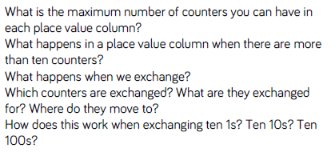
Key vocabulary and questions
Place value
Exchanging
Column addition

Slide 16
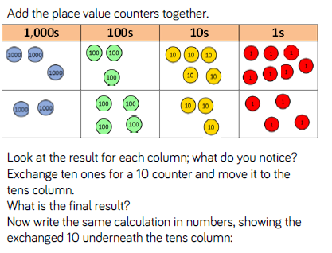
Fluency

Slide 17
Fluency

Slide 18
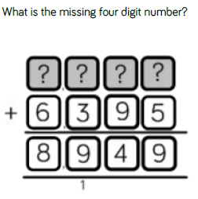
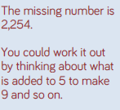
Reasoning and problem solving
Answer
Notes:
Some children might use the inverse and subtract 6,395 from 8,949 to find the answer.

Slide 19
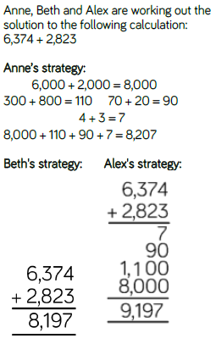
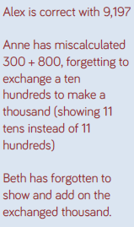
Reasoning and problem solving
Answer

Slide 20
Year 4 Autumn Week 5 Maths
Add two 4-digit numbers
NCLO: To add numbers with up to 4 digits using the formal written methods of columnar addition where appropriate.

Slide 21
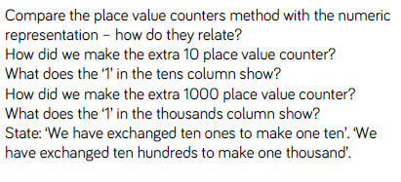
Key vocabulary and questions

Slide 22
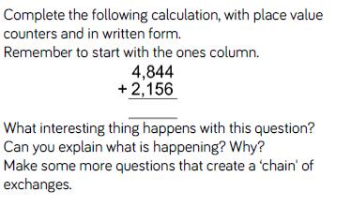
Fluency

Slide 23
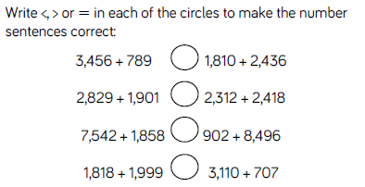
Fluency

Slide 24
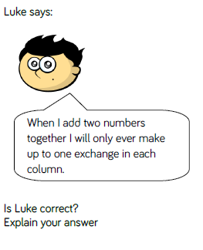
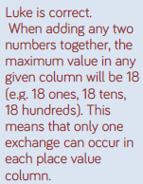
Reasoning and problem solving
Answer
Notes:
Children may explore what happens when more than two numbers are added together.

Slide 25
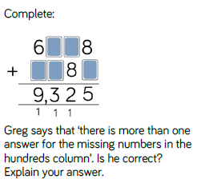
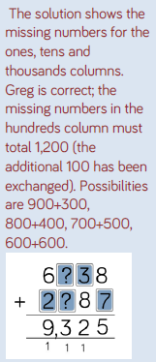
Reasoning and problem solving
Answer

Slide 26
Year 4 Autumn Week 5 Maths
Subtract 4-digit numbers
NCLO: To subtract numbers with up to 4 digits using the formal written methods of columnar subtraction where appropriate.

Slide 27
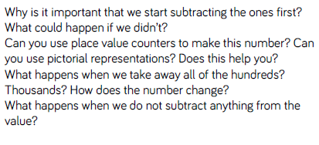
Key vocabulary and questions
Subtraction
Place value

Slide 28
Fluency

Slide 29
Fluency

Slide 30
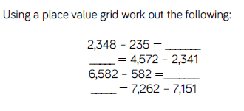
Fluency

Slide 31
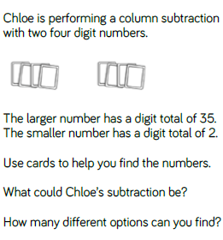
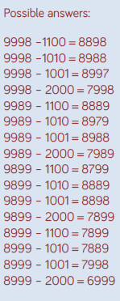
Reasoning and problem solving
Answers

Slide 32
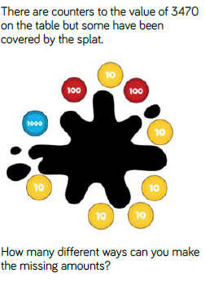
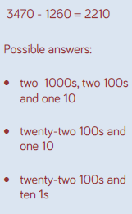
Reasoning and problem solving
Answers

Slide 33
Year 4 Autumn Block 2 Maths
Addition and Subtraction
NCLO: To Subtract four digit numbers using the formal written methods of columnar subtraction..

Slide 34
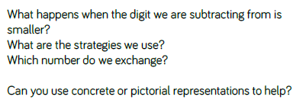
Key vocabulary and questions

Slide 35
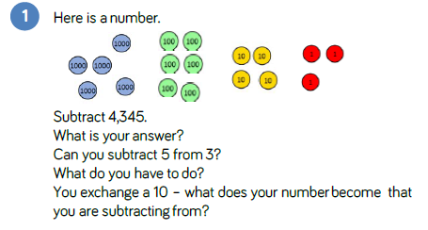
Fluency

Slide 36
Fluency

Slide 37
Fluency

Slide 38
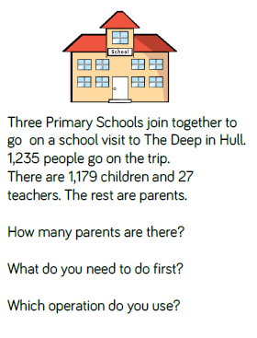
Reasoning and Problem Solving

Slide 39
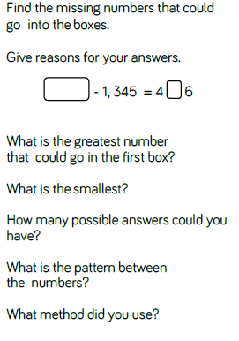
Reasoning and Problem Solving

Slide 40
Year 4 Autumn Block 2 Maths
Addition and Subtraction
NCLO: To Subtract four digit numbers using the formal written methods of columnar subtraction..

Slide 41
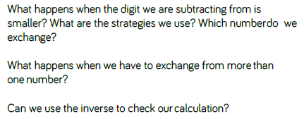
Key vocabulary and questions

Slide 42
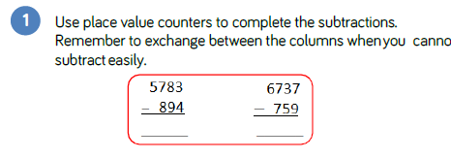
Fluency

Slide 43
Fluency

Slide 44
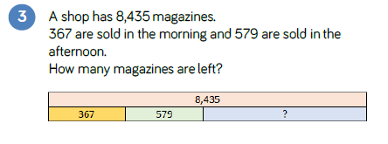
Fluency

Slide 45
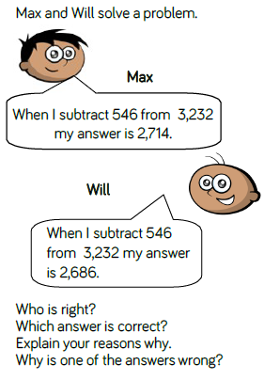
Reasoning and Problem Solving

Slide 46
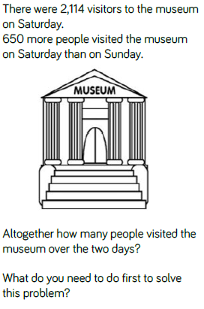
Reasoning and Problem Solving

Slide 47
Year 4 Autumn Block 2 Maths
Addition and Subtraction
NCLO: To Subtract four digit numbers using the formal written methods of columnar subtraction..

Slide 48
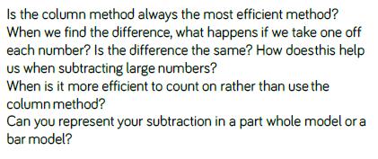
Key vocabulary and questions

Slide 49
Fluency

Slide 50
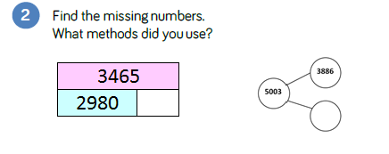
Fluency

Slide 51
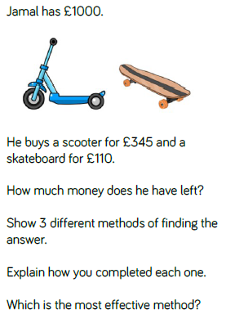
Reasoning and Problem Solving

Slide 52
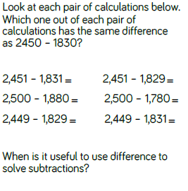
Reasoning and Problem Solving

Slide 53
Year 4 Autumn Block 2 Maths
Addition and Subtraction
NCLO: To estimate and use inverse operations to check answers to a calculation.

Slide 54
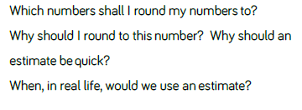
Key vocabulary and questions

Slide 55
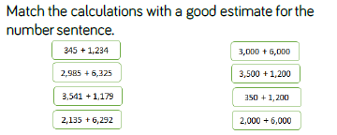
Fluency

Slide 56
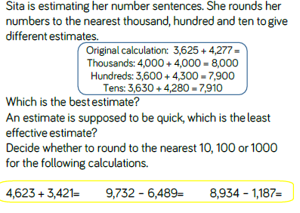
Fluency

Slide 57
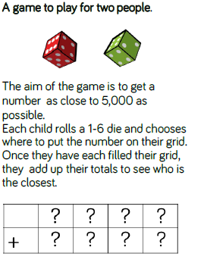
Reasoning and problem solving

Slide 58
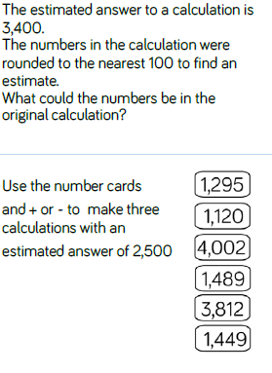
Reasoning and problem solving

Slide 59
Year 4 Autumn Block 2 Maths
Addition and Subtraction
NCLO: To estimate and use inverse operations to check answers to a calculation.

Slide 60
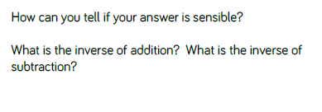
Key vocabulary and questions

Slide 61
Fluency

Slide 62
Fluency

Slide 63
Fluency

Slide 64
Reasoning and problem solving

Slide 65
Reasoning and problem solving

