Slide 1
Year 4 Autumn Block 4 Maths
Multiplication and Division
NCLO: Recall and use multiplication and division facts for multiplication tables up to 12 x12

Slide 2
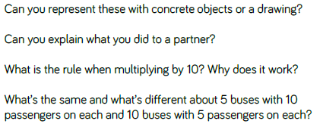
Key vocabulary and questions
Lots of

Slide 3
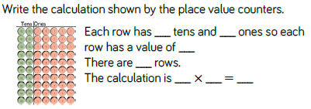
Fluency

Slide 4
Fluency

Slide 5
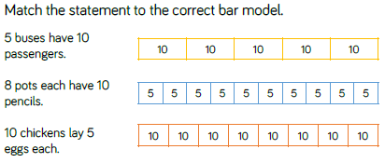
Fluency

Slide 6
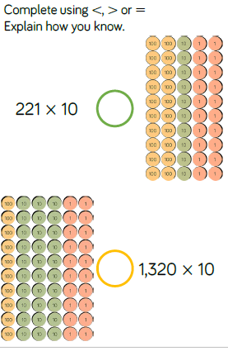
Reasoning and problem solving

Slide 7
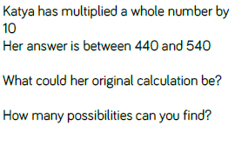
Reasoning and Problem Solving

Slide 8
Year 4 Autumn Block 4 Maths
Multiplication and Division
NCLO:To count in multiples up to 1000

Slide 9
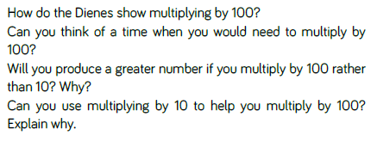
Key vocabulary and questions

Slide 10
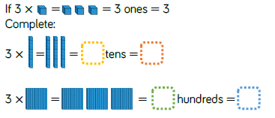
Fluency

Slide 11
Fluency

Slide 12
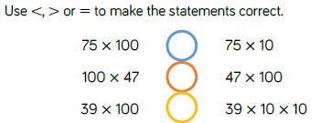
Fluency

Slide 13
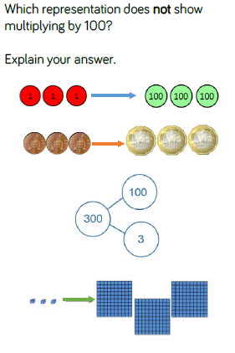
Reasoning and problem solving

Slide 14
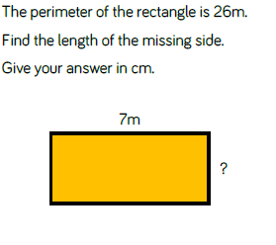
Reasoning and problem solving

Slide 15
Year 4 Autumn Block 4 Maths
Multiplication and Division
NCLO:To count in multiples up to 1000

Slide 16
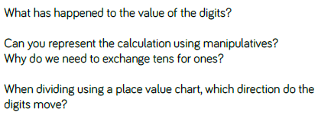
Key vocabulary and questions

Slide 17
Fluency

Slide 18
Fluency

Slide 19
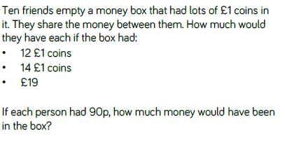
Fluency

Slide 20
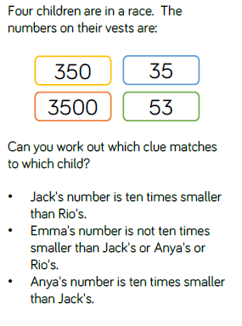
Reasoning and Problem Solving

Slide 21
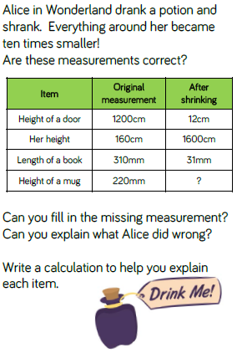
Reasoning and Problem Solving

Slide 22
Year 4 Autumn Block 4 Maths
Multiplication and Division
NCLO:To use place value and derived facts to multiply and divide mentally.

Slide 23
Key vocabulary and questions

Slide 24
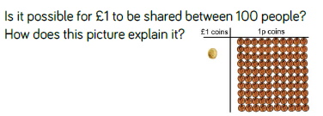
Fluency

Slide 25
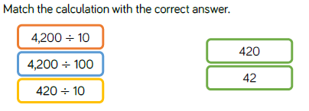
Fluency

Slide 26
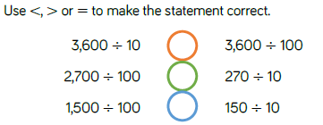
Fluency

Slide 27
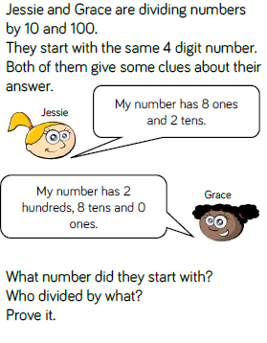
Reasoning and problem solving

Slide 28
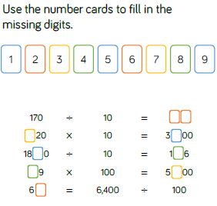
Reasoning and problem solving

Slide 29
Year 4 Autumn Block 4 Maths
Multiplication and Division
NCLO:To solve problems involving multiplying and adding including using the distributive law

Slide 30
Key vocabulary and questions

Slide 31
Fluency

Slide 32
Fluency

Slide 33
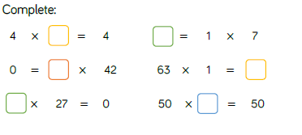
Fluency

Slide 34
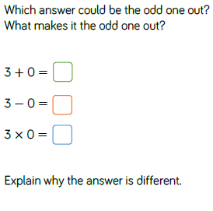
Reasoning and problem solving

Slide 35
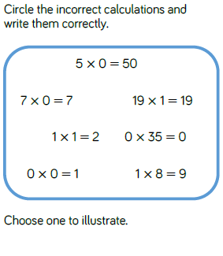
Reasoning and problem solving

Slide 36
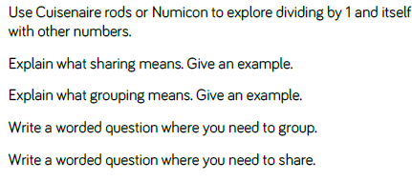
Key vocabulary and questions
Numicon, Cuisenaire rods

Slide 37
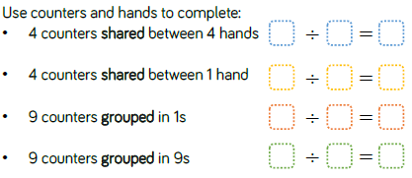
Fluency

Slide 38
Fluency

Slide 39
Fluency

Slide 40
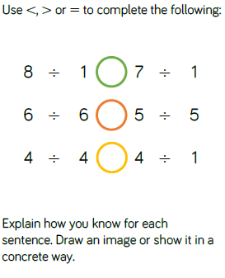
Reasoning and problem solving

Slide 41
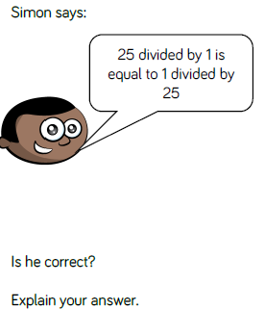
Reasoning and problem solving

Slide 42
Year 4 Autumn Block 4 Maths
Multiplication and Division
NCLO:To solve problems involving multiplying and adding including using the distributive law

Slide 43
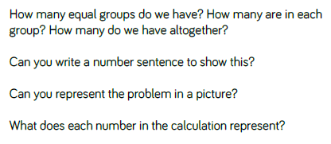
Key vocabulary and questions

Slide 44
Fluency

Slide 45
Fluency

Slide 46
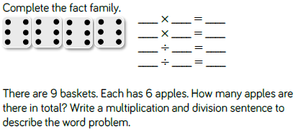
Fluency

Slide 47
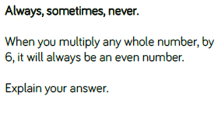
Reasoning and problem solving

Slide 48
Year 4 Autumn Block 4 Maths
Multiplication and Division
NCLO:To solve problems involving multiplying and adding including using the distributive law

Slide 49
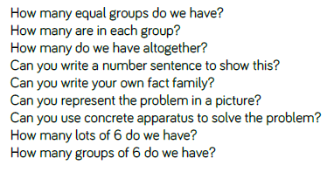
Key vocabulary and questions
Sum, Product

Slide 50
Fluency

Slide 51
Fluency

Slide 52
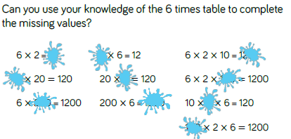
Fluency

Slide 53
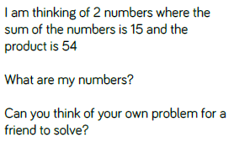
Reasoning and problem solving

Slide 54
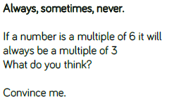
Reasoning and problem solving

Slide 55
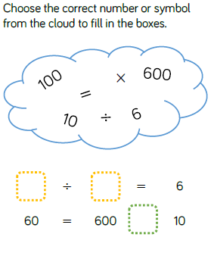
Reasoning and problem solving

Slide 56
Year 4 Autumn Block 4 Maths
Multiplication and Division
NCLO:To solve problems involving multiplying and adding including using the distributive law

Slide 57
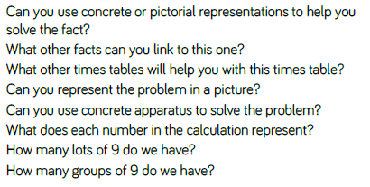
Key vocabulary and questions

Slide 58
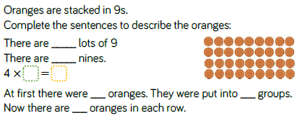
Fluency

Slide 59
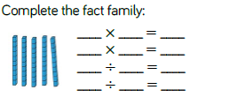
Fluency

Slide 60
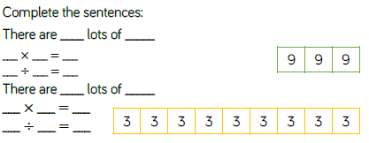
Fluency

Slide 61
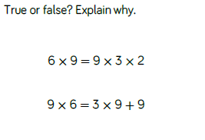
Reasoning and problem solving

Slide 62
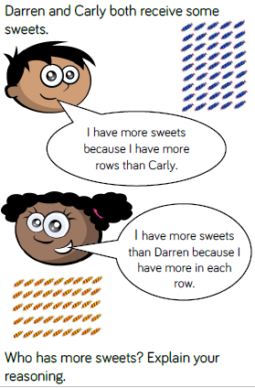
Reasoning and problem solving

Slide 63
Year 4 Autumn Block 4 Maths
Multiplication and Division
NCLO:To solve problems involving multiplying and dividing including using the distributive law

Slide 64
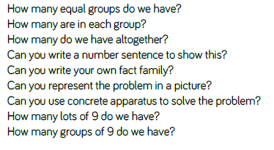
Key vocabulary and questions

Slide 65
Fluency

Slide 66
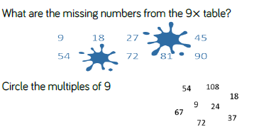
Fluency

Slide 67
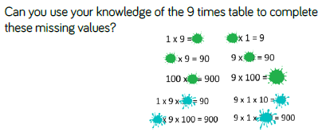
Fluency

Slide 68
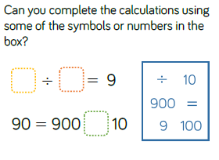
Reasoning and problem solving

Slide 69
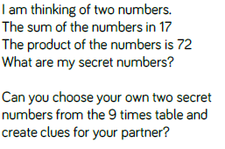
Reasoning and problem solving

Slide 70
Reasoning and problem solving

Slide 71
Year 4 Autumn Block 4 Maths
Multiplication and Division
NCLO:To solve problems involving multiplying and dividing including using the distributive law

Slide 72
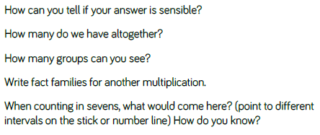
Key vocabulary and questions

Slide 73
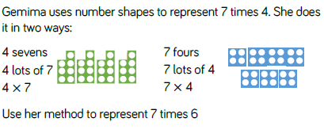
Fluency

Slide 74
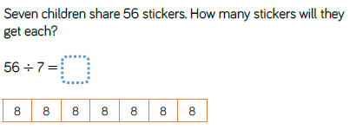
Fluency

Slide 75
Fluency

Slide 76
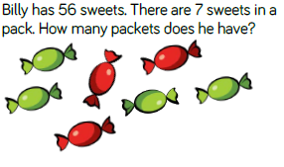
Reasoning and problem solving

Slide 77
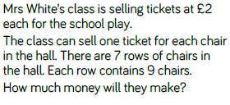
Reasoning and problem solving

Slide 78
Reasoning and problem solving

Slide 79
Reasoning and problem solving

Slide 80
Year 4 Autumn Block 4 Maths
Multiplication and Division
NCLO:To solve problems involving multiplying and dividing including using the distributive law

Slide 81
Key vocabulary and questions

Slide 82
Fluency

Slide 83
Fluency

Slide 84
Fluency

Slide 85
Reasoning and problem solving

Slide 86
Reasoning and problem solving

Slide 87
Reasoning and problem solving

