Slide 1
Year 4 Summer Block 1 Decimals
NCLO: To identify the value of the digits in an answer as ones, tenths and hundredths.

Slide 2
ones, tenths, hundredths, whole, decimal

Slide 4
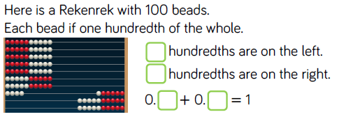

Slide 5
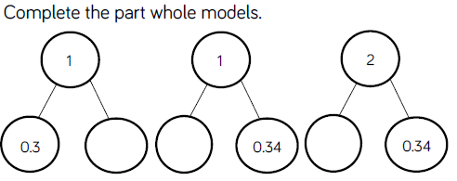

Slide 6
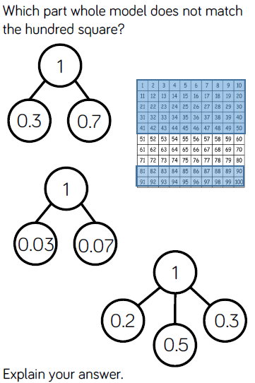

Slide 7
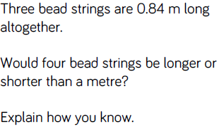

Slide 8
Year 4 Summer Block 1 Decimals
NCLO: To identify the value of the digits in an answer as ones, tenths and hundredths.
To find the effect of dividing a one or two digit number by 10 or 100.

Slide 9
place holder, partition, digit, place value

Slide 10
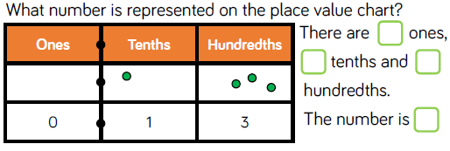

Slide 12
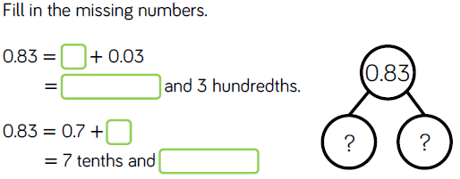

Slide 13
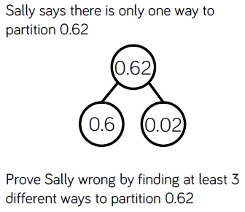

Slide 14
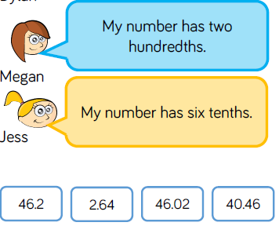

Slide 15
Year 4 Summer Block 1 Decimals
NCLO: To compare numbers with the same number of decimal places and up to two decimal places.

Slide 16
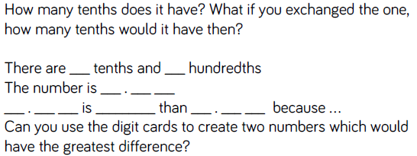

Slide 19
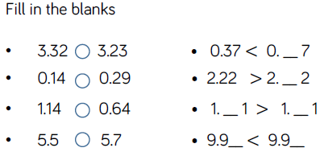

Slide 20
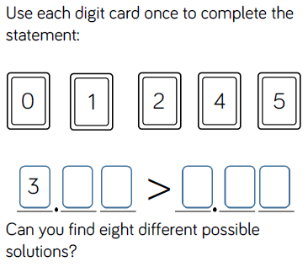

Slide 21
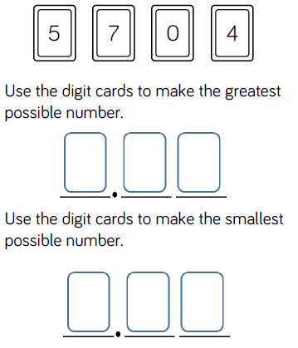

Slide 22
Year 4 Summer Block 1 Decimals
NCLO: To compare numbers with the same number of decimal places and up to two decimal places.

Slide 23
order

Slide 24
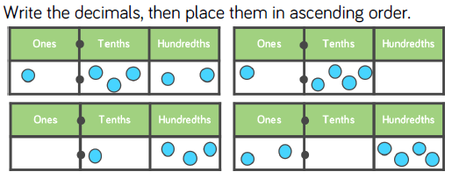

Slide 26
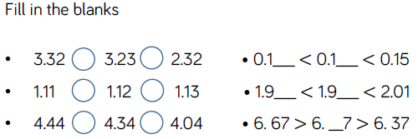

Slide 28
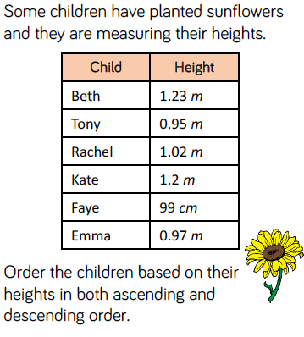

Slide 29
Year 4 Summer Block 1 Decimals
NCLO: To round decimals with one decimal place to the nearest whole number.

Slide 30
round

Slide 31
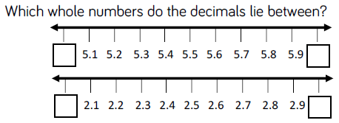

Slide 32
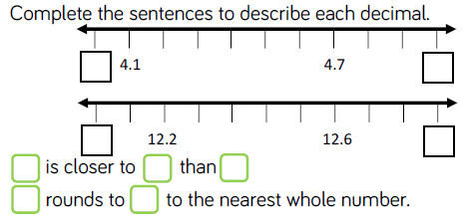

Slide 34
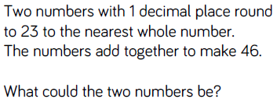

Slide 35
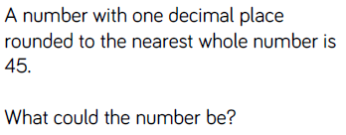

Slide 36
Year 4 Summer Block 1 Decimals
NCLO: To recognise and write decimal equivalents to ¼, ½ and ¾.

Slide 37
decimal, fraction, place value, tenths, hundredths

Slide 39
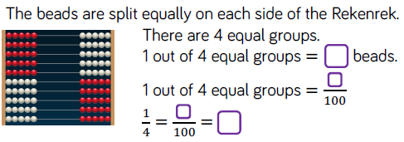

Slide 42
