Slide 1
Year 5 Spring Block 2 Fractions
Equivalent fractions
NCLO:Identify, name and write equivalent fractions of a given fraction, represented visually including tenths and hundredths

Slide 2
Key vocabulary and questions
Equivalent
Numerator
Denominator

Slide 3
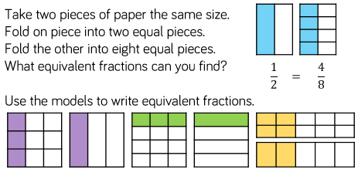
Fluency

Slide 4
Fluency

Slide 5
Fluency

Slide 6
Reasoning and problem solving

Slide 7
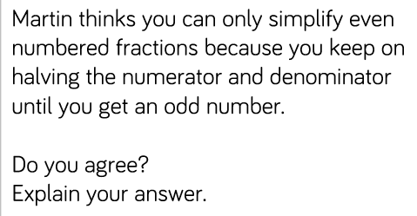
Reasoning and problem solving

Slide 8
Reasoning and problem solving

Slide 9
Year 5 Spring Block 2 Fractions
Improper fractions to mixed numbers
NCLO:Recognise mixed numbers and improper fractions and convert from one form to the other and write mathematical statements >1 as a mixed number

Slide 10
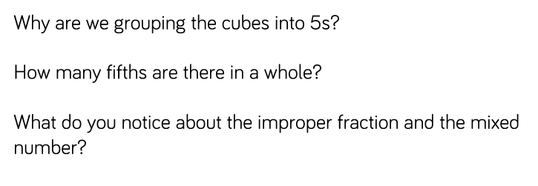
Key vocabulary and questions
Improper fraction
Mixed number

Slide 11
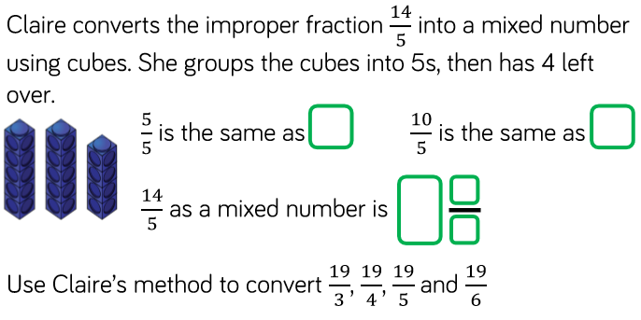
Fluency

Slide 12
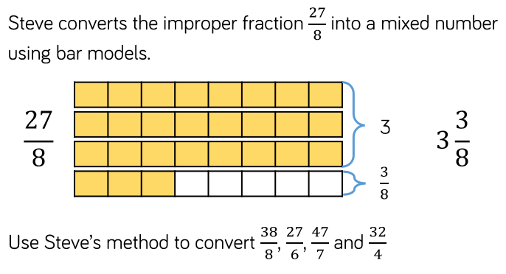
Fluency

Slide 13
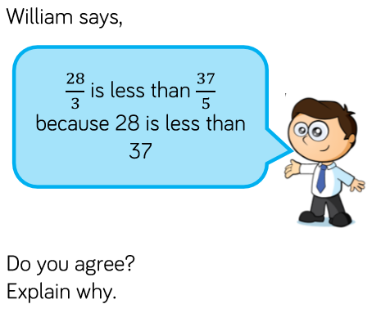
Reasoning and problem solving

Slide 14
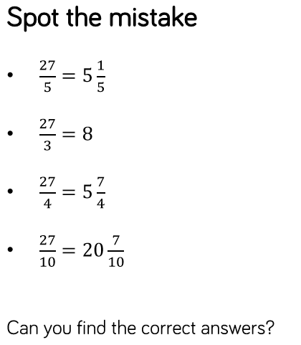
Reasoning and problem solving

Slide 15
Year 5 Spring Block 2 Fractions
Mixed numbers to improper fractions
NCLO:Recognise mixed numbers and improper fractions and convert from one form to the other and write mathematical statements >1 as a mixed number.

Slide 16
Key vocabulary and questions

Slide 17
Fluency

Slide 18
Fluency

Slide 19
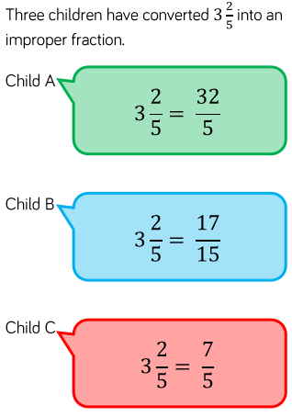
Reasoning and problem solving

Slide 20
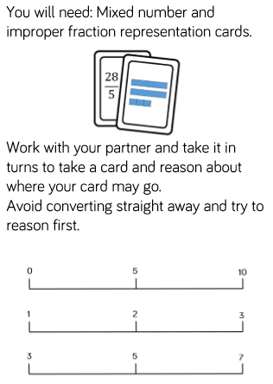
Reasoning and problem solving

Slide 21
Year 5 Block 2 Fractions
Number sequences
NCLO:

Slide 22
Key vocabulary and questions

Slide 23
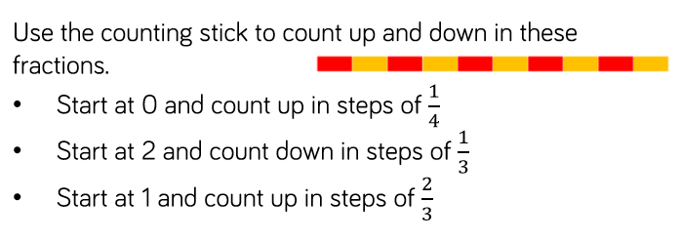
Fluency

Slide 24
Fluency

Slide 25
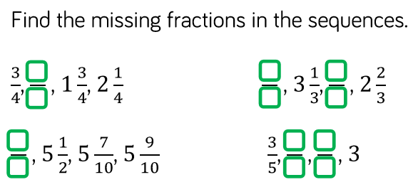
Fluency

Slide 26
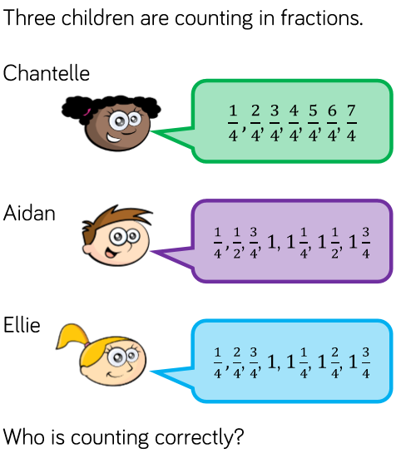
Reasoning and problem solving

Slide 27
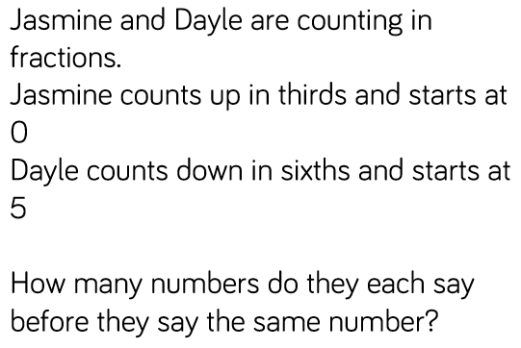
Reasoning and problem solving

Slide 28
Year 5 Spring Block 2 Fractions
Compare and order less than 1
NCLO:Compare and order fractions whose denominators are multiples of the same number.

Slide 29
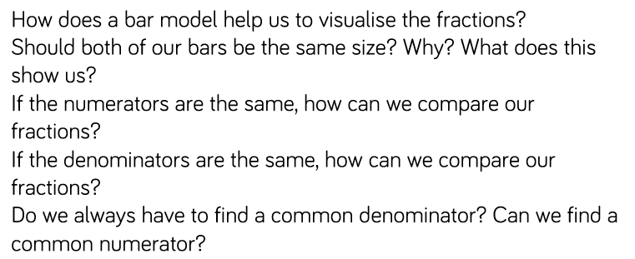
Key vocabulary and questions
Common denominator

Slide 30
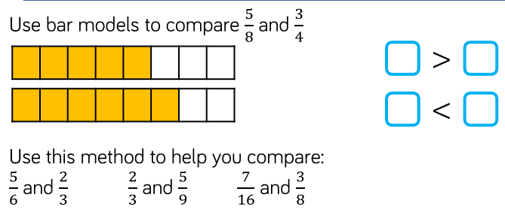
Fluency

Slide 31
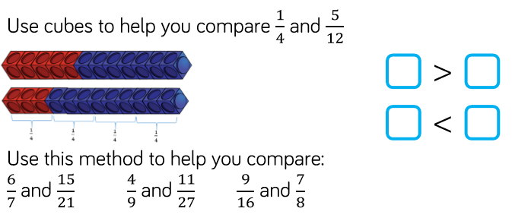
Fluency

Slide 32
Fluency

Slide 33
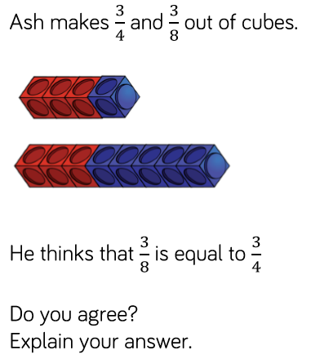
Reasoning and problem solving

Slide 34
Reasoning and problem solving

Slide 35
Year 5 Spring Block 2 Fractions
Compare and order more than 1
NCLO:Compare and order fractions whose denominators are multiples of the same number.

Slide 36
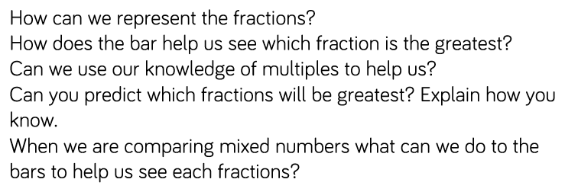
Key vocabulary and questions

Slide 37
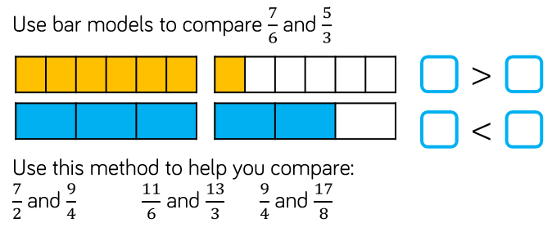
Fluency

Slide 38
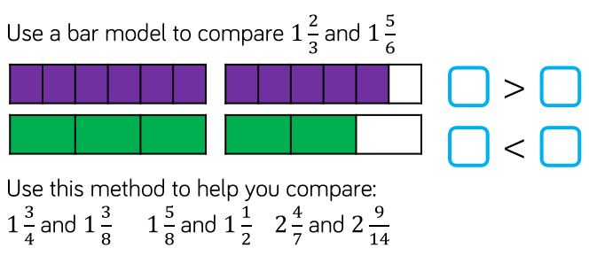
Fluency

Slide 39
Fluency

Slide 40
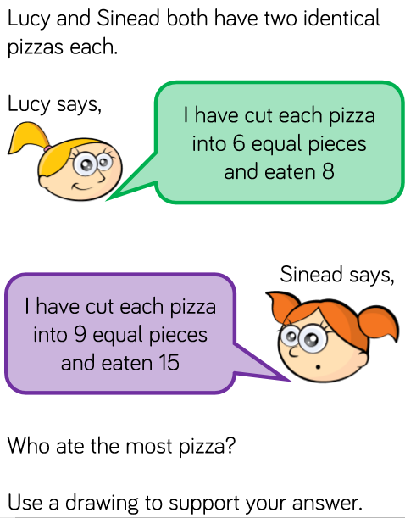
Reasoning and problem solving

Slide 41
Reasoning and problem solving

Slide 42
Year 5 Spring Block 2 Fractions
To add and subtract fractions
NCLO:Add and subtract fractions with the same denominator and denominators that are multiples of the same number.

Slide 43
Key vocabulary and questions

Slide 44
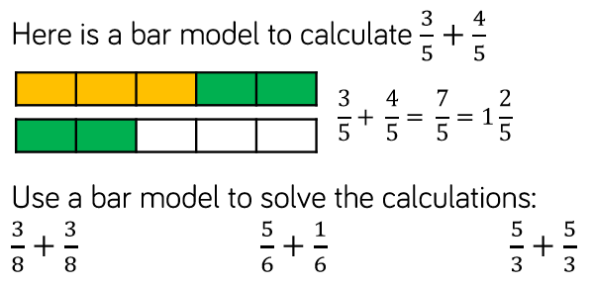
Fluency

Slide 45
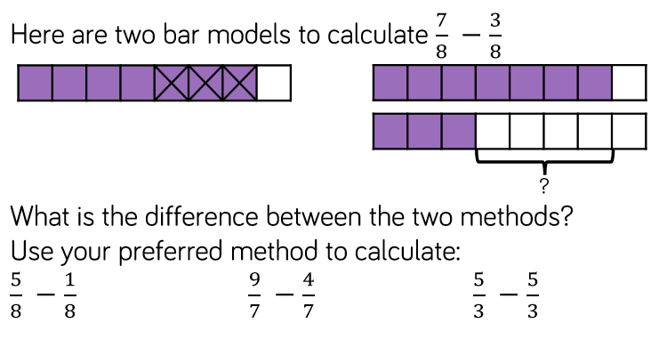
Fluency

Slide 46
Fluency

Slide 47
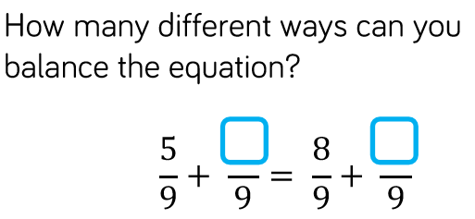
Reasoning and problem solving

Slide 48
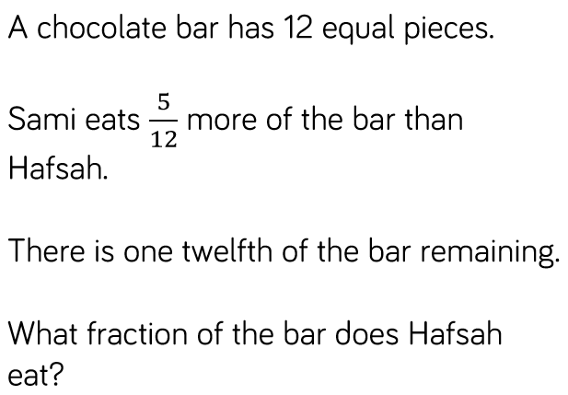
Reasoning and problem solving

Slide 49
Year 5 Spring Block 2 Fractions
Add fractions within 1
NCLO:Add and subtract fractions with the same denominator and denominators that are multiples of the same number.

Slide 50
Key vocabulary and questions
Simplify
Convert

Slide 51
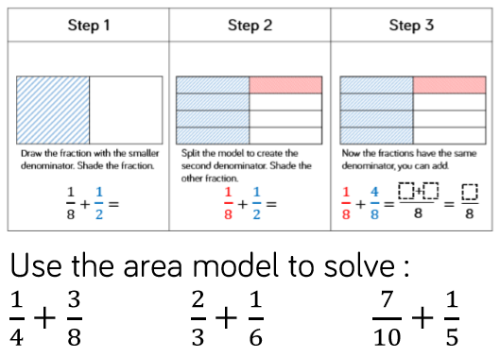
Fluency

Slide 52
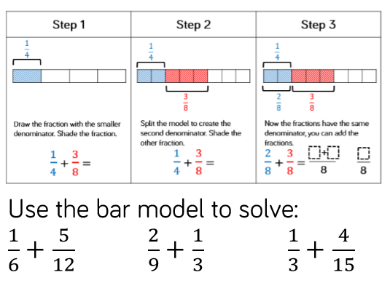
Fluency

Slide 53
Fluency

Slide 54
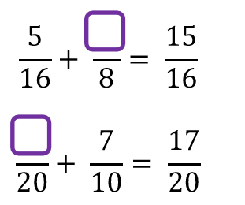
Reasoning and problem solving

Slide 55
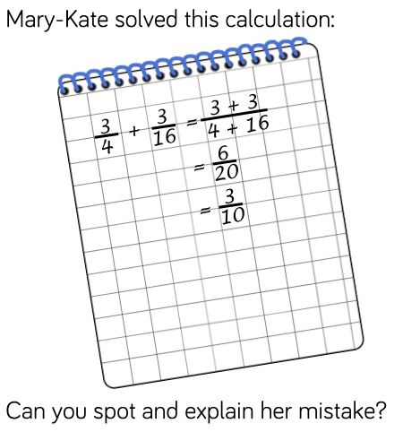
Reasoning and problem solving

Slide 56
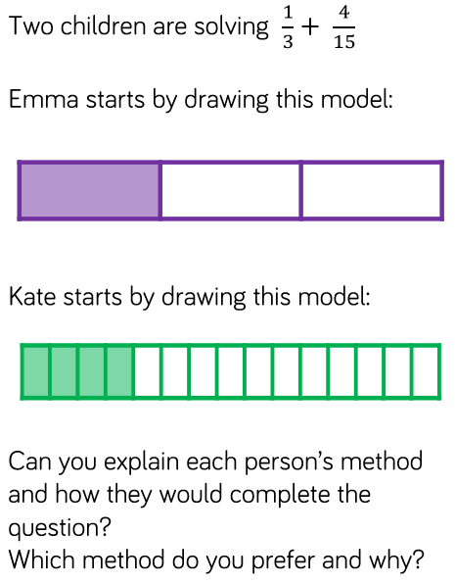
Reasoning and problem solving

Slide 57
Year 3 Autumn Block 1 Place Value
Add 3 or more fractions
NCLO:Add and subtract fractions with the same denominator and denominators that are multiples of the same number

Slide 58
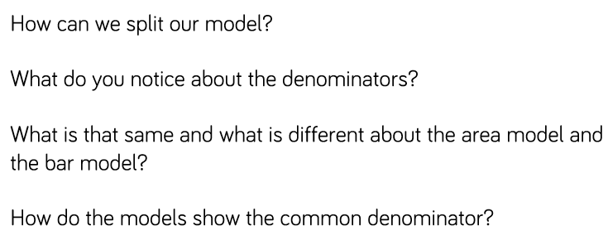
Key vocabulary and questions

Slide 59
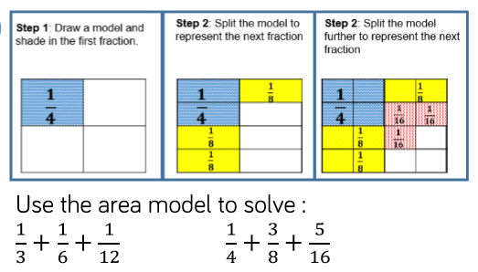
Fluency

Slide 60
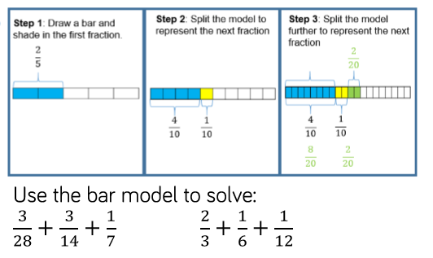
Fluency

Slide 61
Fluency

Slide 62
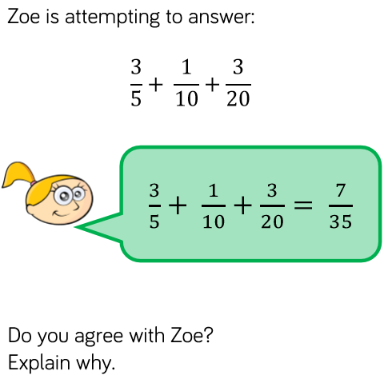
Reasoning and problem solving

Slide 63
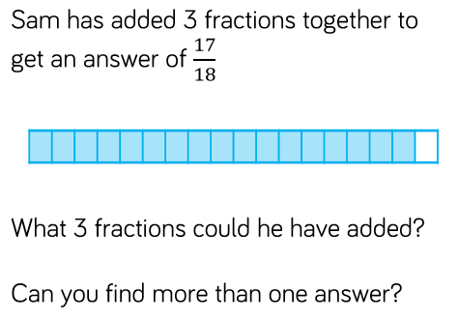
Reasoning and problem solving

Slide 64
Year 5 Spring Block 2 Fractions
Add fractions
NCLO:To add and subtract fractions with the same denominator and denominators that are multiples of the same number

Slide 65
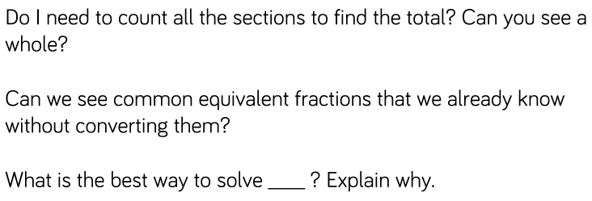
Key vocabulary and questions

Slide 66
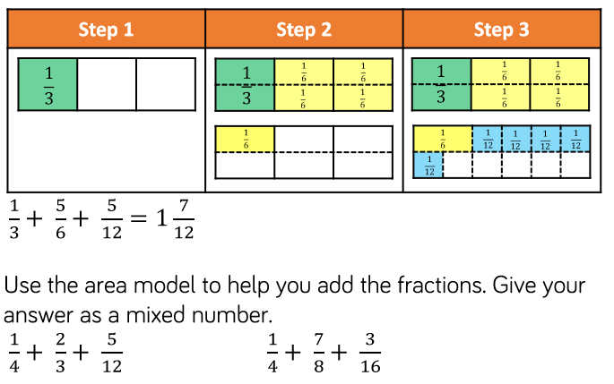
Fluency

Slide 67
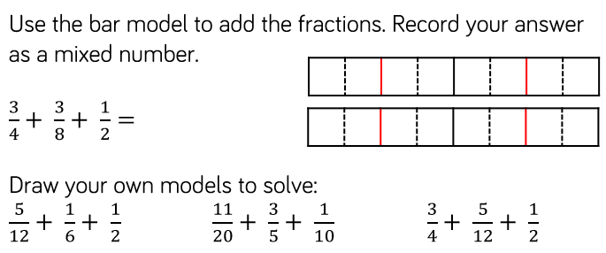
Fluency

Slide 68
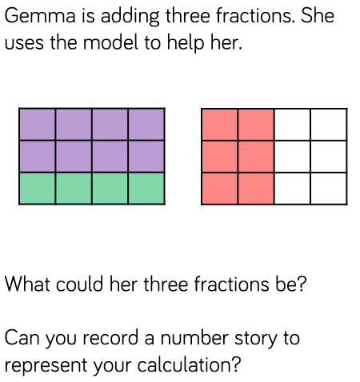
Reasoning and problem solving

Slide 69
Reasoning and problem solving

Slide 70
Year 5 Spring Block 2 Fractions
Add mixed numbers
NCLO:Recognise mixed numbers and improper fractions and convert from one form to the other and write mathematical statements >1 as a mixed number

Slide 71
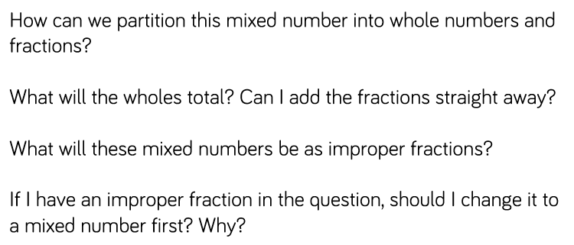
Key vocabulary and questions

Slide 72
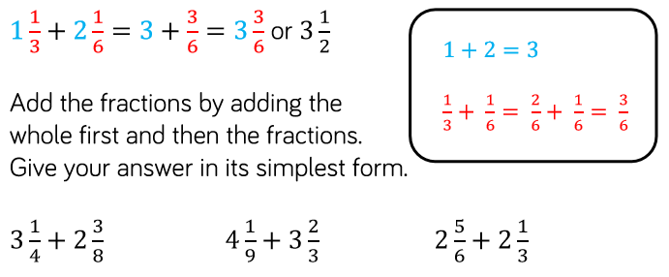
Fluency

Slide 73
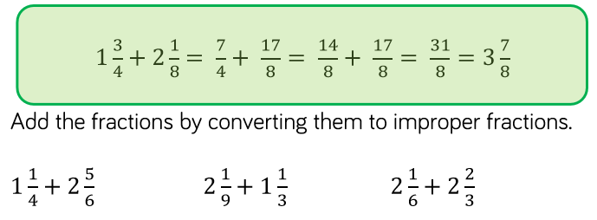
Fluency

Slide 74
Fluency

Slide 75
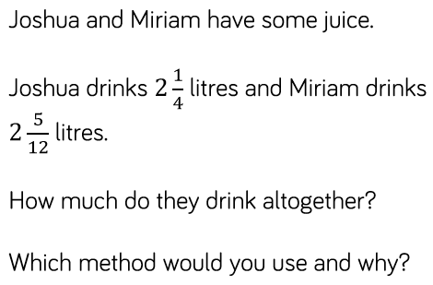
Reasoning and problem solving

Slide 76
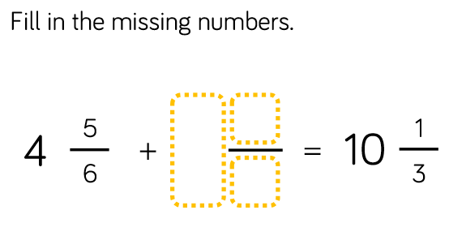
Reasoning and problem solving

Slide 77
Year 5 Spring Block 2 Fractions
Subtract fractions
NCLO: To add and subtract fractions with the same denominator and denominators that are multiples of the same number.

Slide 78
Key vocabulary and questions

Slide 79
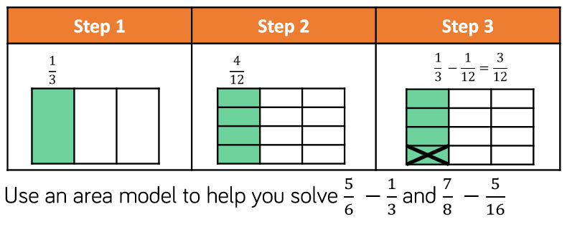
Fluency

Slide 80
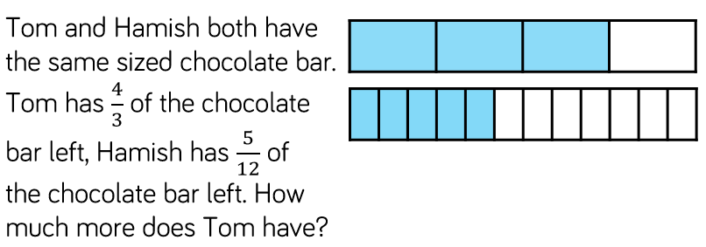
Fluency

Slide 81
Fluency

Slide 82
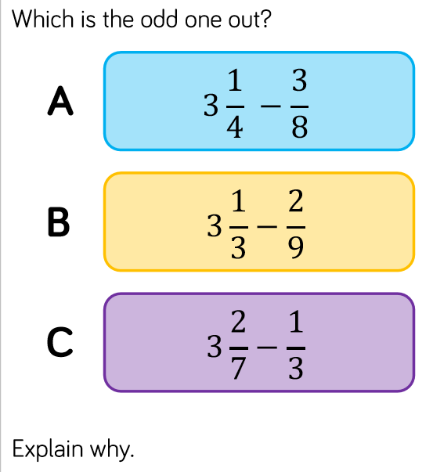
Reasoning and problem solving

Slide 83
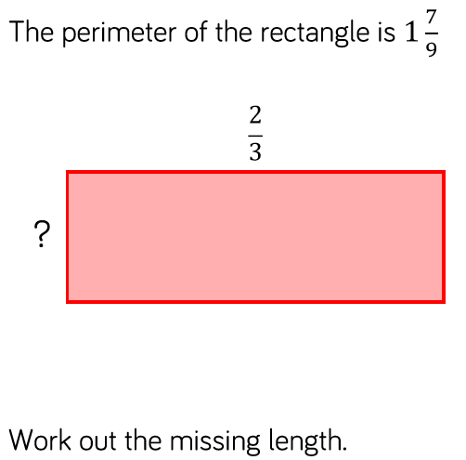
Reasoning and problem solving

Slide 84
Year 5 Spring Block 2 Fractions
Subtract mixed numbers (1)
NCLO:Recognise mixed numbers and improper fractions and convert from one form to the other and write mathematical statements >1 as a mixed number

Slide 85
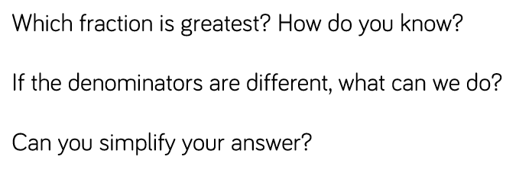
Key vocabulary and questions

Slide 86
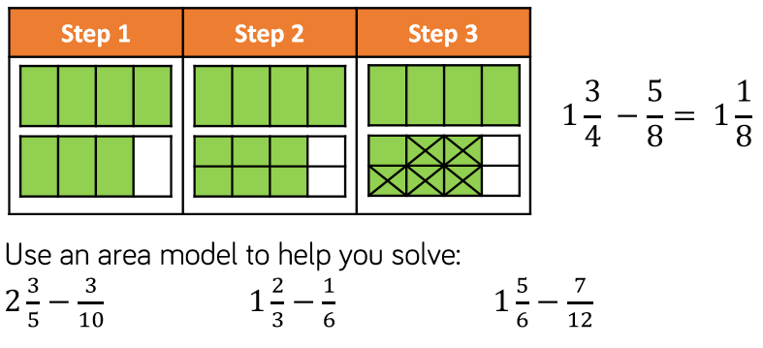
Fluency

Slide 87
Fluency

Slide 88
Fluency

Slide 89
Reasoning and problem solving

Slide 90
Reasoning and problem solving

Slide 91
Year 5 Spring Block 2 Fractions
Subtract mixed numbers (2)
NCLO:Recognise mixed numbers and improper fractions and convert from one form to the other and write mathematical statements >1 as a mixed number

Slide 92
Key vocabulary and questions
Flexible partitioning

Slide 93
Fluency

Slide 94
Fluency

Slide 95
Fluency

Slide 96
Reasoning and problem solving

Slide 97
Reasoning and problem solving

Slide 98
Year 5 Spring Block 2 Fractions
Subtract 2 mixed numbers
NCLO: To add and subtract fractions with the same denominator and denominators that are multiples of the same number.

Slide 99
Key vocabulary and questions

Slide 100
Fluency

Slide 101
Fluency

Slide 102
Reasoning and problem solving

Slide 103
Reasoning and problem solving

Slide 104
Year 5 Spring Block 2 Fractions
Multiply unit fractions by an integer (1)
NCLO:Multiply proper fractions and mixed numbers by whole numbers, supported by materials and diagrams.

Slide 105
Key vocabulary and questions

Slide 106
Fluency

Slide 107
Fluency

Slide 108
Fluency

Slide 109
Reasoning and problem solving

Slide 110
Reasoning and problem solving

Slide 111
Reasoning and problem solving

Slide 112
Year 5 Spring Block 2 Fractions
Multiply unit fractions by an integer (2)
NCLO:Multiply proper fractions and mixed numbers by whole numbers, supported by materials and diagrams.

Slide 113
Key vocabulary and questions

Slide 114
Fluency

Slide 115
Fluency

Slide 116
Fluency

Slide 117
Reasoning and problem solving

Slide 118
Reasoning and problem solving

Slide 119
Year 5 Spring Block 2 Fractions
Multiply unit fractions by an integer (3)
NCLO:Multiply proper fractions and mixed numbers by whole numbers, supported by materials and diagrams.

Slide 120
Key vocabulary and questions

Slide 121
Fluency

Slide 122
Fluency

Slide 123
Fluency

Slide 124
Reasoning and problem solving

Slide 125
Reasoning and problem solving

Slide 126
Year 5 Spring Block 2 Fractions
Fraction of an amount
NCLO:Solve problems involving multiplication and division, including scaling by simple fractions and problems involving simple rates.

Slide 127
Key vocabulary and questions

Slide 128
Fluency

Slide 129
Fluency

Slide 130
Fluency

Slide 131
Reasoning and problem solving

Slide 132
Reasoning and problem solving

Slide 133
Reasoning and problem solving

Slide 134
Year 5 Spring Block 2 Fractions
Fractions as operators
NCLO:Solve problems involving multiplication and division, including scaling by simple fractions and problems involving simple rates.

Slide 135
Key vocabulary and questions

Slide 136
Fluency

Slide 137
Fluency

Slide 138
Fluency

Slide 139
Reasoning and problem solving

Slide 140
Reasoning and problem solving

