Slide 1
Year 1 Spring Block 1 Number: Addition and Subtraction within 20
Add by counting on
NCLO:
Represent and use number bonds and related subtraction facts within 20.

Slide 2
Key vocabulary and questions
Add, more than.
Which number should we start with? Why?
Where do we start using a number line?
How many ___ were there at first?
Then what was added?
How many are there now?

Slide 3
Fluency

Slide 4
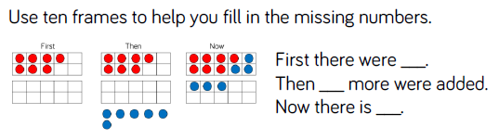
Fluency

Slide 5
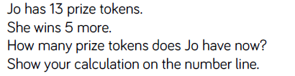
Fluency

Slide 6
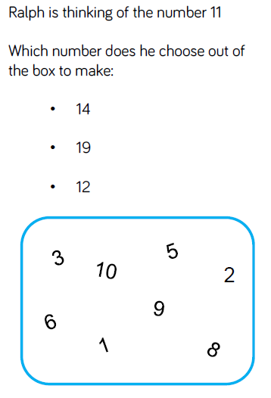
Reasoning and problem solving

Slide 7
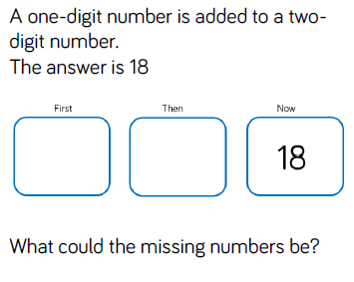
Reasoning and problem solving

Slide 8
Year 1 Spring Block 1 Number: Addition and Subtraction within 20
Find and Make Number bonds
NCLO:

Slide 9
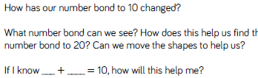
Key vocabulary and questions
Number bonds, more than, total.

Slide 10
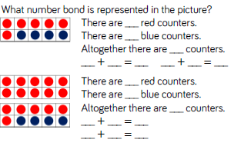
Fluency

Slide 11
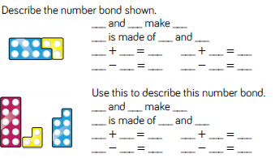
Fluency

Slide 12
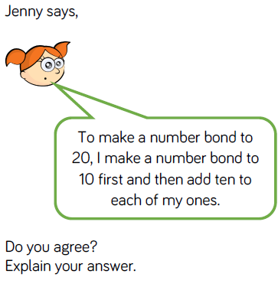
Reasoning and problem solving

Slide 13
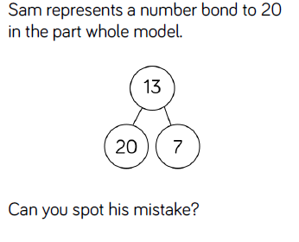
Reasoning and problem solving

Slide 14
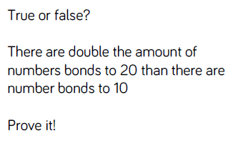
Reasoning and problem solving

Slide 15
Year 1 Spring Block 1 Number: Addition and subtraction to 20
Add By Making 10
NCLO: Read, write and interpret mathematical statements involving additition and the equals sign.

Slide 16
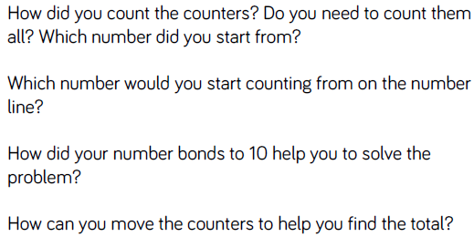
Key vocabulary and questions
Equals, addition, array, number line

Slide 17
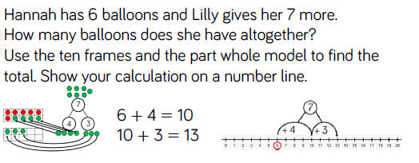
Fluency

Slide 18
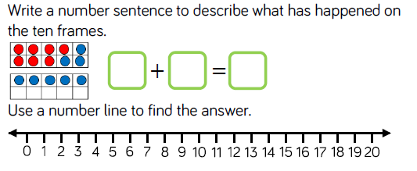
Fluency

Slide 19
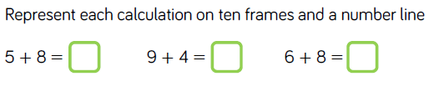
Fluency

Slide 20
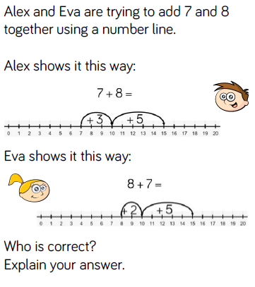
Reasoning and problem solving

Slide 21
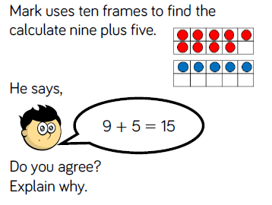
Reasoning and problem solving

Slide 22
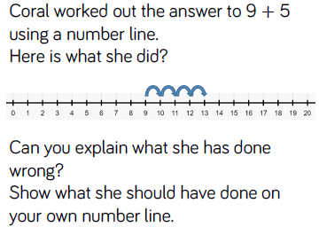
Reasoning and problem solving

Slide 23

Year 1 Spring Block 1 Number: addition and subtraction to 20
Subtraction – not crossing ten
NCLO: read, write and interpret mathematical statements involving subtraction and the equals sign.

Slide 24
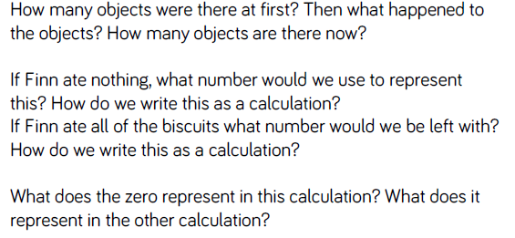
Key vocabulary and questions

Slide 25
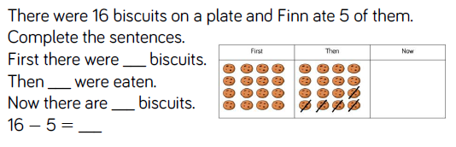
Fluency

Slide 26
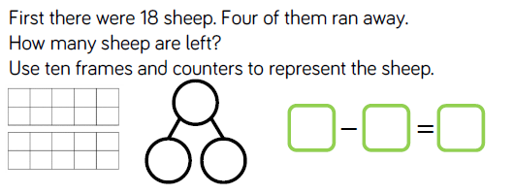
Fluency

Slide 27
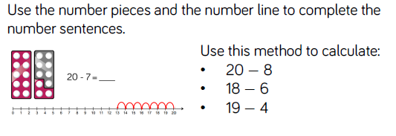
Fluency

Slide 28
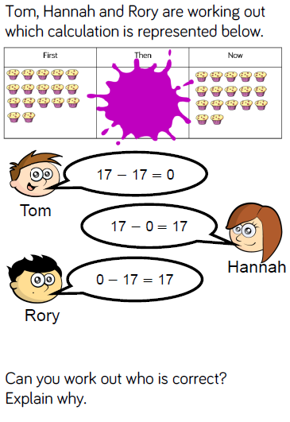
Reasoning and problem solving

Slide 29
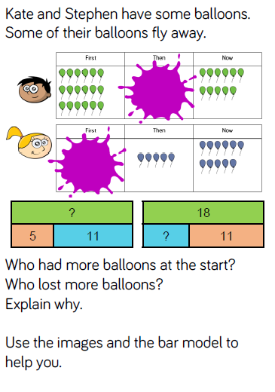
Reasoning and problem solving

Slide 30

Year 1 Spring Block 1 Number: addition and subtraction within 20
Subtraction – crossing ten
NCLO: Add and subtract one-digit and two-digit numbers to 20, including zero

Slide 31
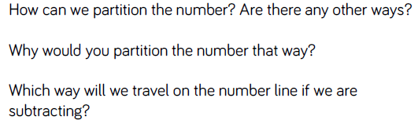
Key vocabulary and questions
Tens, crossing , subtract

Slide 32
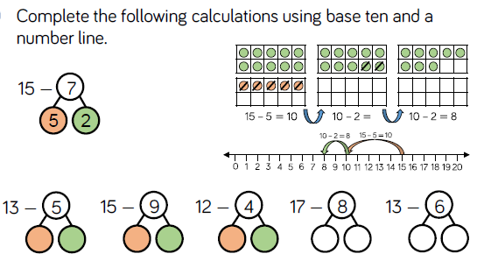
Fluency

Slide 33
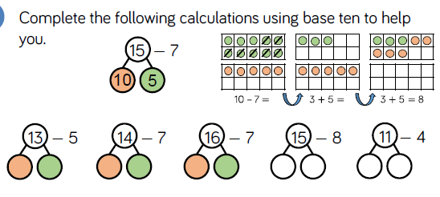
Fluency

Slide 34
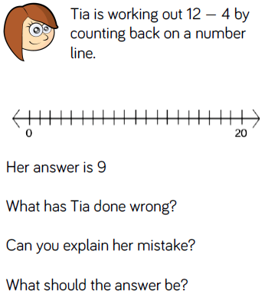
Reasoning and problem solving

Slide 35
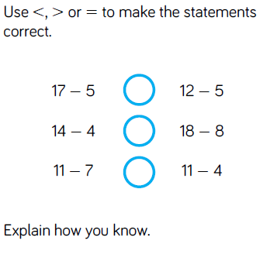
Reasoning and problem solving

Slide 36
Year 1 Spring Block 1 Number: Addition and subtraction within 20
Subtraction crossing ten.
NCLO: Solve one step problems that involve addition and subtraction using concrete objects, pictorial representations and missing number problems.

Slide 37
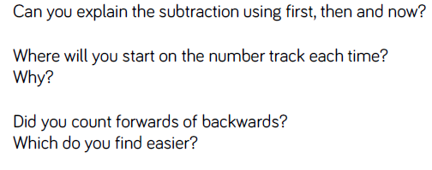
Key vocabulary and questions

Slide 38
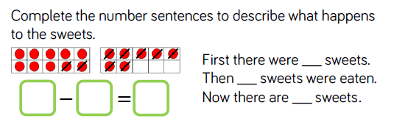
Fluency

Slide 39
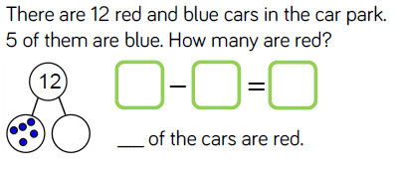
Fluency

Slide 40
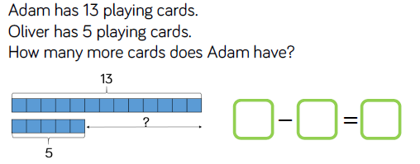
Fluency

Slide 41
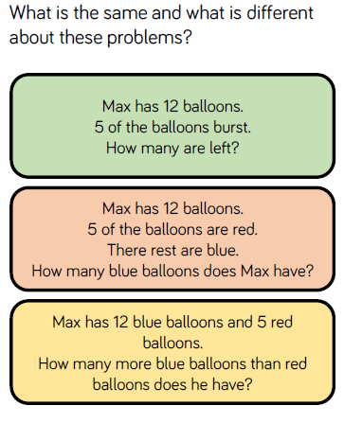
Reasoning and problem solving

Slide 42
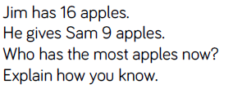
Reasoning and problem solving

Slide 43
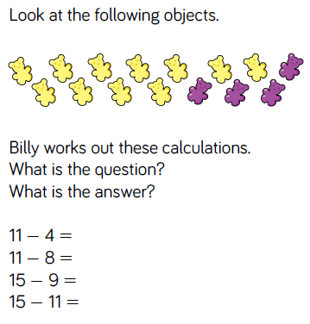
Reasoning and problem solving

Slide 44
Year 1 Spring Block 1 Number: Addition and subtraction within 20
Related Facts
NCLO: Solve one step problems that involve addition and subtraction using concrete objects, pictorial representations and missing number problems.

Slide 45
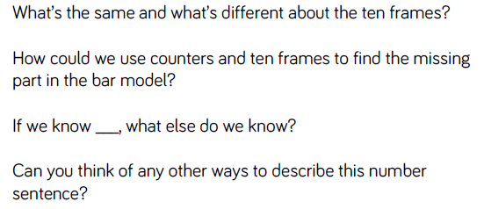
Key vocabulary and questions

Slide 46
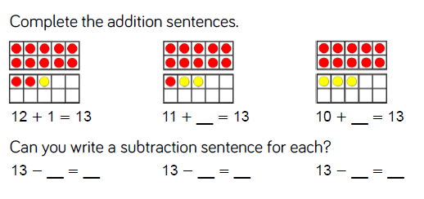
Fluency

Slide 47
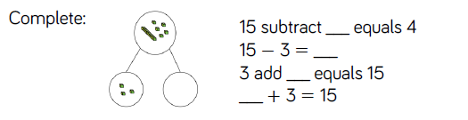
Fluency

Slide 48
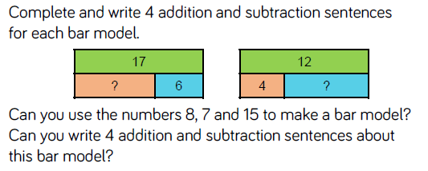
Fluency

Slide 49
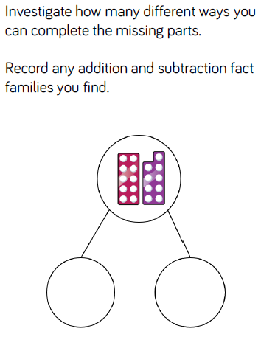
Reasoning and problem solving

Slide 50
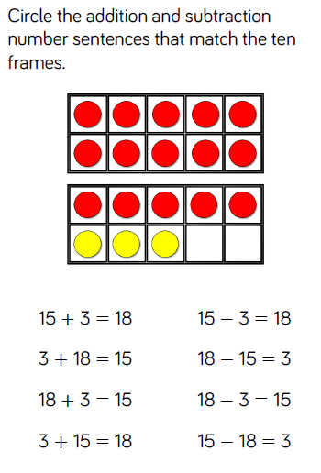
Reasoning and problem solving

Slide 51
Year 1 Spring Block 1 Number: Addition and subtraction within 20
Compare number sentences
NCLO:Solve one step problems that involve addition and subtraction using concrete objects, pictorial representations and missing number problems.

Slide 52
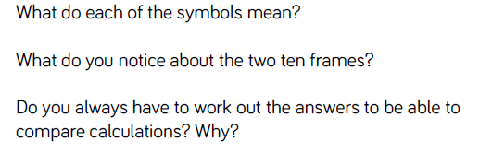
Key vocabulary and questions
Greater than and less than

Slide 53
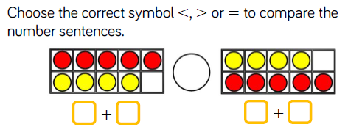
Fluency

Slide 54
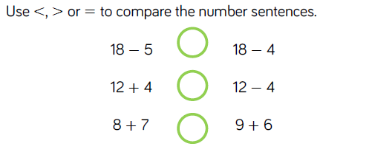
Fluency

Slide 55
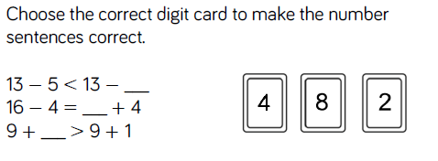
Fluency

Slide 56
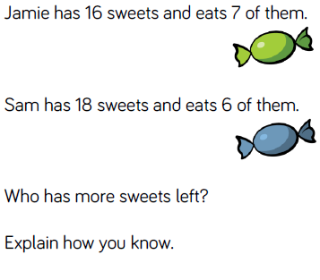
Reasoning and problem solving

Slide 57
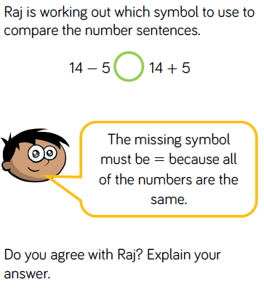
Reasoning and problem solving

