Slide 1
Year 1 Summer Block 4 Number: Place Value
Count to 100
NCLO: Count to and across 100, forwards and backwards, beginning with 0 or 1, or from any given number.

Slide 2
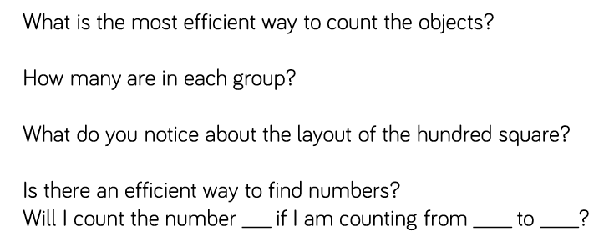
Key vocabulary and questions
Array, Equal, Groups, Bundles.

Slide 3
Fluency

Slide 4
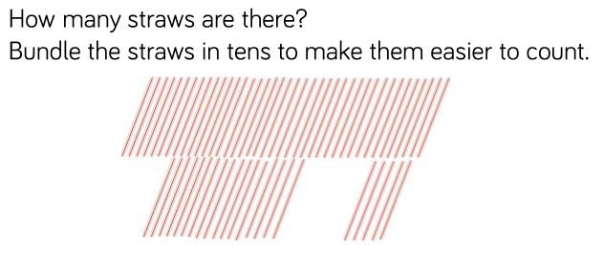
Fluency

Slide 5
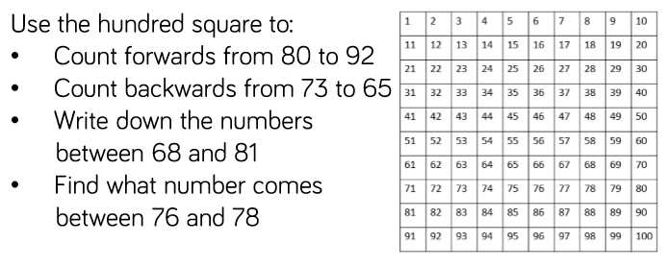
Fluency

Slide 6
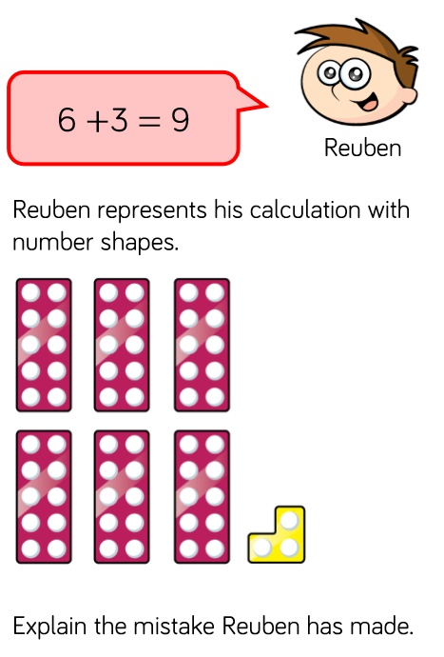
Reasoning and problem solving

Slide 7
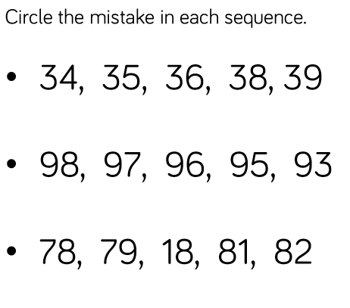
Reasoning and problem solving

Slide 8
Year 1 Summer Block 4 Number: Place Value
NCLO: Count, read and write numbers to 100 in numerals

Slide 9
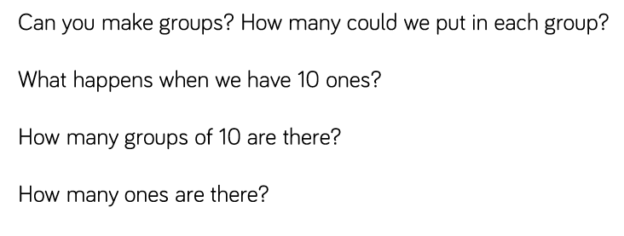
Key vocabulary and questions
Part, Part, Whole, Groups, Array.

Slide 10
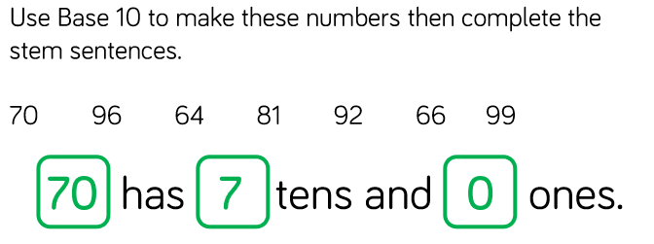
Fluency

Slide 11
Fluency

Slide 12
Fluency

Slide 13
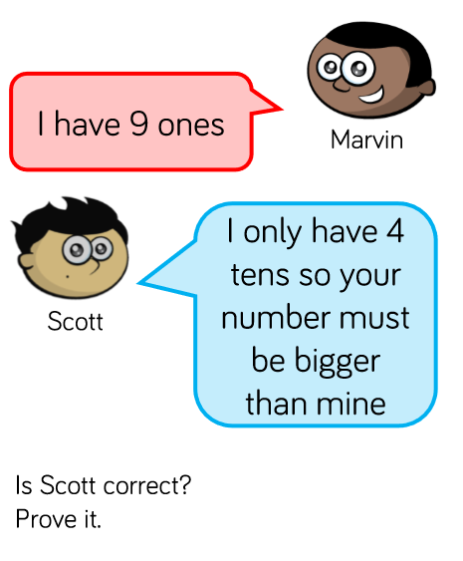
Reasoning and problem solving

Slide 14
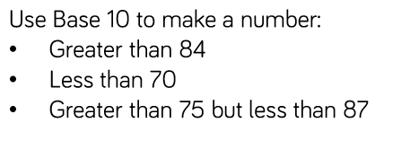
Reasoning and problem solving

Slide 15
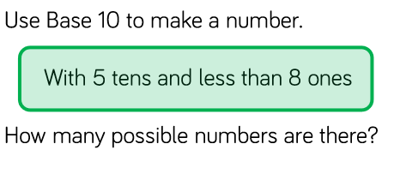
Reasoning and problem solving

Slide 16
Year 1 Summer Block 4 Number: Place Value
NCLO: Identify and represent numbers using objects and pictorial representations including the number line, and use the language of: equal to, more than, less than, most, least.
.

Slide 17
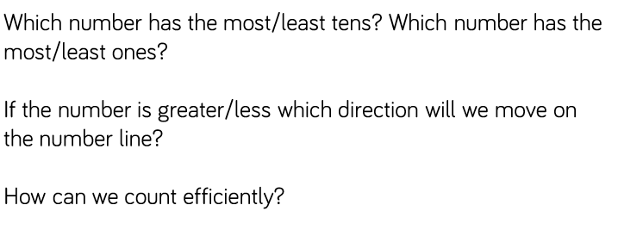
Key vocabulary and questions
Equals, Sharing, Array, Pattern, Equal to, More than, Less than, Most, least.
.

Slide 18
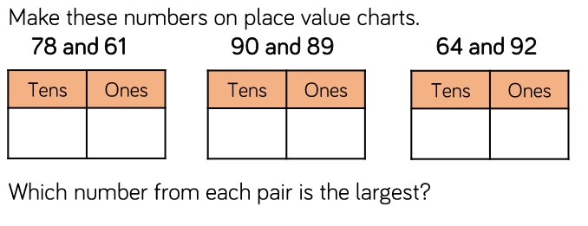
Fluency

Slide 19
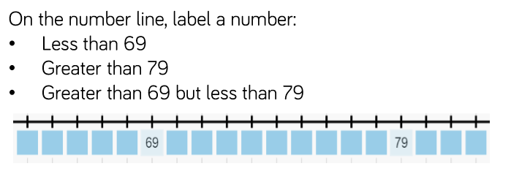
Fluency

Slide 20
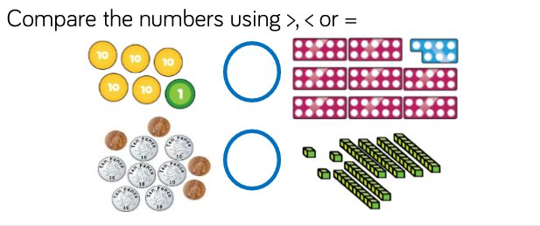
Fluency

Slide 21
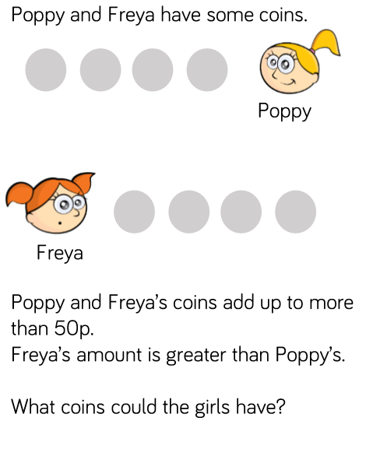
Reasoning and problem solving

Slide 22
Reasoning and problem solving

Slide 23
Year 1 Summer Block 4 Number: Place Value
NCLO: Count, read and write numbers to 100 in numerals.
Given a number, identify one more and one less.
.

Slide 24
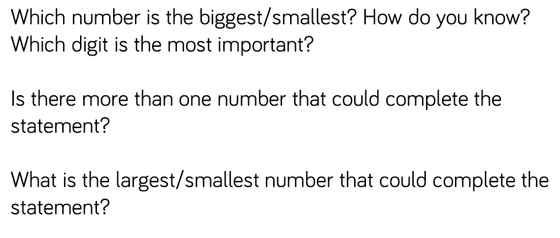
Key vocabulary and questions
Row, Equal, Array,

Slide 25
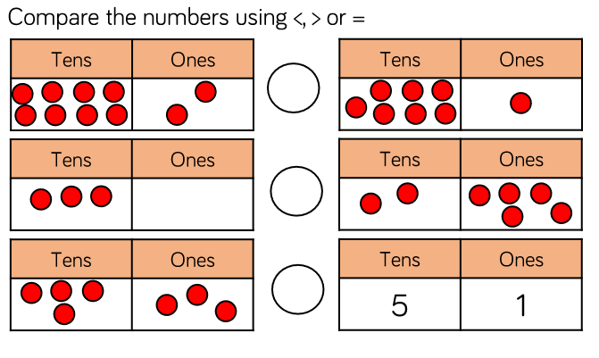
Fluency

Slide 26
Fluency

Slide 27
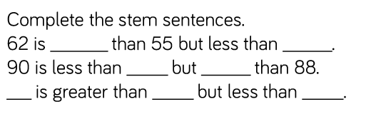
Reasoning and problem solving

Slide 28
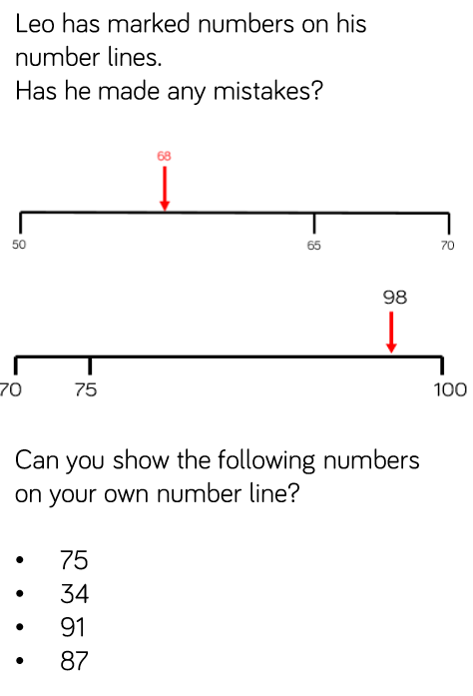
Reasoning and problem solving

Slide 29
Reasoning and problem solving

Slide 30
Year 1 Summer Block 4 Number: Place Value
NCLO: Identify and represent numbers using objects and pictorial representations including the number line, and use the language of: equal to, more than, less than, most, least.

Slide 31
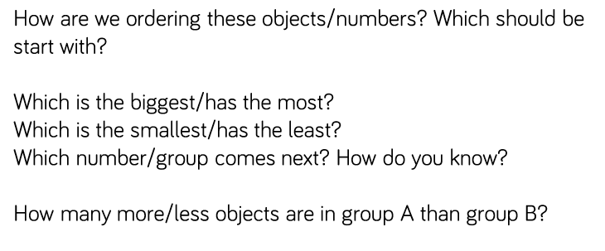
Key vocabulary and questions
Representations, Doubles, Array, Pattern

Slide 32
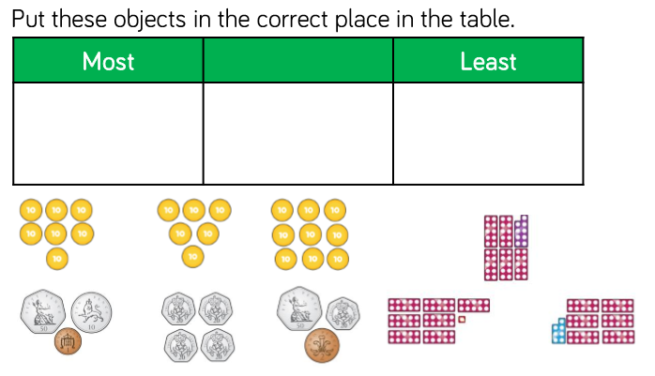
Fluency

Slide 33
Fluency

Slide 34
Fluency

Slide 35
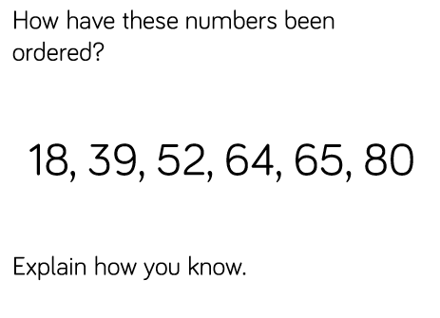
Reasoning and problem solving

Slide 36
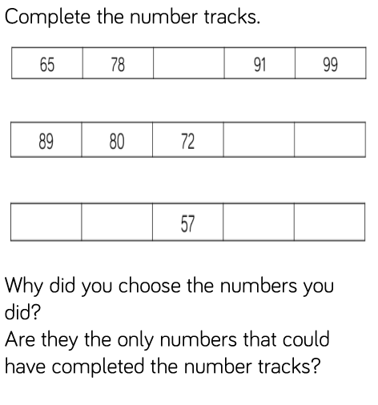
Reasoning and problem solving

Slide 37
Year 1 Summer Block 4 Number: Place Value
NCLO:Given a number, identify one more and one less.
.

Slide 38
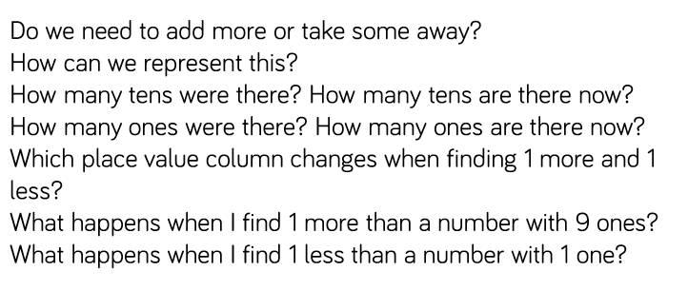
Key vocabulary and questions
Total, Equal, Groups, Array

Slide 39
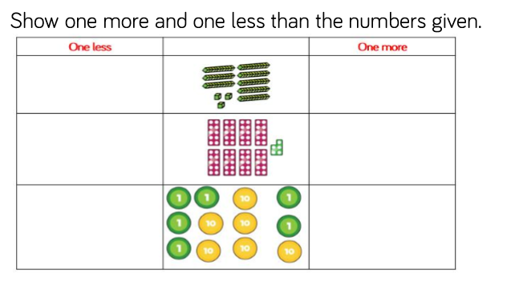
Fluency

Slide 40
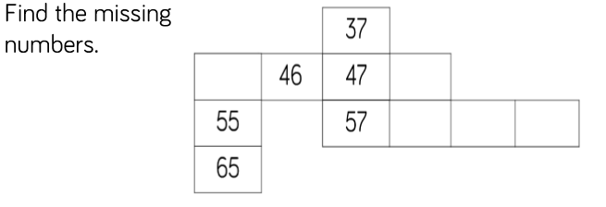
Fluency

Slide 41
Fluency

Slide 42
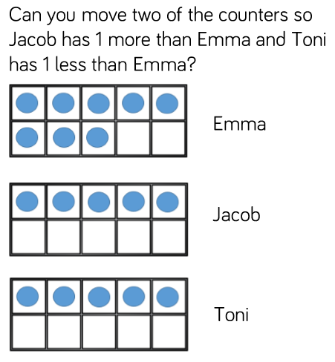
Reasoning and problem solving

Slide 43
Reasoning and problem solving

Slide 44
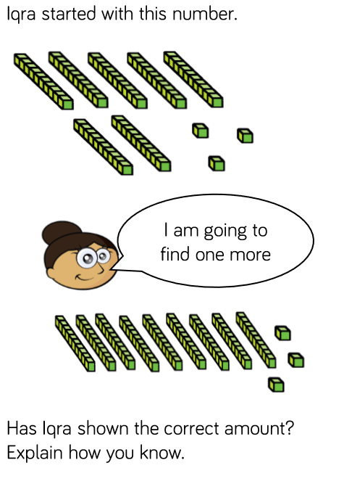
Reasoning and problem solving

